Slide 1
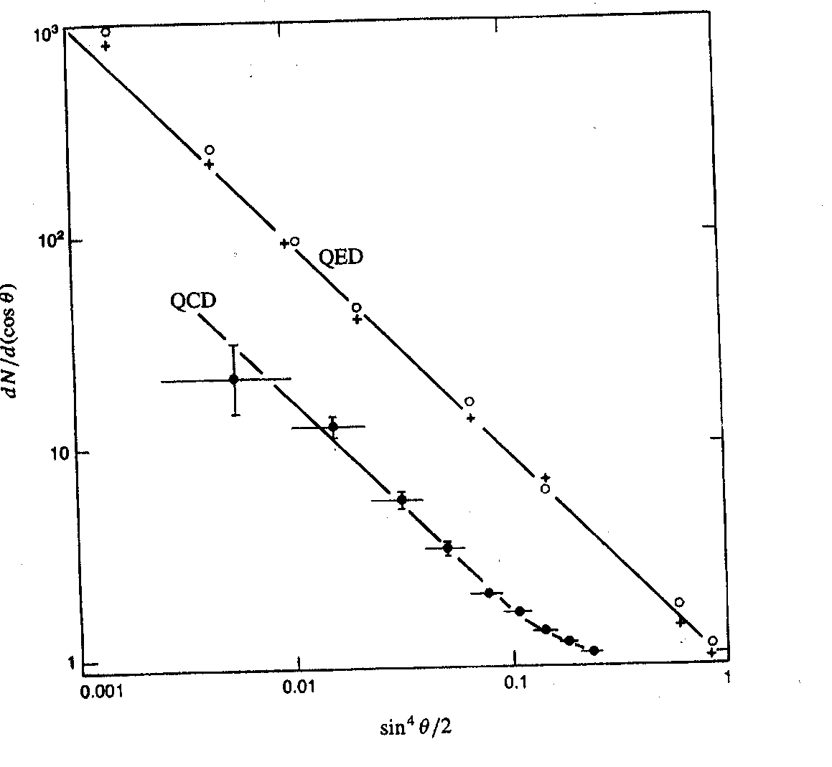
Low Energy Experiment
Scattering of α on Au & Ag ➔ agree with calculation assuming point nucleus
dN/dcosθ
Sin⁴(θ/2)

Slide 2
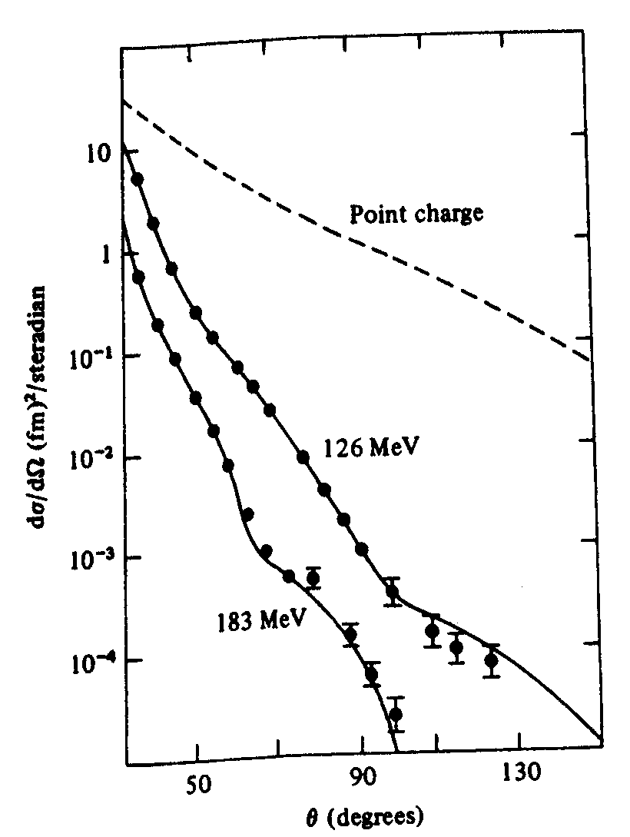
Higher Energy
Electron - Gold
Deviation from Rutherford scattering at higher energy ➔ determine charge distribution in the nucleus.
Form factors is F.T. of charge distribution.

