Slide 1
Higgs boson(s)
Why do we need them?
What do they look like?
Have we found them?

Slide 2
γ
Quantum Electrodynamics predicts one massless spin-1 gauge boson
PHOTON

Slide 3
Quantum Chromodynamics predicts (3²-1) = 8 massless spin-1 gauge bosons
g
g
g
g
g
g
g
g
GLUONS

Slide 4
Quantum Flavour Dynamics predicts (2²-1) = 3 massless spin-1 gauge bosons
?
W
Z

Slide 5
W and Z boson are NOT massless
Mass of W bosons… 80 GeV
Mass of Z bosons … 91 GeV
Weigh more than a copper atom

Slide 6
Massive spin-1 particles have 3 polarisations
Helicity = +1 or 0 or -1

Slide 7
Massless spin-1 particles have only 2 polarisations
Horizontal or vertical polarised photons
Helicity = +1 or -1 only
Longitudinal polarisation lost!
W and Z bosons need extra degree of polarisation as massive

Slide 8
Giving mass to the W and Z
New field
H
V
V
W and Z bosons (V) pick up mass from
interaction with new scalar field
Modifies V propagator from massless to effectively massive

Slide 9
“Higgs” field
Field must have non-zero vacuum value everywhere
Universe filled with “relativistic ether” of field
Coupling to the field gives mass to W and Z

Slide 10
Symmetry breaking in Higgs Field
Require that underlying theory is symmetric
Vacuum or ground state has broken symmetry

Slide 11
Magnet at high temperatures
Symmetric in direction

Slide 12
Magnet at low temperature
Symmetry broken – special direction

Slide 13
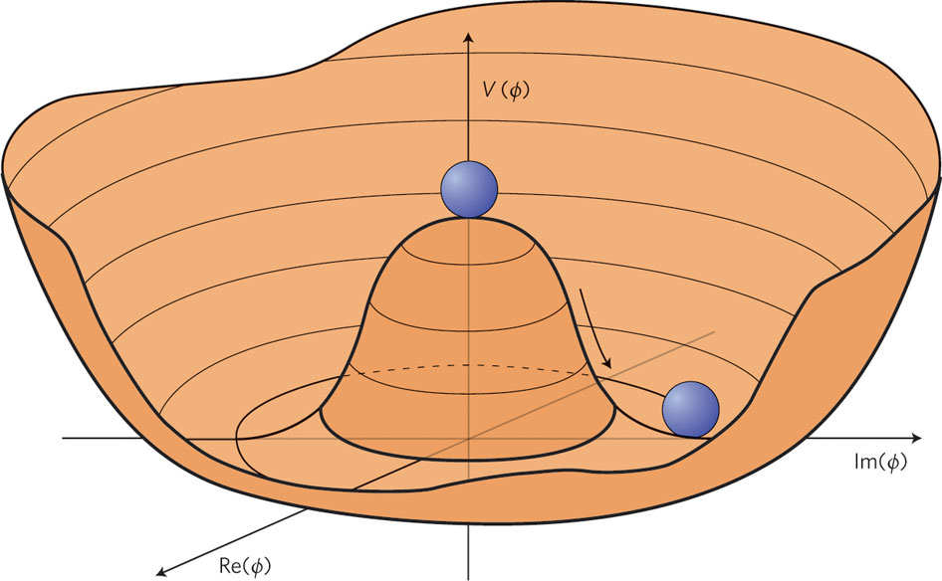
Broken symmetry for a complex field

Slide 14
Standard Model has complex doublet
$$\left(\begin{matrix}φ_{1} \\ φ_{2}\end{matrix}\right)$$
4 degrees of freedom
3 give longitudinal polarisation to W and Z bosons
1 left over – excitation of the field – Higgs Boson

Slide 15
In the Standard Model the SAME Higgs field
gives mass to the:
W boson
Z boson
all the quarks and leptons

Slide 16
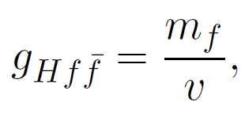
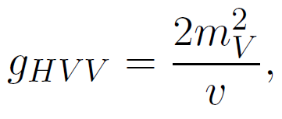
Higgs couplings to mass
H
H
V
V
f
f

Slide 17
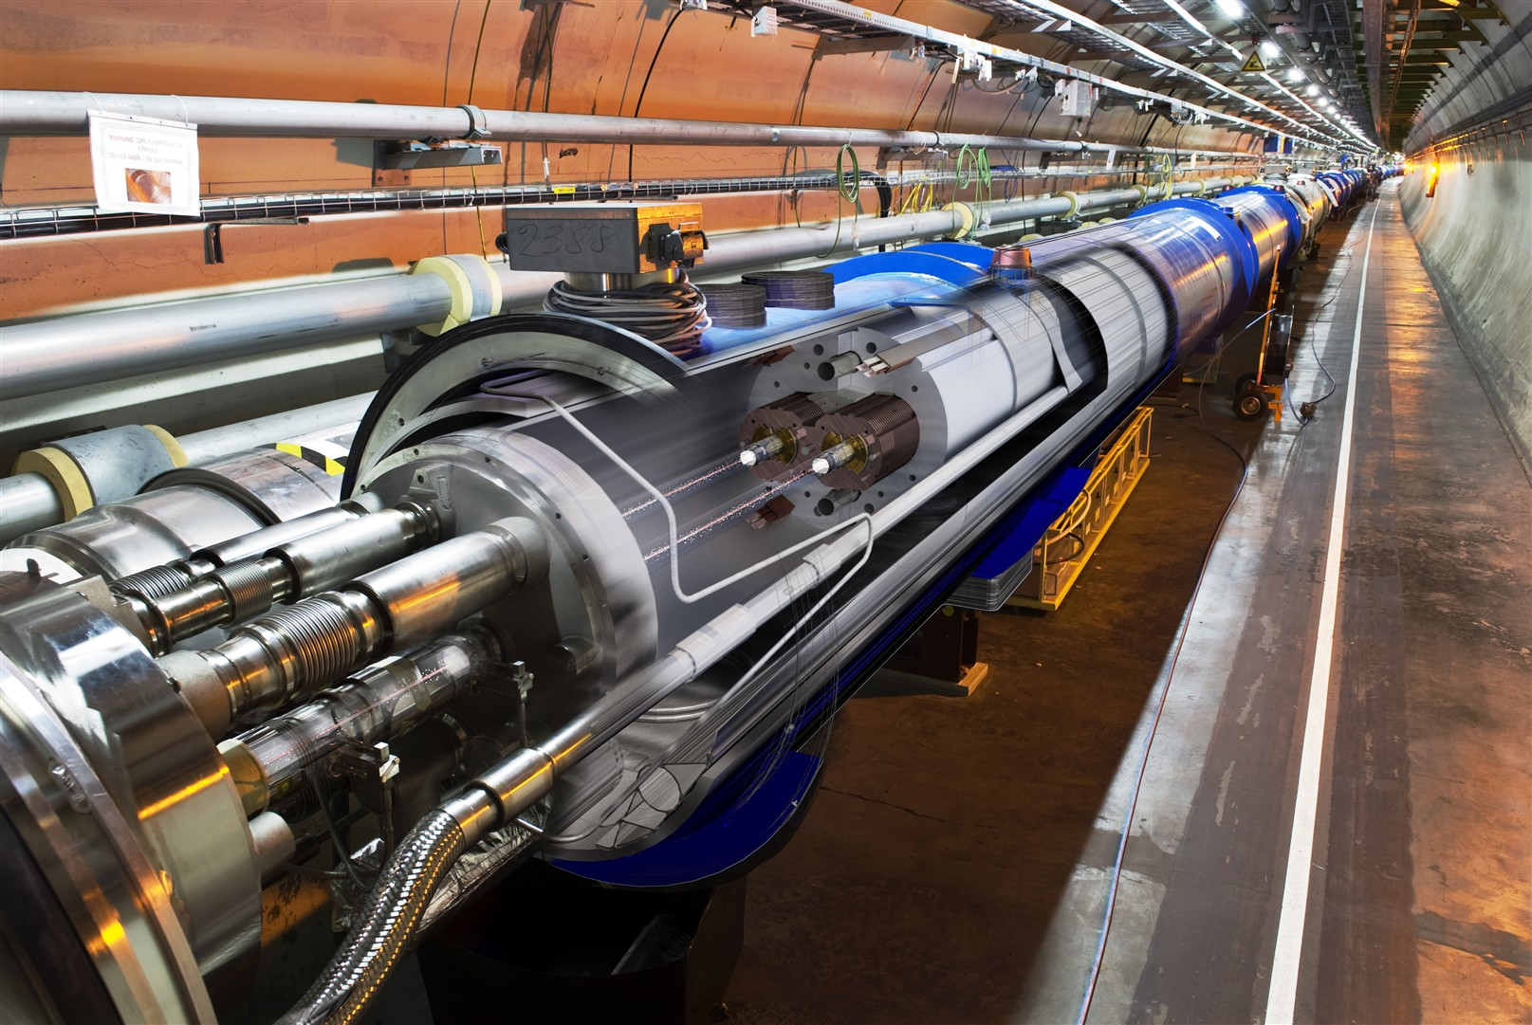

Slide 18
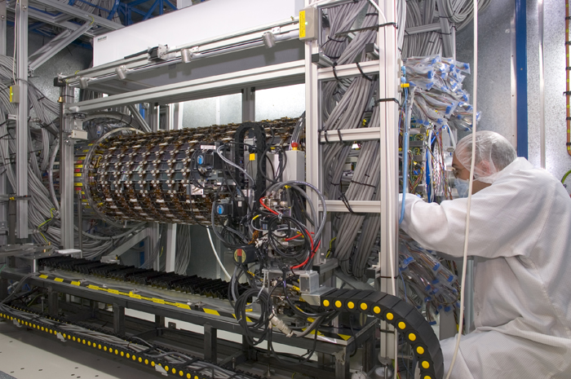
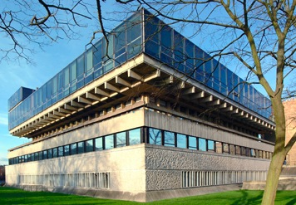
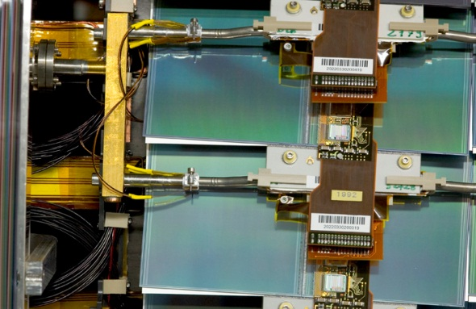
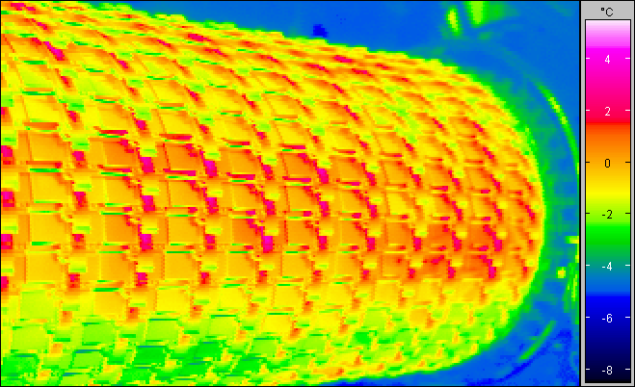
Detectors…
Robotic assembly of precision silicon tracker – Denys Wilkinson Building
Summer 2004 to Summer 2005

Slide 19
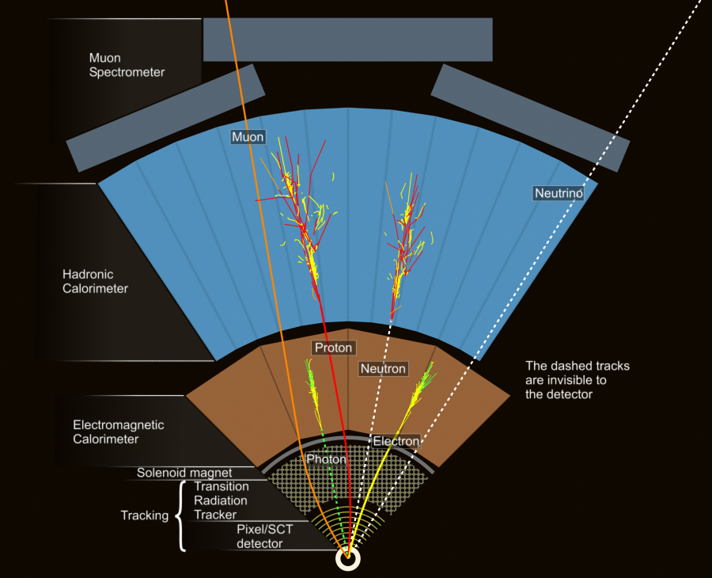
ATLAS
Segment of detector

Slide 20
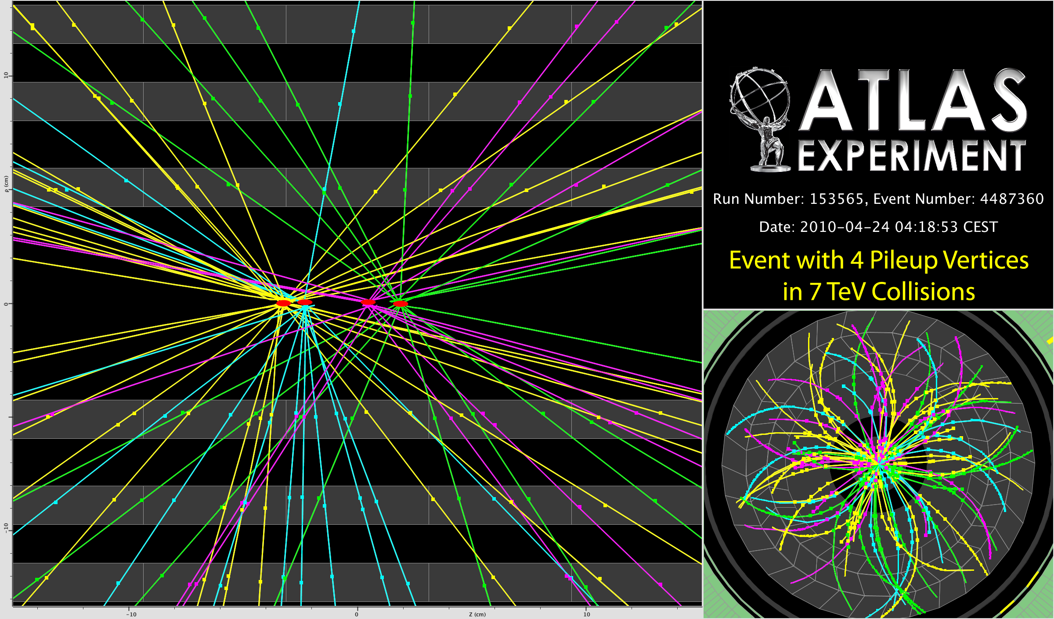
P
Reconstructing the debris

Slide 21
A collision producing 2 high-energy photons
Higgs → γ + γ ?

Slide 22
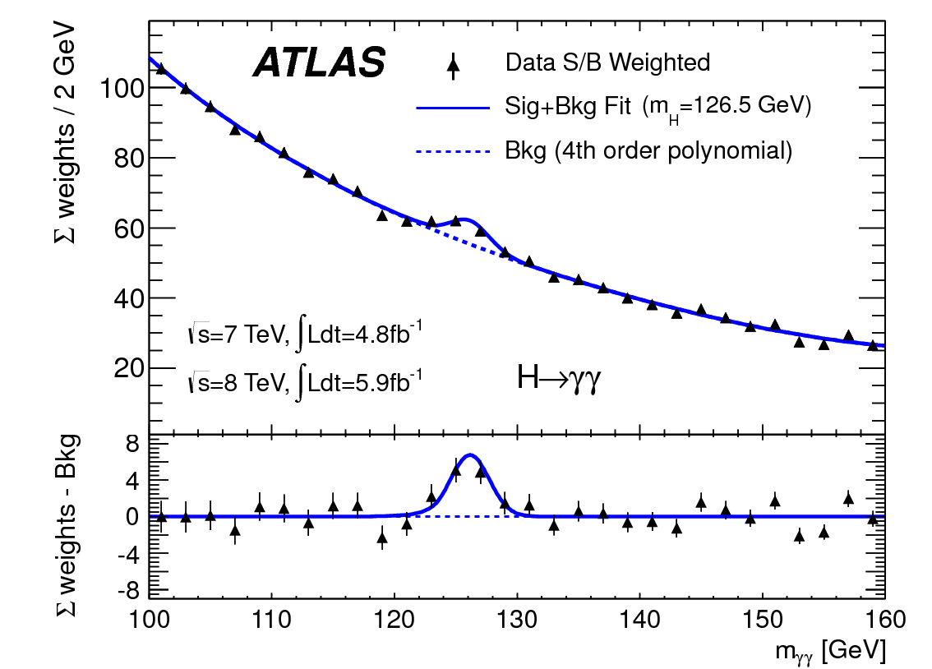
Higgs → 2 photons
Bump at mass of new particle - discovery

Slide 23
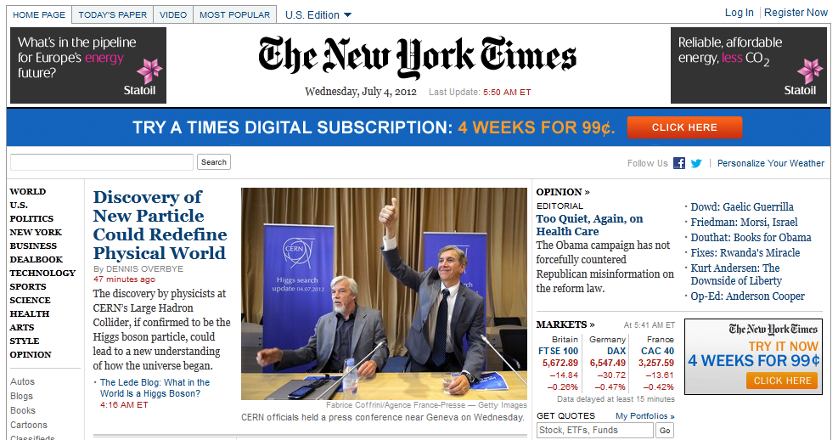
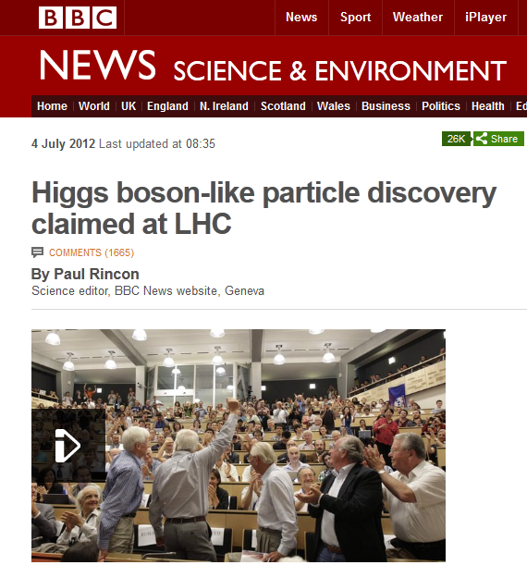
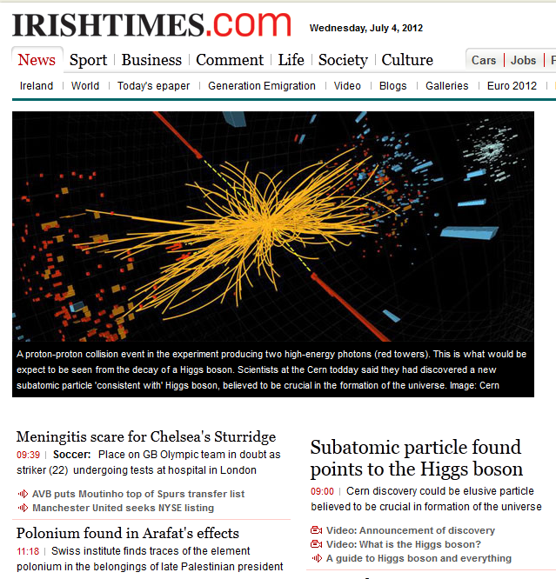
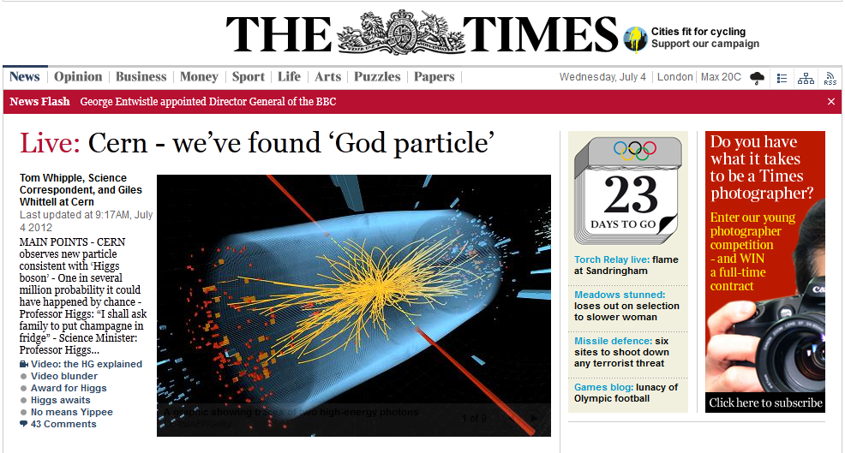
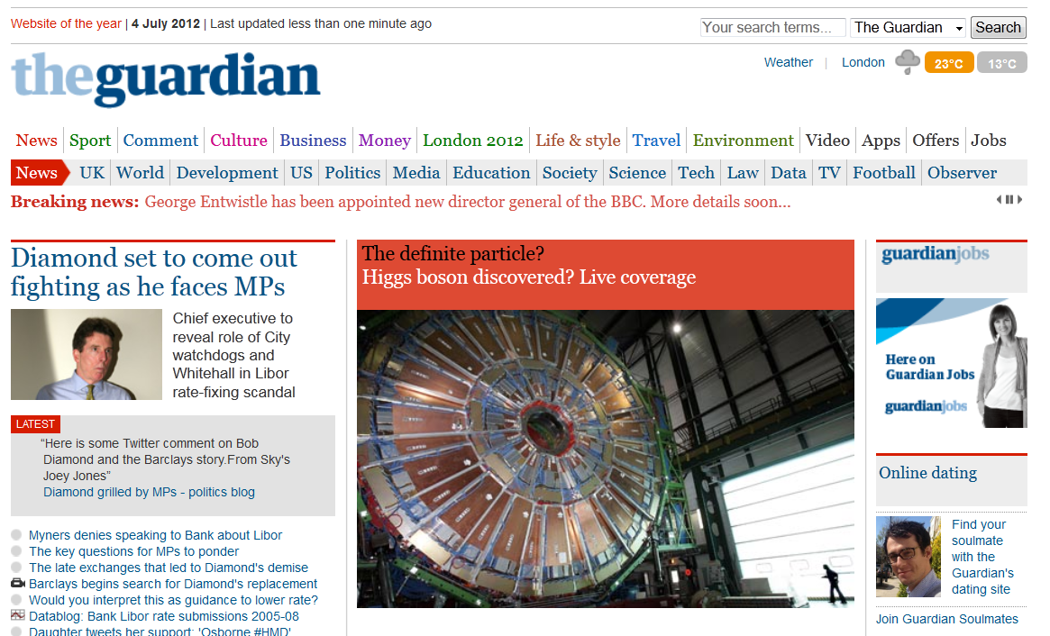
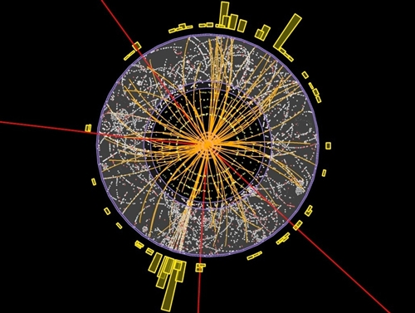
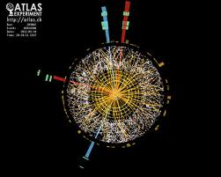

Slide 24
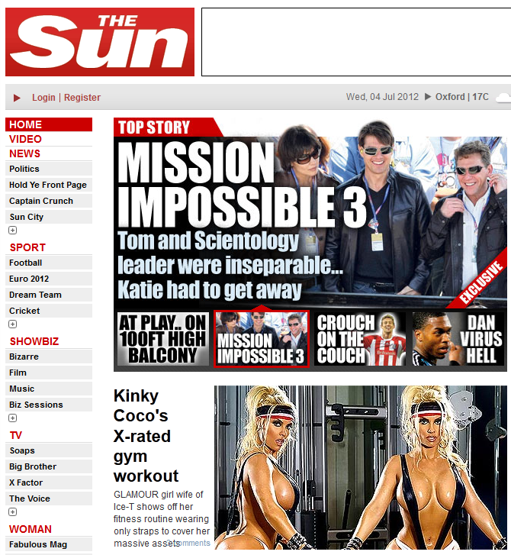
Almost all the papers…

Slide 25
The ATLAS paper(s)
July 2012 Phys.Lett. B716 (2012) 1-29
December 2012 Science 338 (2012) 1576-1582

Slide 26
End of term report card
New particle discovered
Mass measured to reasonable precision
Measurement of its spin?
How well does it play with others?
Does it have any friends?

Slide 27
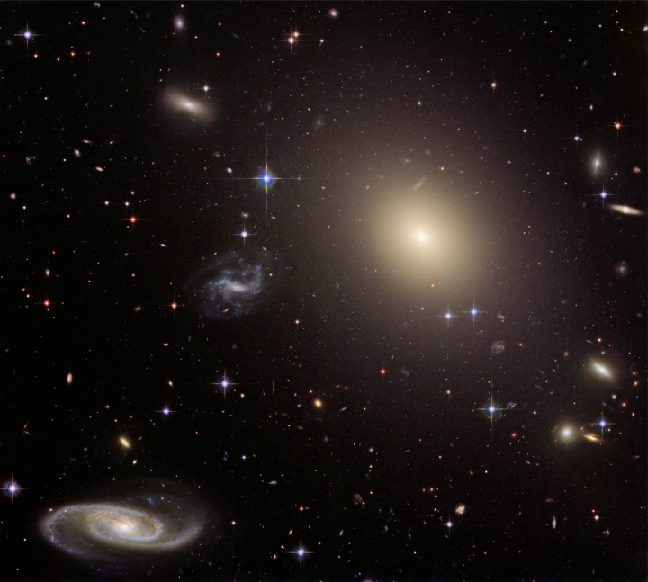
Many questions unanswered…
Have we found the (or even a) Higgs boson?
What are its properties?
Where has all the anti-matter gone?
What is dark matter made of?
What else is out there?

