Slide 1
Higgs boson(s)
Why do we need them?
What do they look like?
Have we found them?

Slide 2
γ
Quantum Electrodynamics predicts one massless spin-1 gauge boson
PHOTON

Slide 3
Quantum Chromodynamics predicts (3²-1) = 8 massless spin-1 gauge bosons
g
g
g
g
g
g
g
g
GLUONS

Slide 4
Quantum Flavour Dynamics predicts (2²-1) = 3 massless spin-1 gauge bosons
?
W
Z

Slide 5
W and Z boson are NOT massless
Mass of W bosons… 80 GeV
Mass of Z bosons … 91 GeV
Weigh more than a copper atom

Slide 6
Massive spin-1 particles have 3 polarisations
Helicity = +1 or 0 or -1

Slide 7
Massless spin-1 particles have only 2 polarisations
Horizontal or vertical polarised photons
Helicity = +1 or -1 only
Longitudinal polarisation is lost!
W and Z bosons need extra degree of polarisation as massive

Slide 8
Giving mass to the W and Z
New field
H
W or Z
W or Z
W and Z bosons pick up mass from
interaction with new scalar field
Pops out of vacuum & modifies propagator

Slide 9
“Higgs” field
Field must have non-zero vacuum value everywhere
Universe filled with “relativistic ether” of this field
Coupling to the field gives mass to W and Z

Slide 10
Symmetry breaking & the Higgs field
Require: underlying theory is symmetric
Vacuum or ground state has broken symmetry

Slide 11
Magnetic material at high temperatures
Symmetric in direction

Slide 12
Magnetic material at low temperature
Symmetry broken – special direction

Slide 13
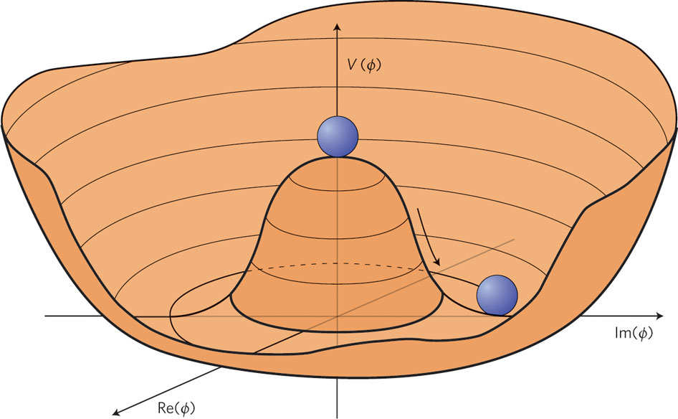
Broken symmetry for a complex field

Slide 14
Standard Model has complex doublet
4 degrees of freedom
3 end up as longitudinal polarisations of W and Z bosons
1 left over – excitation of the field – Higgs Boson

Slide 15
In the Standard Model the SAME Higgs field
gives mass to the:
W boson
Z boson
all the quarks and leptons

Slide 16
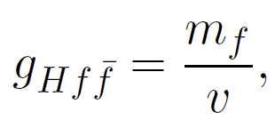
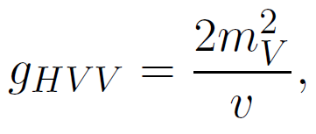
Higgs couplings to mass
H
H
V
V
f
f

Slide 17
Higgs boson production and decay
Blackboard

Slide 18
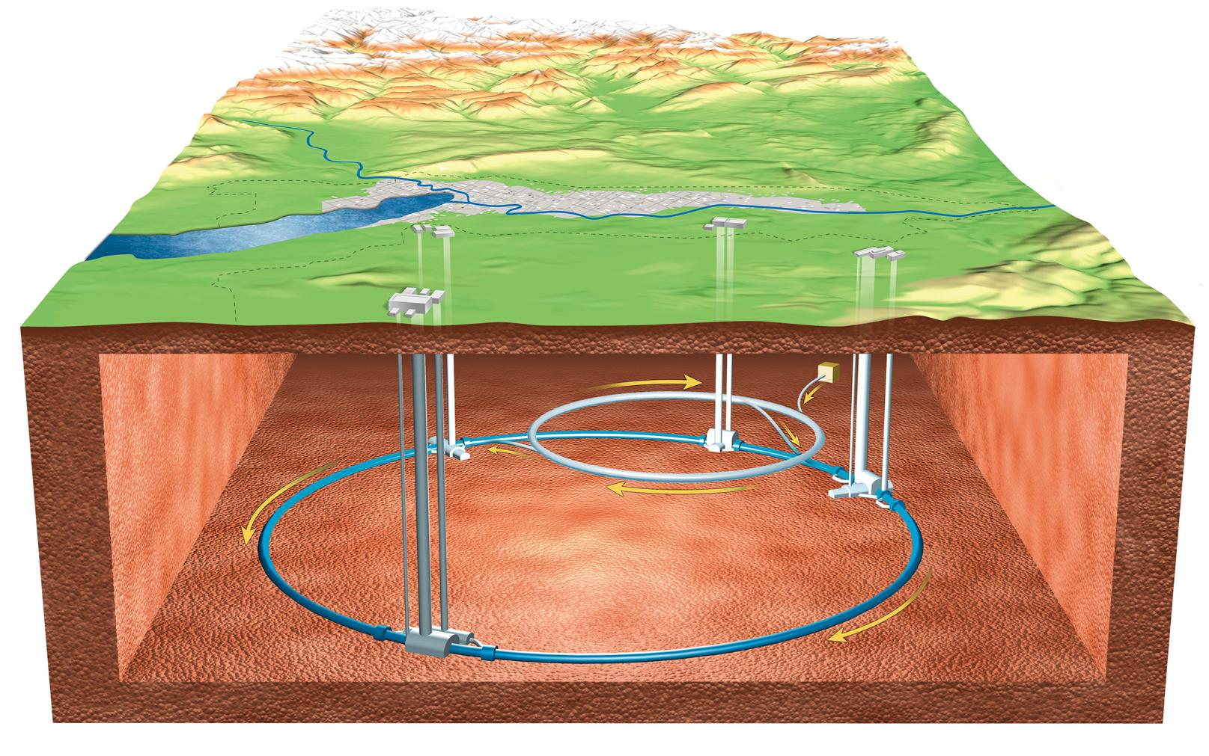

Slide 19
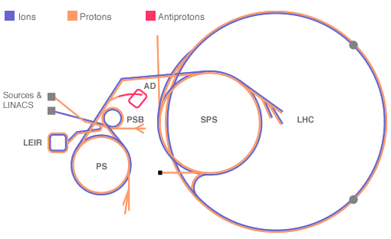
Accelerator complex @ CERN

Slide 20
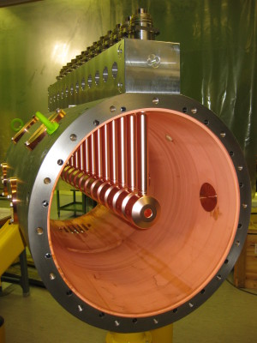
LINear ACcelerator

Slide 21
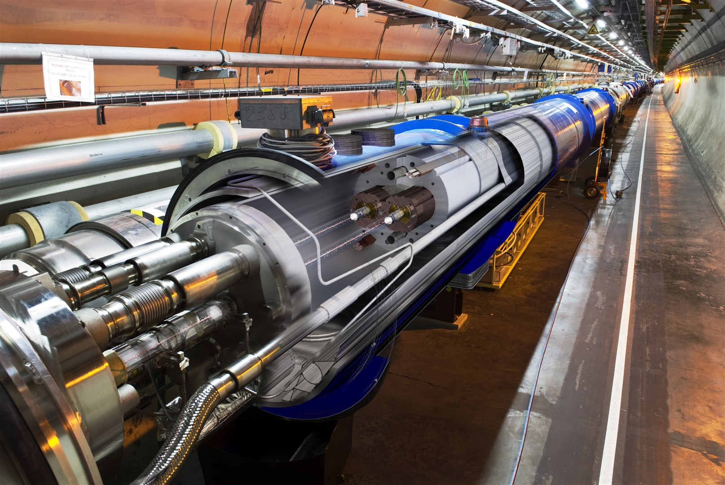

Slide 22
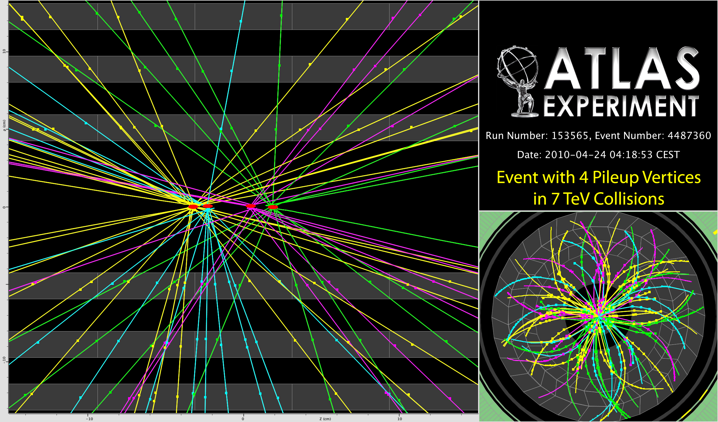
P
Reconstructing the debris

Slide 23
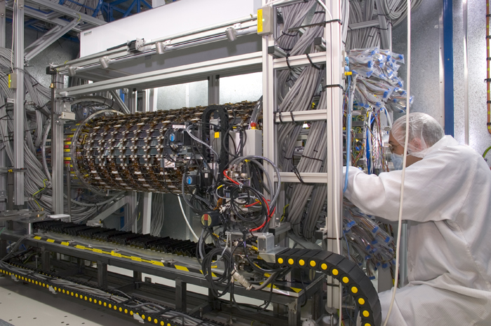
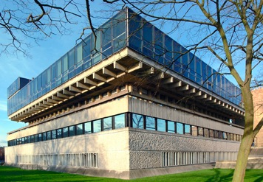
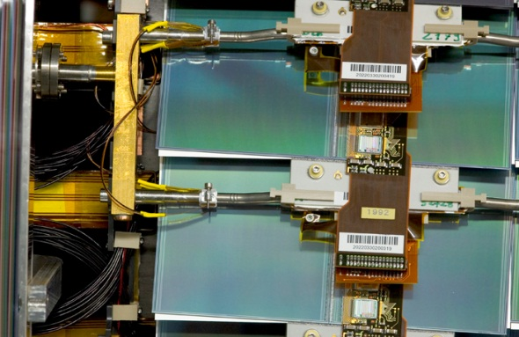
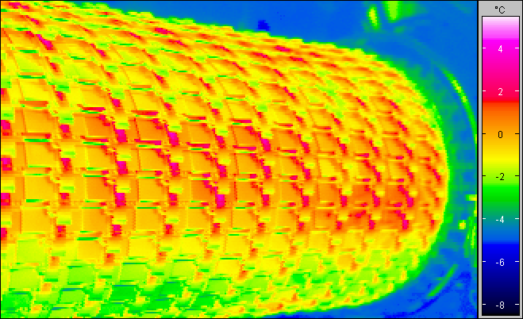
Detectors…
Robotic assembly of precision silicon tracker – Denys Wilkinson Building

Slide 24
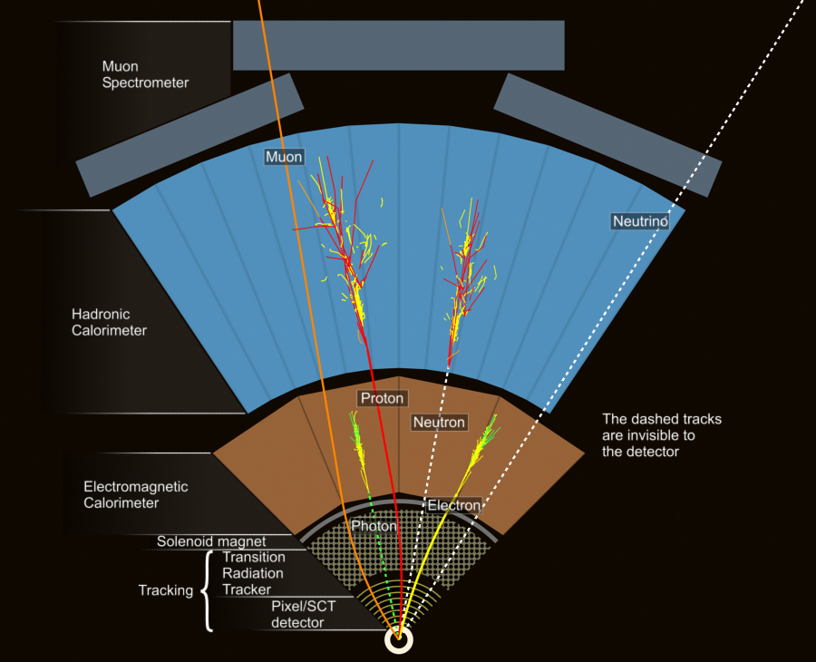
ATLAS
Segment of detector

Slide 25
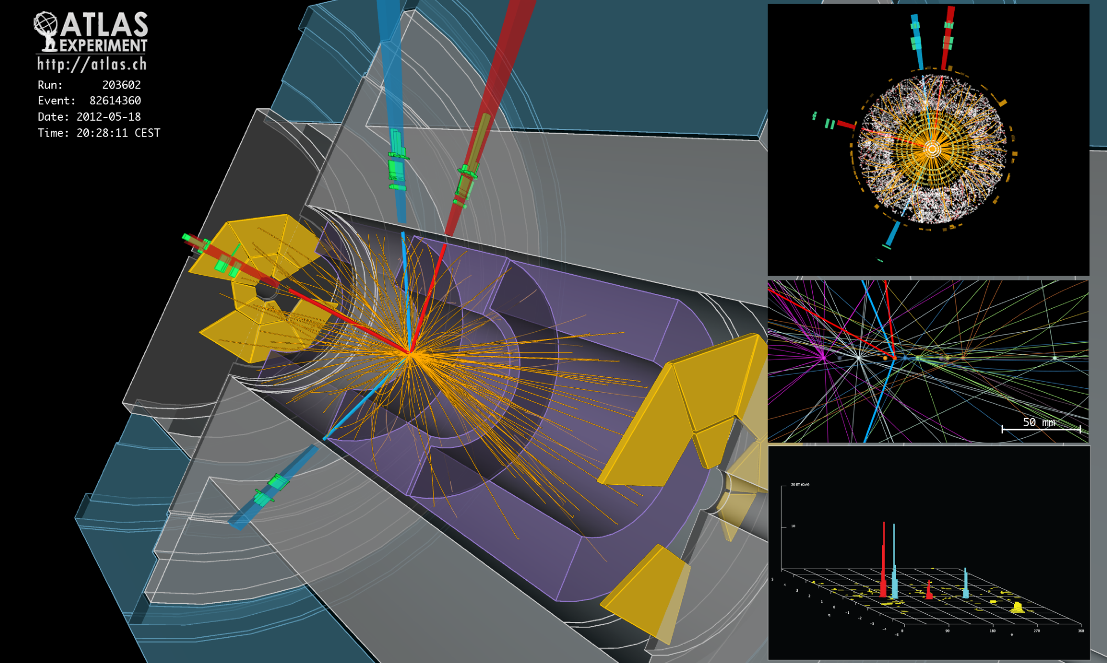
H → Z + Z* → (e⁺ + e⁻) + (e⁺ + e⁻) candidate

Slide 26
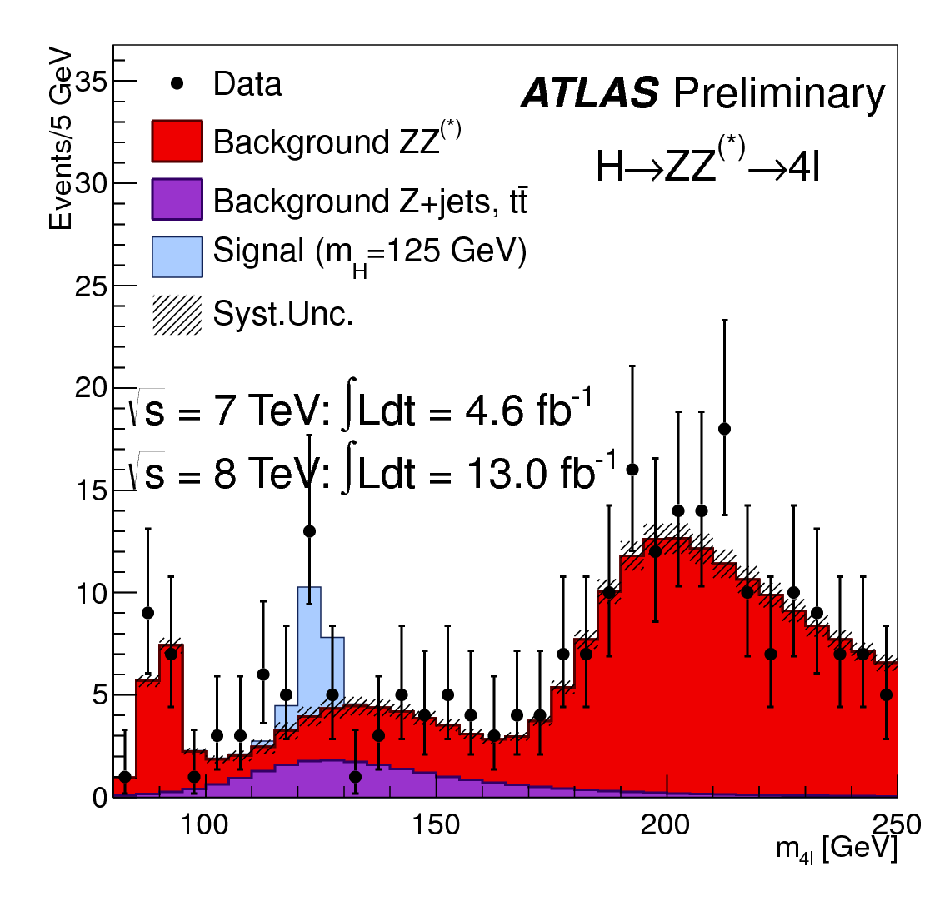

Slide 27
A collision producing 2 high-energy photons
Higgs → γ + γ ?

Slide 28
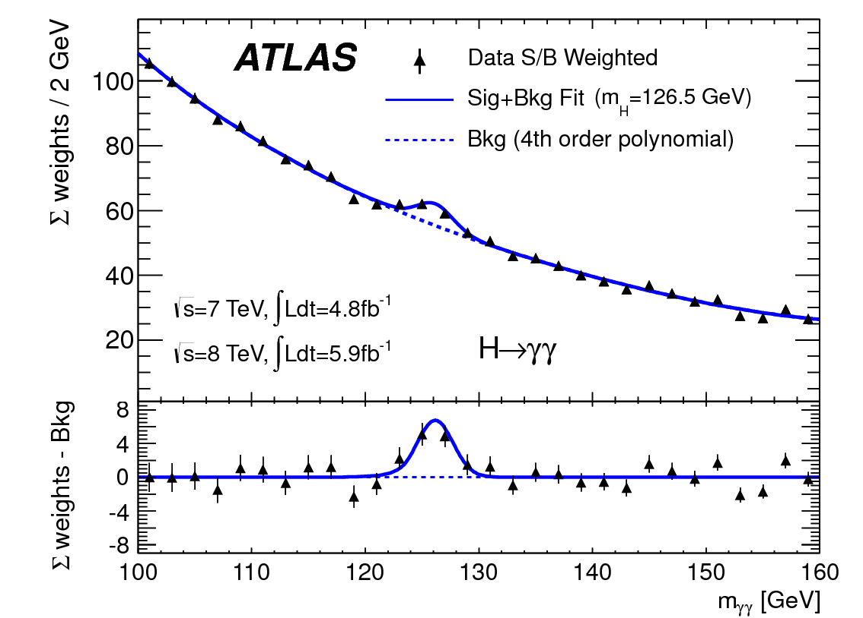
Higgs → 2 photons
Bump at mass of new particle

Slide 29
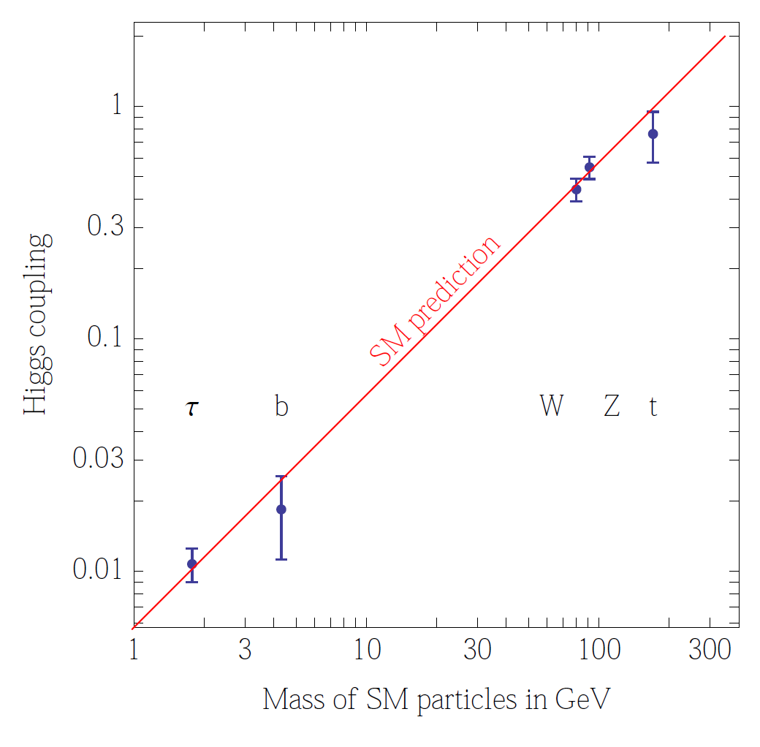
Couplings

Slide 30
Many questions unanswered…
Does it couple to itself?
What shape is the potential
Are there more Higgs bosons?
Why is the mass of the Higgs boson not HUGE?

