Slide 1
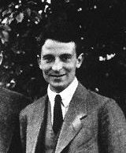
Oskar Benjamin Klein (1894–1977)
Quote by his tutor “I am not of the opinion that finding new laws of nature
and indicating new directions is one of your great strengths,
although you always have developed a certain ambition in this direction.”

