Slide 1
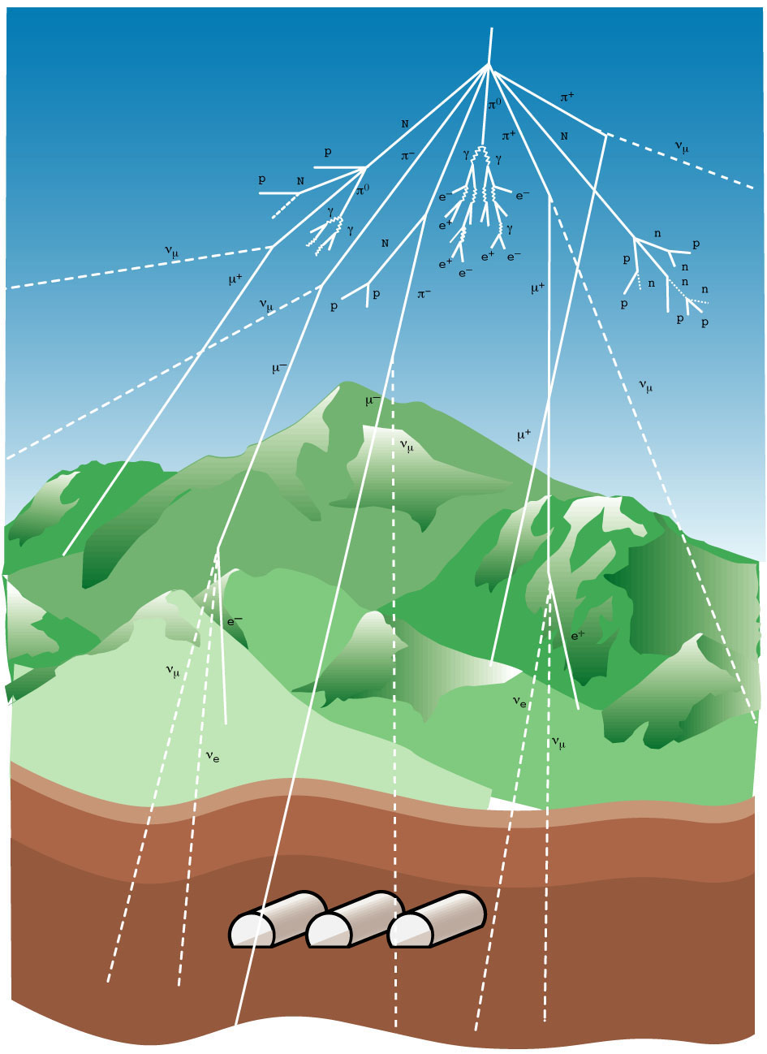
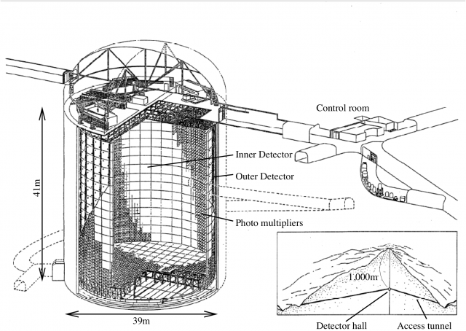
Super Kamiokande

Slide 2
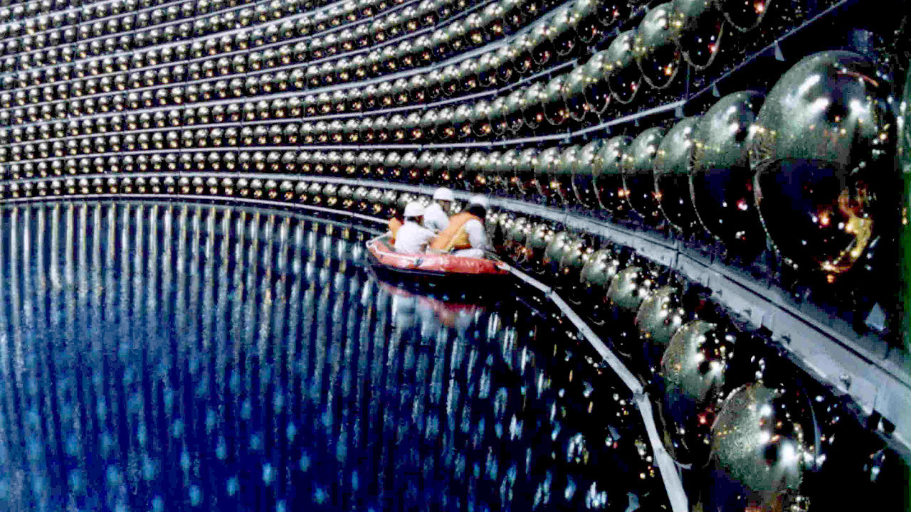
Super Kamiokande

Slide 3
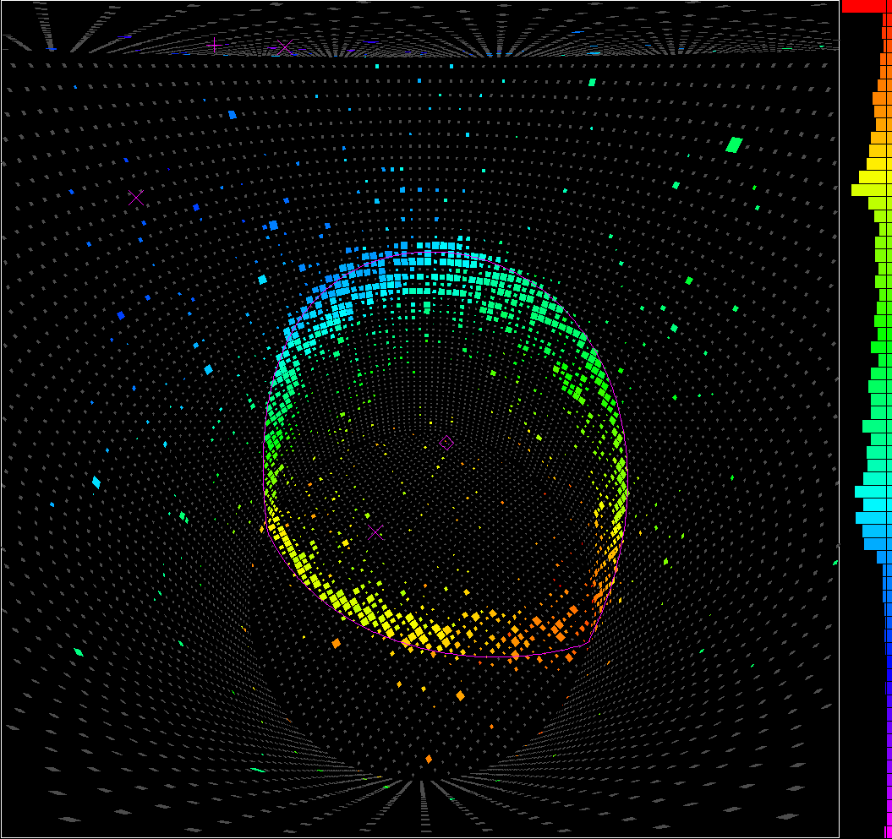

Slide 4
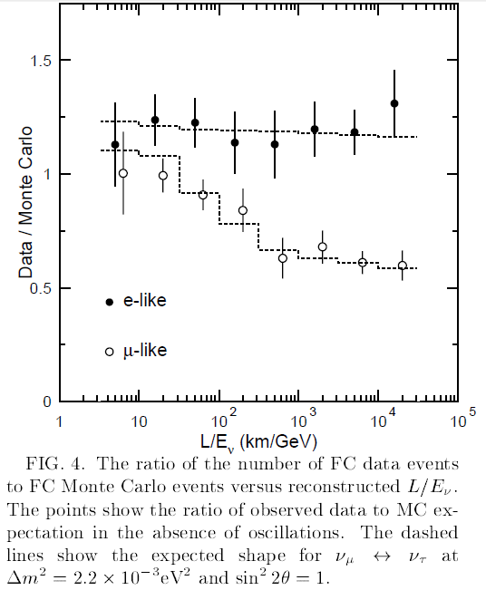
Evidence for oscillation of atmospheric neutrinos The Super-Kamiokande Collaboration, Phys. Rev. Lett. 81 (1998) 1562-1567

Slide 5
Extras

Slide 6
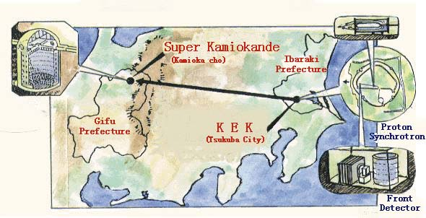

Slide 7
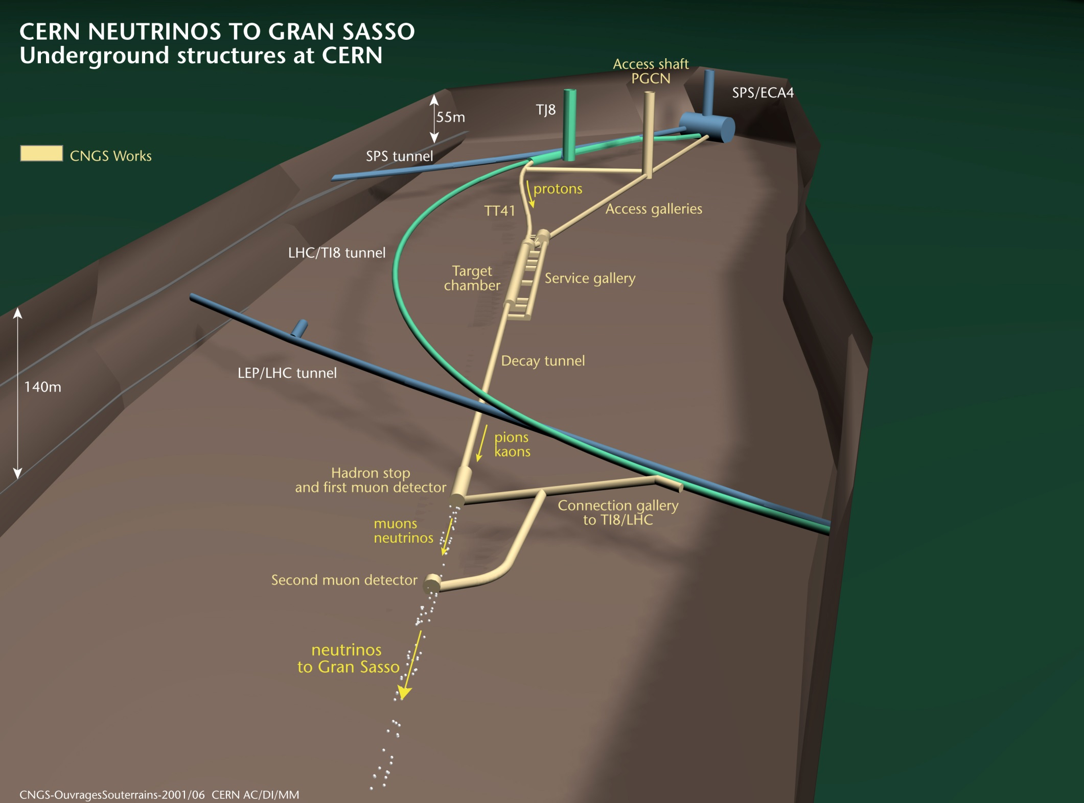

Slide 8
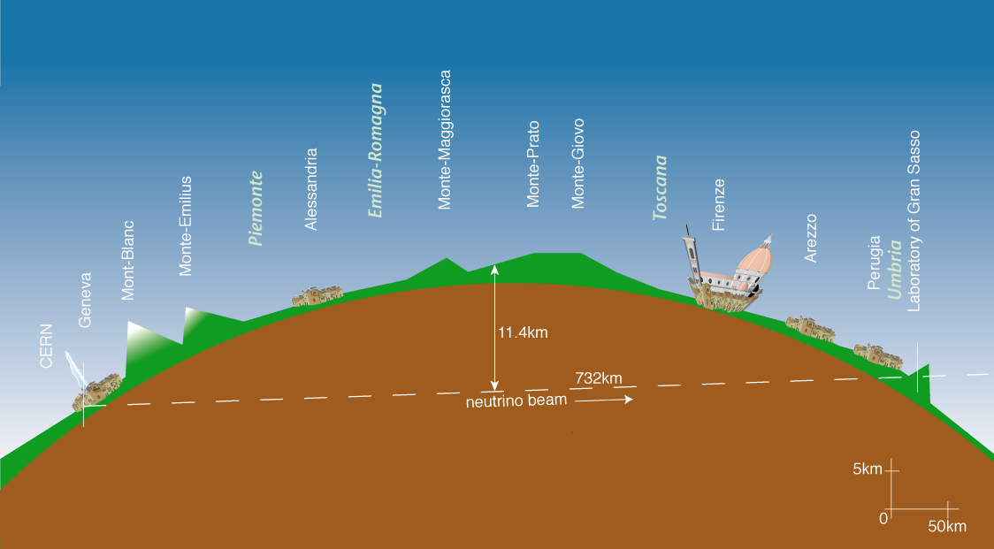

Slide 9
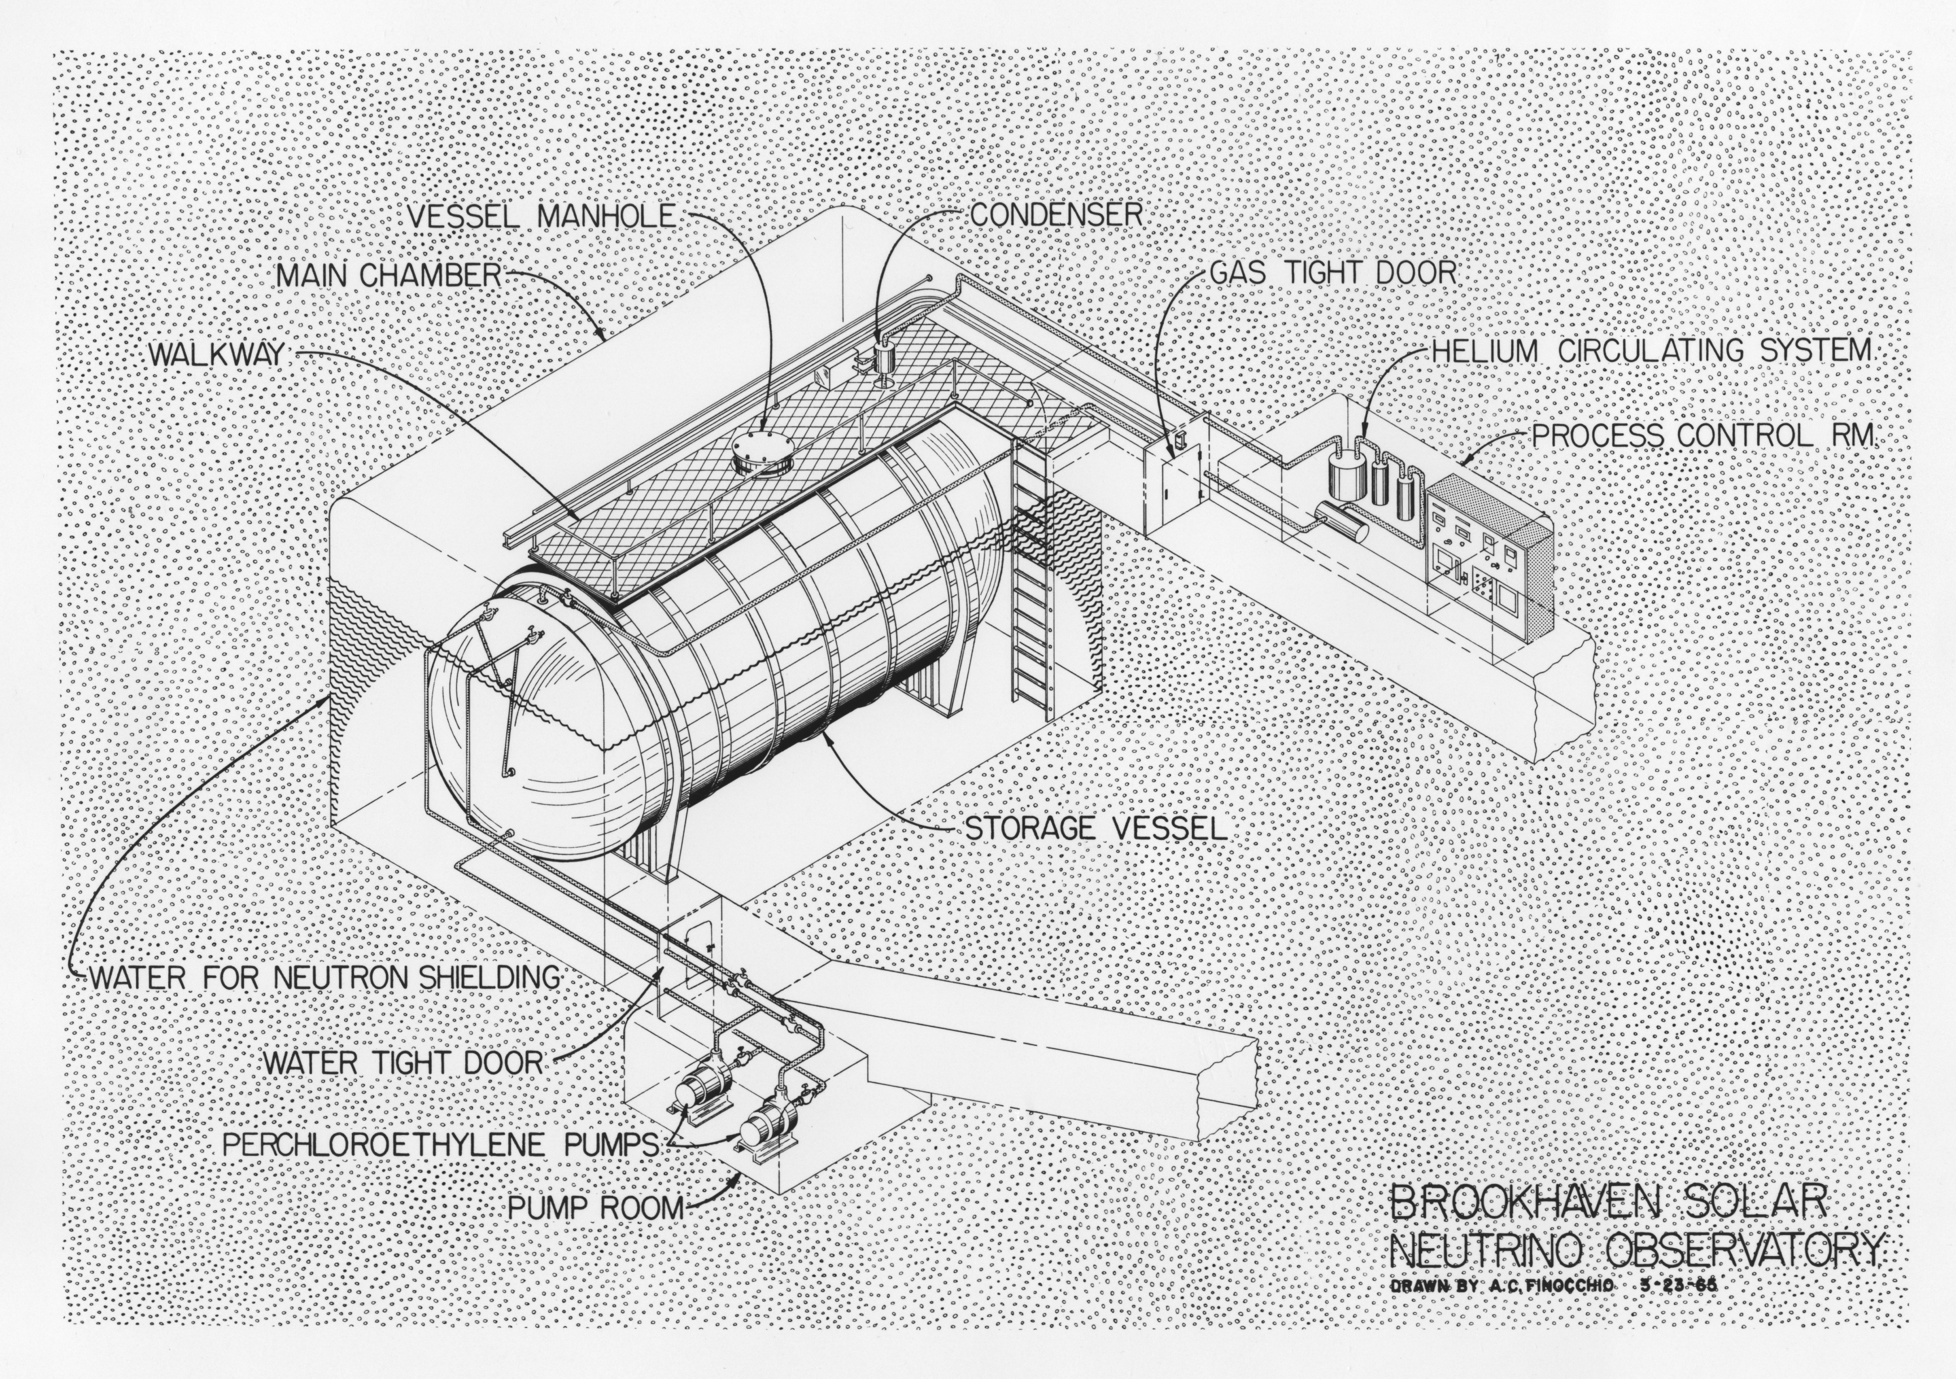

Slide 10
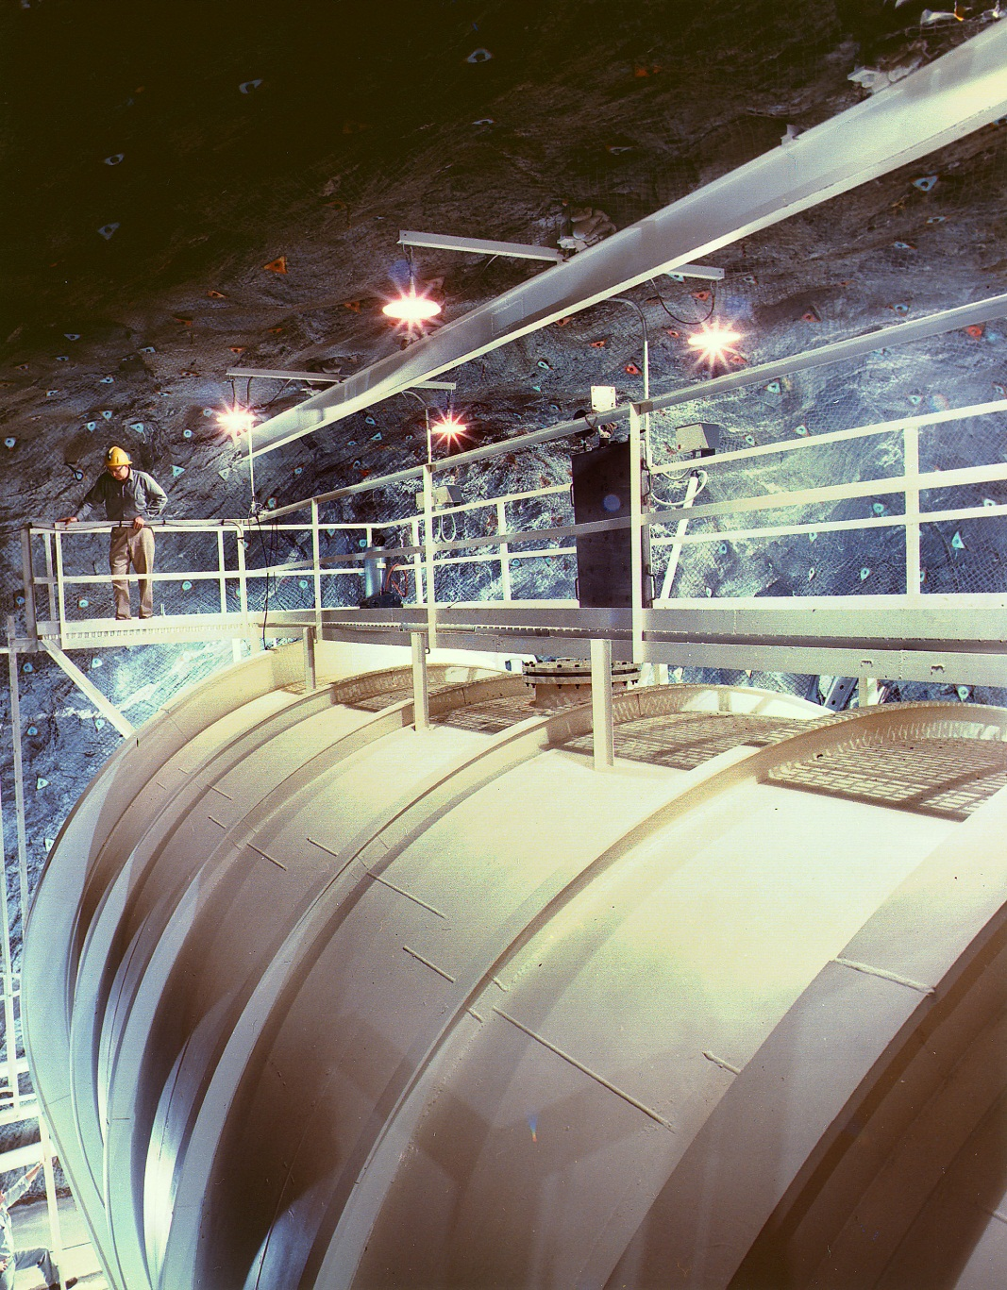
100,000-gallon tank of perchloroethylene
(dry-cleaying fluid containing chlorine)

