Slide 2
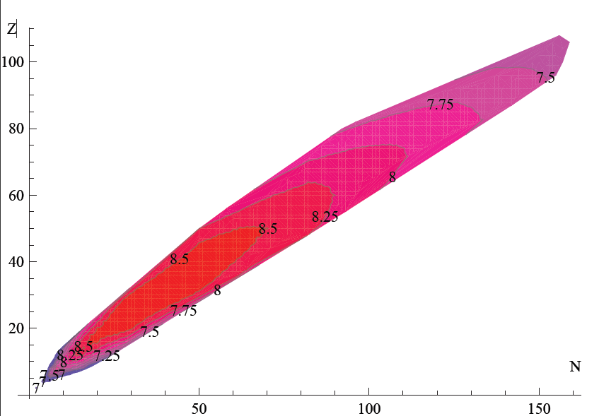
Binding energies in DATA [MeV]

Slide 3
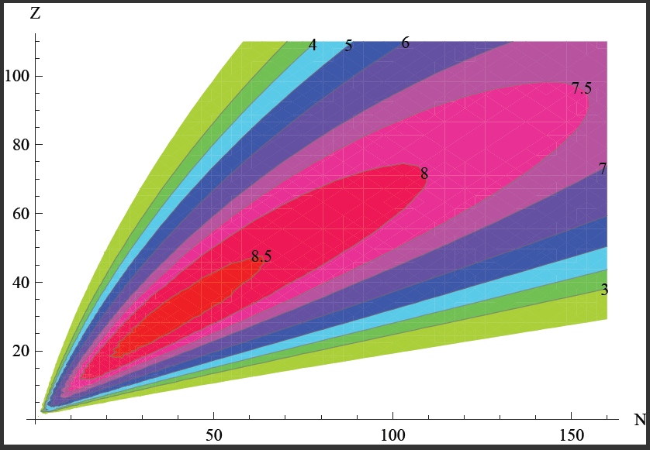
Binding energies from SEMF

Slide 4
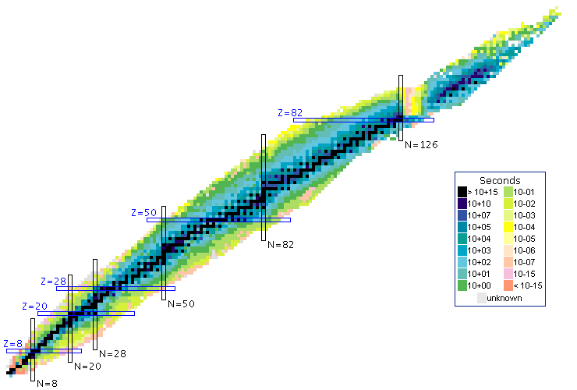
Z
N

Slide 5
