Slide 2
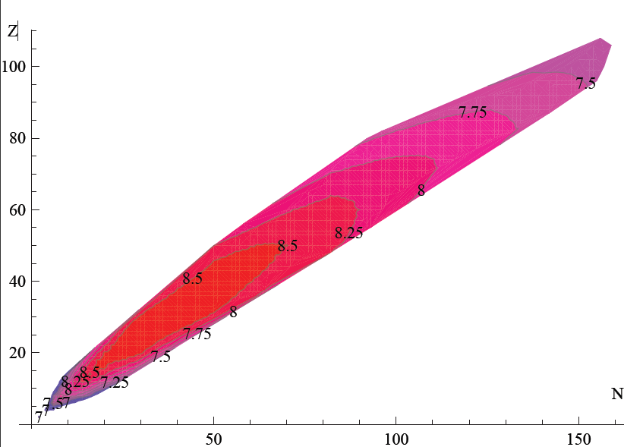
Binding energies in DATA [MeV]

Slide 3
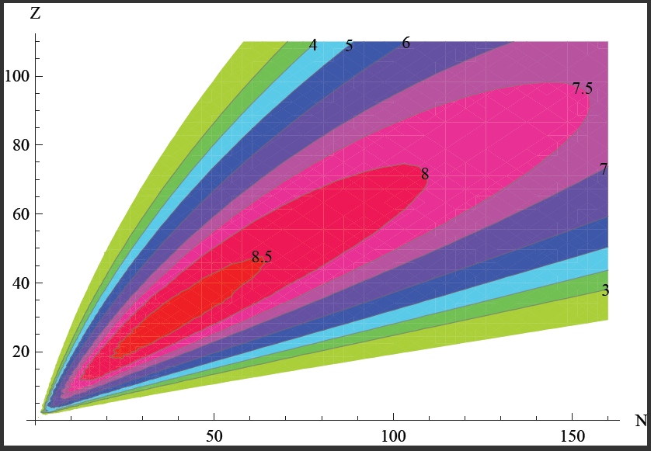
Binding energies from SEMF

Slide 4
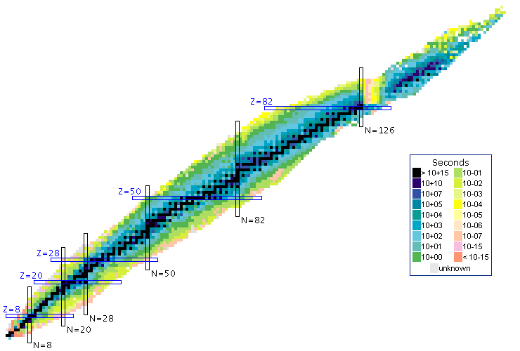
Z
N

Slide 5
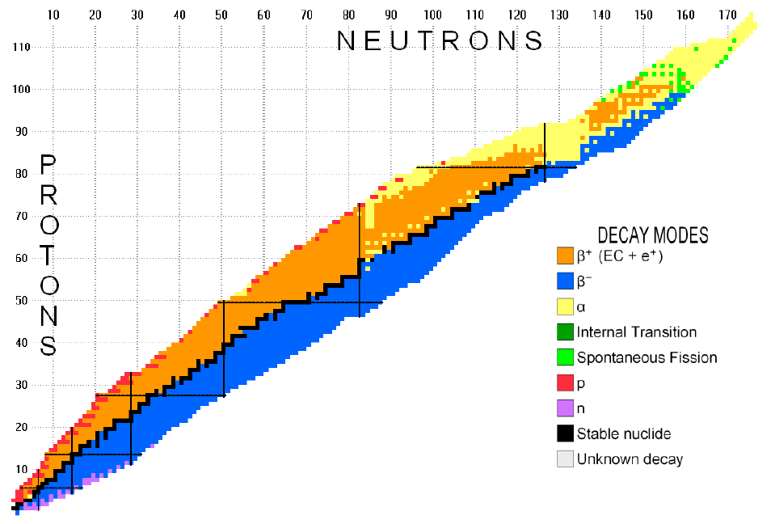

Slide 6
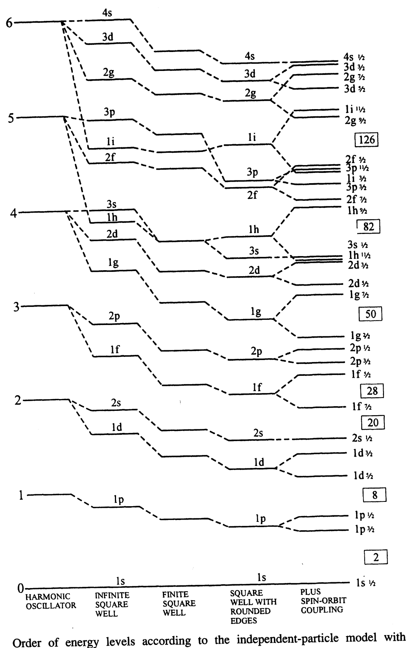
Building the SHELL model
-> SHO (3D)
-> Infinite spherical well
-> Finite spherical well
-> + Spin-Orbit
Magic Numbers
From Hodgeson, Gadioli & Gadioli Erba

