Slide 1
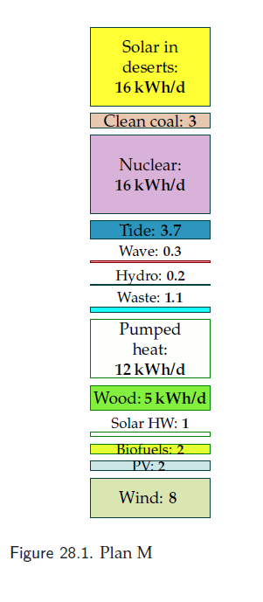
http://www.withouthotair.com/

Slide 2
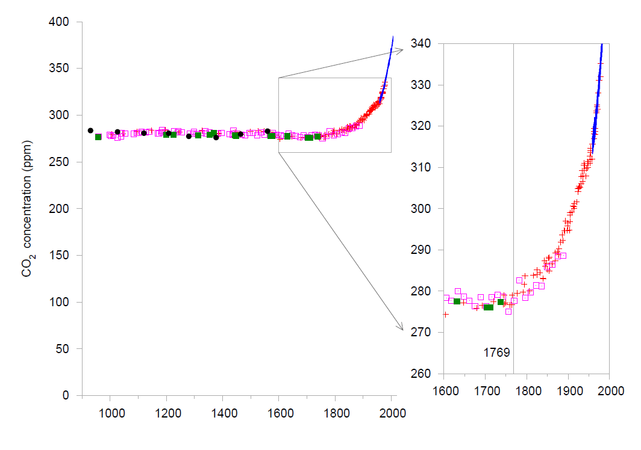
1769: the year James Watt invented the first practical steam engine

