Slide 1
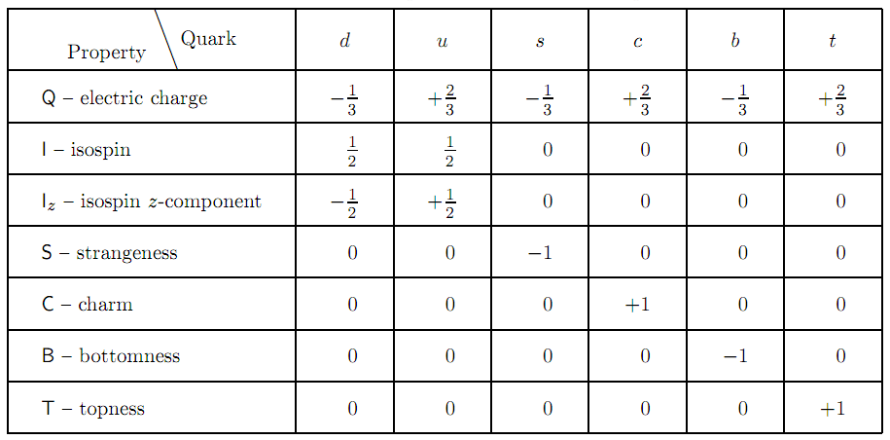
Quantum numbers of the quarks

Slide 2
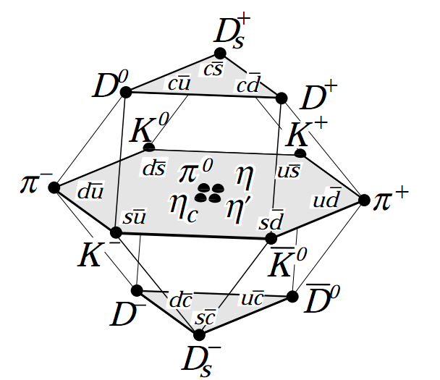
Pseudo-scalar Mesons
J^{P}=1⁻
Ground state mesons of the “u”, “d”, “c” and “s” quarks (and their anti-quarks)
K. Nakamura et al., JPG 37, 075021 (2010) (http://pdg.lbl.gov)

Slide 3
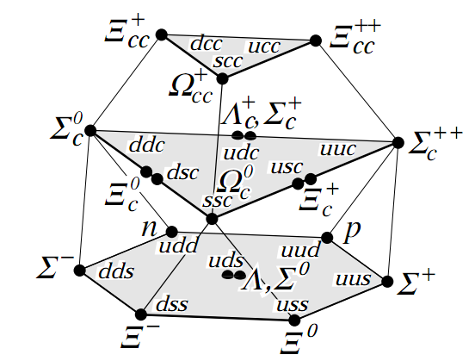
Lightest baryon multiplets
J^{P}=½⁺
Ground state baryons of the “u”, “d”, “c” and “s” quarks
K. Nakamura et al., JPG 37, 075021 (2010) (http://pdg.lbl.gov)

