Slide 1
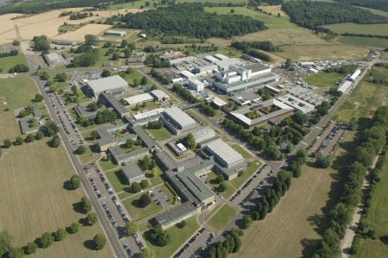
Culham Center for Fusion Energy

Slide 2
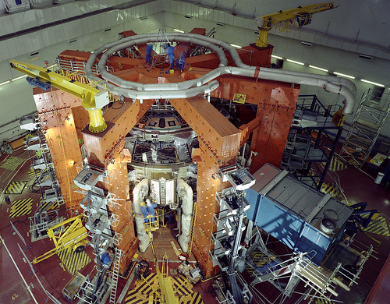

Slide 3
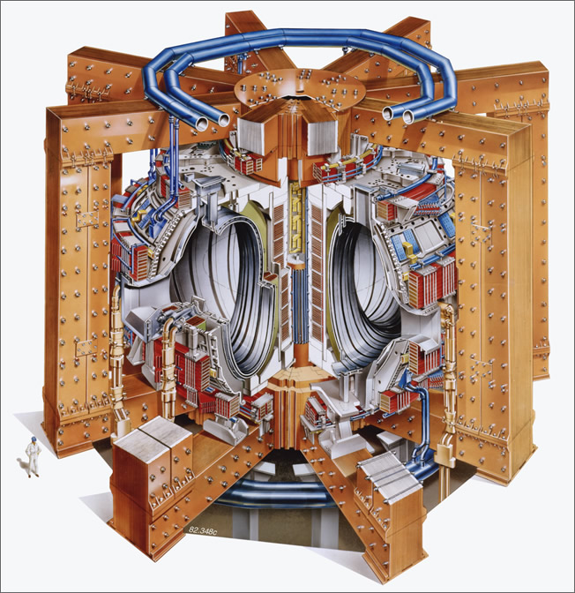

Slide 4
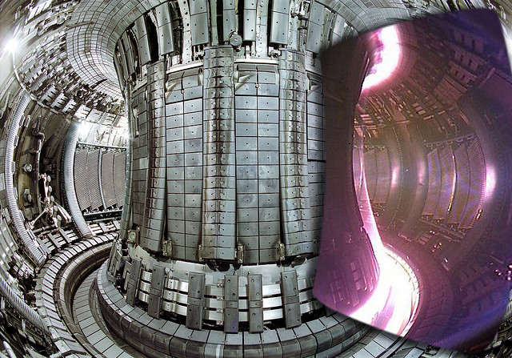
http://www.youtube.com/culhamfusionenergy#p/u/6/JPK-mLnNriI

