Slide 1
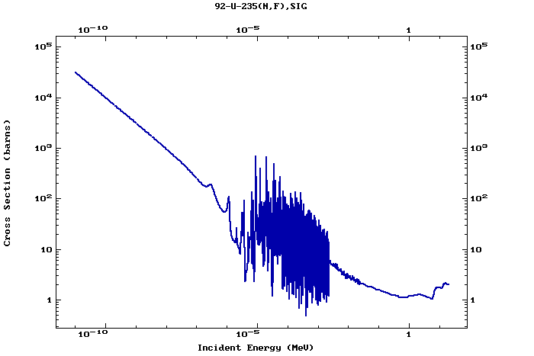
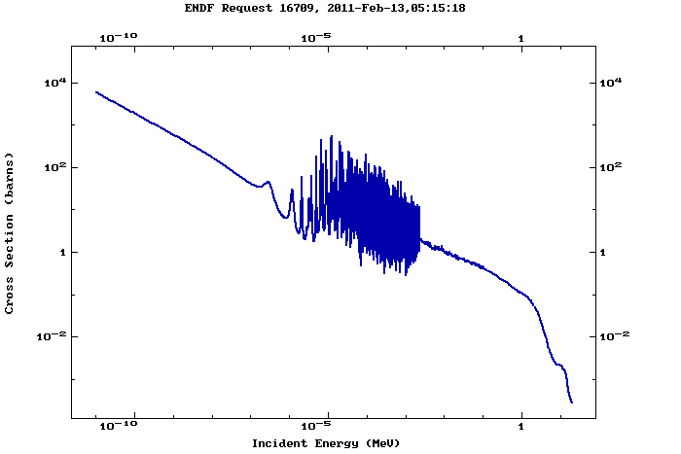
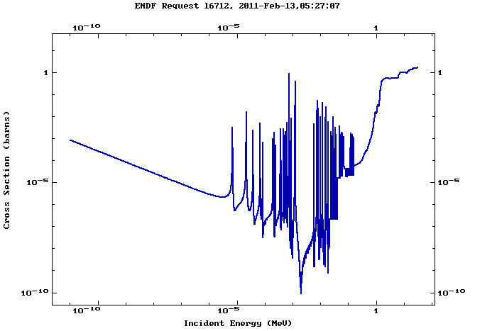
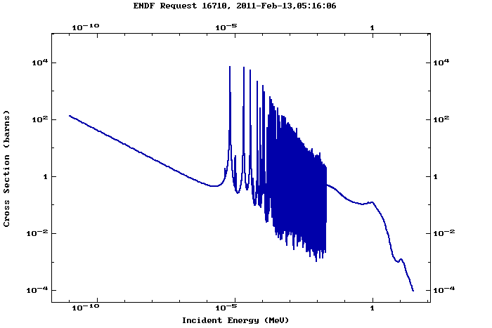
Thermal
235U (n,f)
235U (n,γ)
238U (n,f)
238U (n,γ)
Data from http://www.nndc.bnl.gov/

