Slide 1



Impact of ATLAS measurements on
the knowledge of proton structure
Claire Gwenlan, Oxford
on behalf of the ATLAS collaboration
Baryons16
Tallahassee, Florida, 16 – 20 May 2016
introduction
quarks (light, heavy)
gluon constraints

Slide 2
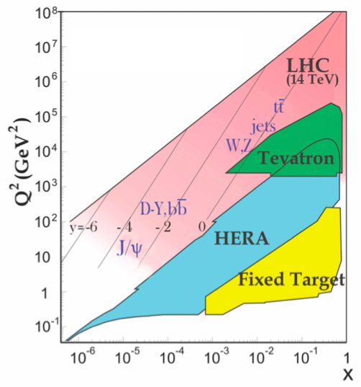
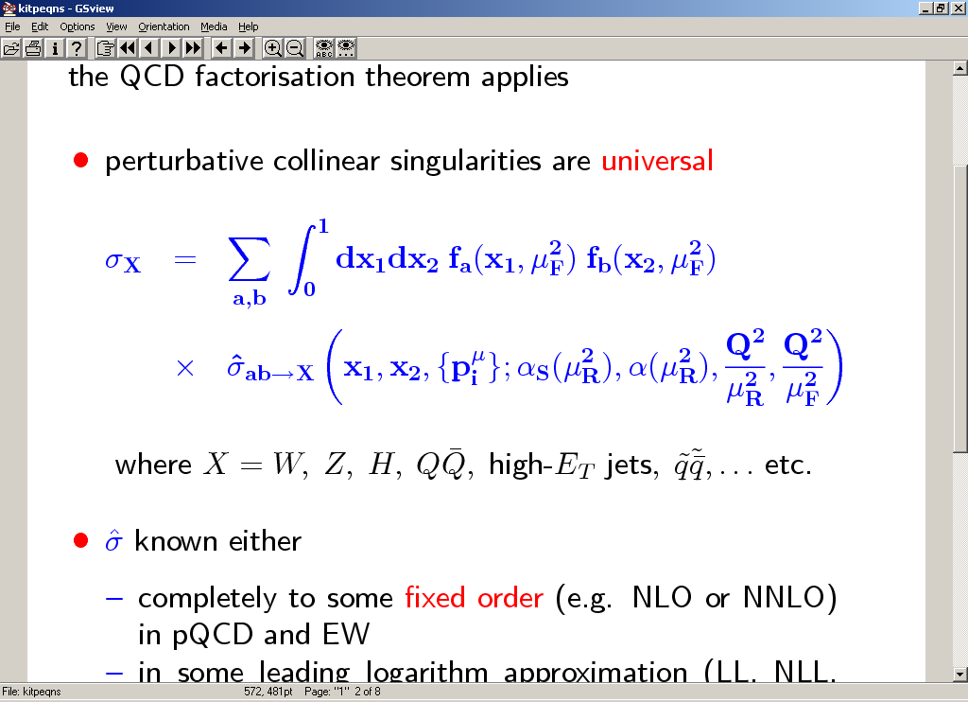
proton structure and the LHC
information on the deep structure of the proton encoded in parton distribution functions (PDFs)
probability of finding quark or gluon at particular Bjorken x and scale Q
PDFs not known a priori; must be determined from fits to exp. data
QCD factorisation:
PDFs
perturbatively calculable hard subprocess cross section
HERA DIS data provide primary source of information for proton PDFs; LHC gives new and complementary information, especially on quark flavour and gluon

Slide 3
PDFs: why do they matter?
Gluon-Gluon PDF luminosity
SUSY
√s = 13 TeV
ratio
arXiv:1211.5102
small x
new physics discovery
Higgs
crucial for SM and BSM physics at hadron colliders
dominant theory uncert. on Higgs production;
limit precision on fundamental parameters (MW, 𝝰s, …);
limit searches for new, massive particles
dilepton search
other questions: validity of factorisation, intrinsic heavy quarks in proton, small x dynamics, …
EPJC (2014) 74:3134
Notes:
also open questions, such as validity of factorisation; presence of heavy quarks in proton; small x dynamics, …

Slide 4
LHC data and proton structure
  wealth of SM measurements from ATLAS, sensitive to PDFs, allowing:
    PDF discrimination (confronting data with theory)
    improved PDFs, by including LHC data in QCD fits

Slide 5
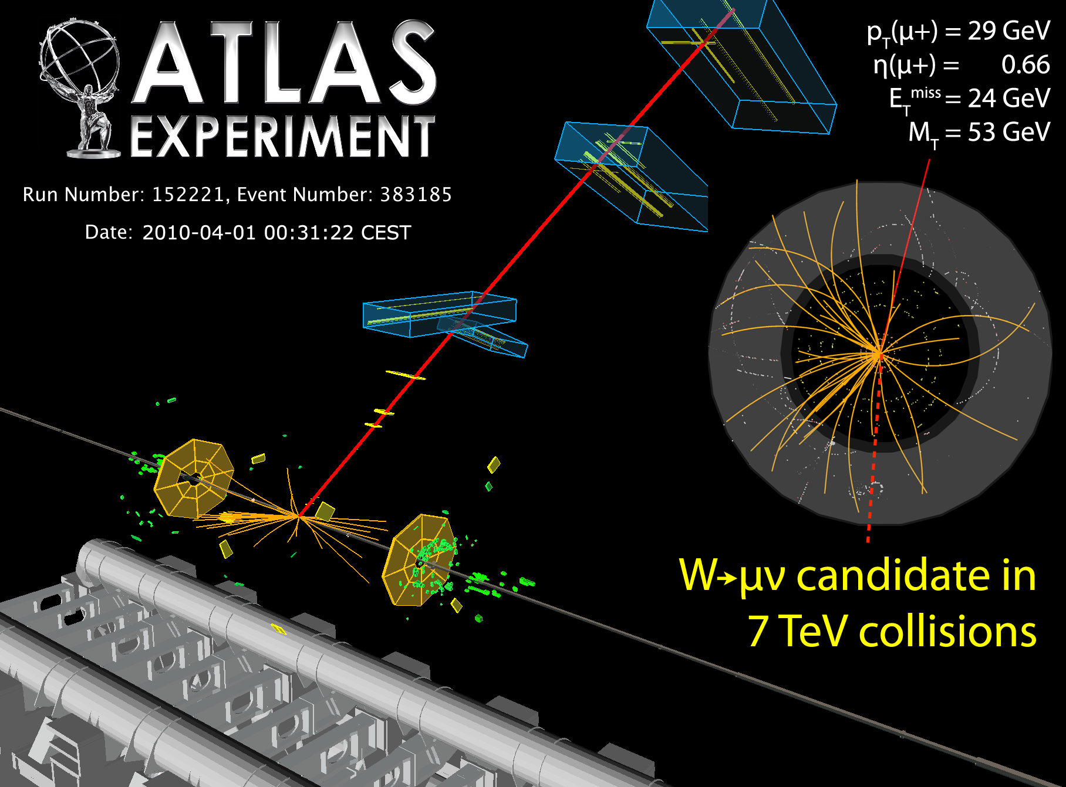
Gauge Boson production
(quarks, flavour decomposition; photon density)
clean experimental signatures and advanced theoretical predictions

Slide 6
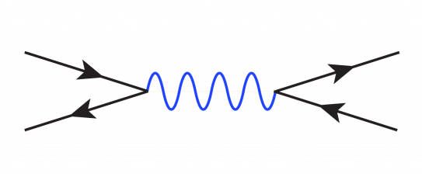
ATLAS inclusive W, Z
  sensitivity to light quarks (u, d, s)
  different quark combinations contribute to each process; flavour separation
q (’)
Z/γ* (W)
l (ν)
q
l
(accurate modelling of contribution from second-generation quarks essential for precision physics)

Slide 7
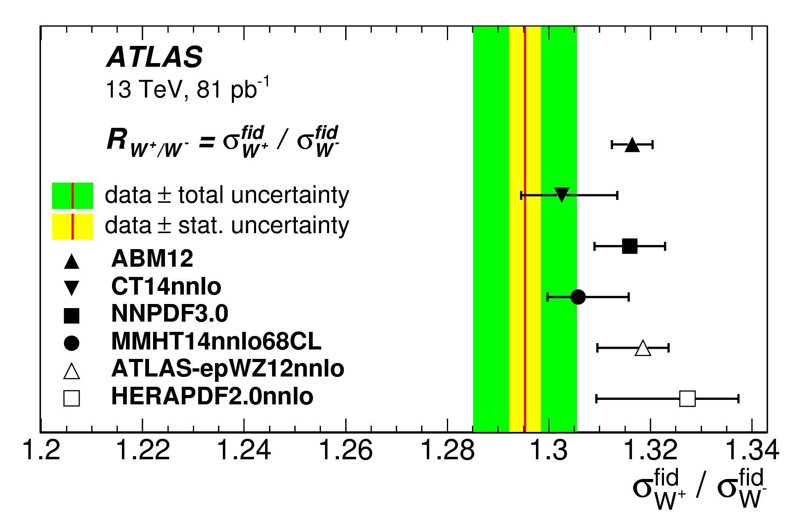
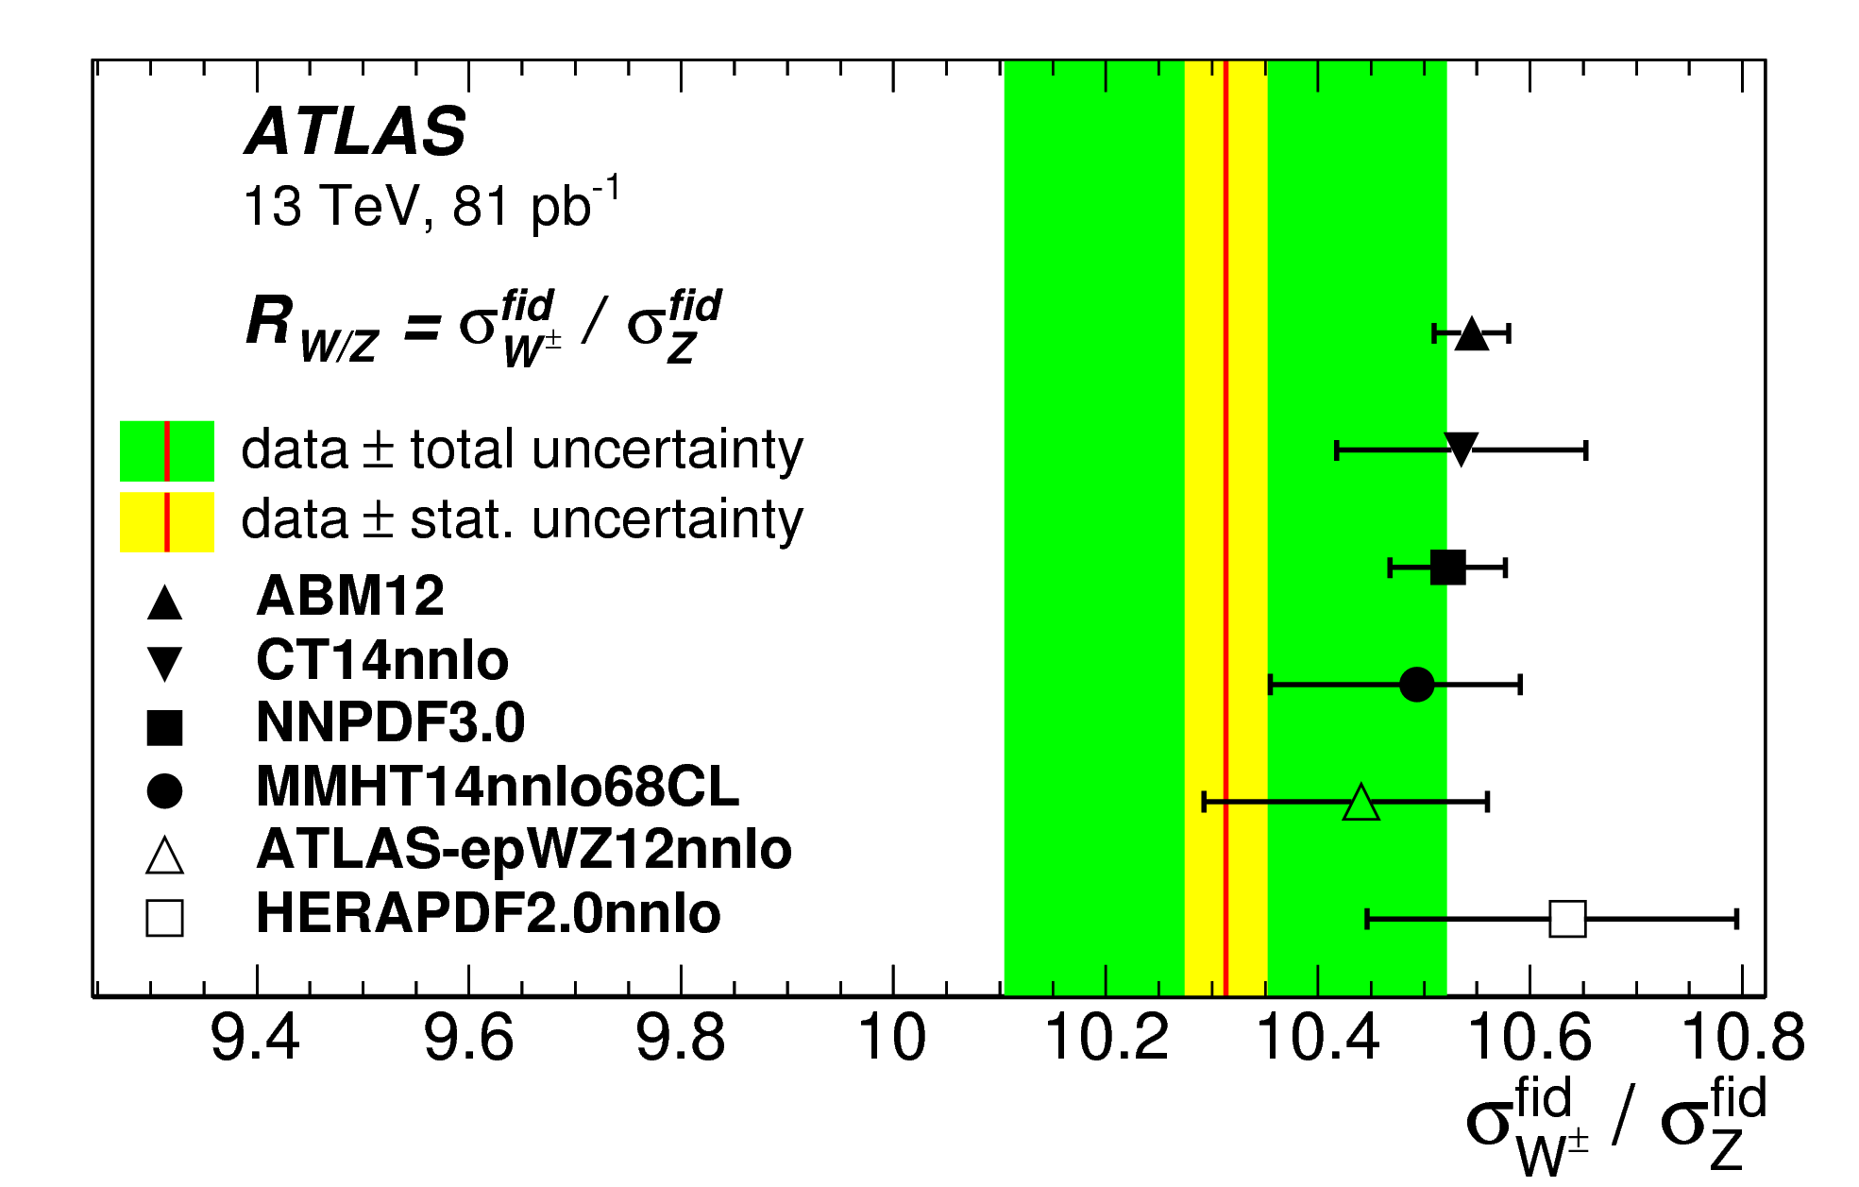
ATLAS inclusive W, Z
arXiv:1603.09221
  sensitivity to light quarks (u, d, s)
  different quark combinations contribute to each process; flavour separation
q (’)
Z/γ* (W)
l (ν)
q
l
  ATLAS √s = 13 TeV measurement
  total and fiducial cross sections (supercedes previous ATLAS-CONF-2015-035)
  sensitivity to PDF differences
new
W⁺/W⁻
W/Z
W⁺/W– sensitive to uv and dv at low x
W/Z constrains strange quark density

Slide 8
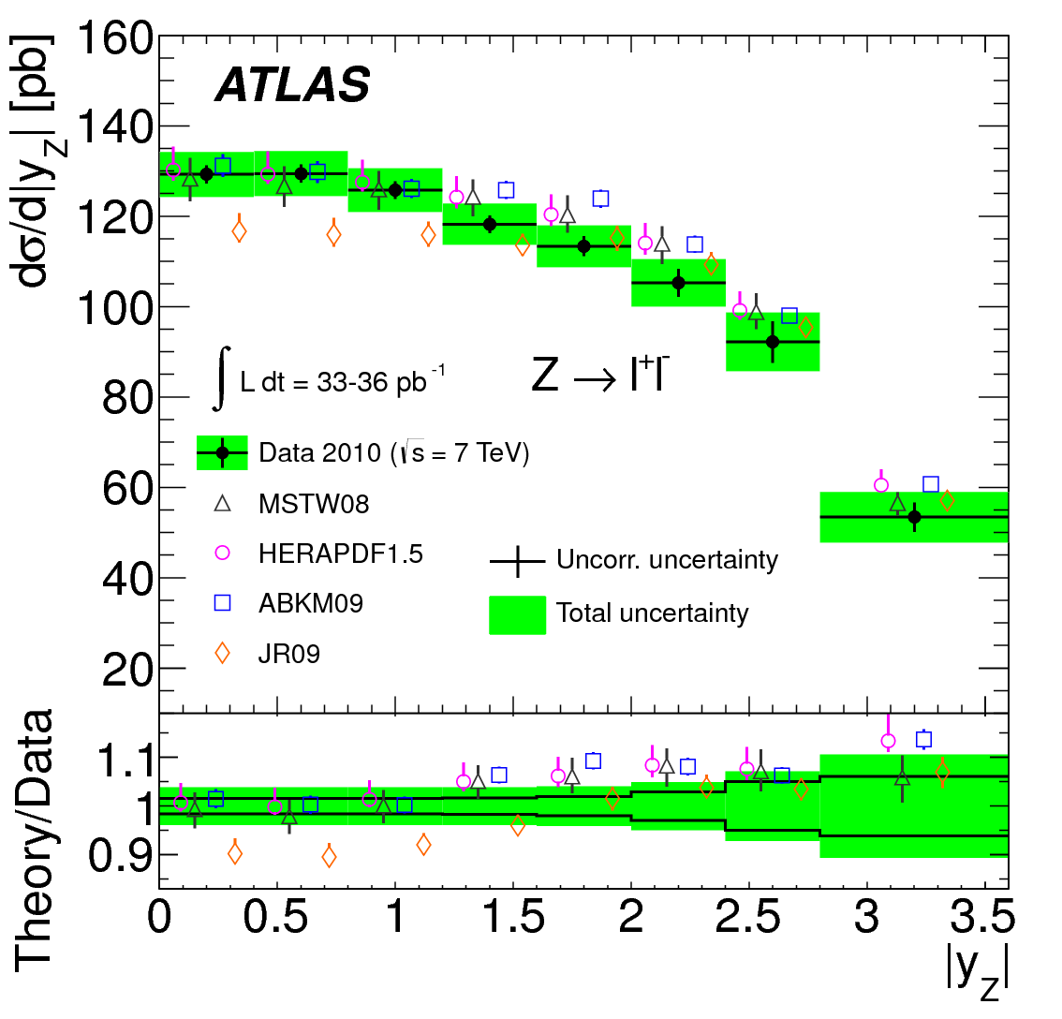
ATLAS inclusive W, Z, and strange
Phys Rev D85 (2012) 072004
strange density
strange quark density poorly known; usual assumption sbar ~ 0.5 dbar; constrained from s⟶Wc in fixed target νN DIS exps. (NuTeV, CCFR) at around x=0.1, Q²=10 GeV², but large uncertainties from charm fragmentation and nuclear corrections
LHC: strange prominent in Z production at central rapidity; Z rapidity spectrum sensitive to amount of strange

Slide 9
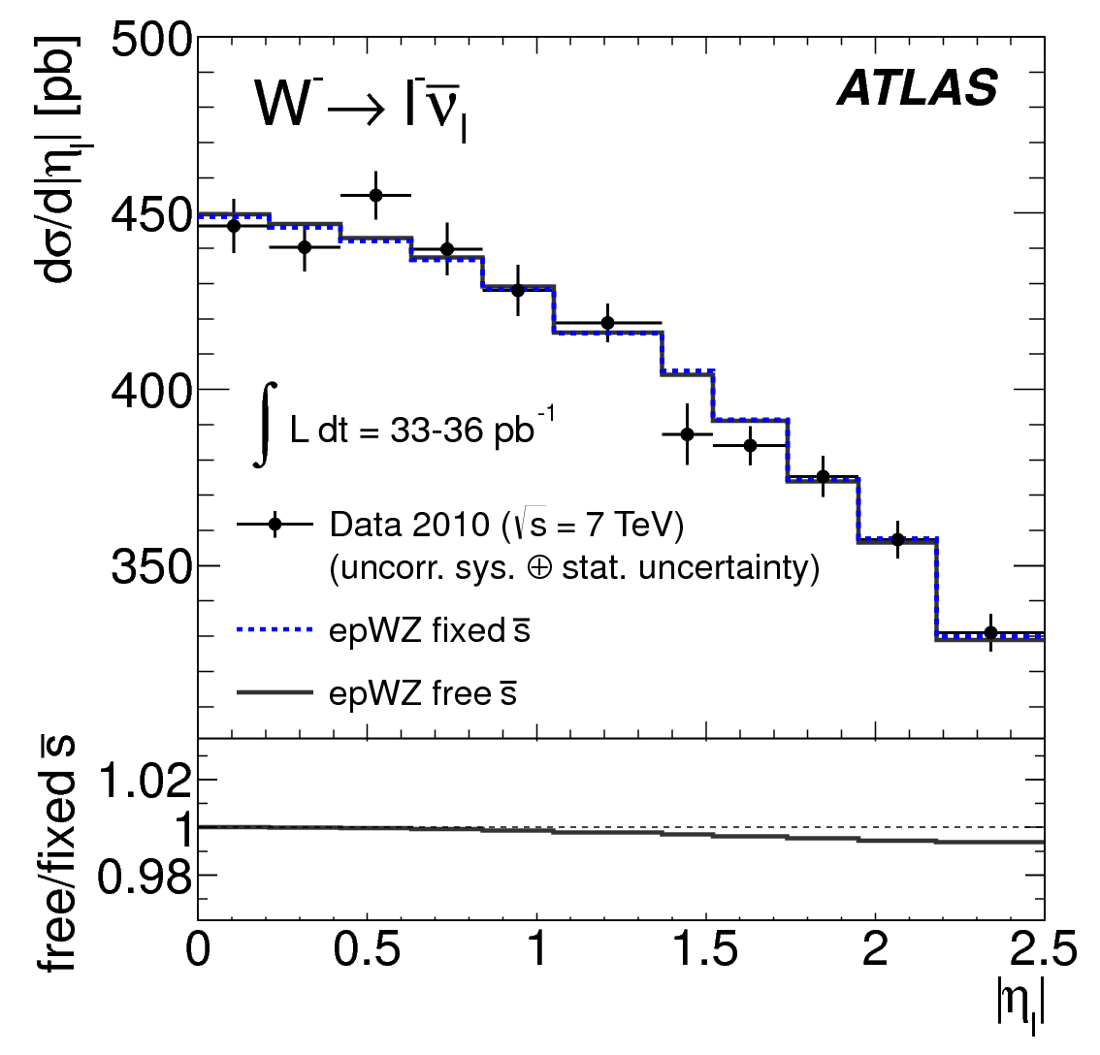
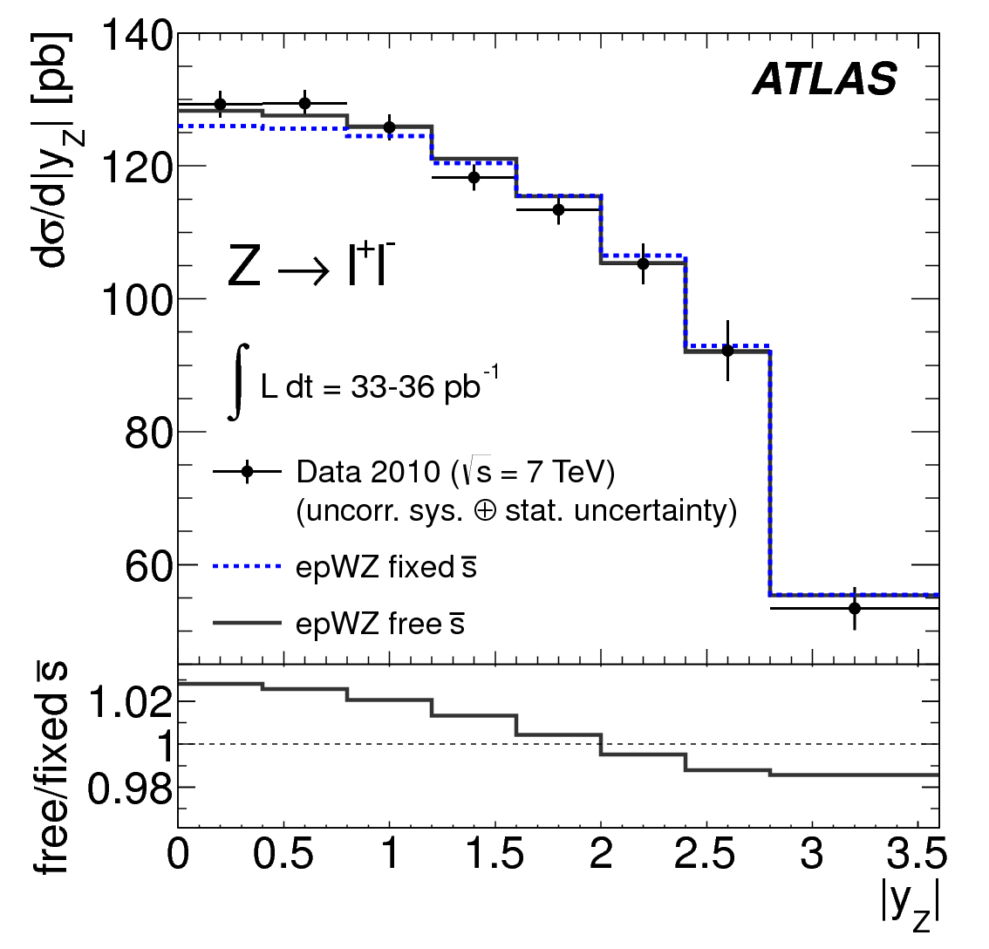
ATLAS inclusive W, Z, and strange
  constrained from shape of Z rapidity distribution, with normalisation from W
  NNLO QCD fit using HERA 1 NC and CC DIS data, and ATLAS √s=7 TeV W, Z 1) fixed (sbar = 0.5dbar) and 2) free strange content
  (using HERAPDF ansatz, and xFitter
Phys Rev Lett 109 (2012) 012001
https://wiki-zeuthen.desy.de/xFitter/)
Phys Rev D85 (2012) 072004

Slide 10
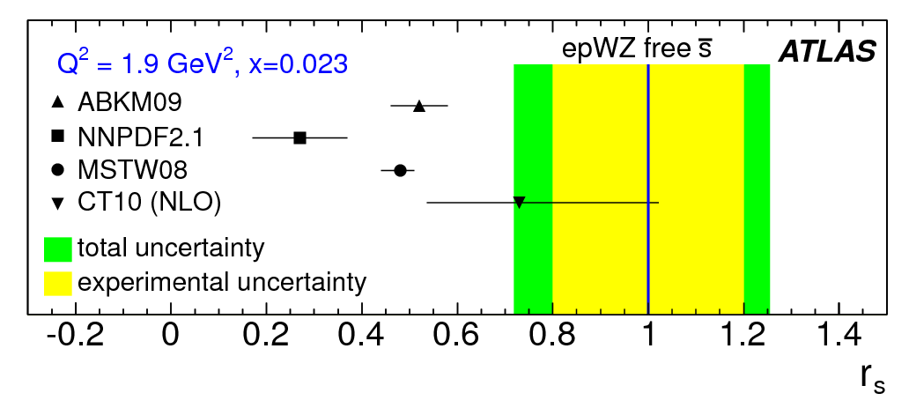
How strange is the proton?
Phys Rev Lett 109 (2012) 012001
sbar
rs : ratio of strange to down sea
at Q² = 1.9 GeV², x = 0.023
  ATLAS W, Z inclusive data support non-suppressed strange density; SU(3) symmetric sea at around x=0.01
  note, a full NNLO PDF fit produced, not just an extraction of rs (ATLAS-epWZ12, available in LHAPDF)

Slide 11
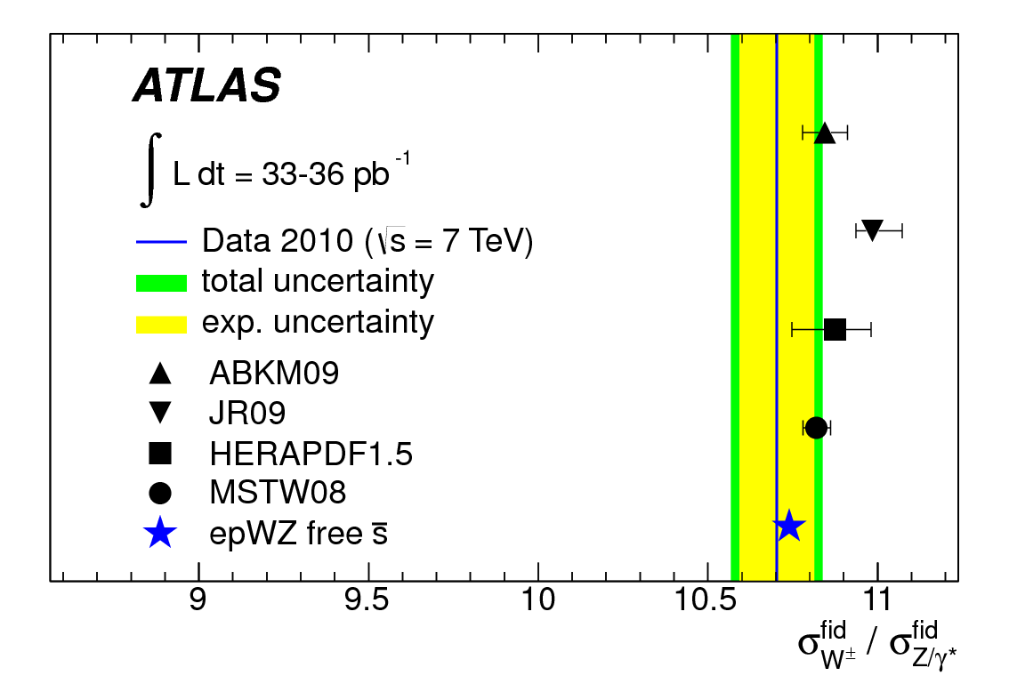
ATLAS W/Z ratio revisited
Phys Rev Lett 109 (2012) 012001
arXiv:1603.09221
√s = 7 TeV
√s = 13 TeV
ATLAS-epWZ12 PDF
  non-suppressed strange results in more Z and a low W/Z ratio
  also appears evident in √s = 13 TeV measurement

Slide 12
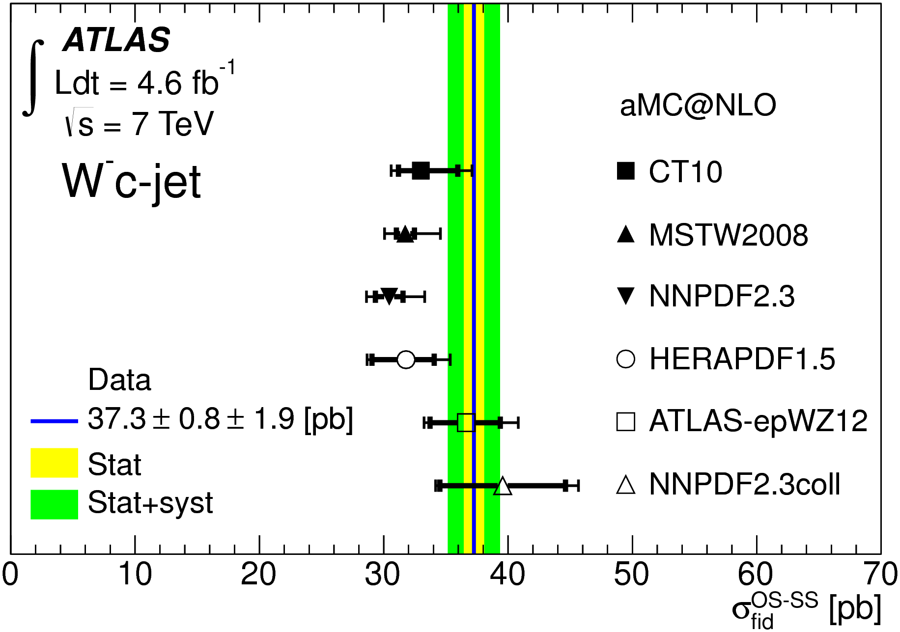
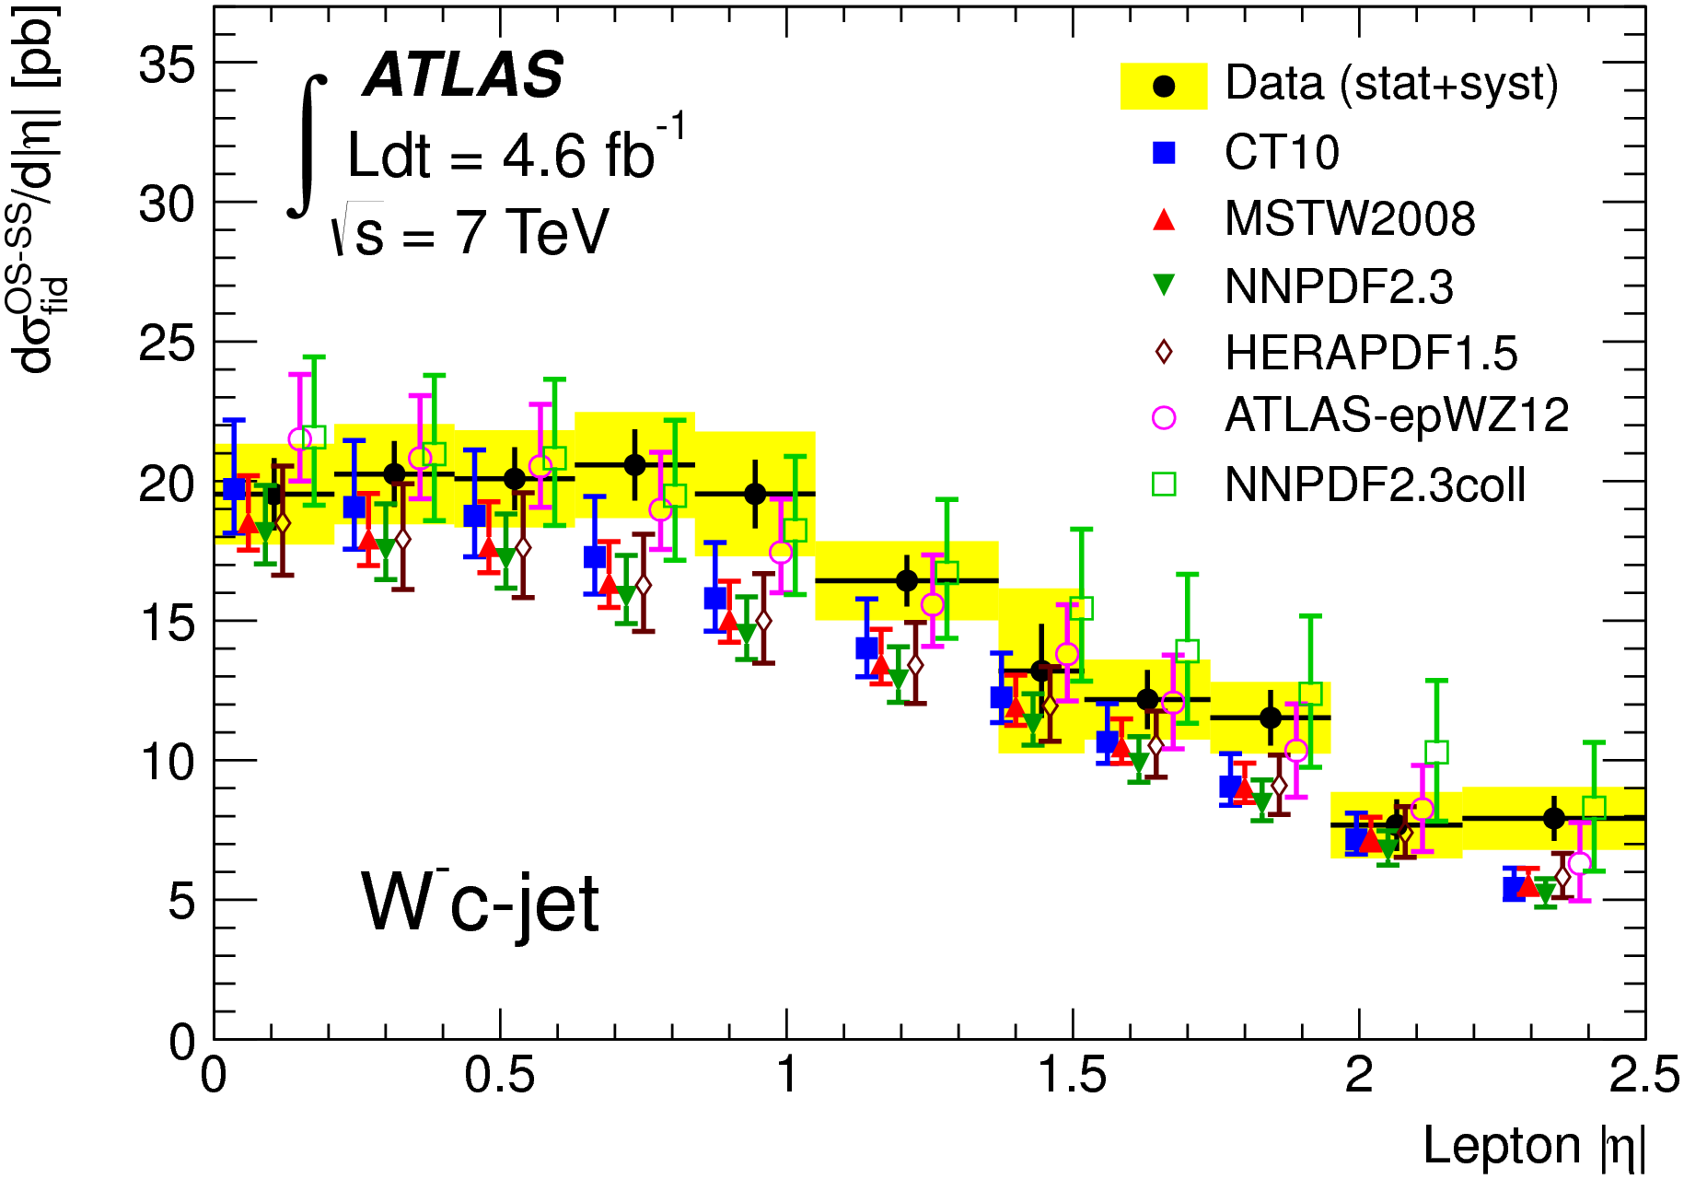
ATLAS W+c and strange
JHEP05 (2014) 068
PDFs with sbar ~ dbar
theory: aMC@NLO+Herwig++
  W+charm: direct sensitivity to strange content of proton
  W+c-jet and W+D(*) total and differential cross sections
  PDFs with less suppressed strange give best description

Slide 13
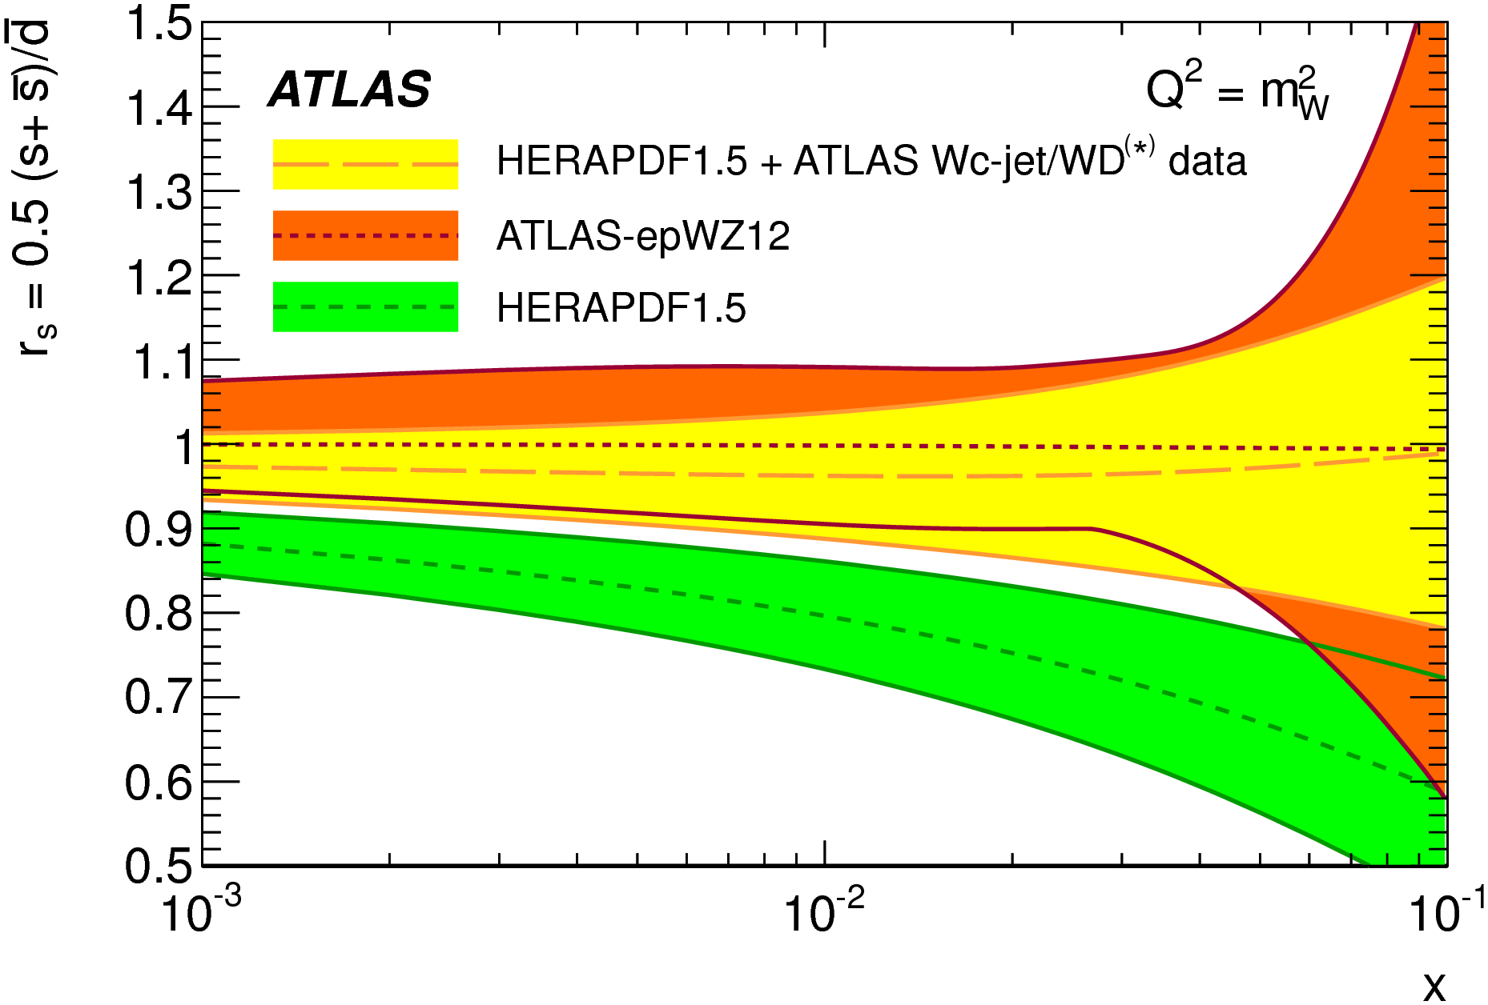
ATLAS W+c and strange
JHEP05 (2014) 068
X² minimisation for rs performed:
(using xFitter)
ATLAS W+charm measurement supports non-suppressed strange

Slide 14
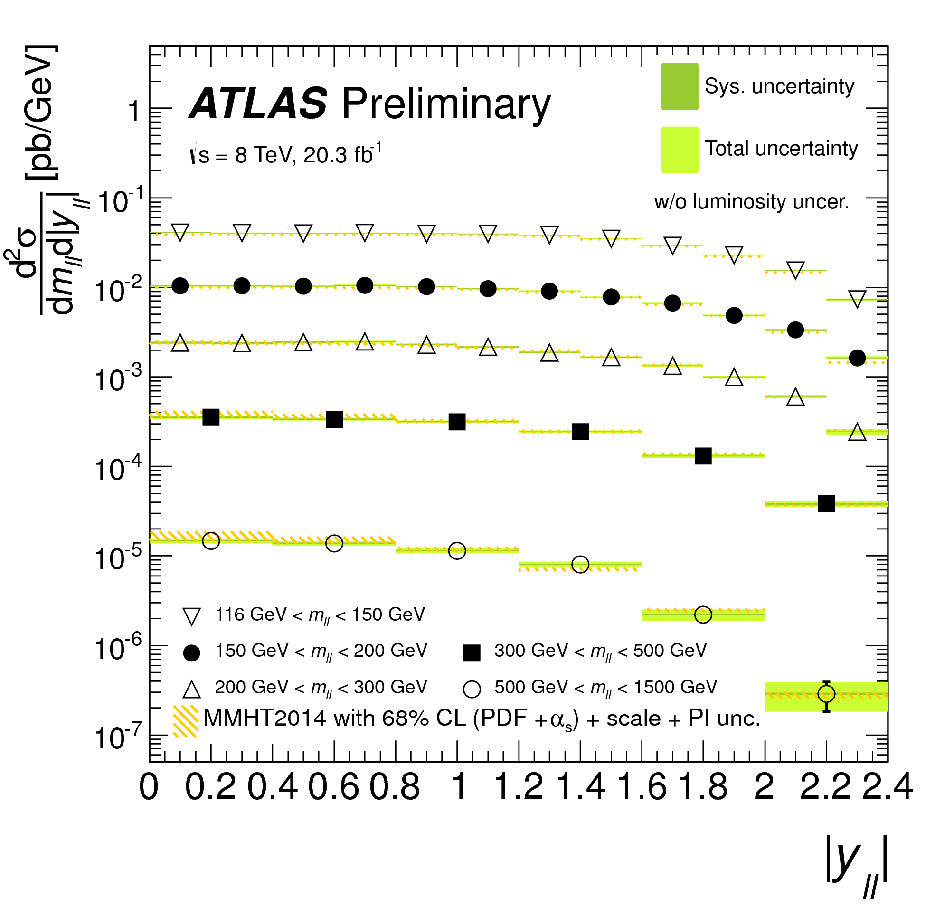
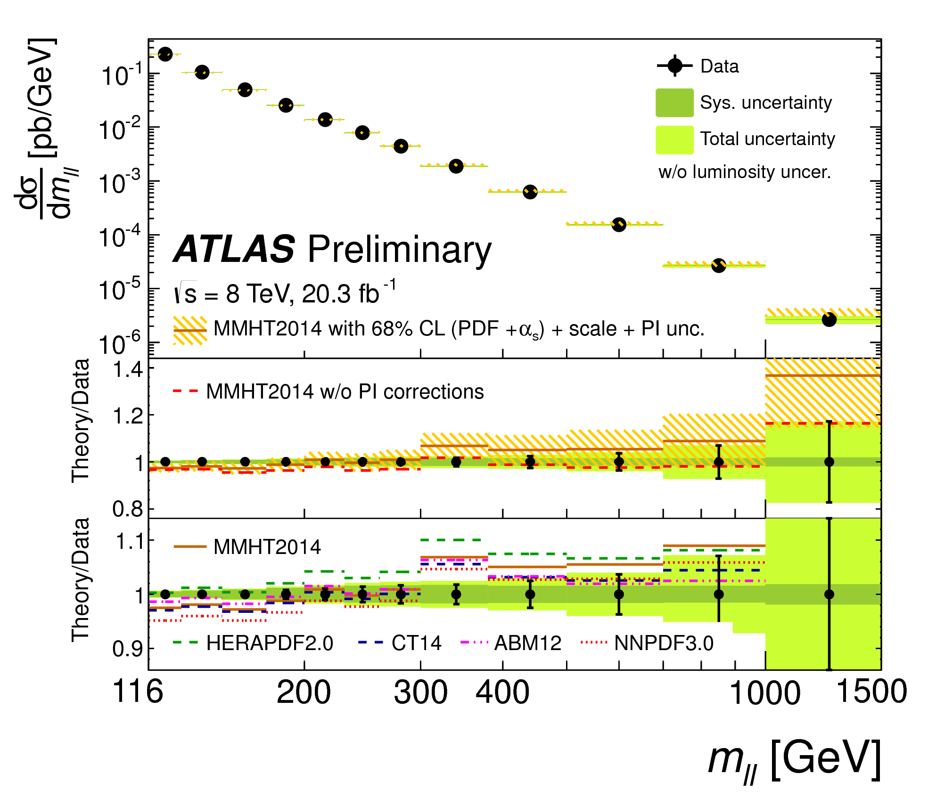
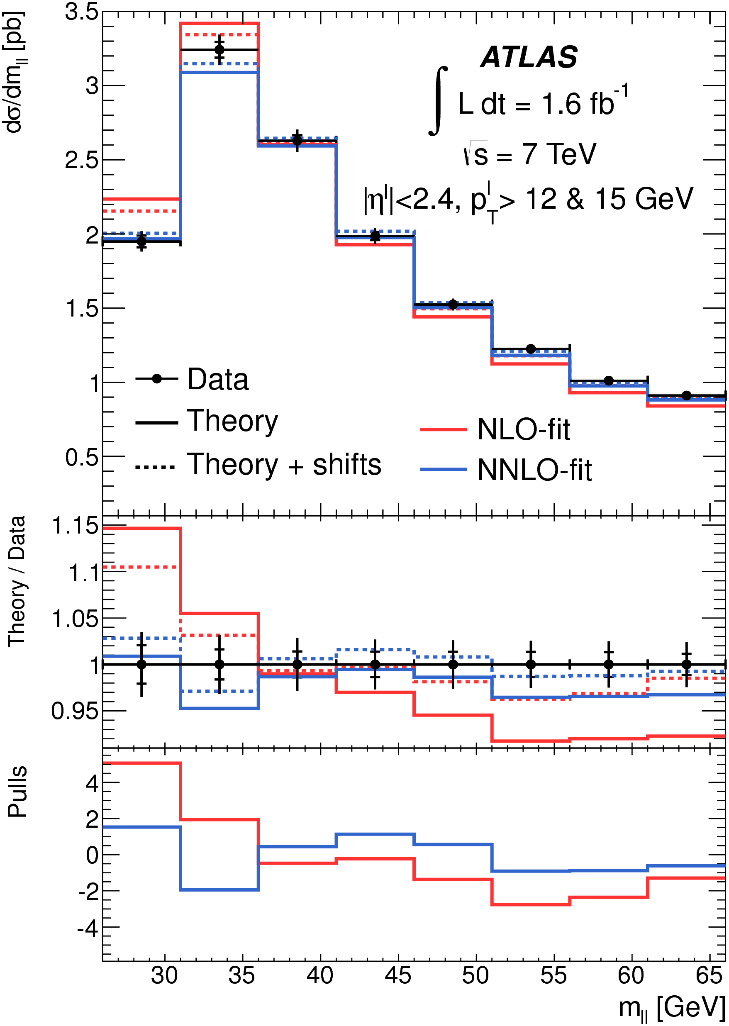
Drell-Yan (away from Z peak)
Low Mass, mll down to 26 (12) GeV for nominal (extended, muon only) analysis
JHEP06 (2014) 112
High Mass, mll to 1.5 TeV, √s=8 TeV
(also √s=7 TeV result, Phys Lett B75 (2013) 223)
new
LM
HM
STDM-2014-06
nominal
sensitive to quarks and quark flavour at low and high x
complementary sensitivity c.f. measurements near Z resonance
Notes:
LM DY: sensitivity to PDFs still small; sensitive to NLO/NNLO differences

Slide 15
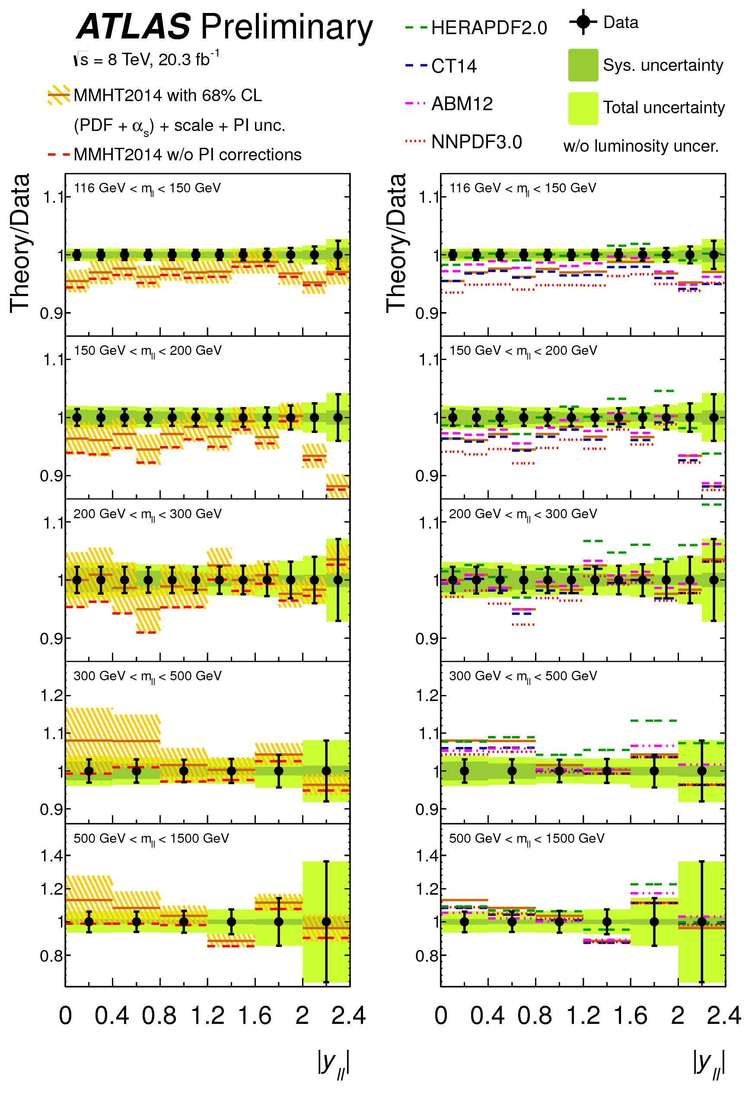
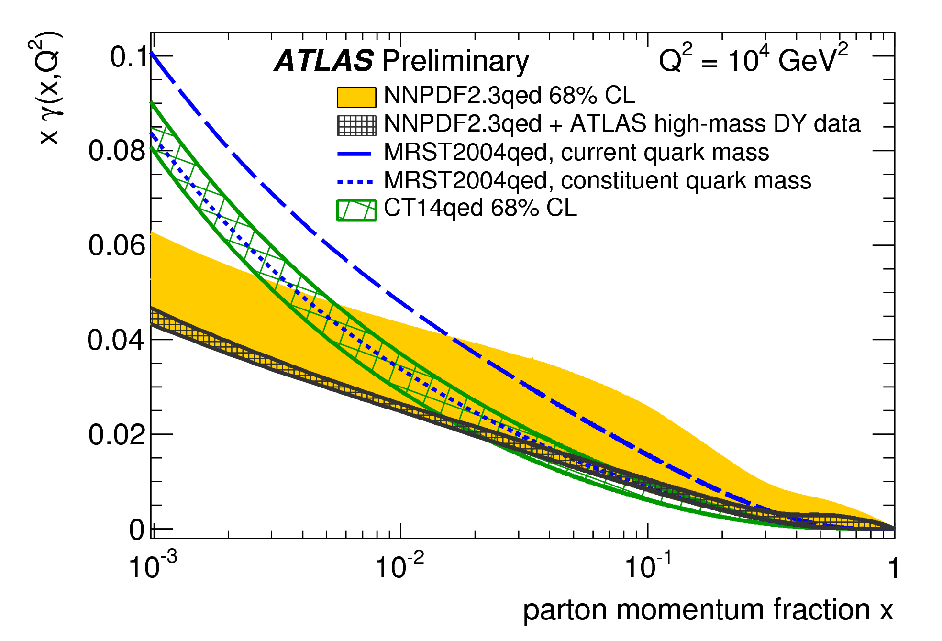
High Mass DY and photon content of proton
important contribution from irreducible photon induced (PI) contribution (γγ➛ll)
ATLAS High Mass DY can yield information on photon PDF of proton (ATLAS 7 TeV HM DY already used in NNPDF2.3QED PDF, arXiv:1308.0598)
potential impact of new data assessed using Bayesian reweighting of NNPDF2.3QED with MMHT2014 proton PDFs fixed
impact is dramatic
new
STDM-2014-06
Notes:
Each replica takes a weight determined by its X2

Slide 16
High Mass DY and photon content of proton
important contribution from irreducible photon induced (PI) contribution
ATLAS HM DY can yield information on photon PDF of proton (ATLAS 7TeV HM DY data already used in NNPDF2.3 QED PDF, arXiv:1308.0598)
photon contribution to proton PDFs increasingly important at high energies
very relevant for future machines!
LHC data crucial to pin down and reduce uncertainties
new
potential impact of new data assessed using Bayesian reweighting of NNPDF2.3QED with with MMHT2014 proton PDF fixed
impact is dramatic
to properly assess impact, need full, simultaneous fit to proton and photon PDFs:– now technically possible due to implementation of QED contribution in parton evolution codes and hard process matrix elements
Notes:
Mention that full pdf fits now possible

Slide 17
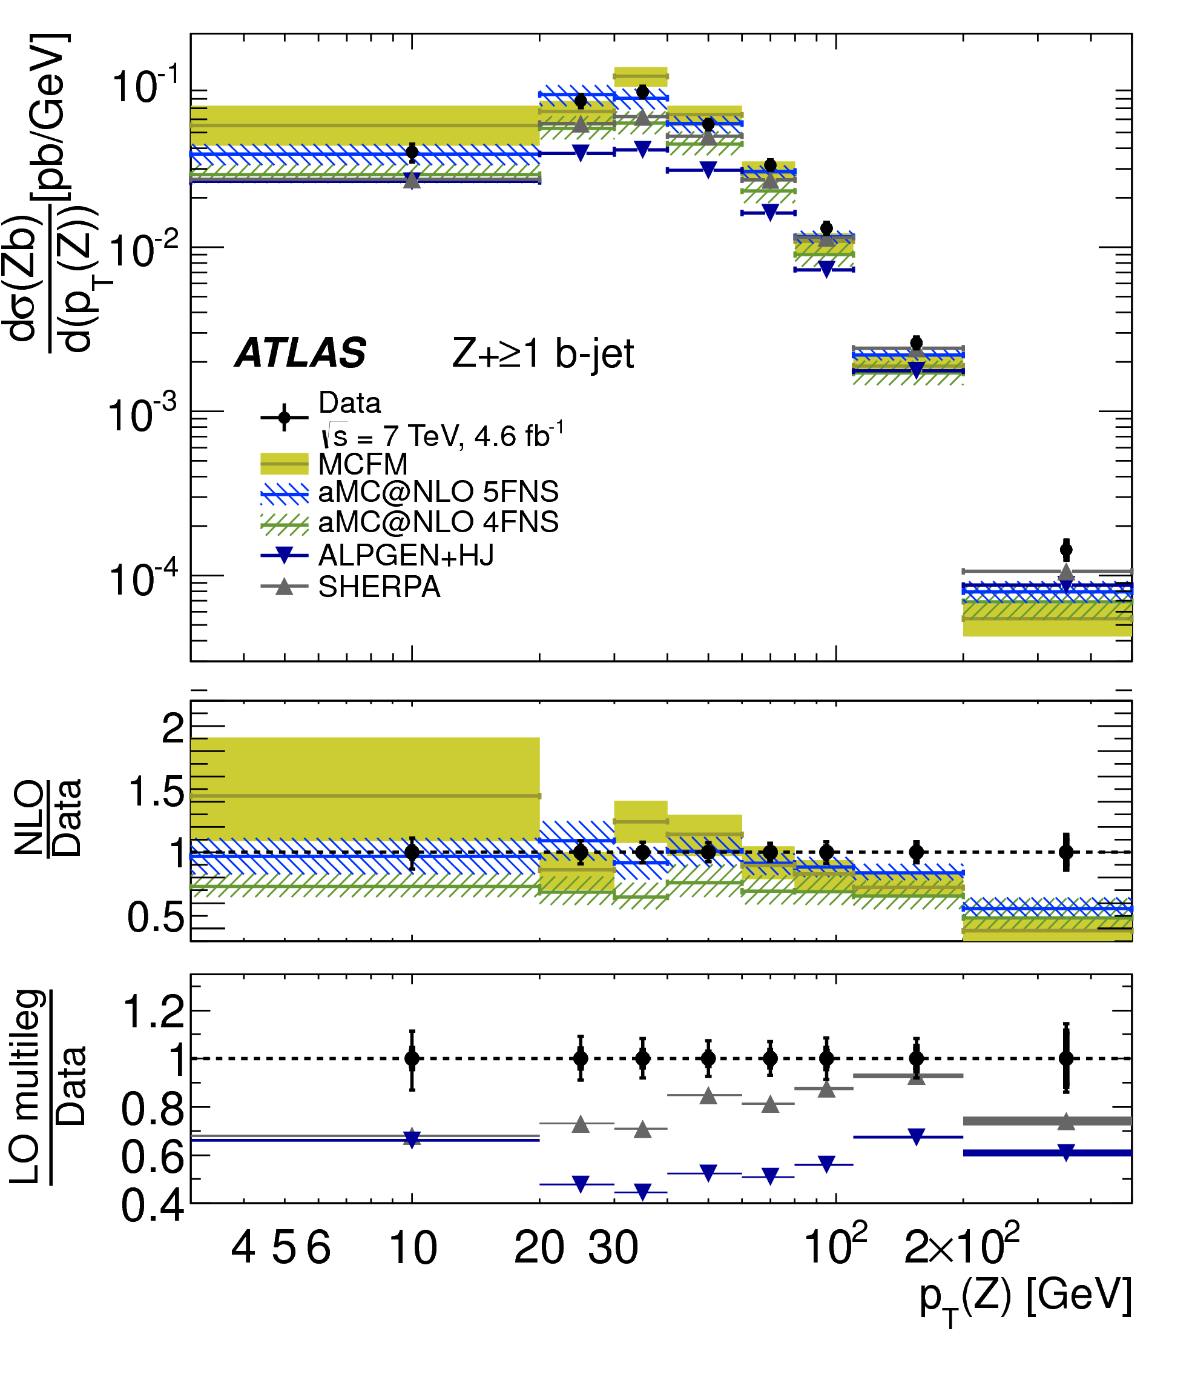
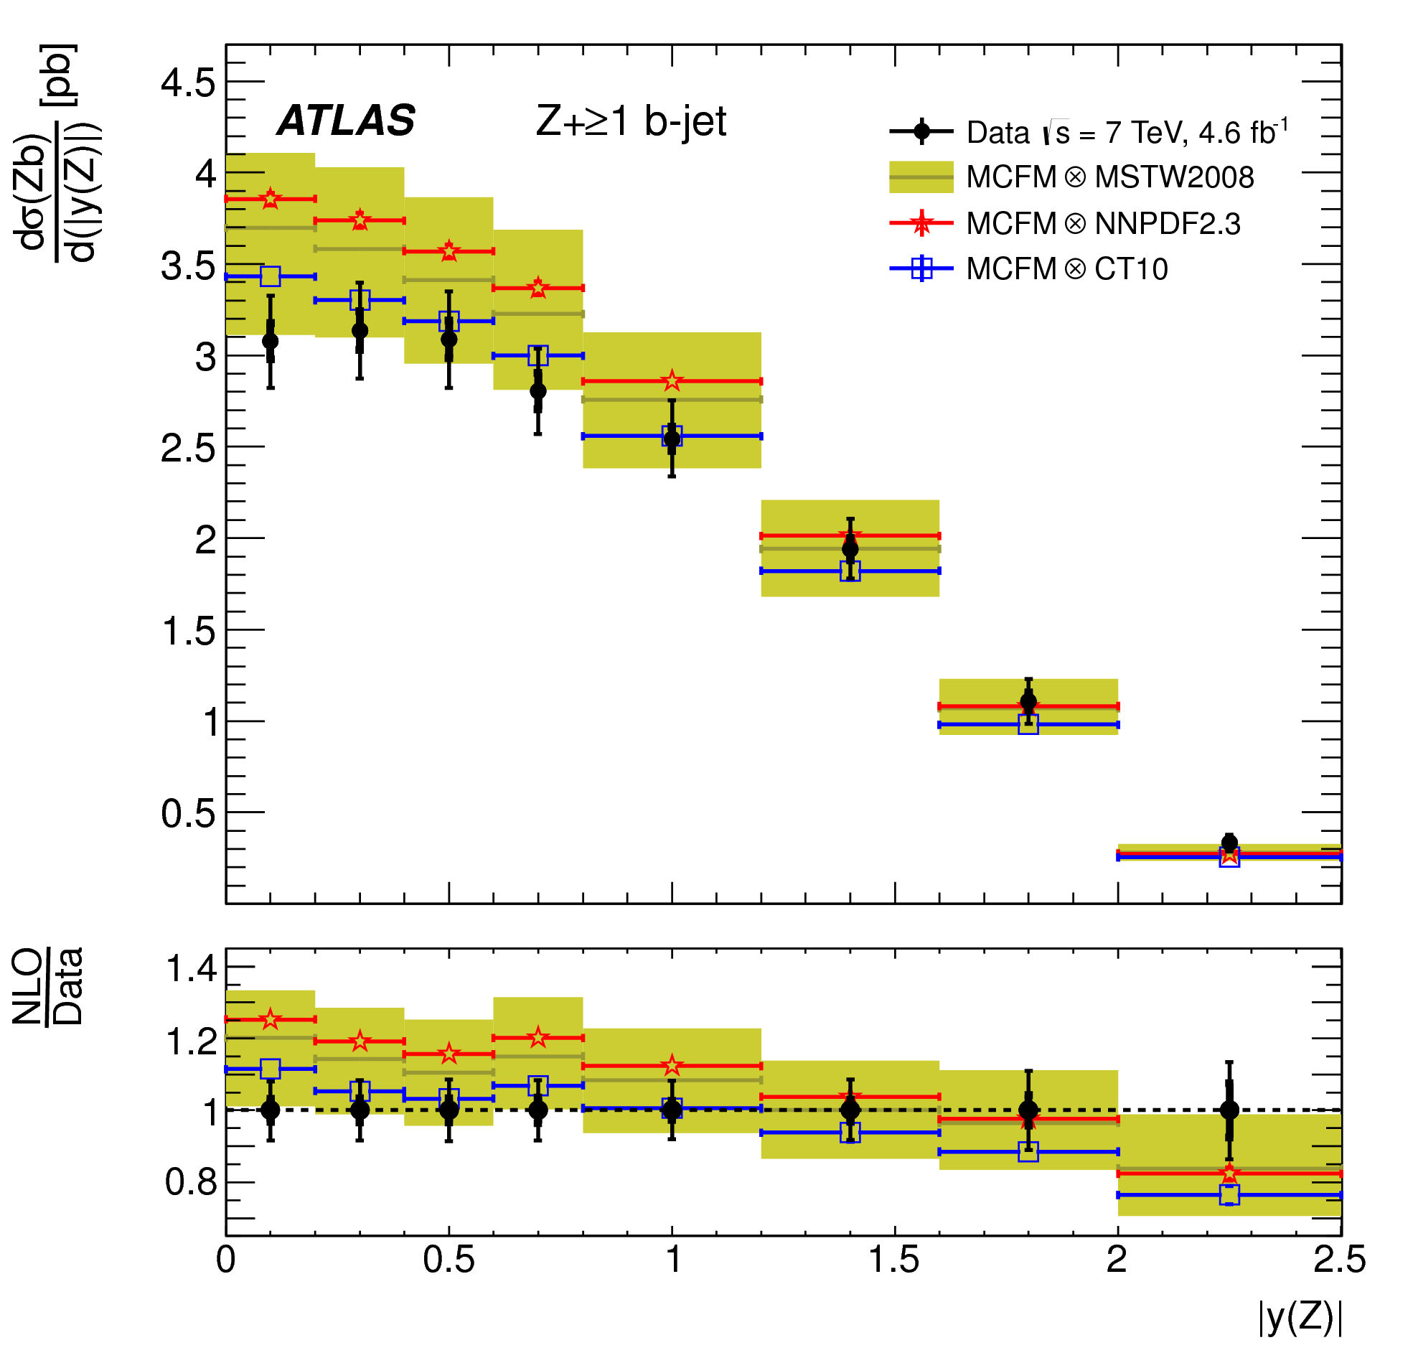
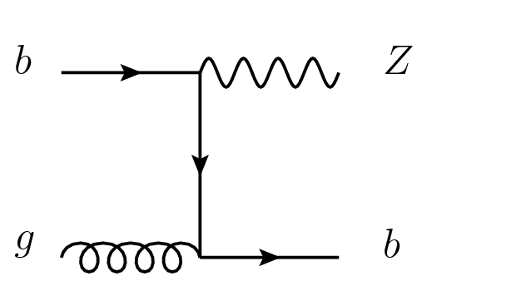
ATLAS Z+b
JHEP10 (2014) 141
scale uncertainties dominate
5FNS includes:
potential sensitivity to b quark content of proton
total and differential 𝞂(Zb) and 𝞂(Zbb) measured
sensitive to MC heavy flavour scheme (4FNS versus 5FNS)
scale uncertainties dominate, limiting current sensitivity to PDFs
(together with photon+b, may prove sensitive in the future)

Slide 18
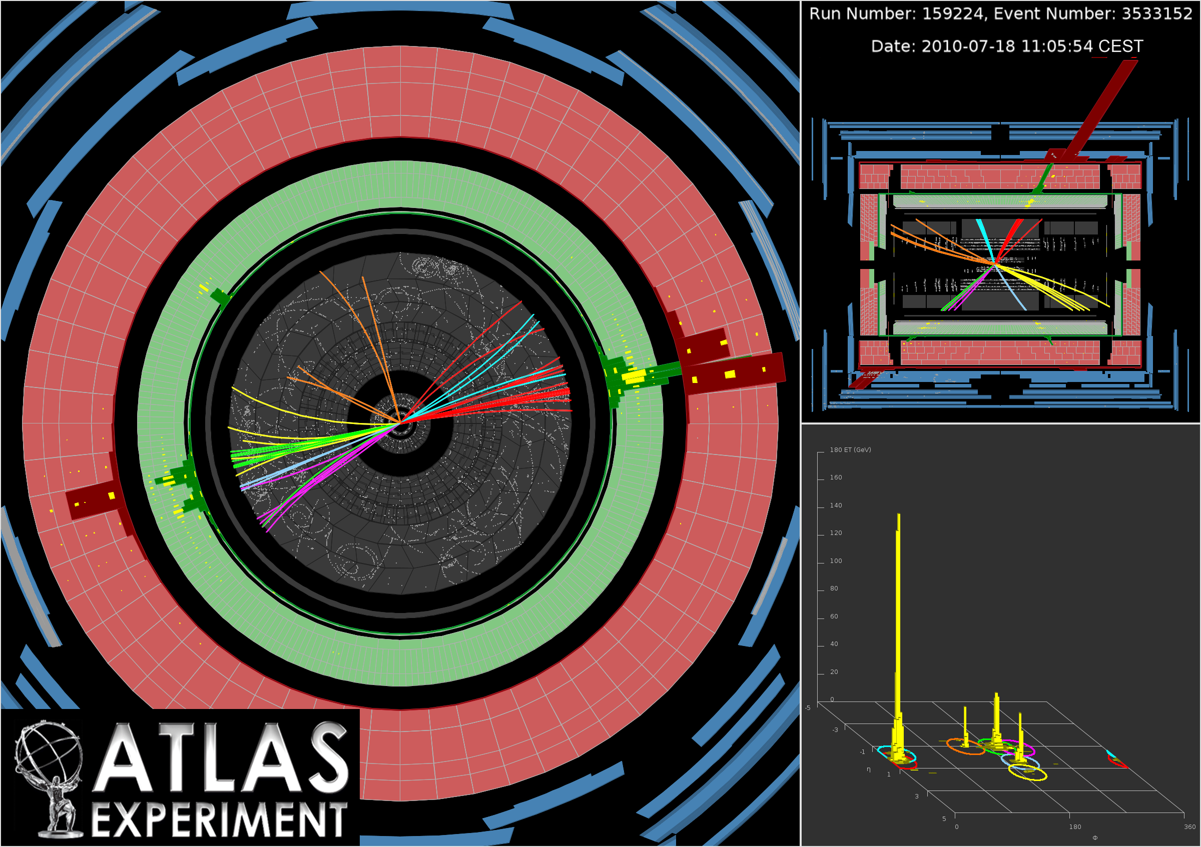
constraining the gluon
(jets, photons, top, ZPt)
several theoretical developments recently arrived, or on the way

Slide 19
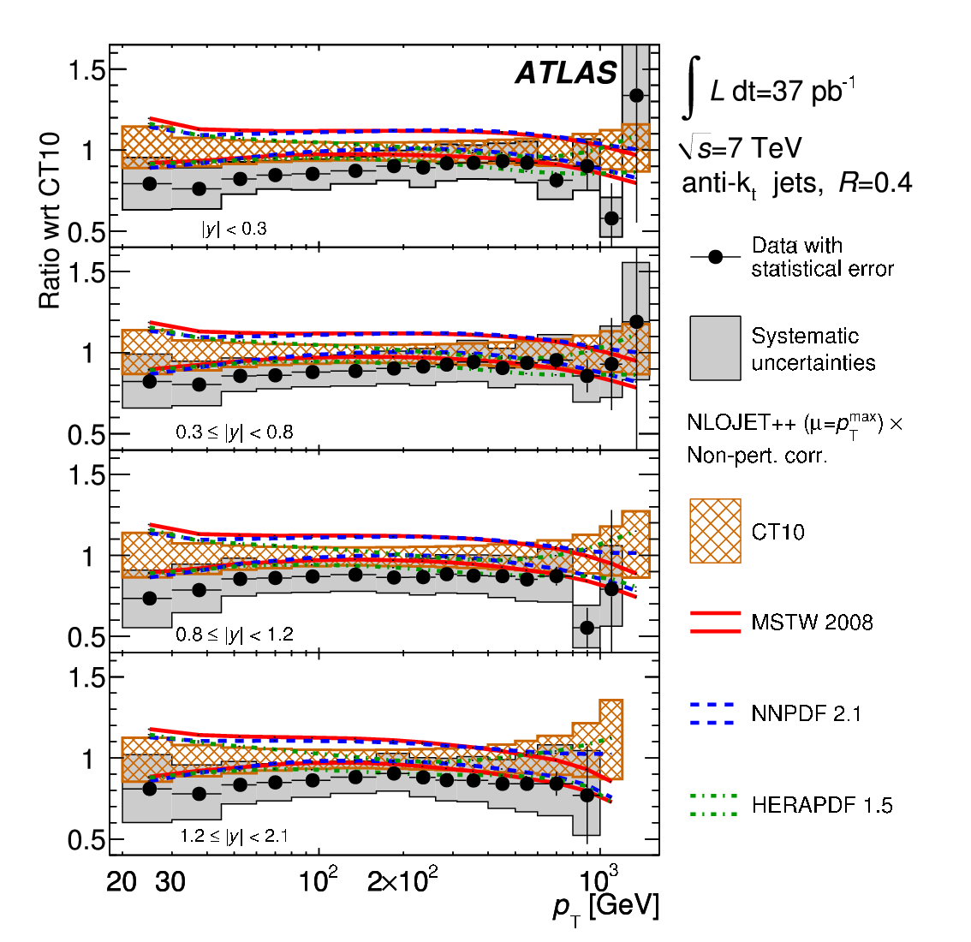
ATLAS jet production
gluon at high x poorly known; impact on direct searches for new physics
jet production: direct constraints on gluon (and at high pt, quarks) and 𝝰s
√s = 7 TeV
ATLAS incl. jet measurements at √s=7 TeV (2010) and √s=2.76 TeV already used as input to modern global fits (NNPDF2.3 and after, MMHT14, CT14)
Phys Rev D86 (2012) 014022
ATLAS SM measurements now available for inclusive, dijet, trijet (and four-jet)
Notes:
Scale uncertainty dominant at NLO
PDF uncert dominant at NNLO

Slide 20
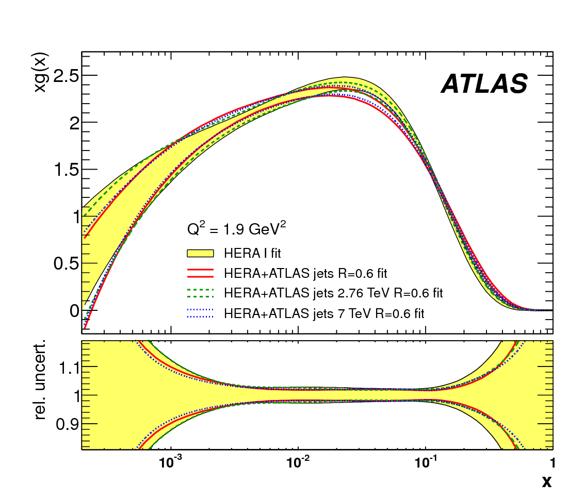
the power of ratios …
(inclusive jet cross section ratio: √s=2.76 to 7 TeV)
EPJC (2013) 73, 2509
momentum distribution of the gluon g(x)
previous result: ATLAS 2010 inclusive jet measurement at √s=7 TeV, together with 2011 data at √s=2.76 TeV
dominant exp. systematic, jet energy scale, largely cancels in ratio; total uncert. reduction of 20 to 5% in ratio
different CM energies probe different x, Q² for same pt, y: PDF sensitivity does not cancel
NLO QCD fit to HERA and ATLAS inclusive jet ratio (epATLJet13 PDF): gluon uncertainty reduced, distribution becomes harder
(limited luminosity here, but powerful proof of principle …)

Slide 21
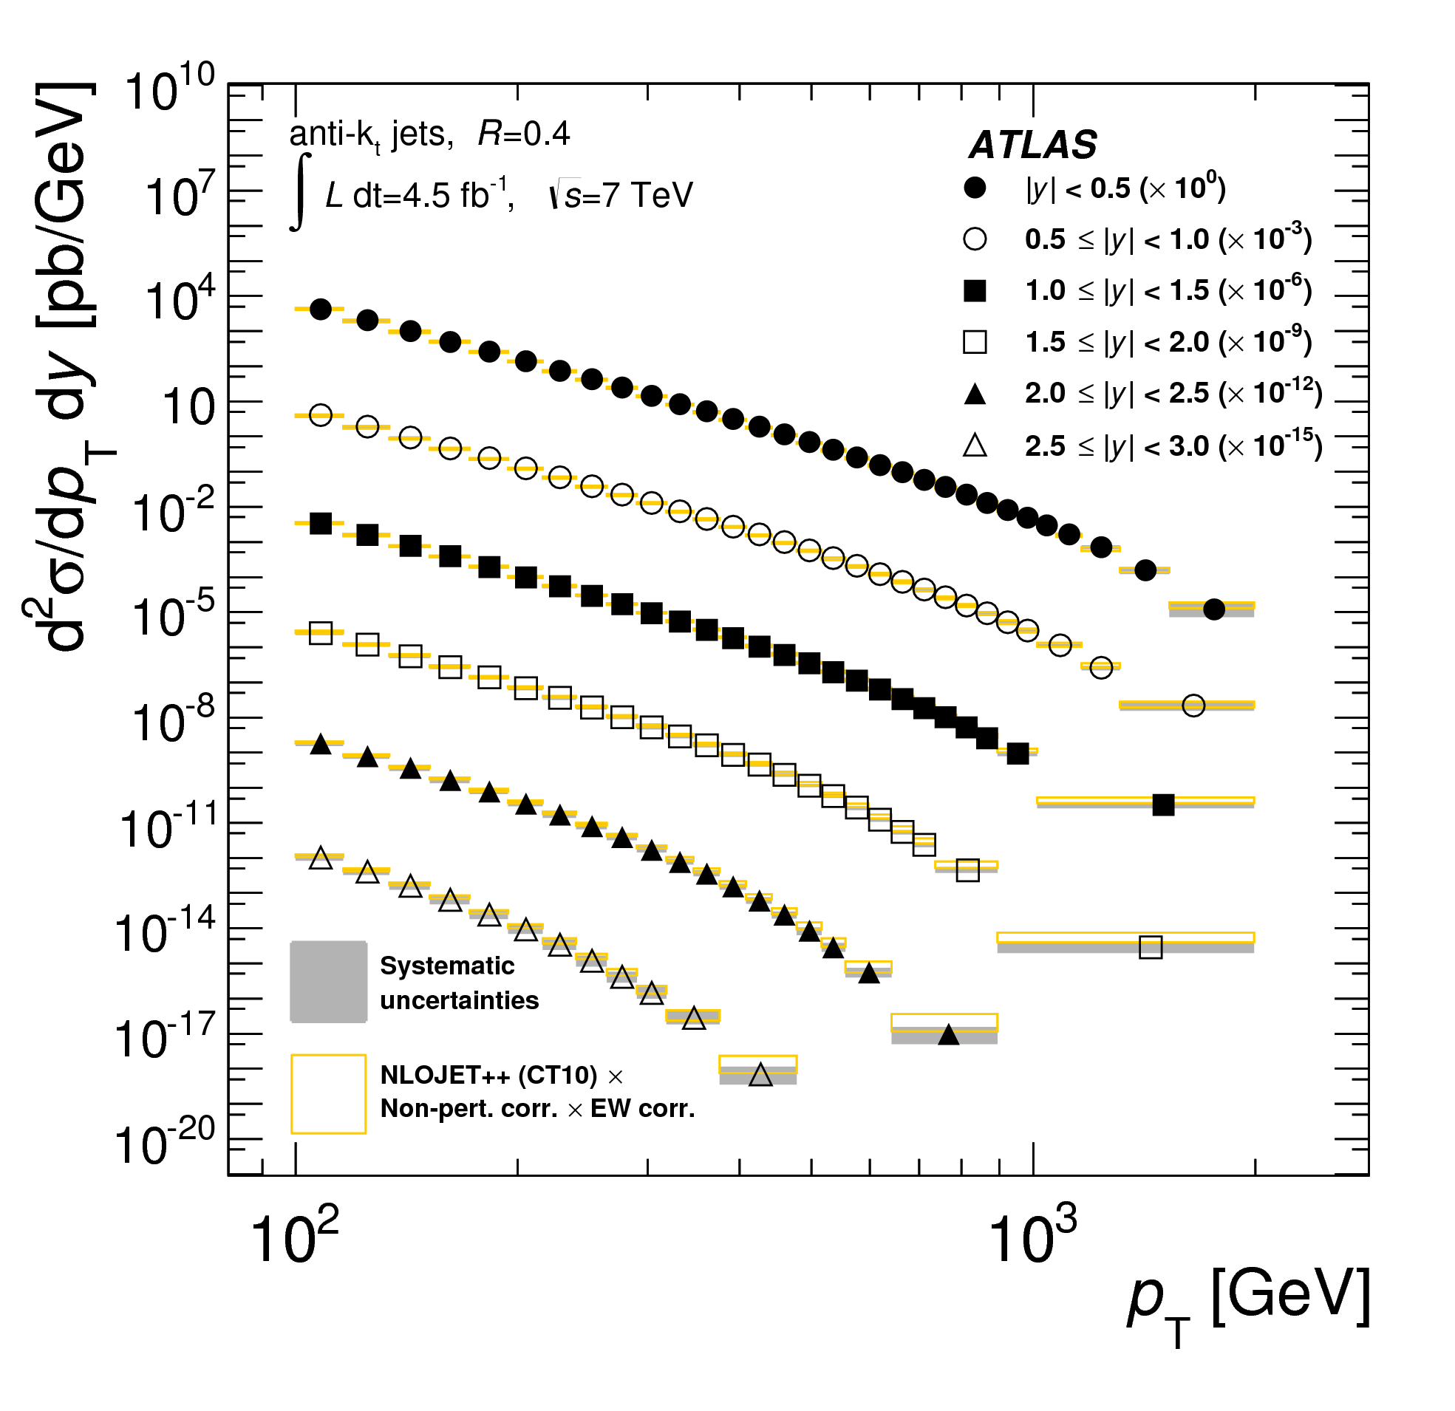
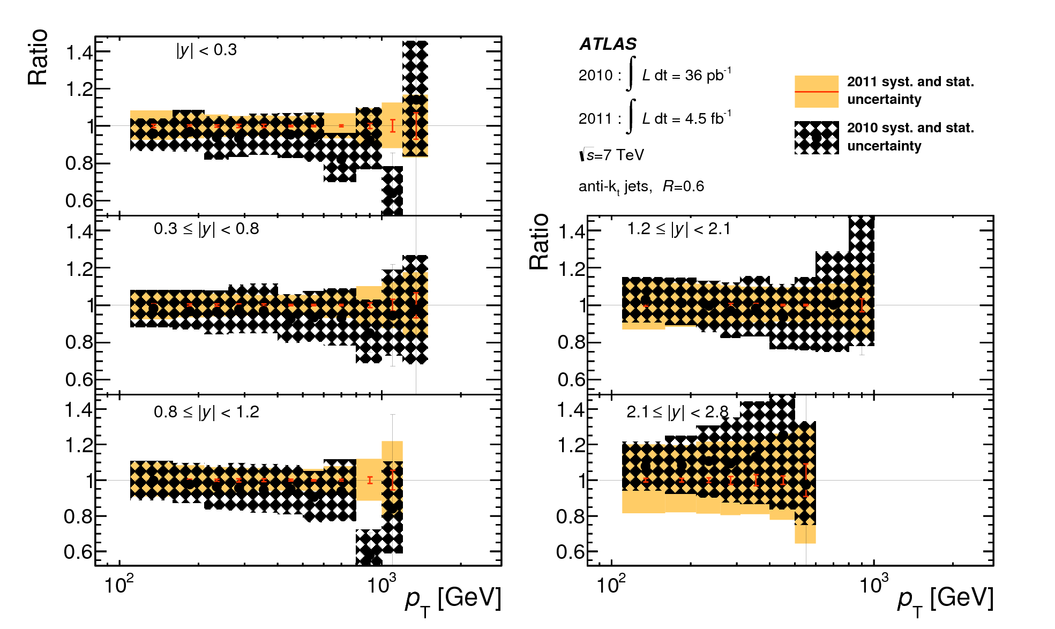
ATLAS inclusive jets: to higher precision
JHEP02 (2015) 153
2011 uncert.
2010 uncert.
ratio
ATLAS √s=7 TeV 2011 data
analysis probes QCD up to 2 TeV
total exp. uncert. reduced from 2010
EW and NP corrs. applied to NLO QCD
cross sections double differential in pt and y, well described by NLO QCD across 8 orders of magnitude in cross section
NNLO QCD inclusive and dijet calcs. coming (J. Currie, A. Gehrmann-De Ridder, E.W.N. Glover, J. Pires)
Notes:
Scale uncertainty dominant at NLO
PDF uncert dominant at NNLO

Slide 22
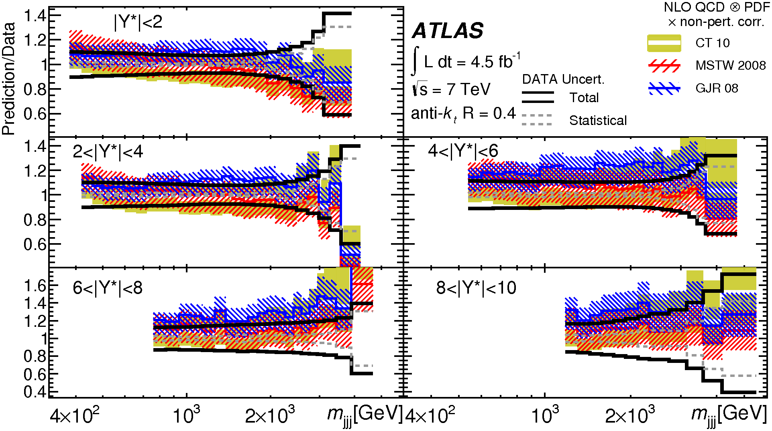
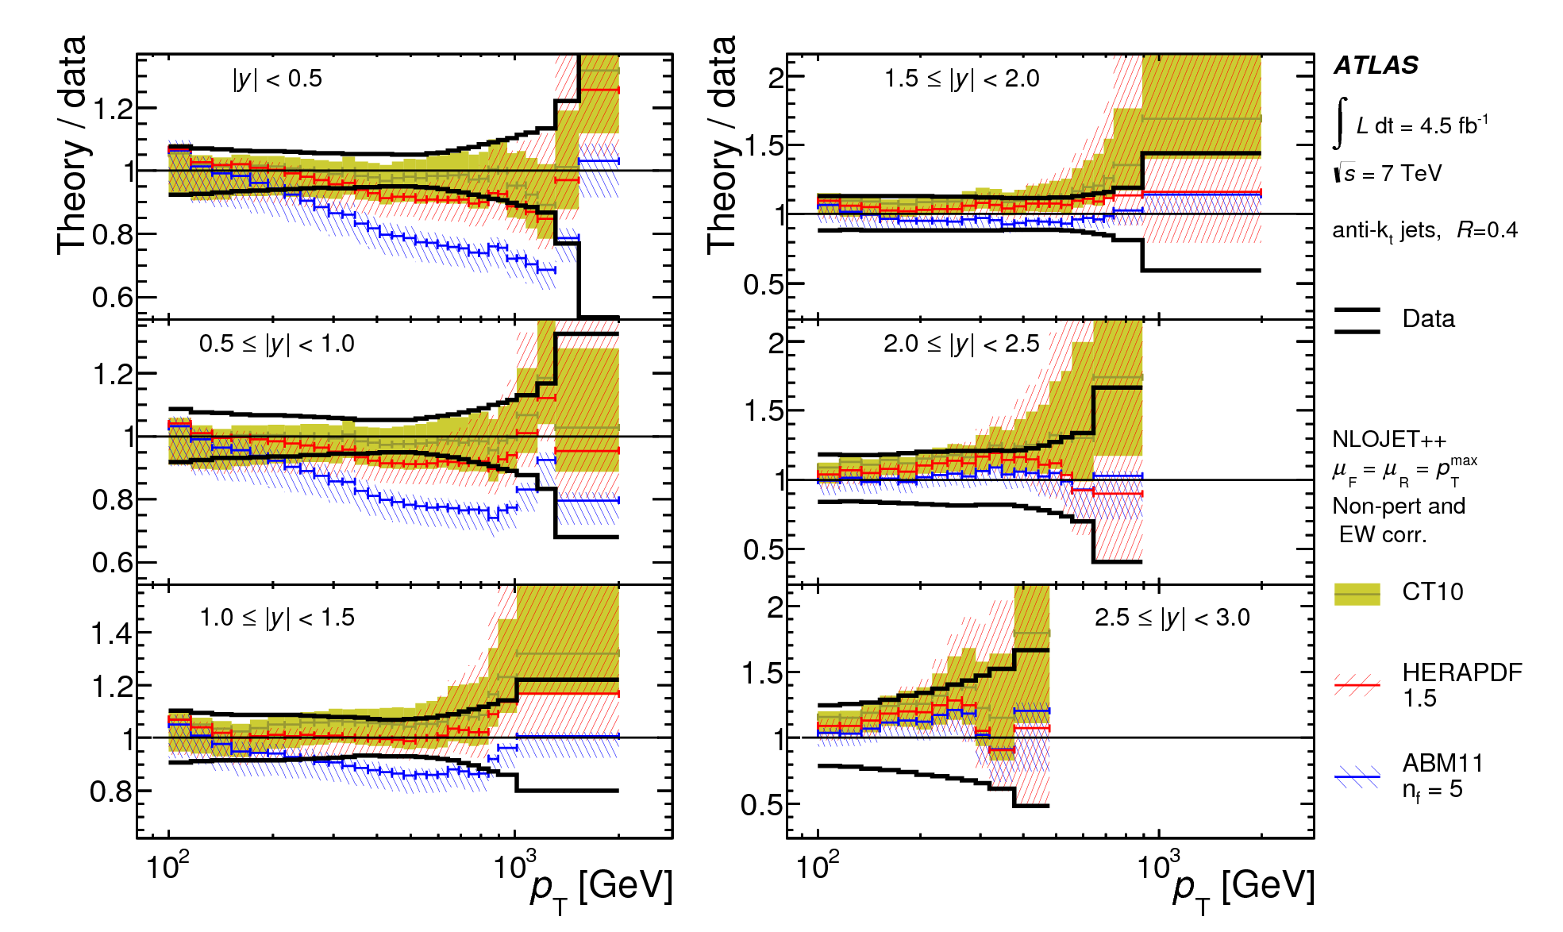
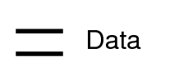
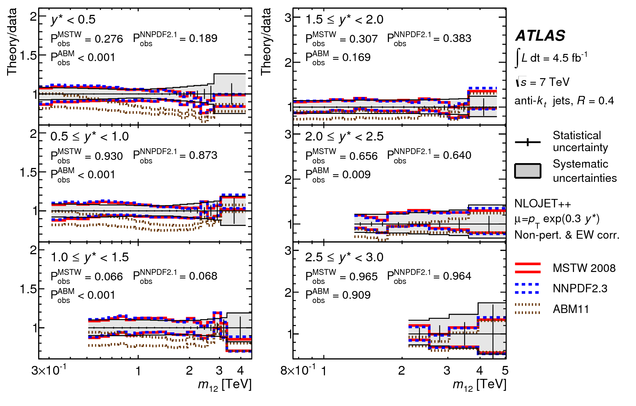
ATLAS inclusive, dijet and trijet @ 7TeV
ratio
trijets
ratio
inclusive
JHEP02 (2015) 153
1
0.8
0.6
EPJC (2015) 75, 228
m_{JJJ} (GeV)
ratio
dijets
pt (GeV)
R=0.4 (shown) and 0.6 anti-kt jets measured
JHEP05 (2014) 059
(binned in pt or invariant mass, and rapidity variables)
theory: NLOJET++, electroweak (inclusive and dijet) and non-perturbative corrections applied
m_{JJ} (TeV)
ratio of NLO QCD predictions to data (‘typical’ bins shown); sensitive to PDF choice
coherent treatment of correlated systematics across the three measurements full statistical and systematic correlation matrices evaluated
20
Notes:
measurement precision better than or similar to theoretical uncertainties

Slide 23
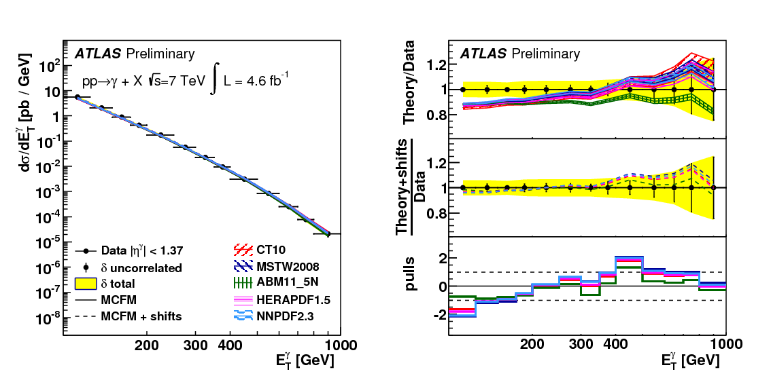
ATLAS prompt photons
ATLAS √s=7 TeV measurement:
Phys Rev D89 (2014) 052004
sensitive to gluon density at medium and high x
cleaner exp. environment compared to jet cross section measurements
ATLAS study: comparison of data with different PDFs; validated use of MCFM for fast NLO calculations (via APPLGRID, EPJC 66 (2010) 503) vs. JetPhox
JetPhox has NLO fragmentation, MCFM only LO (fragmentation k-factors applied to MCFM)
ATL-PHYS-PUB-2013-018
scale uncertainties dominate theory preds.
central region
21
Notes:
Large differences observed with NLO theory, with different PDFs
For some time problematic agreement, now agrees well with NLO QCD

Slide 24
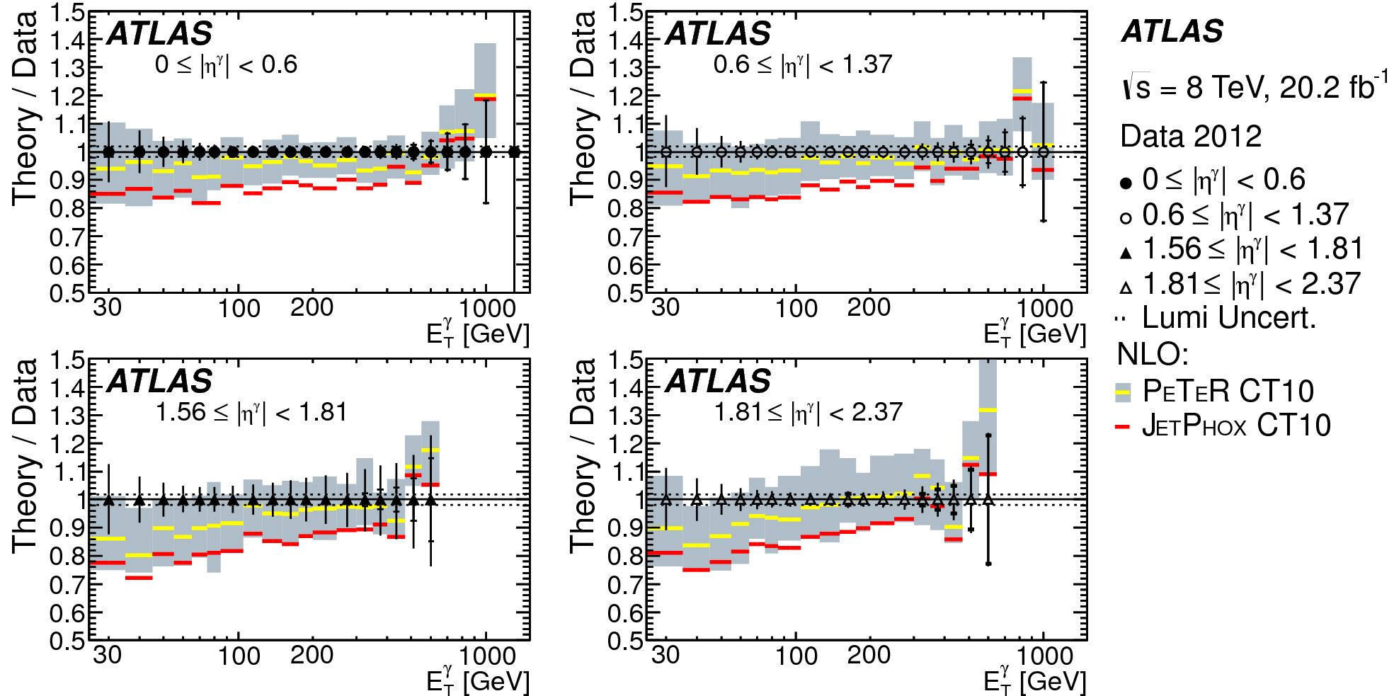
ATLAS photons @ 8TeV
arXiv: 1605.03495
new
new ATLAS measurements, here compared to JetPhox and PeTer PeTer based on JetPhox calculations, but with running 𝝰EM and threshold resummation; improved agreement and reduced uncertainties (by about 20% c.f. JetPhox)
covers wider phase space and uncerts. halved c.f. previous ATLAS analyses
useful constraints for future global PDF fits
22

Slide 25
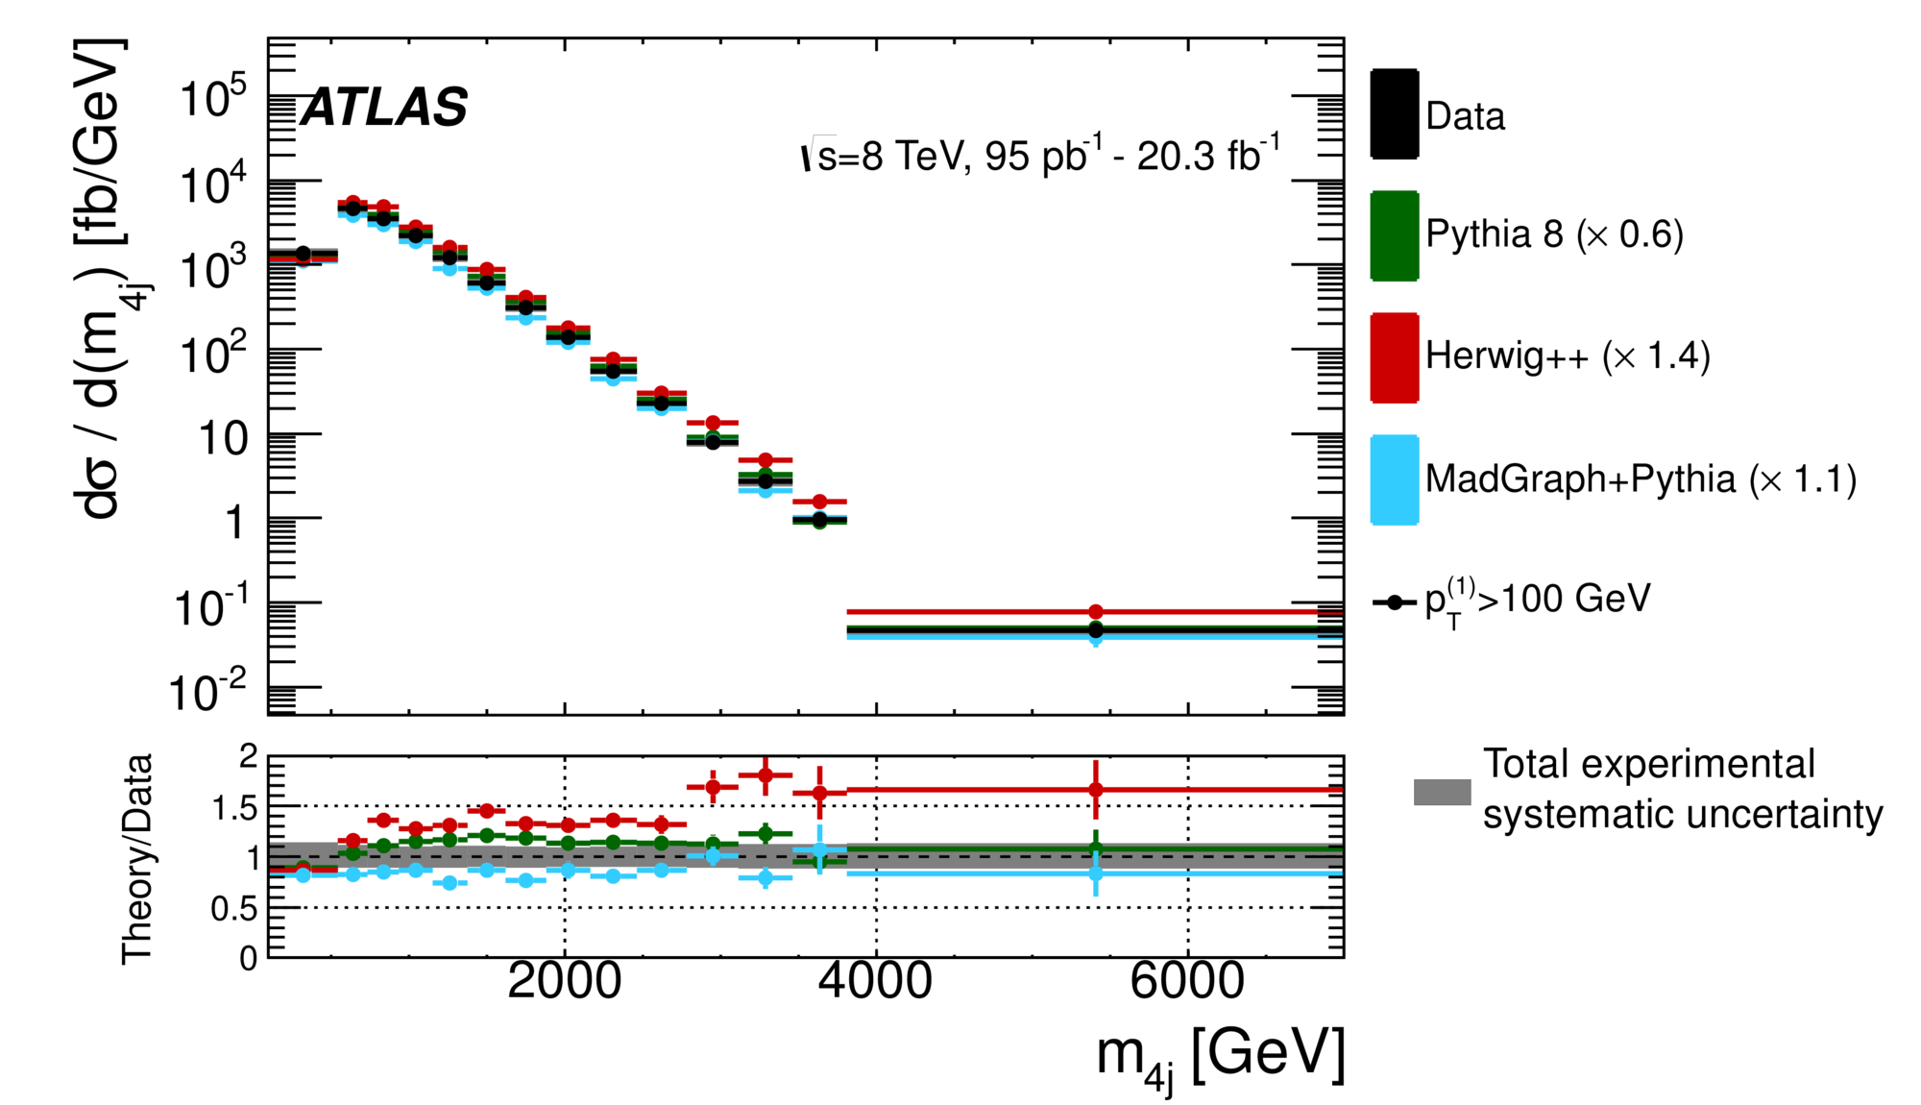
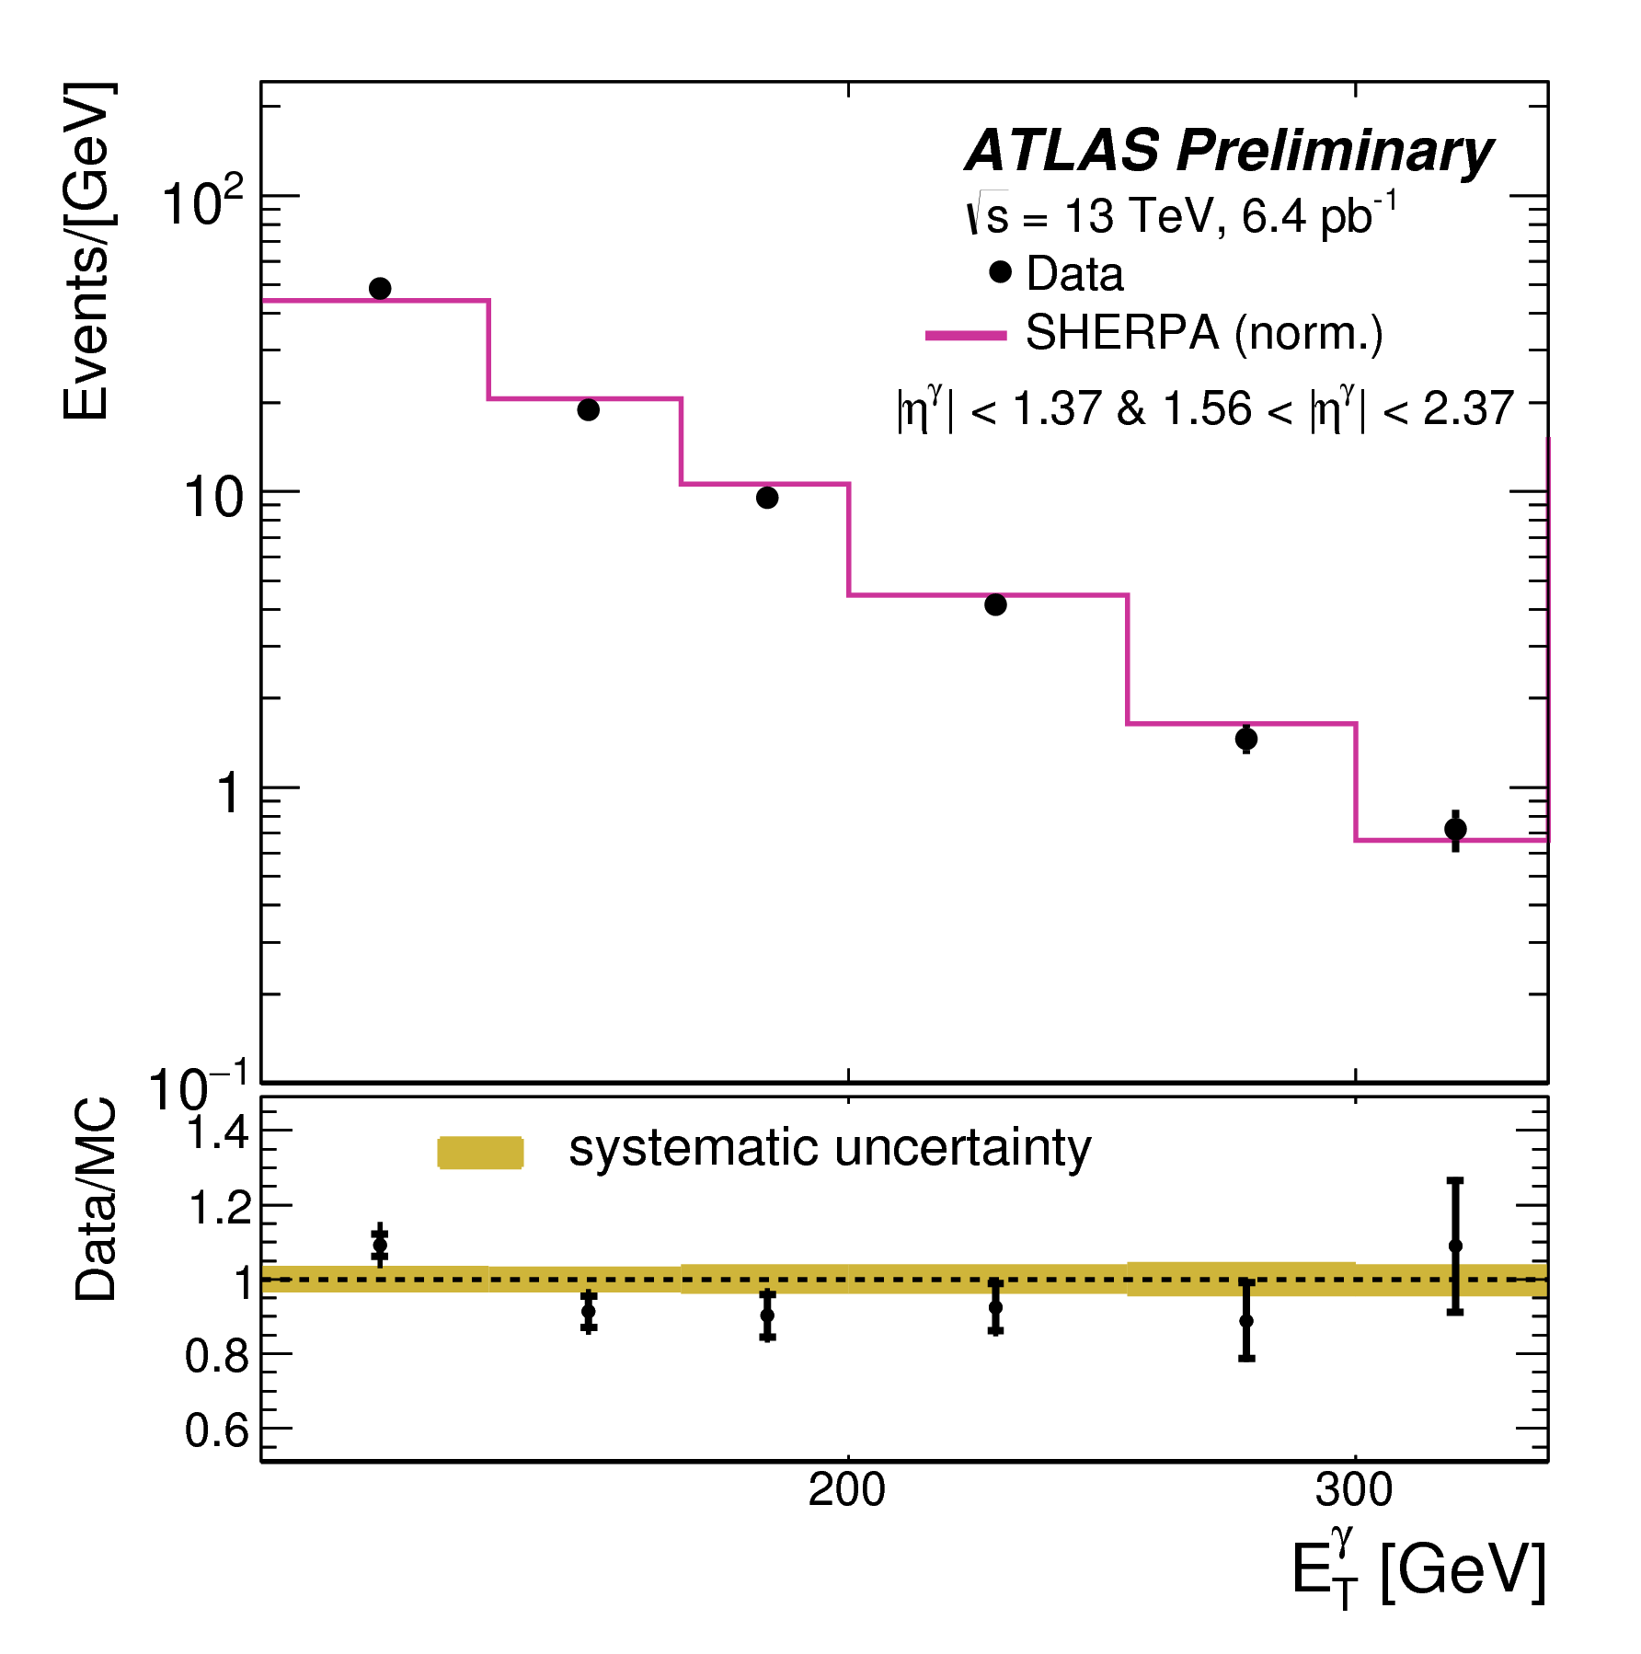
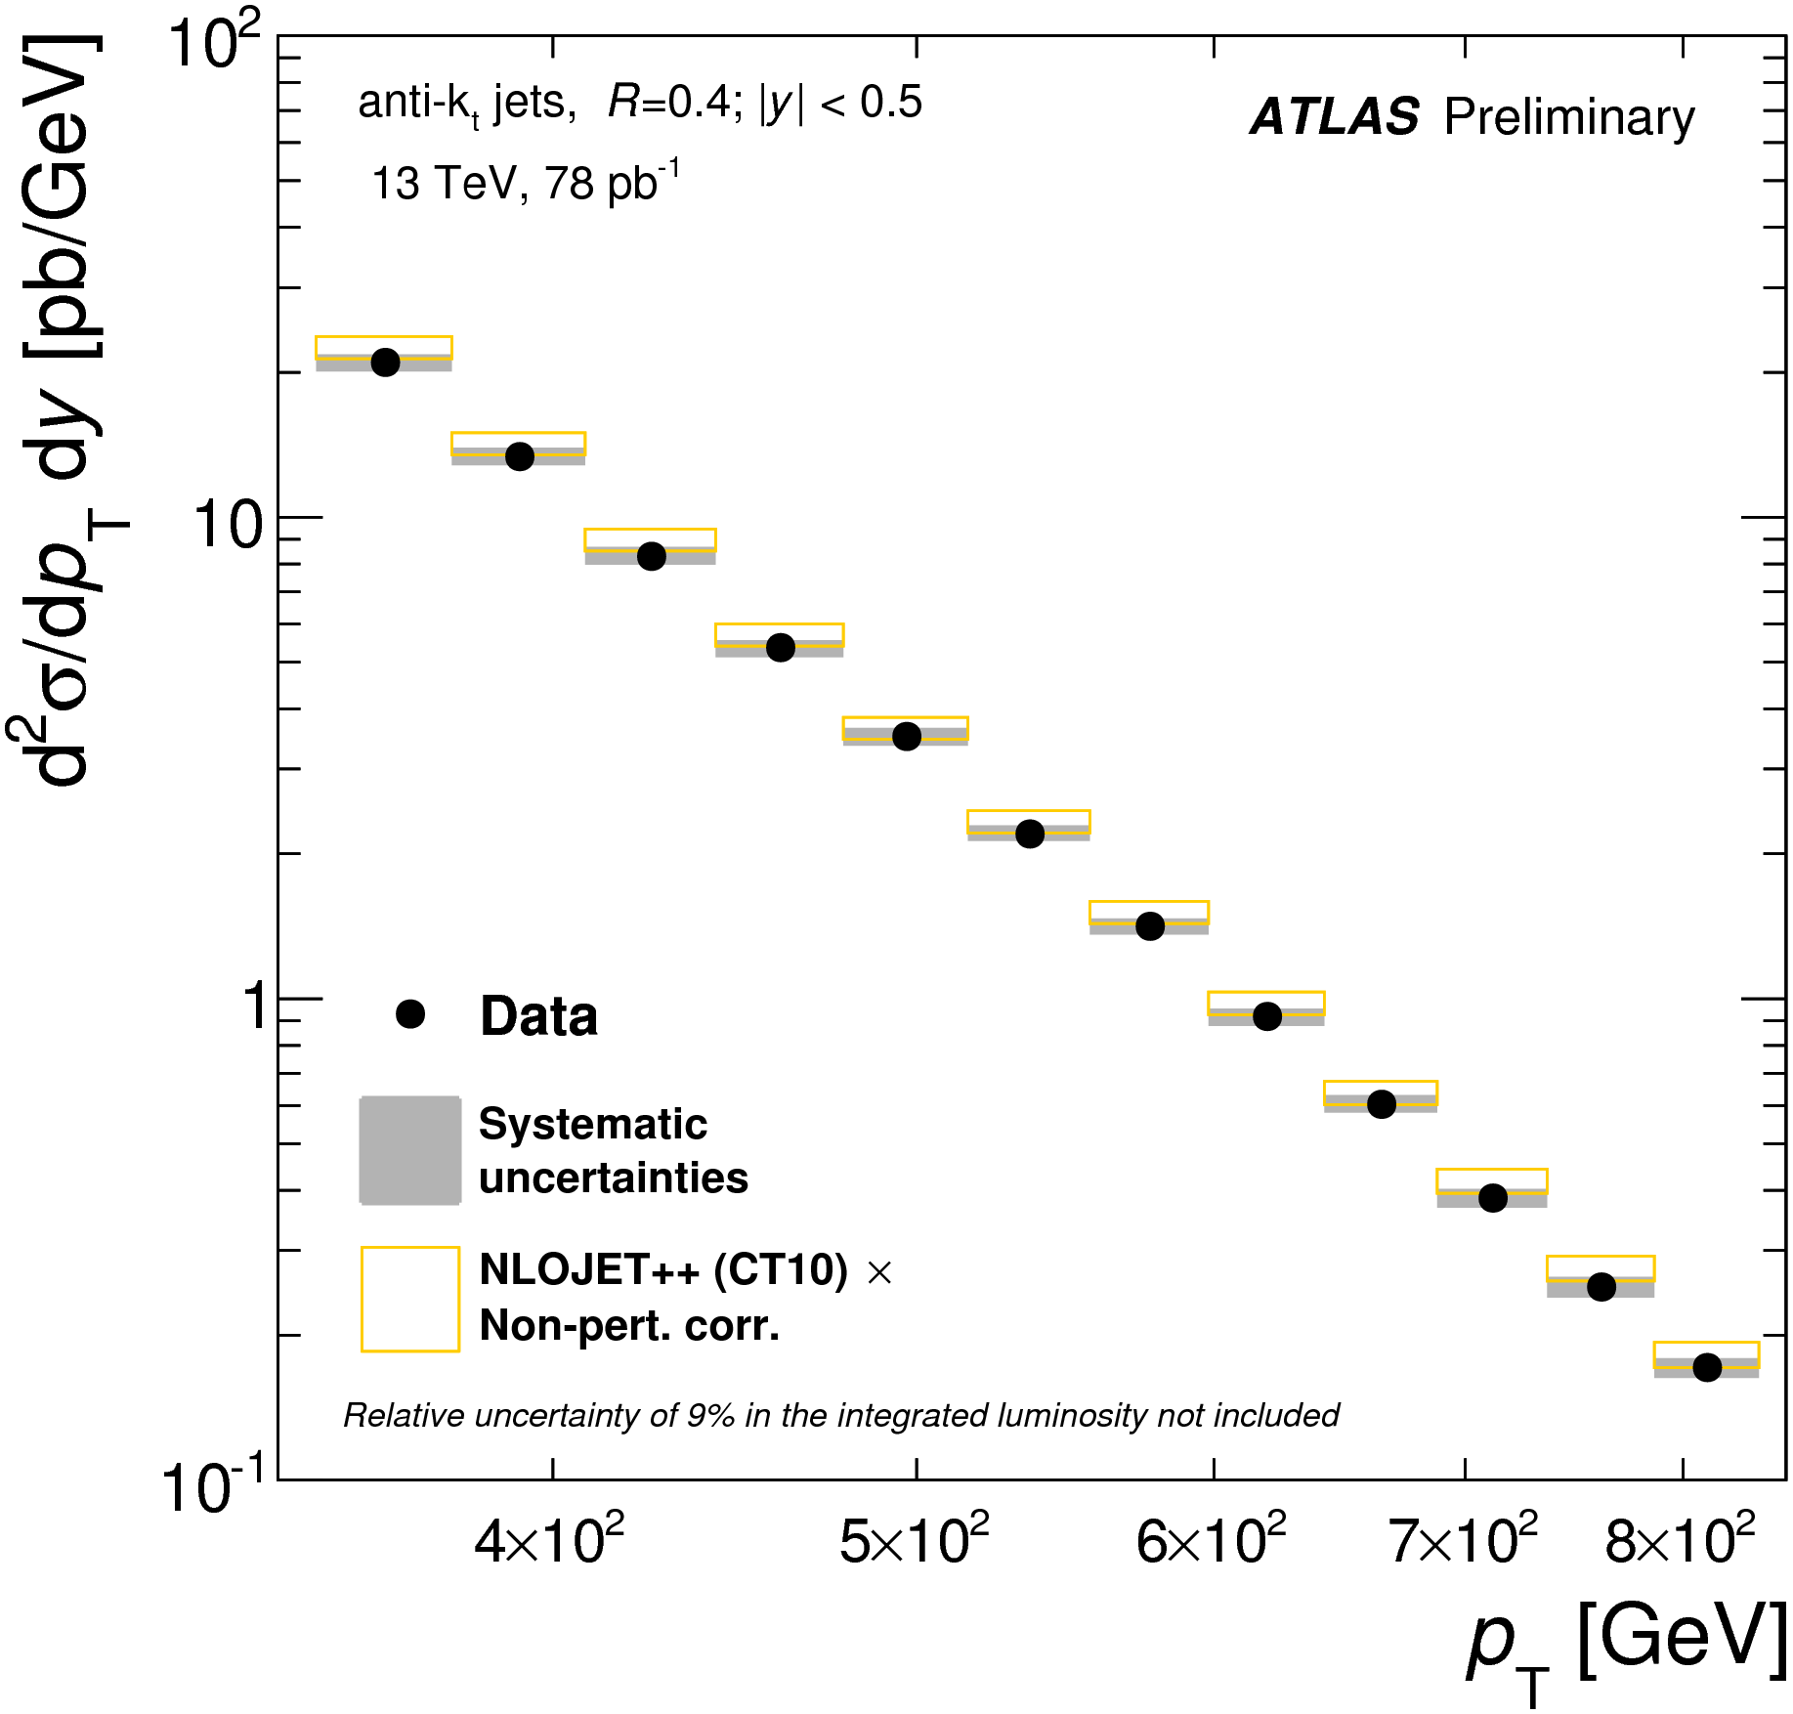
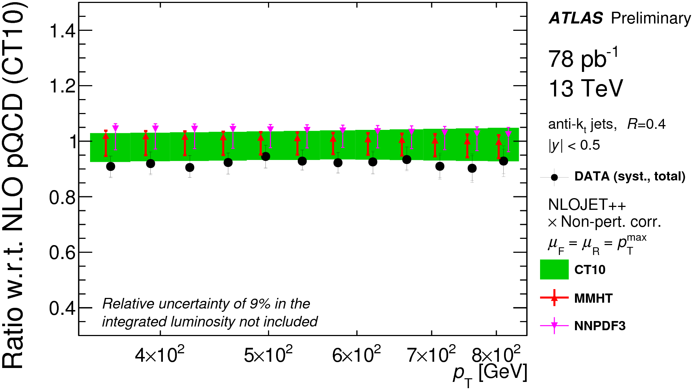
other jet and photon inputs:
√s=8 TeV
ATLAS four-jet measurement
not a direct input for PDFs currently, but potential in the future JHEP12 (2015) 105
√s=13 TeV
ATLAS-CONF-2015-034
ATLAS-PHYS-PUB-2015-016
ATLAS first inclusive jet and prompt photon measurements at √s=13 TeV
23
Notes:
Measurements with larger integrated luminosity will come

Slide 26
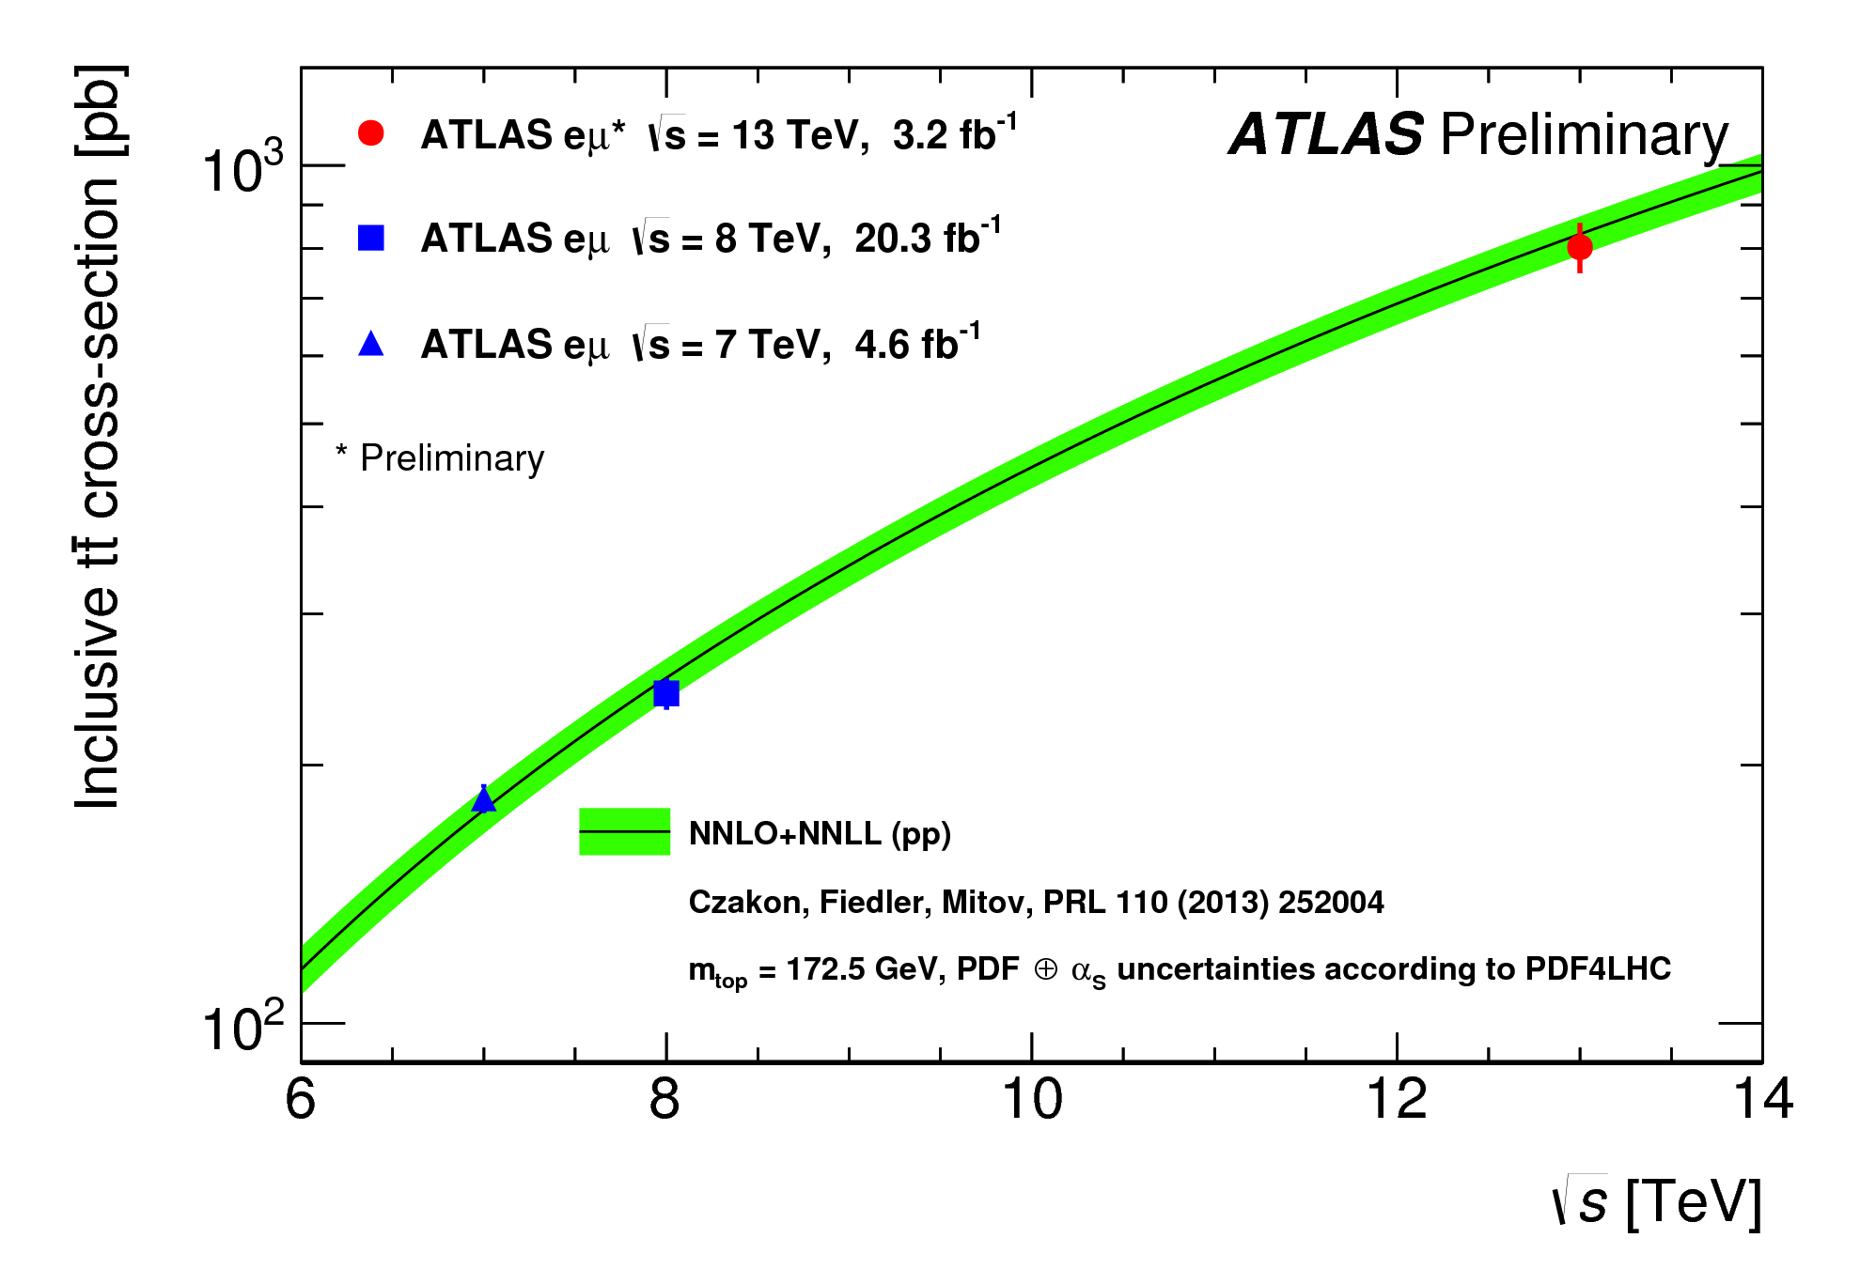
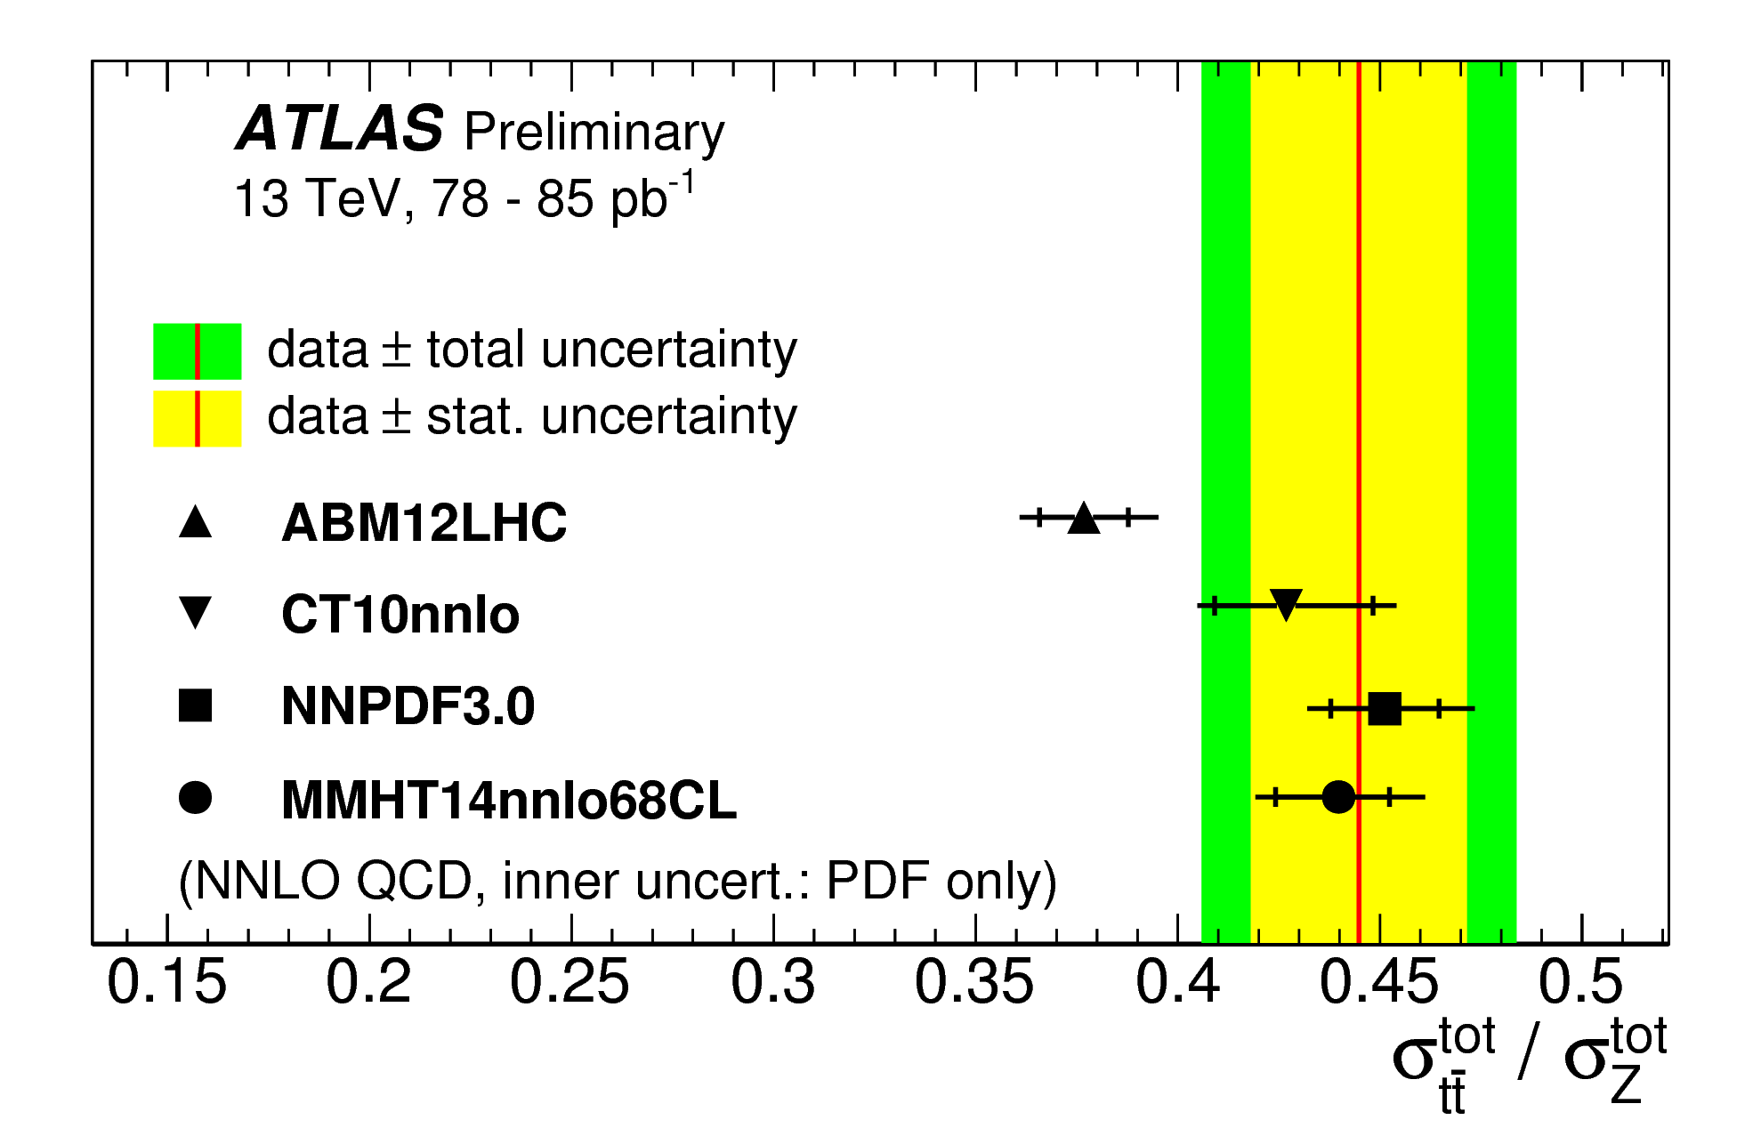
ATLAS top quark pair production
sensitive to gluon at high x (strong correlation between gluon, 𝝰s, mtop)
ATLAS-CONF-2016-006
ATLAS-CONF-2015-049
new
ATLAS ttbar total cross sections available at √s=7, 8 and 13 TeV eμ (shown), ee/μμ and l+jets channels Run 1 measurements already used in modern, global PDF fits
ATLAS ttbar to Z cross section ratio at √s=13 TeV; dominant systematics largely cancel in ratio sensitive to ratio of gluon to sea quarks

Slide 27
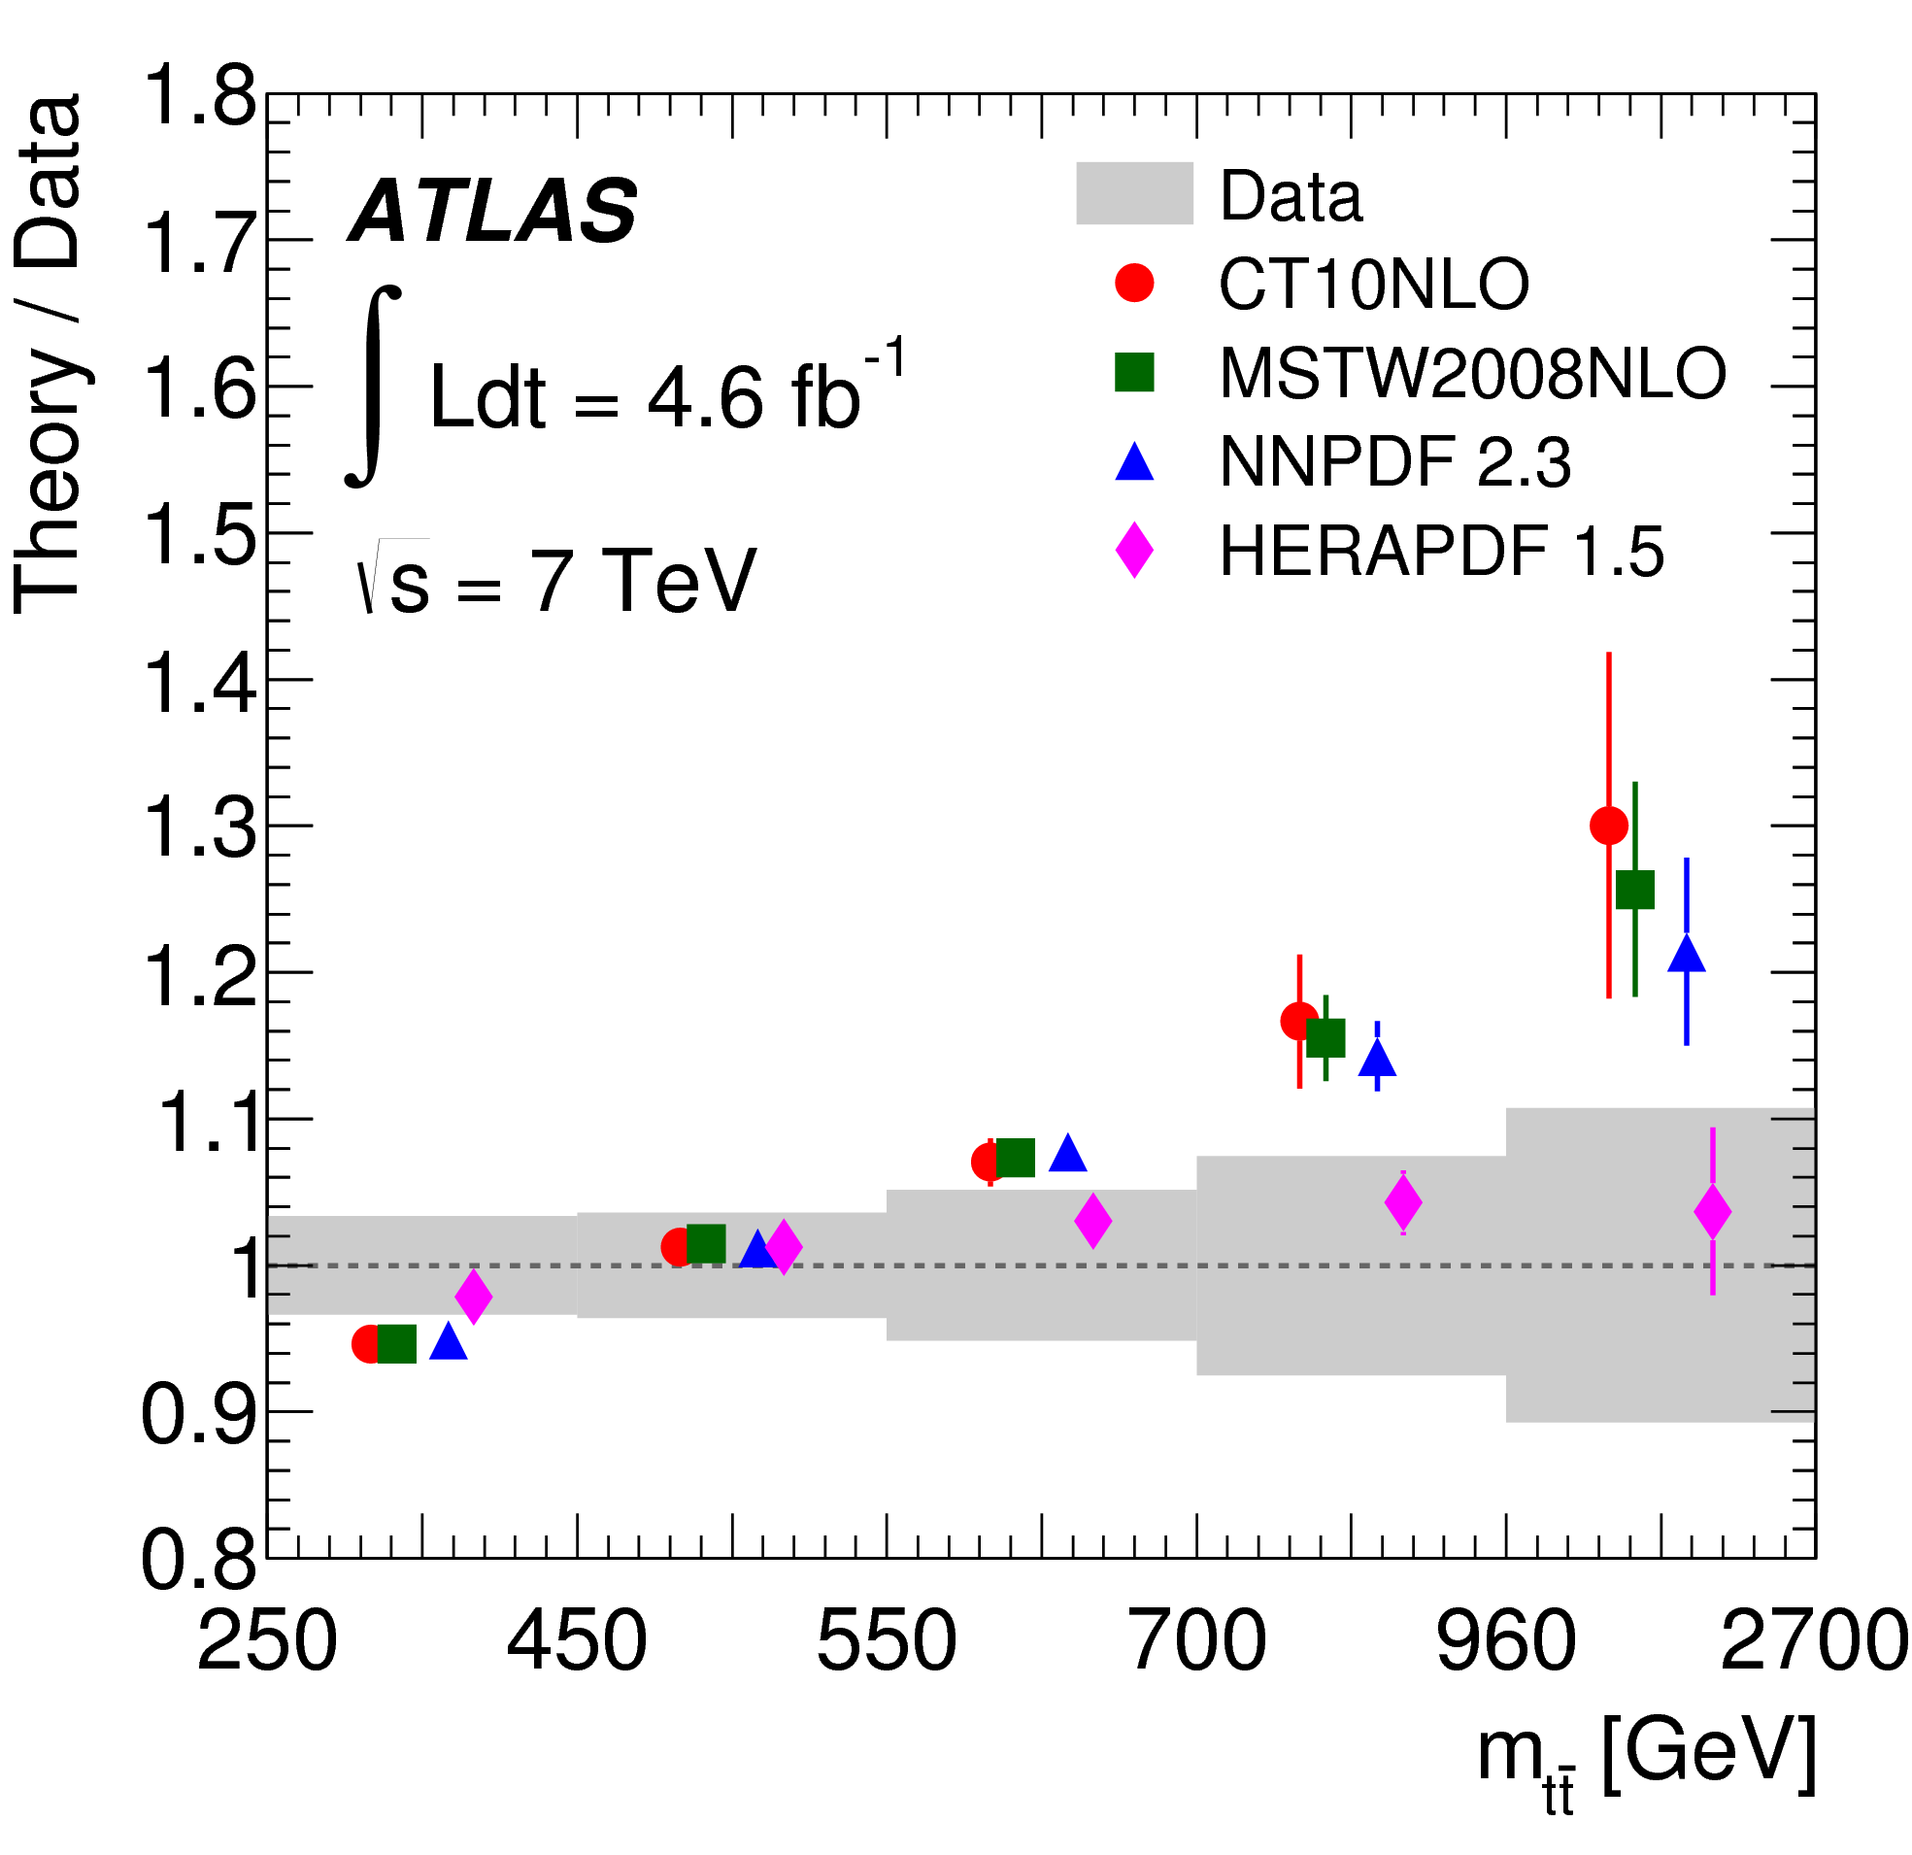
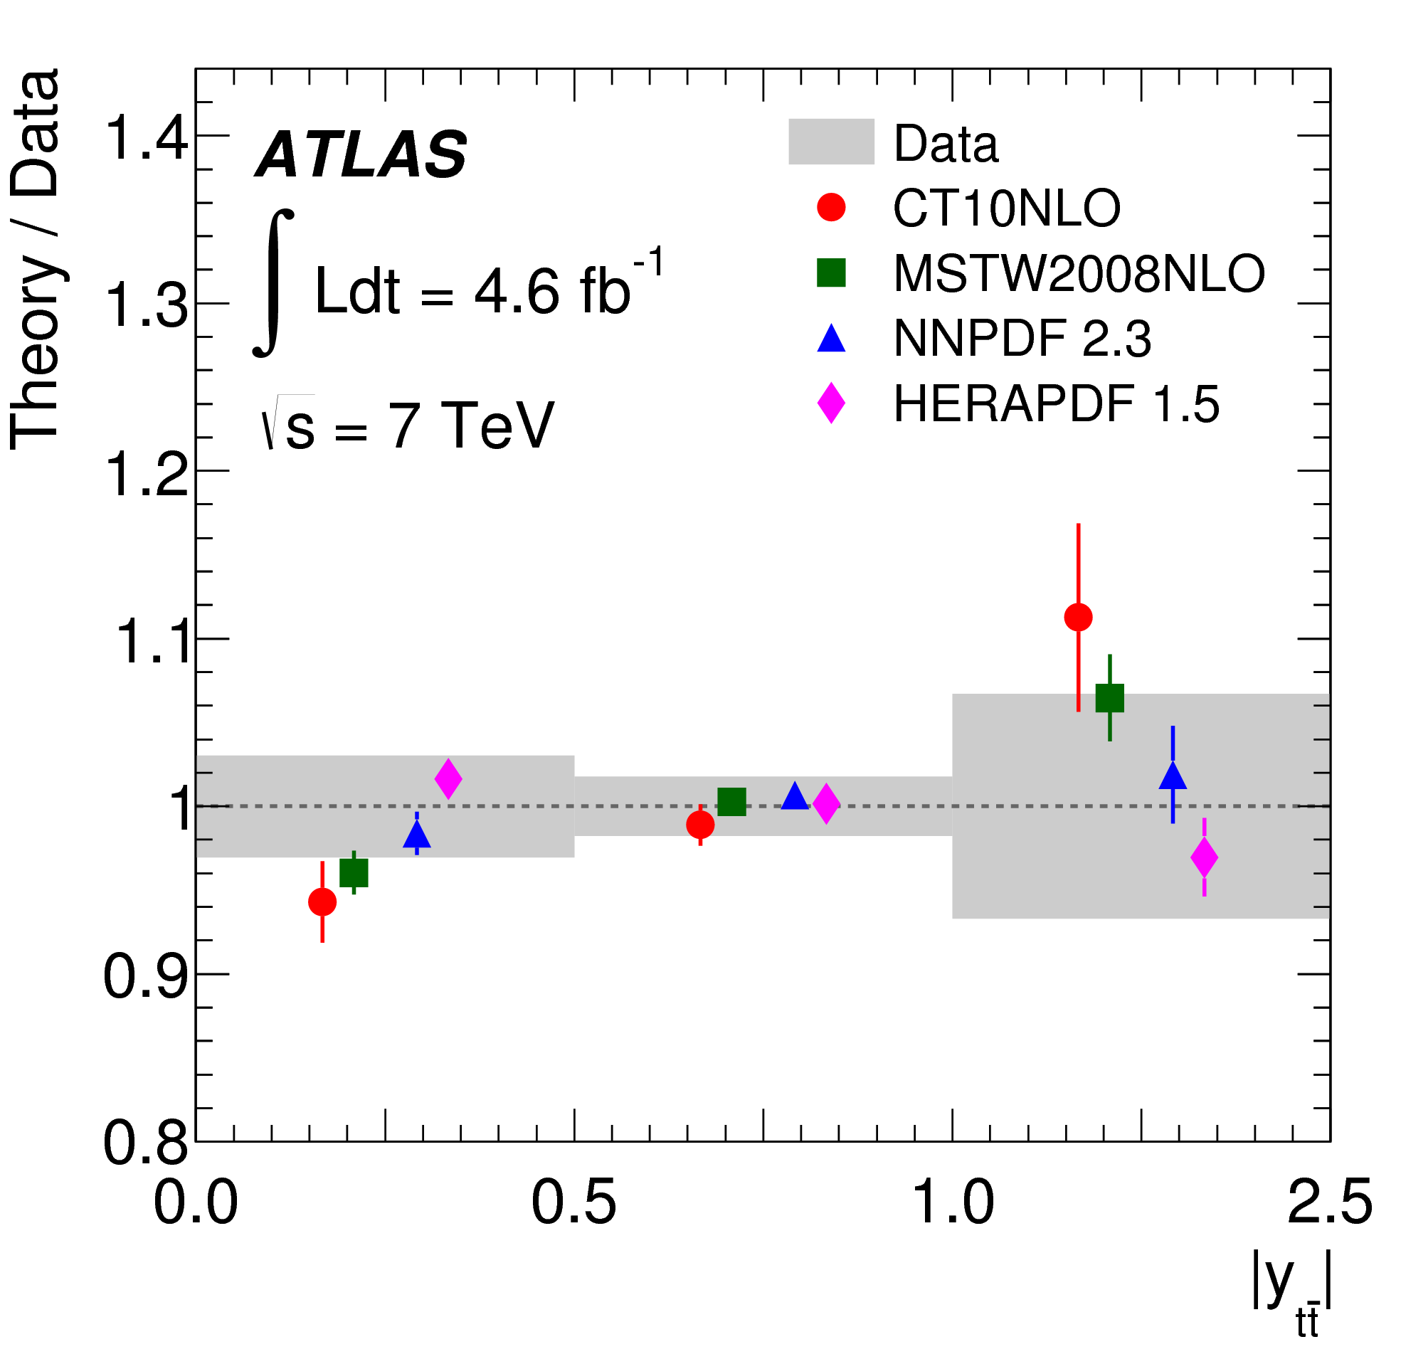
ATLAS top quark pair production
Phys Rev D90 (2014) 072004
cross sections differential in mtt, |ytt|, pttt, pttop (normalised for reduced dependence on HO corrs.)
full statistical correlation matrix between different differential cross sections provided
sensitivity to different PDF sets (caveat: no EW or NNLO QCD corrections here)
NNLO QCD calculations now available for differential distributions (M. Czakon, D. Heymes, A. Mitov)
25
Notes:
Mention that mplementation in fast grid interfaces underway

Slide 28
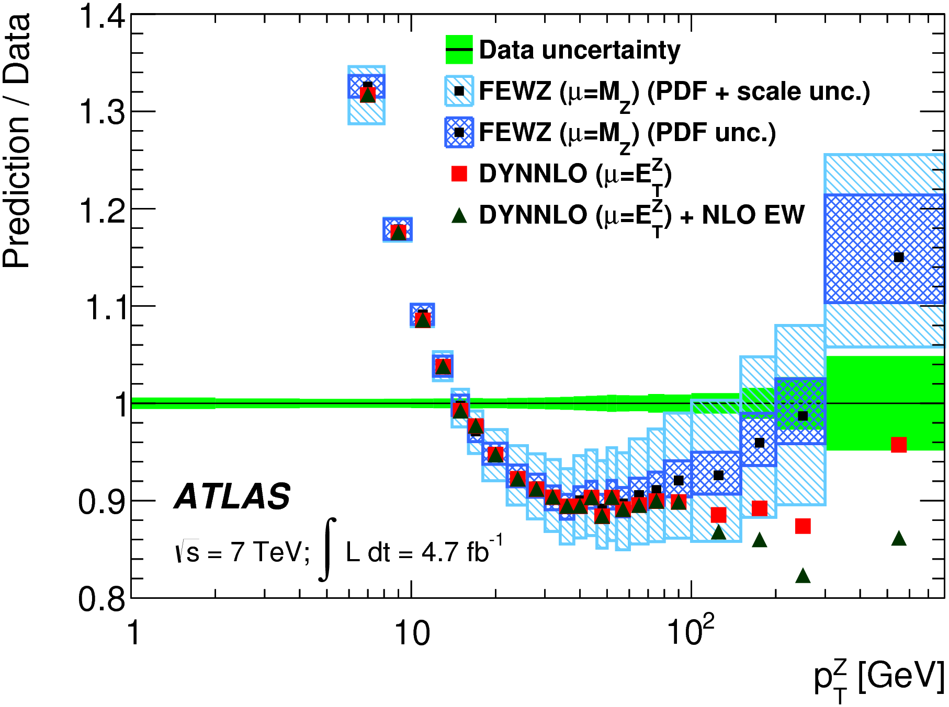
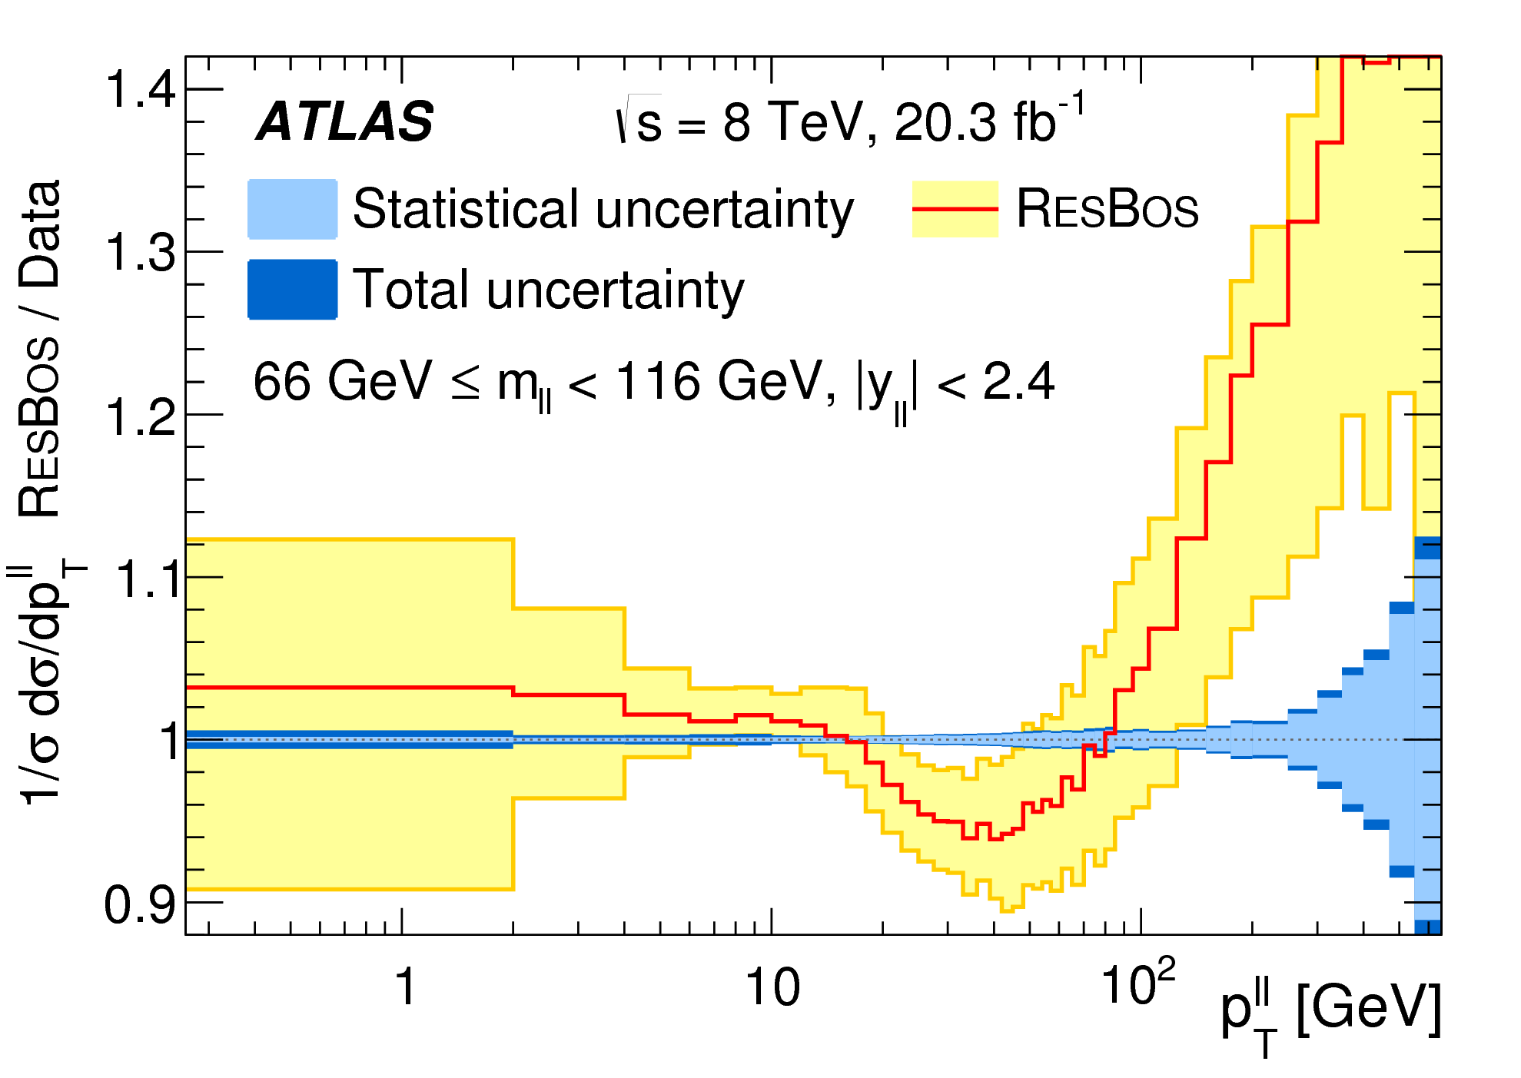
ATLAS ptZ
√s=7 TeV: JHEP09 (2014) 145 √s=8 TeV: arXiv:1512.02192
resummed calculation
FEWZ and DYNNLO are Z+0 jet @ NNLO only NLO accurate in this observable
10% disagreement
sensitive to PDFs, especially gluon
challenging observable:
resummation required at low ptZ
HO QCD (and EW corrs.) needed at high ptZ; qg scattering dominates
26
ATLAS 7 TeV measurement used to tune Pythia8 and Powheg+Pythia8 PS models
Notes:
Needs to be well understood for a number of reasons – backgrounds to many processes, W mass etc
Low pt region governed by emission of soft partons (modelled by resummation or parton shower models)
Large scale and resummation uncertainties; large dependence on non-pQCD parameterisation
Mention the tuning if possible?

Slide 29
ptZ
arXiv:1605.04295
ATLAS ptZ data arXiv:1512.02192
A. Gehrmann-De Ridder, T. Gehrmann, E.W.N. Glover, A. Huss, T.A. Morgan
normalised
fully inclusive, i.e. no jet-pt cuts, Z+1-jet @ NNLO calculation
NNLO corrections relatively flat, at level of 5–10%
improved agreement with data, and reduction of scale uncertainties
good agreement when normalised to the relevant fiducial σDY
(note, exp. luminosity and PDF uncertainties not included in comparisons)
27
Notes:
Large scale and resummation uncertainties; large dependence on non-pQCD parameterisation
Mention the tuning if possible?

Slide 30
summary
PDFs crucial for SM and BSM physics at current and future colliders
wealth of measurements from ATLAS, sensitive to proton structure several used in modern QCD fits, providing improved PDFs
LHC provides additional constraints c.f. DIS, esp. on quark flavour and gluon
ATLAS measurements support SU(3) symmetric light quark sea
new constraints on poorly known high x gluon from ATLAS jets, top (photon)
ATLAS high mass DY data also sensitive to photon content of proton new √s=8 TeV data suggest substantial constraints
recent (and forthcoming) theoretical and technical developments open the way for potential of several ATLAS measurements to be further realised
further theoretical understanding also needed in some areas…
several ATLAS results at √s=13 TeV presented (inclusive W, Z; jet; photon) already some PDF discrimination; results with larger integrated lumi. will come
28
Notes:
Implementation in fast grid interfaces underway

Slide 31
extras
Notes:
Implementation in fast grid interfaces underway

Slide 32
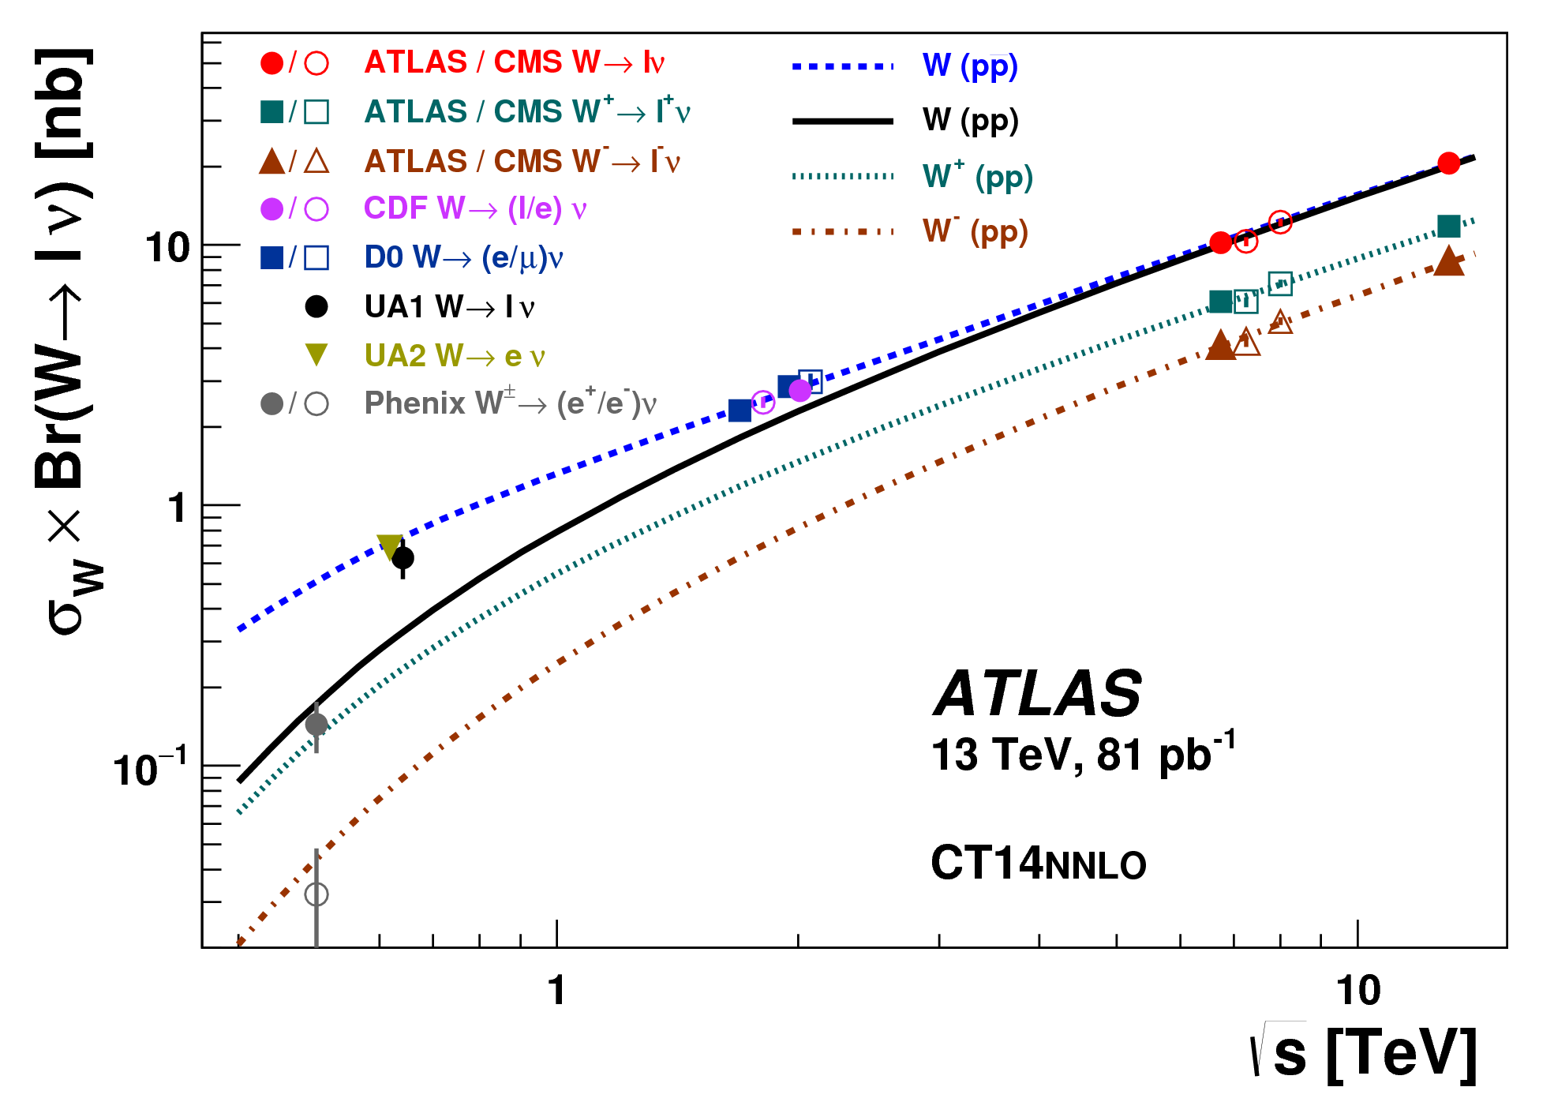
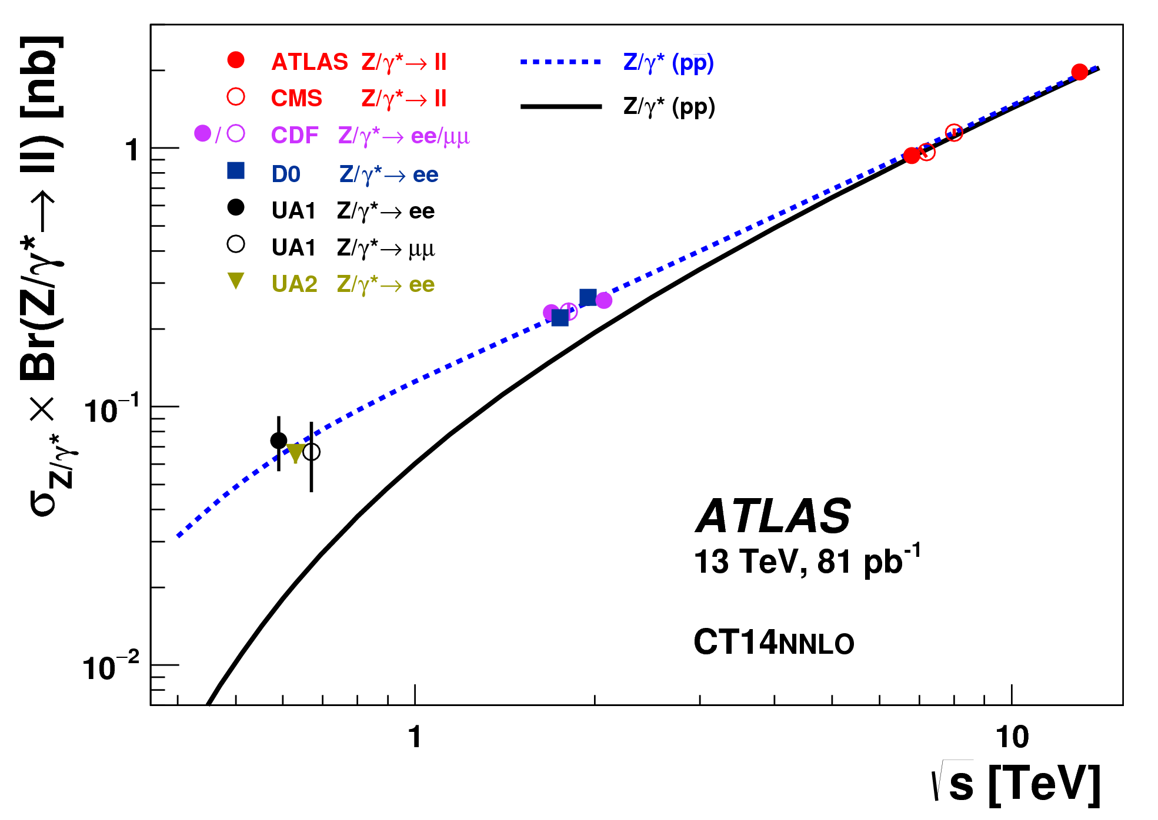
ATLAS inclusive W, Z
arXiv:1603.09221
new
  ATLAS √s = 13 TeV total cross section measurement
  energy dependence well described
30

Slide 33
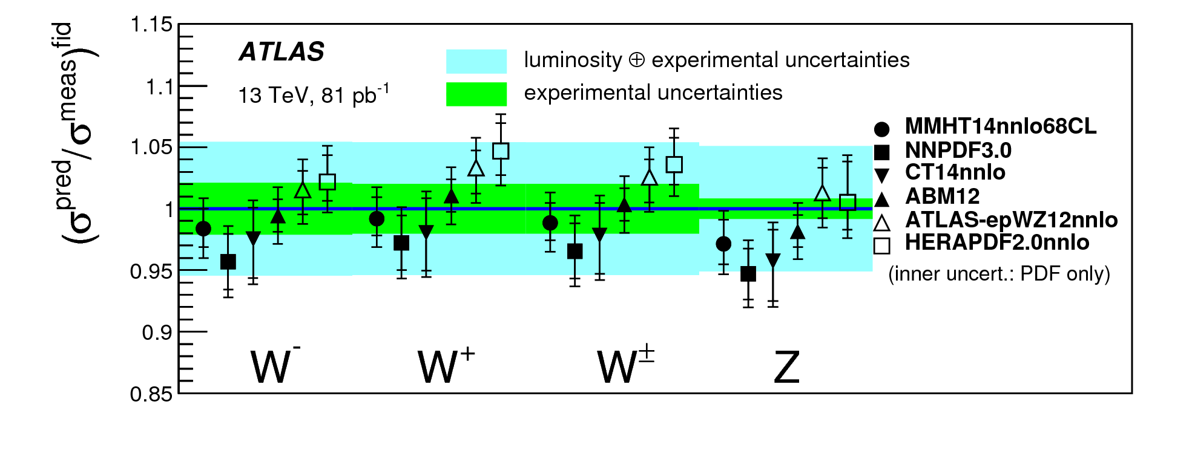
ATLAS inclusive W, Z
arXiv:1603.09221
new
31

Slide 34
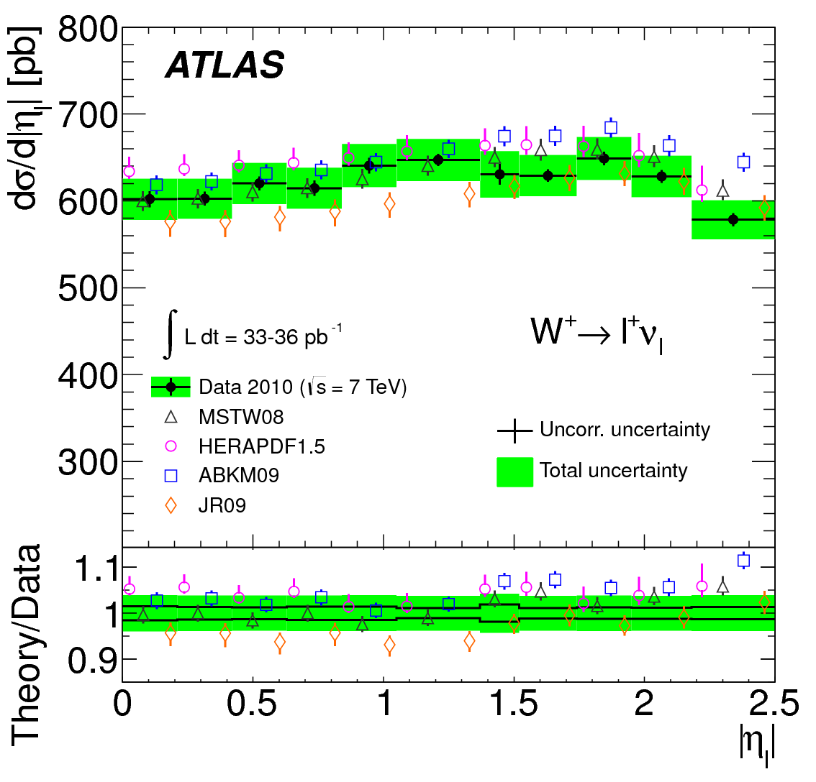
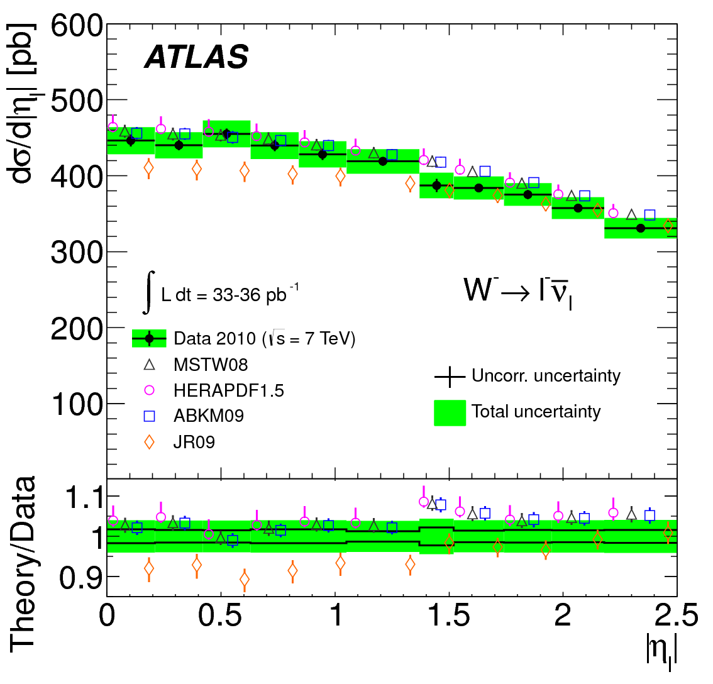
ATLAS inclusive W, Z
Phys Rev D85 (2012) 072004
  ATLAS √s = 7 TeV differential cross sections; PDF discrimination
  full correlations between measurements provided (these cross sections have been included in modern global QCD fits)
32

Slide 35
High Mass Drell Yan
ATLAS STDM-2014-06
new
sensitivity to PI contribution (left)
sensitivity to PDF choice (right)
33
Notes:
Large scale and resummation uncertainties; large dependence on non-pQCD parameterisation
Mention the tuning if possible?

Slide 36
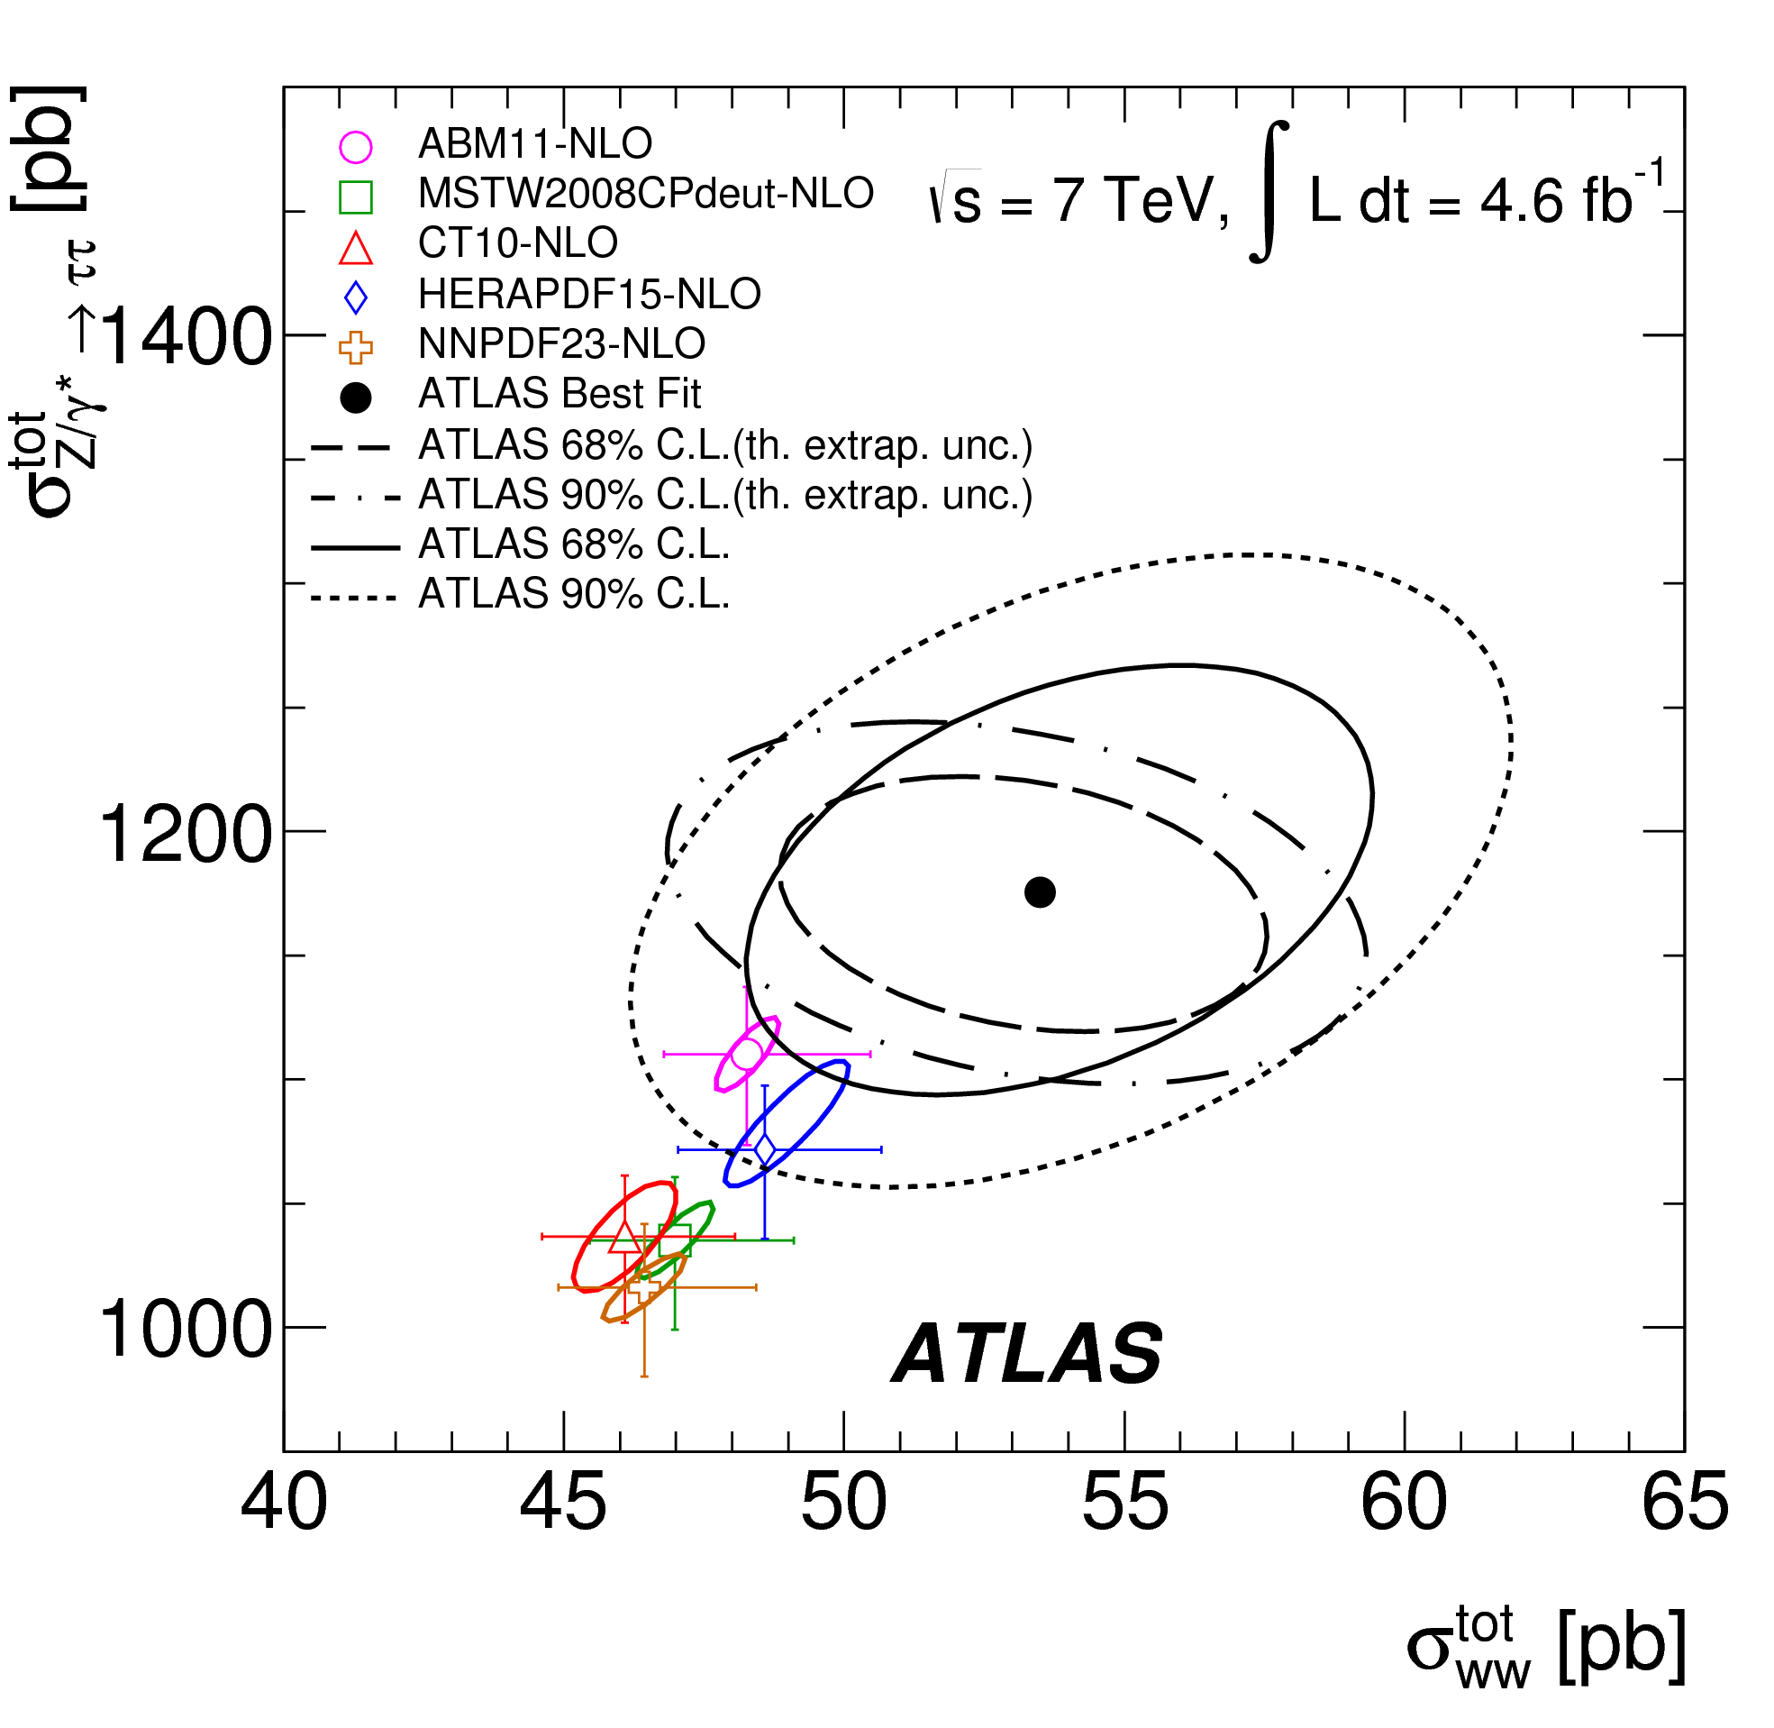
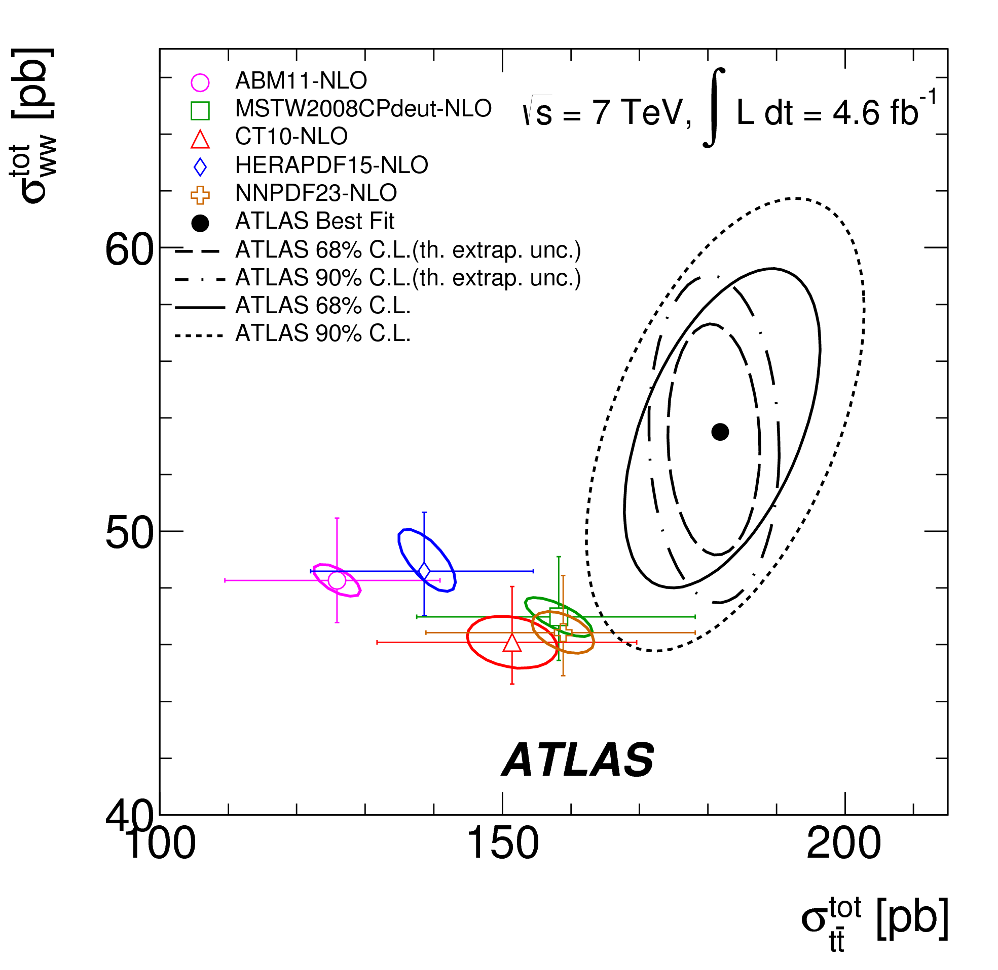


ATLAS combined W, Z, t analysis
ATLAS simultaneous measurement of WW, Z⟶ττ, tt (based on common eμ final state)
very sensitive to PDFs
NNLO PDFs give better description than NLO
potentially strong constraints from such combined analyses
NLO
NNLO
Phys Rev D91 (2015) 052005
34
Notes:
Scale uncertainty dominant at NLO
PDF uncert dominant at NNLO

Slide 37


W/Z+Jets
ratio of production cross sections for W and Z bosons in association with jets
complementary to individual W+jets and Z+jets measurements
EPJC (2014) 74:3168
35
Notes:
Scale uncertainty dominant at NLO
PDF uncert dominant at NNLO

Slide 38
ptZ
arXiv:1605.04295
ATLAS ptZ data arXiv:1512.02192
A. Gehrmann-De Ridder, T. Gehrmann, E.W.N. Glover, A. Huss, T.A. Morgan
fully inclusive, i.e. no jet-pt cuts, Z+1-jet @ NNLO calculation
NNLO corrections relatively flat, at level of 5 – 10 %
improved agreement with data, and reduction of scale uncertainties
36

Slide 39
ptZ
arXiv:1605.04295
ATLAS ptZ data arXiv:1512.02192
A. Gehrmann-De Ridder, T. Gehrmann, E.W.N. Glover, A. Huss, T.A. Morgan
very good agreement when normalised to the relevant fiducial inclusive dilepton cross section
37

Slide 40
abstract
Several measurements performed by the ATLAS collaboration can be used to
constrain the proton structure.
Measurements of the W+c production and the inclusive W and Z
differential cross sections are found to constrain the poorly known
strange-quark density at low x. Similarly, the ratio of W+/W- production
is found to constrain the valence quarks at low x. New results will be
presented using W,Z production at 13 TeV.
New precise measurements of Drell-Yan cross section measurements
performed above the Z peak region have a different sensitivity to parton
flavour, parton momentum fraction x and scale Q compared to measurements
on the Z peak. A large impact is found on the photon content of the
proton as well as high x quarks.
Measurements of the inclusive jet and photon cross sections are standard
candles and constrain the medium and high x gluon densities. New precise
measurements of inclusive photon and jet cross sections at 8 TeV are
presented and compared to various PDF predictions.

Slide 41
LHC data and proton structure
wealth of SM measurements from ATLAS, sensitive to PDFs, allowing:
PDF discrimination (confronting data with theory)
improved PDFs, by including LHC data in QCD fits
Measurement | PDF sensitivity
Inclusive W, Z and asymmetries | Quark flavour separation (u,d,s)
W with charm quarks | Direct sensitivity to s-quark
Off peak Drell-Yan at low and high mass | Quarks at low and high x (u,d)
Z+b production | Sensitive to b-quark
Inclusive jet, dijets, trijets | High x quarks and gluons (alphas)
Isolated photons | Medium-x gluon
ttbar production (total, differential) | Medium-x gluon (alphas)
Single top production | Gluon and b quark
W,Z, W/Z production with jets | Medium-x gluon
Zpt | Gluon sensitivity

Slide 42


LHC data and proton structure
  wealth of SM measurements from ATLAS, sensitive to PDFs, allowing:
    PDF discrimination (confronting data with theory)
    improved PDFs, by including LHC data in QCD fits

Slide 43
summary
wealth of measurements from ATLAS, sensitive to proton structure
several used in modern ATLAS and global QCD fits, providing improved PDFs (Run 1 W, Z; jets; top cross sections)
LHC data provide additional and complementary constraints c.f. DIS data, especially on quark flavour and gluon
ATLAS data support SU(3) symmetric light sea (incl. W, Z; W+c)
constraints on poorly known high x gluon from ATLAS jets; top; (photon)
ATLAS high mass DY data sensitive to photon content of proton; new √s=8 TeV data suggest substantial constraints
recent (and forthcoming) theoretical and technical developments opening the way for potential of several ATLAS measurements to be further realised
… further theoretical understanding also needed in some areas
several ATLAS results at √s=13 TeV presented (inclusive W, Z; jet; photon) already some PDF discrimination; larger integrated lumi. results will come
26
Notes:
Implementation in fast grid interfaces underway

Slide 44

ATLAS top quark pair production
sensitive to gluon at high x (strong correlation between gluon, 𝝰s, mtop)
ATLAS-CONF-2016-006
ATLAS-CONF-2015-049
new
ATLAS ttbar total cross sections available at √s=7, 8 and 13 TeV eμ (shown), ee/μμ and l+jets channels Run 1 measurements already used in modern, global PDF fits
ATLAS ttbar to Z cross section ratio at √s=13 TeV; dominant systematics largely cancel in ratio sensitive to ratio of gluon to sea quarks

