Slide 1



Constraints on proton PDFs
with the ATLAS detector
Claire Gwenlan, Oxford
on behalf of the ATLAS collaboration

Slide 2
ATLAS SM measurements
… providing insight into pQCD, proton structure (pdfs), non-pert. effects, and other SM parameters
extraordinary agreement between measurements and SM predictions
status: March 2018
Notes:
Remarkable agreement between measurements and theoretical predictions

Slide 3
proton pdfs – why do they matter?
ATLAS 2017
W± production
MW
Higgs
BSM
…
ATLAS today
large x quarks matter
crucial for SM and BSM physics at hadron colliders
(other questions: validity of factorisation in pp, intrinsic charm/beauty in proton, small x dynamics, …)
large x gluons matter

Slide 4
LHC measurements sensitive to pdfs
  wealth of SM measurements from ATLAS, sensitive to pdfs, provide:
  pdf discrimination, by confronting theoretical predictions with data
  pdf improvements, by including LHC data in QCD fits
extraction of precision pdfs requires both precise data, and precise theory calculations

Slide 5
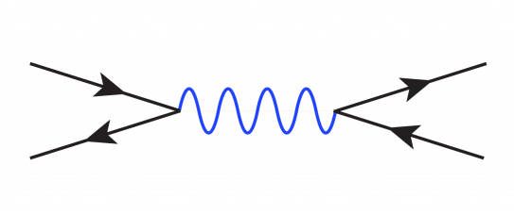
ATLAS inclusive W, Z
  sensitivity to light quarks (u, d, s)
  different quark combinations contribute to each process; flavour separation
q (’)
Z/γ* (W)
l (ν)
q
l
plots by S. Glazov, V. Radescu
experimentally very precise; state-of-the-art theory available (NNLO QCD + NLO EW)
(accurate modelling of contribution from second-generation quarks essential for precision physics)
Notes:
- W and Z bosons produced in abundance at LHC with clear experimental signatures
- Inclusive cross sections of W and Z well understood at NNLO
- Composition of incoming flavours different for W and Z production
- u and d quark dominate for W production; all flavours contibute for Z production
25% of W production induced by 2nd generation quark

Slide 6
ultimate precision W,Z differential cross sections
ATLAS incl. W,Z differential cross sections: W± |ηl|, Z |yll| (3 mll central, 2 mll forward)
(LM and HM drell-yan also available: LM: JHEP06 (2014) 112; HM: JHEP08 (2016) 009, PLB 725 (2013) 223)
Z peak, central
W⁺
EPJ C77 (2017) 367
EPJ C77 (2017) 367
4.6 fb⁻¹; extraordinary total experimental precision (< 1% uncertainty)
light quark pdf constraints; enhanced from provision of both W,Z with full syst. correlations
Notes:
Light quark pdf constraints, including strange

Slide 7
a strange story
NNLO QCD analysis
HERA I+II plus ATLAS (4.6 pb⁻¹) W± |ηl|, Z |yll| (3 mll central, 2 mll forward)
NLO (MCFM interfaced to APPLGRID) plus k-factors, NNLO QCD (DYNNLO) + NLO EW (MCSANC)
→ ATLAS-epWZ16 pdf (available on lhapdf)
(following HERAPDF ansatz; xFitter framework)
EPJ C77 (2017) 367
strange quark
consistent with previous ATLAS results
PRL 109 (2012) 012001 (W,Z inclusive, 36 pb⁻¹)
JHEP05 (2014) 068 (W+c analysis)

Slide 8
impact on modern global pdfs
EPJ C77 (2017) 367
uv
strange pdf
dv
profiling exercise to study impact of ATLAS inclusive W,Z (4.6 pb⁻¹) differential cross sections on global pdf fits
improved valence; enhanced strange, consistent with ATLAS QCD fit
Notes:
table with chi2 in backups?

Slide 9
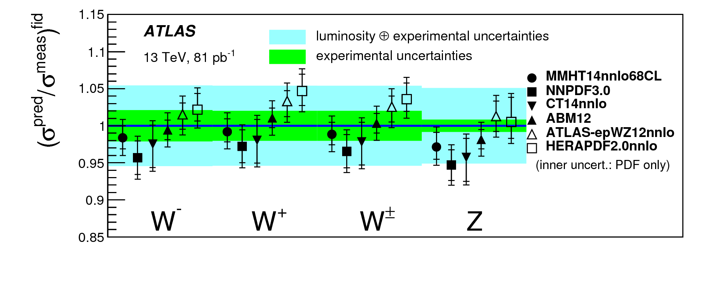
ATLAS inclusive W,Z @ 13 TeV
(syst uncerts: 2% (W), 1% (Z); lumi uncert: 2.1%)
PLB 759 (2016) 601
(pdfs shown use different combinations of HERA, Tevatron and LHC data)
  measurements at higher CM energy give access to different kinematic region in x, providing new and complementary pdf sensitivity
consistent with LHC Run 1 results and provides extra handle to constrain pdfs
Notes:
-- ABM12 has the best agreement with the data: no Tevatron data, but LHC W,Z and top
-- NNPDF3.0, MMHT14nnlo68CL and CT14nnlo generally a little bit low:
Tevatron as well as most LHC data (except top and W + c for CT14, except W + c for MMHT)
-- HERAPDF2.0nnlo a little bit high in W+ (different u,d content from other PDFs): only HERA data

Slide 10
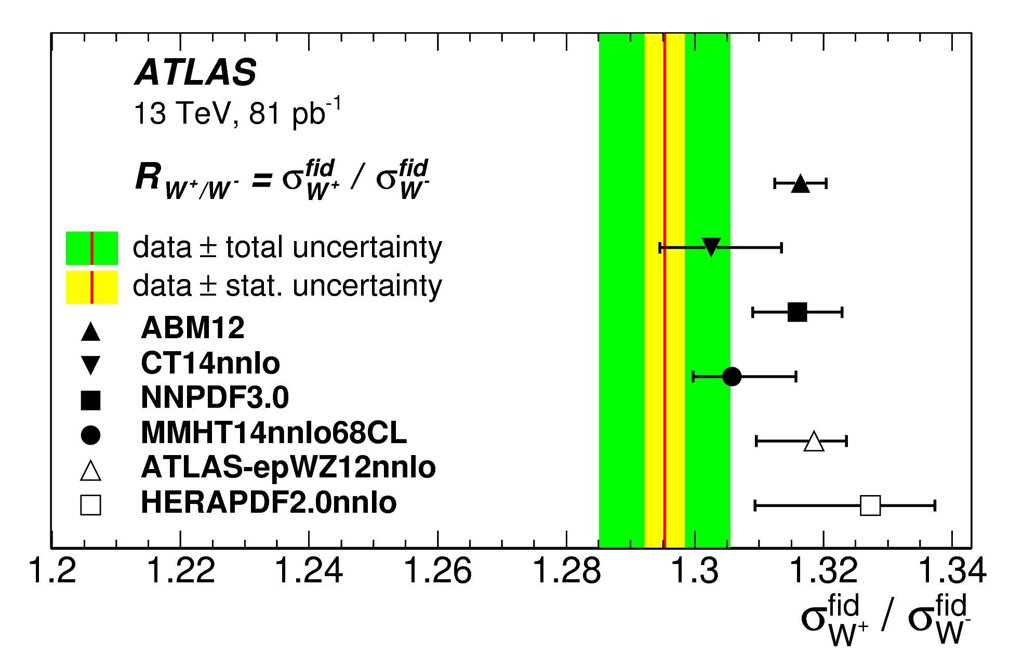
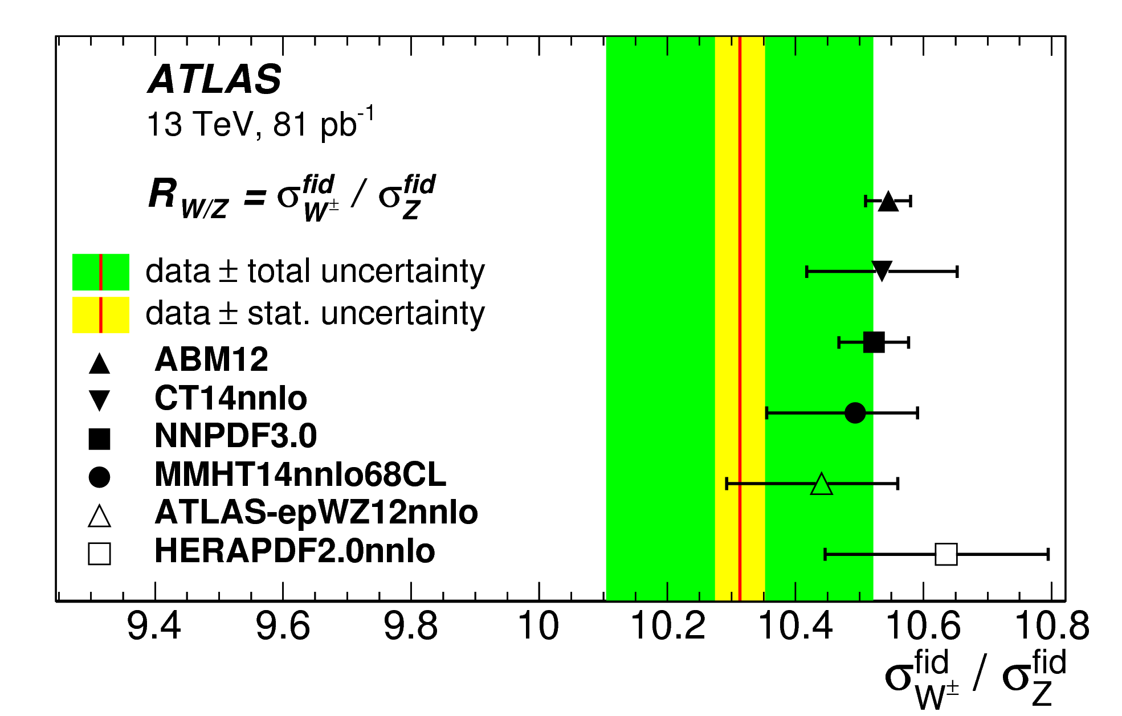
ATLAS W and Z cross section ratios @ 13 TeV
PLB 759 (2016) 601
W+/W–:
sensitive to valence quarks at low x
W/Z:
constrains strange quark density
cross section ratio measurements: partial cancellation of systematics
sensitivity to pdf differences; W/Z ratio consistent with enhanced strange
Notes:
Consistent since more strange == more Z and so a lower W/Z ratio
Dominant exp uncert. In W/Z are from the multijet background and jet energy scale/resolution, and in W+/W- from uncorrelated part of multijet background

Slide 11
ATLAS inclusive jet and dijets
JHEP05 (2018) 195
gluon at high x very poorly known – direct impact on BSM searches
jet production in pp sensitive to gluon and quarks at high x
new ATLAS 13 TeV measurements of inclusive jets (dijets) reach to pt=3.5 TeV (mjj = 9 TeV)

Slide 12
ATLAS inclusive jets in detail
JHEP05 (2018) 195
cf. NLO QCD – quantitative comparisons performed for CT14, MMHT14, NNPDF3.0, ABMP16, HERAPDF2.0
(tension when considering all rapidity bins together; also seen previously with 7,8 TeV measurements; sensitive to exact assumptions on correlations for two-point exp. and th. systematics, see EG. JHEP09 (2017) 020)
Notes:
Two point syst – based on simple choice between two options
Examples are:
Theory: scale variations, alt. scale choice, NP corrections
Exp: JES flavour response, JES multijet pt-balance fragmentation, pile-up energy density in jets

Slide 13
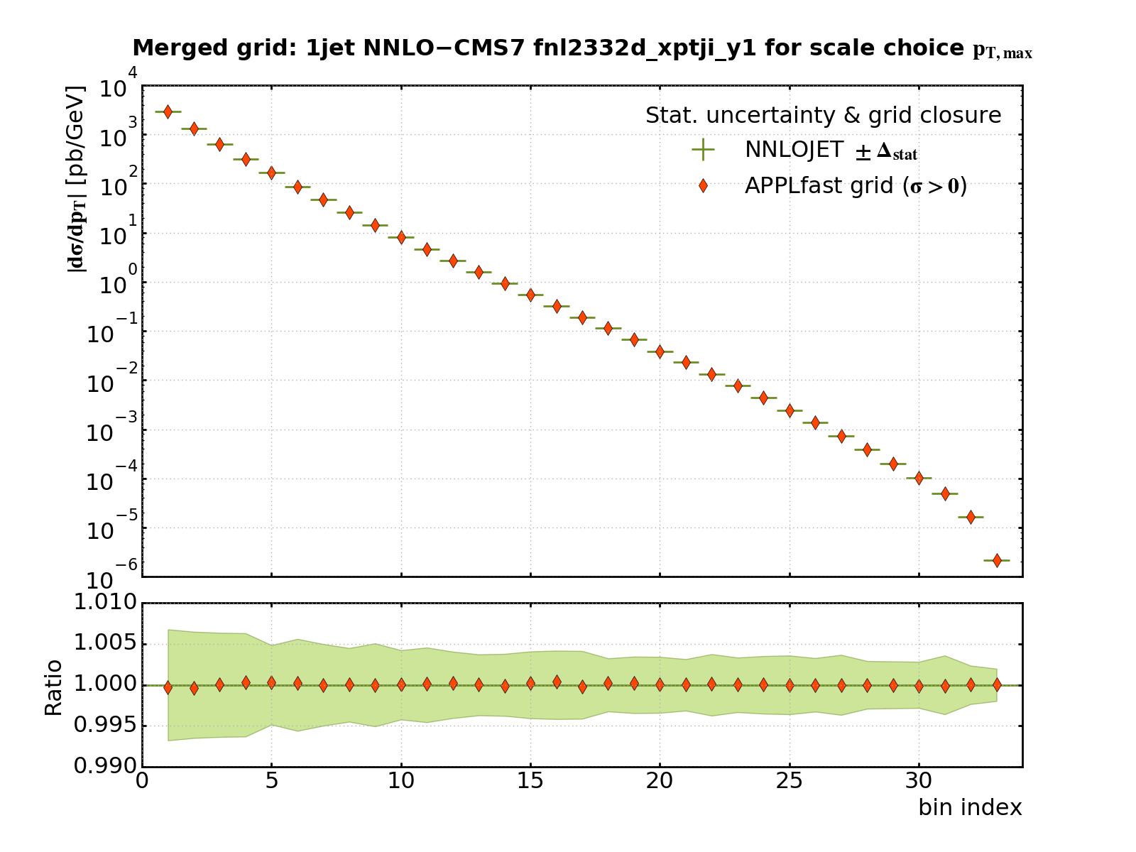
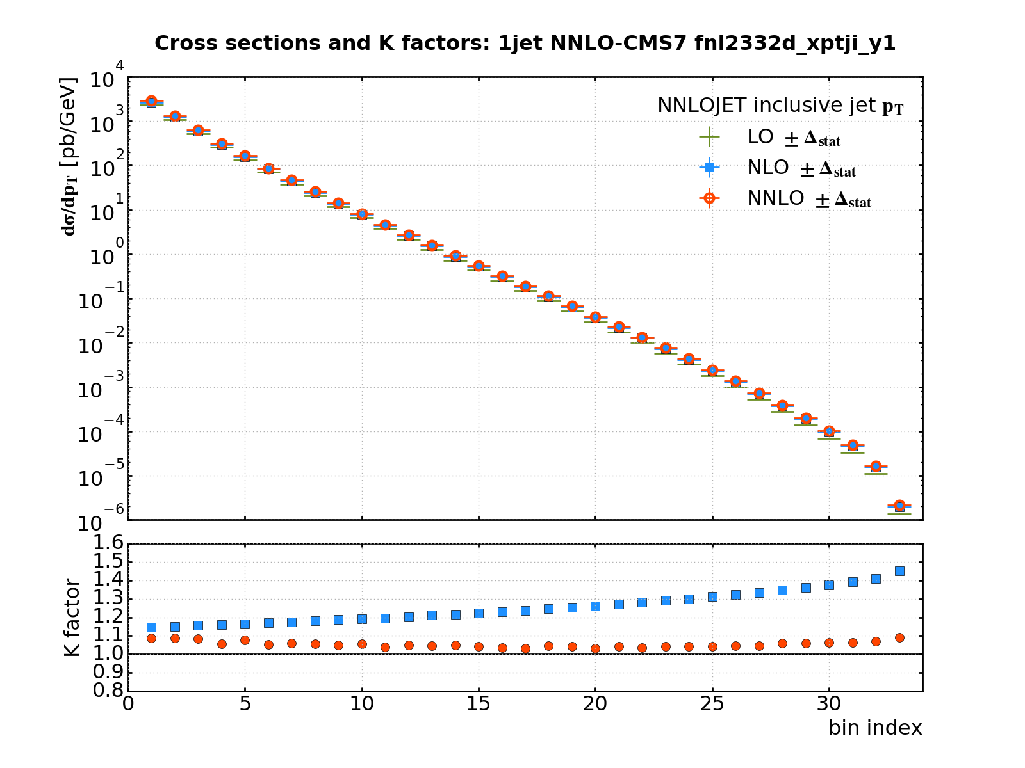
ATLAS inclusive jets at NNLO QCD
JHEP05 (2018) 195
APPLfast coll., status report, DIS18
example rapidity bin:
μR=μF=pt^{max}
NOT FINAL
μR=μF=pt^{jet}
APPLfast reproduction of NNLOJet incl. jet cross section
NNLO QCD calcs. for inclusive and dijets available (PRL 118 (2017) 072002, 119 (2017) 152001)
inclusive jets: NNLO improves description for scale choice of pt^{jet}
APPLfast grid technology on the way to allow rigorous inclusion in pdf fits at NNLO

Slide 14
CG: replace with results from ATLAS top fit PUB note (ATL-COM-PHYS-2018-388) if public in time
ATLAS top quark pair differential cross sections
mainly via gg channel – constraints on gluon
wealth of useful top measurements from ATLAS
EG. dilepton channel ttbar measurement (8TeV, 20.2 fb⁻¹); comparison of normalised cross sections to NLO QCD, corrected for QED FSR ↓
NLO QCD fit
EPJ C77 (2017) 804
gluon
also extracted:
Notes:
Significant sensitivity in some observables to pdfs
Quarks follow HERAPDF ansatz
Comment: brings gluon down for NNPDF3.0 and CT14 (but need NNLO?)

Slide 15
ttbar and Z cross sections and ratios
ttbar and Z inclusive cross sections and their ratios, plus ratios at different CM (7,8,13 TeV)
state-of-the-art theory:
Z: NLO QCD (DYNNLO) + NLO EW (FEWZ); ttbar: NNLO+NNLL (Top++)
JHEP02 (2017) 117
gluon
constraints on gluon (Z,ttbar; shown), and light quark sea (Z)

Slide 16
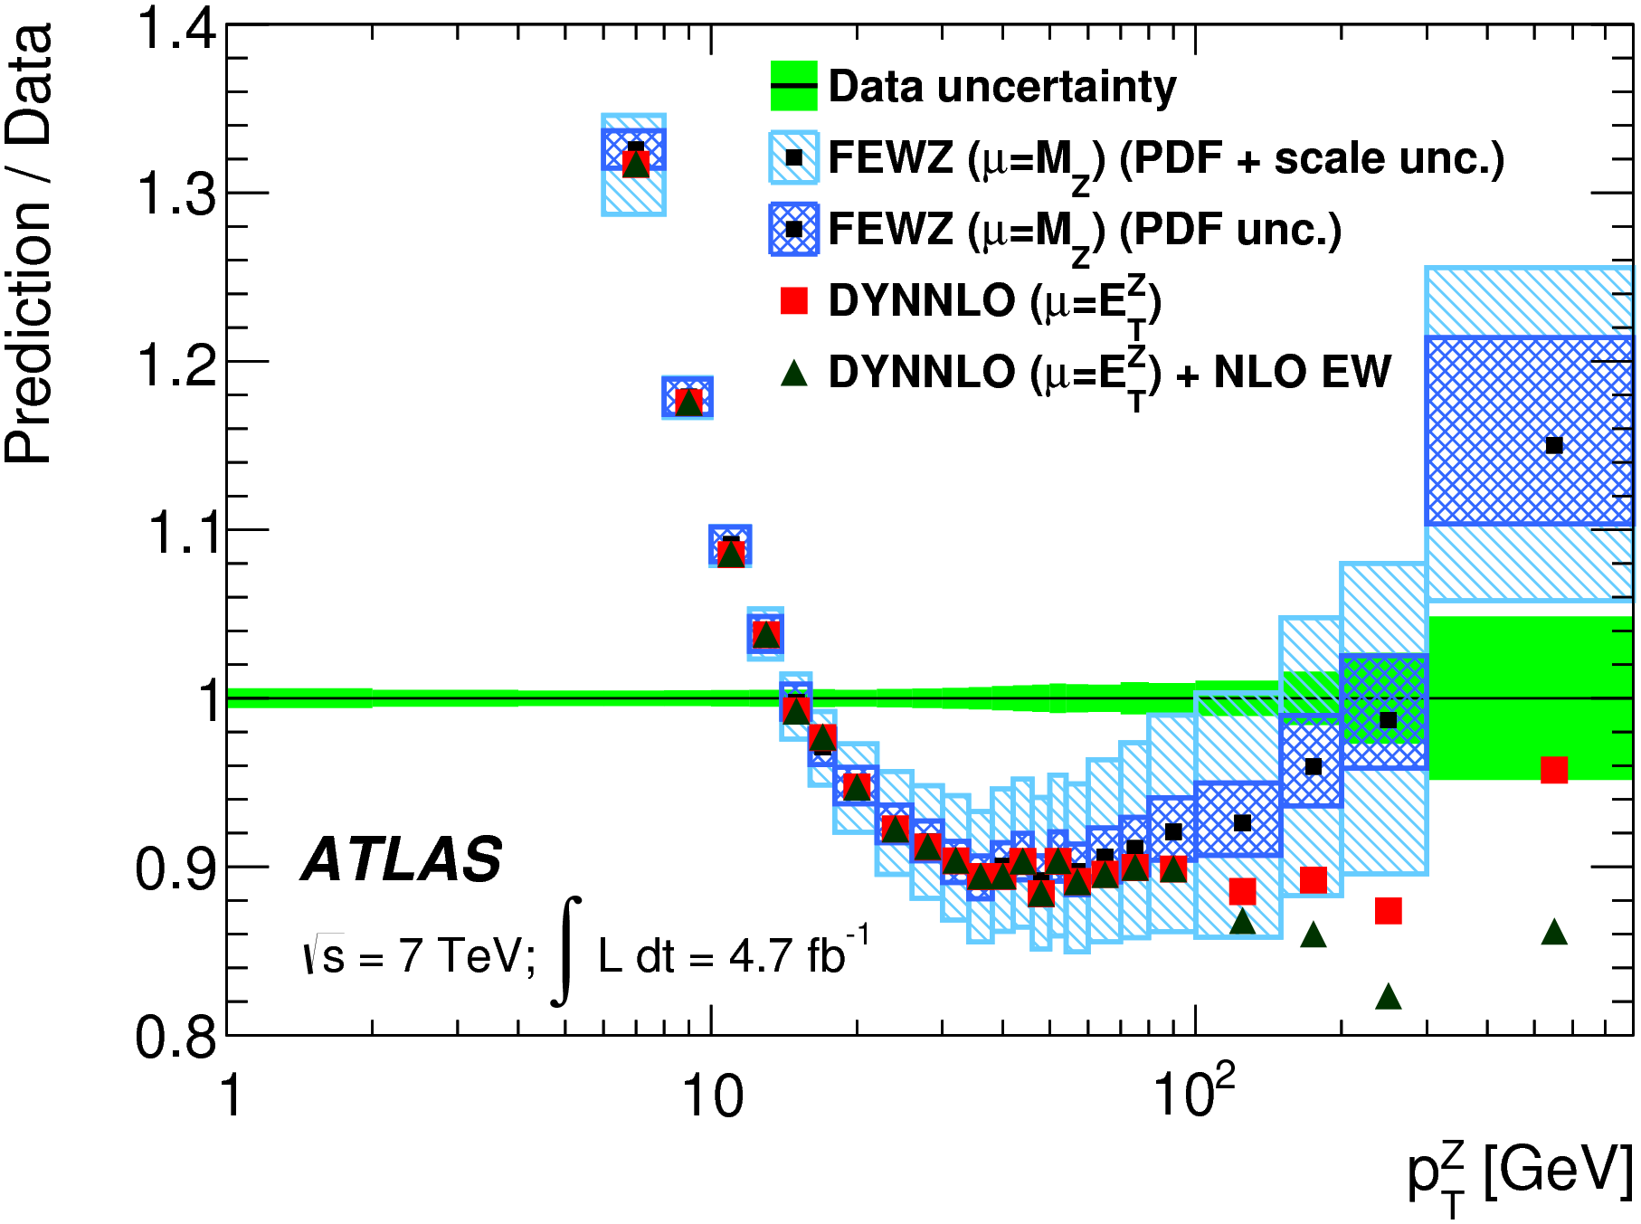
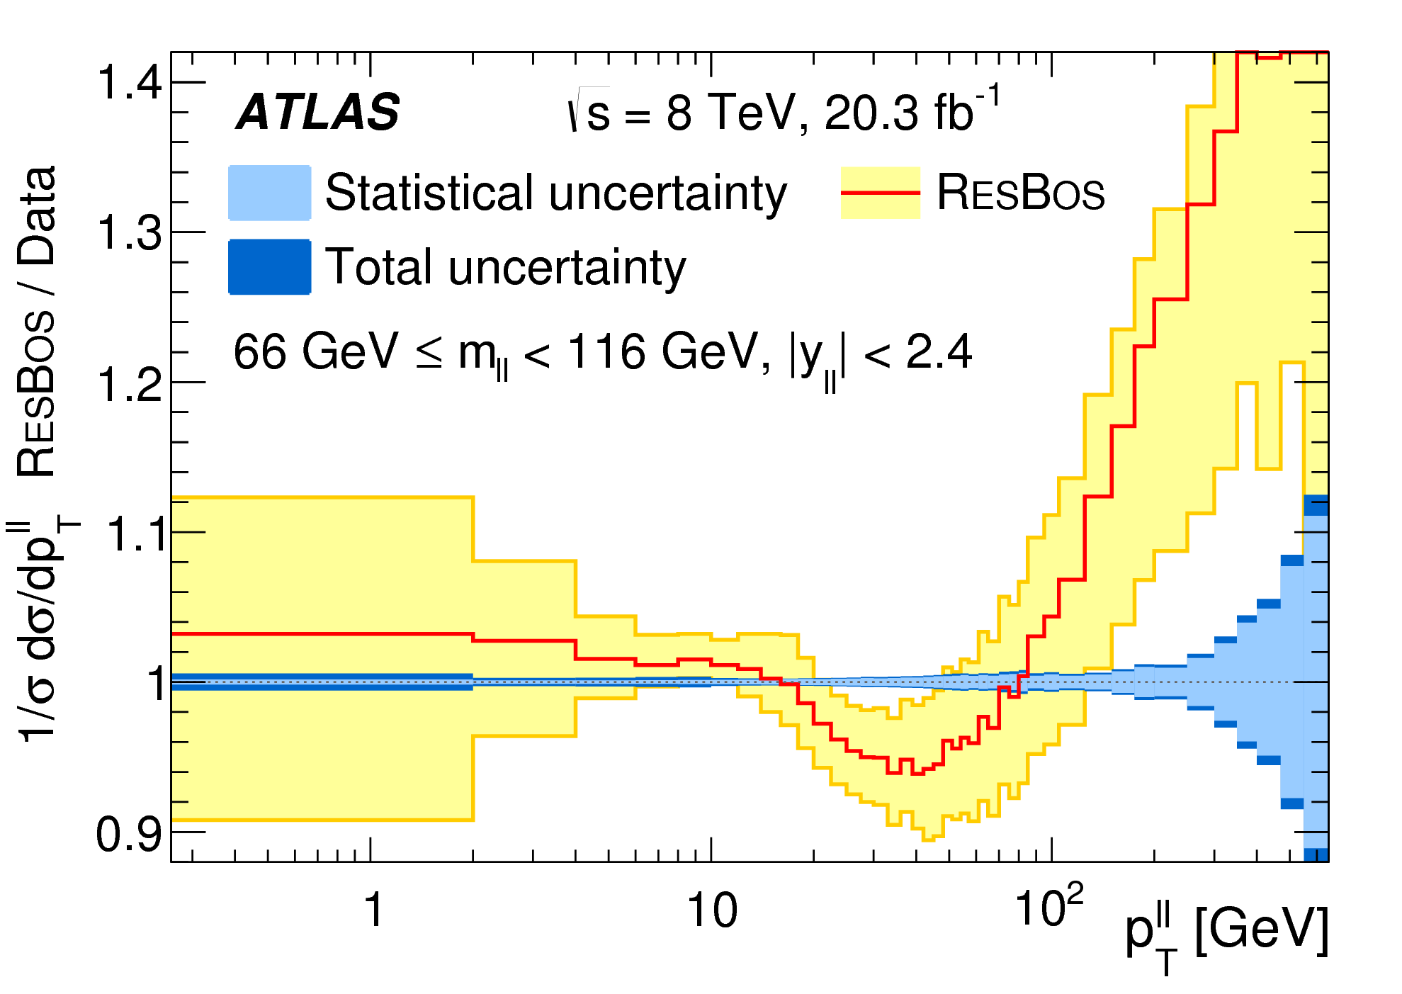
JHEP09 (2014) 145
EPJ C76 (2016) 291
ATLAS ptZ
sensitive to pdfs, especially gluon
experimentally, very precise
ATLAS: ee, μμ channels; combined precision better than 0.5% precision for pt < 100 GeV
theoretically challenging – low pt region dominated by soft particle emission (resummation, shower models); high pt region dominated by emission of hard partons (pdfs)
(NNLO available; APPLfast grids on the way)

Slide 17
PLB 770 (2017) 473
ATLAS prompt photon
isolated photons: mainly sensitive to gluon at medium to high x
(syst uncerts. 5 – 19% at highest Et^{γ}; lumi uncert: 2.1%)
clean experimental environment
cf. JETPHOX (NLO QCD) theory uncertainties dominate across most of phase space
measurements available at different CM energies – similar Et, Q² regions sample different x
NNLO corrections available PRL 118 (2017) 222001
Notes:
syst uncerts. 5 – 19%, stat uncert dominates at highest Et, above 600 GeV; lumi uncert: 2.1%
potentially useful for future pdf determinations
(add refs to previous measurements?)

Slide 18
examples of c,b from ATLAS
𝛄+c
single top
Rt = σ(tq)/σ(tbarq)
𝛄+c,b: PLB 776 (2018) 295 Z+b: JHEP10 (2014) 141
JHEP04 (2017) 086
Notes:
Photon+c,b provide sensitivity to the heavy-flavour content of the proton and aspects related to the modelling of heavy-flavour quarks in perturbative QCD (e.g. models of intrinsic charm)
HF quarks arise in the proton through either extrinsic or intrinsic mechanisms. Extrinsic refers to HF quarks arising through perturbative mechanisms in the proton, while intrinsic refers to non-perturbative mechanisms
Presently, global parton distribution function (PDF) fits show that HF quarks in the proton are almost entirely extrinsic, however non-zero values of the intrinsic contribution have not been ruled out [22]. The photon transverse energy observable provides sensitivity to these effects, by taking advantage of its precise calibration while integrating over the less precise jet kinematic observables. The effect of intrinsic HF quarks in the PDF would be manifest at large Bjorken-x, which in the context of this measurement would give rise to larger cross-section values at large absolute photon pseudorapidities, |ηγ|, with high photon transverse energy, ETγ.2 Due to their smaller mass, c-quarks are more sensitive to these effects than b-quarks.

Slide 19
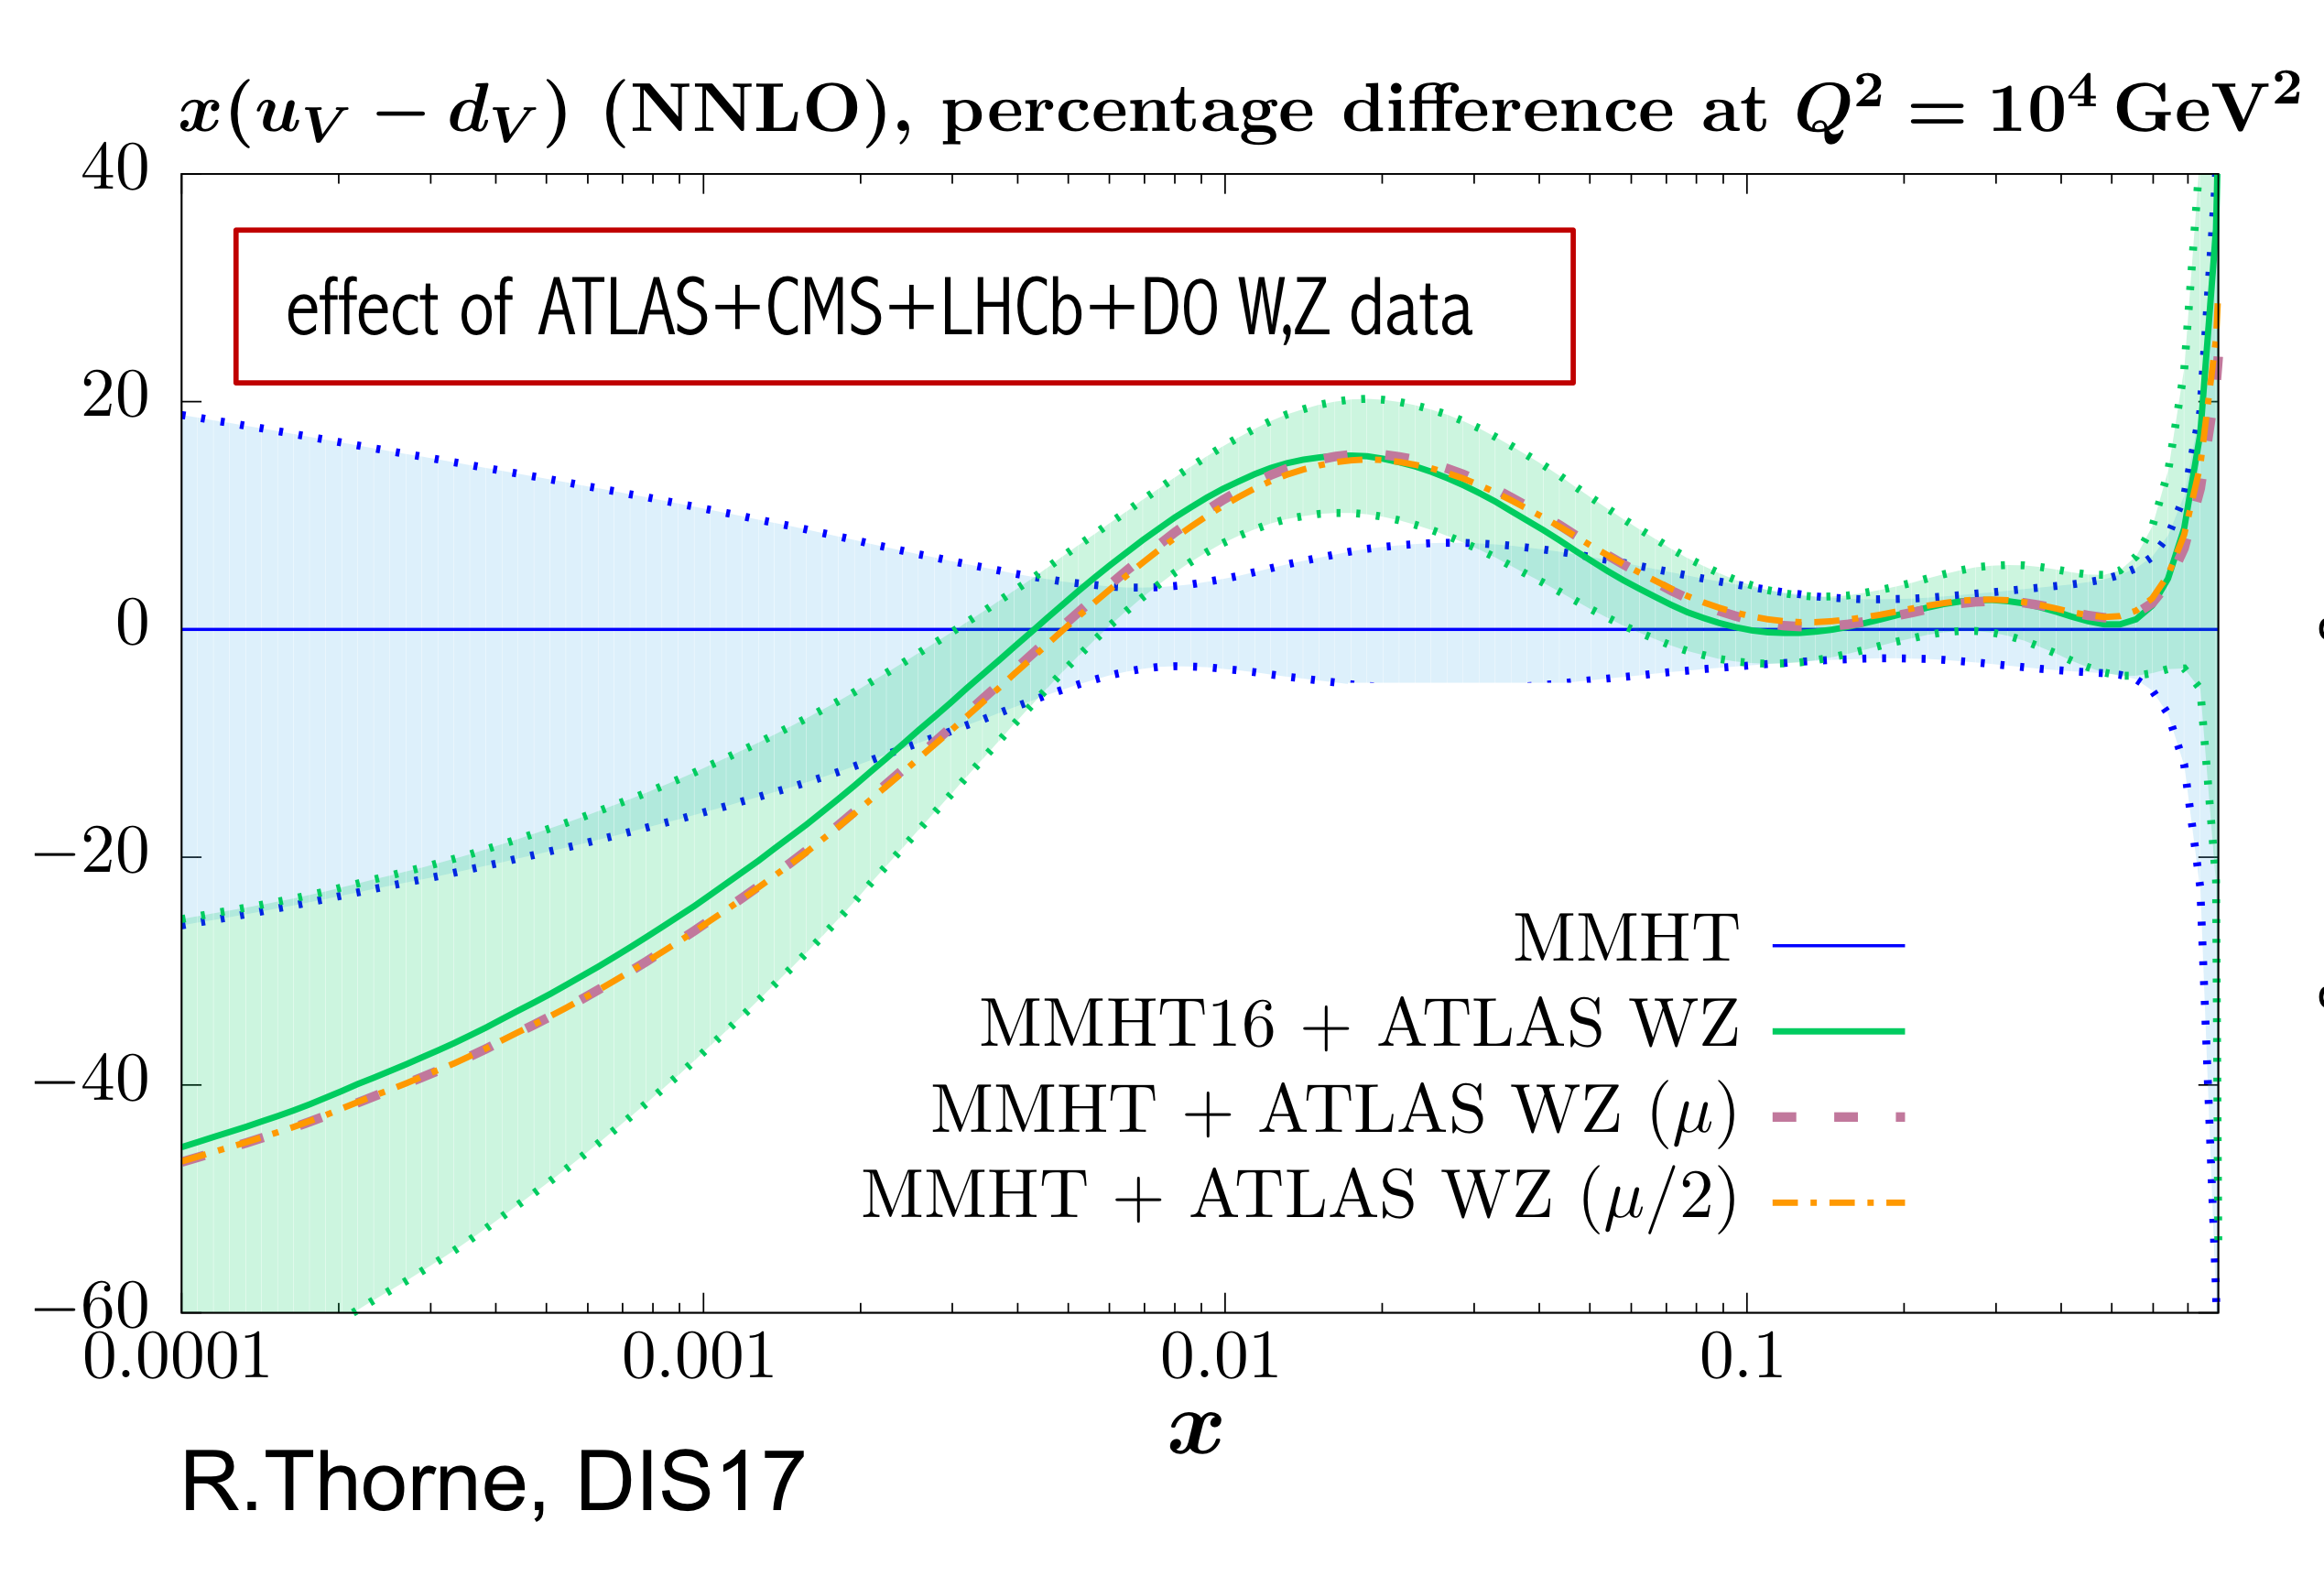
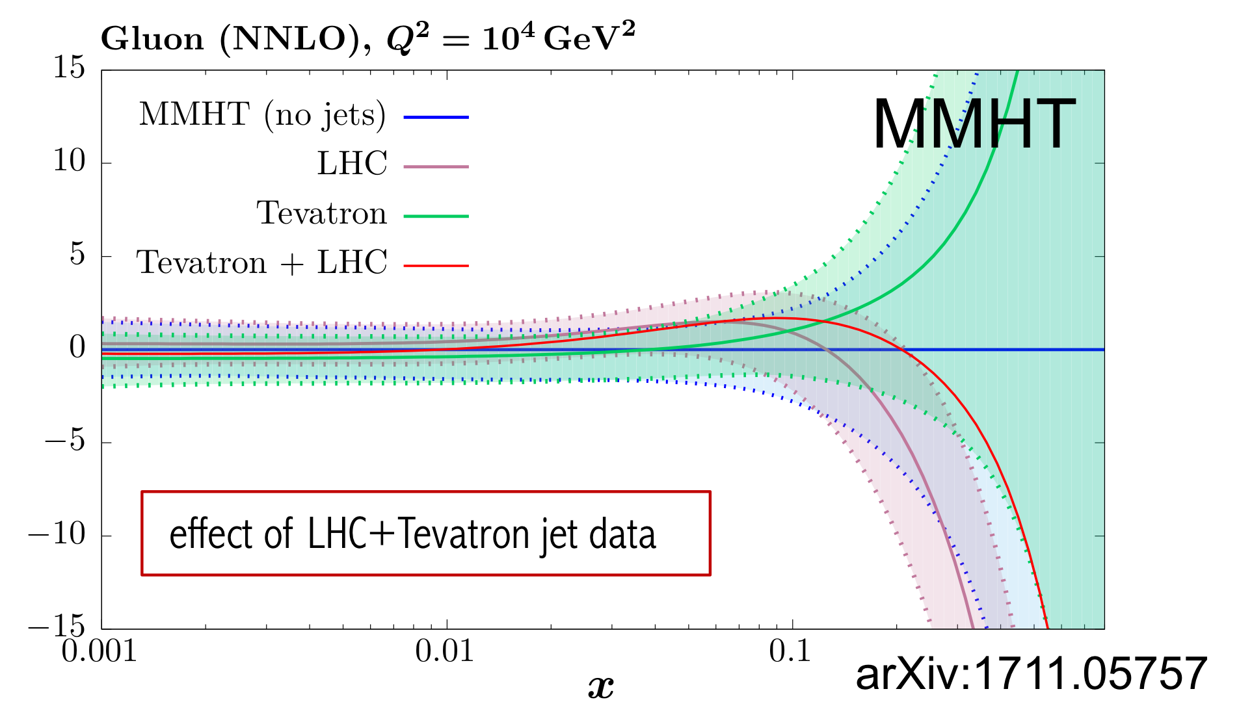
impact of LHC data on modern global pdf fits
MMHT
EPJ C78 (2018), 248
global pdf fitters actively including LHC data from ATLAS, CMS and LHCb
many measurements shown in this talk are yet to be included
much more still to come…
NNPDF3.1
effect of LHC jet+top+ZPt
EPJ C77 (2017), 663
Notes:
Comment on future pdf discrimination and models with/without intrinsic charm etc

Slide 20
summary
ATLAS has extensive and growing portfolio of pdf-sensitive measurements
unavoidably, only a tiny subset presented here – other (mainly) earlier measurements not discussed include: HM and LM DY; W+c; QCD jet measurements at
2.76,7,8 TeV; many more top measurements; Z/W+Jets; …
measurements of same process at different CM energies, and ratio measurements (EG. of different processes, or same process at different energies) with partially cancelling systematics can provide significant pdf constraints
NNLO QCD calculations available for important physics processes – developments in grid technology (APPLfast) mean these data should be useable in
rigorous NNLO pdf fits in the near future
still much to come from ATLAS from both Run 1 and Run 2 SM analyses

Slide 21
extras

Slide 22
ultimate precision W, Z differential cross sections
EPJ C77 (2017) 367
Notes:
table with chi2 in backups?

Slide 23
ultimate precision W,Z differential cross sections
e channel
μ channel
EPJ C77 (2017) 367

Slide 24
ATLASepWZ16 QCD fit parameterisation
total of 15 free parameters
with constraints:
ensuring ubar=dbar as x→0:
(momentum sum)
(number sum)

Slide 25
impact on modern global pdfs
EPJ C77 (2017) 367
profiling exercise to study impact of ATLAS W, Z (4.6 pb⁻¹) differential cross sections on proton pdfs from global fitters
Notes:
table with chi2 in backups?

Slide 26
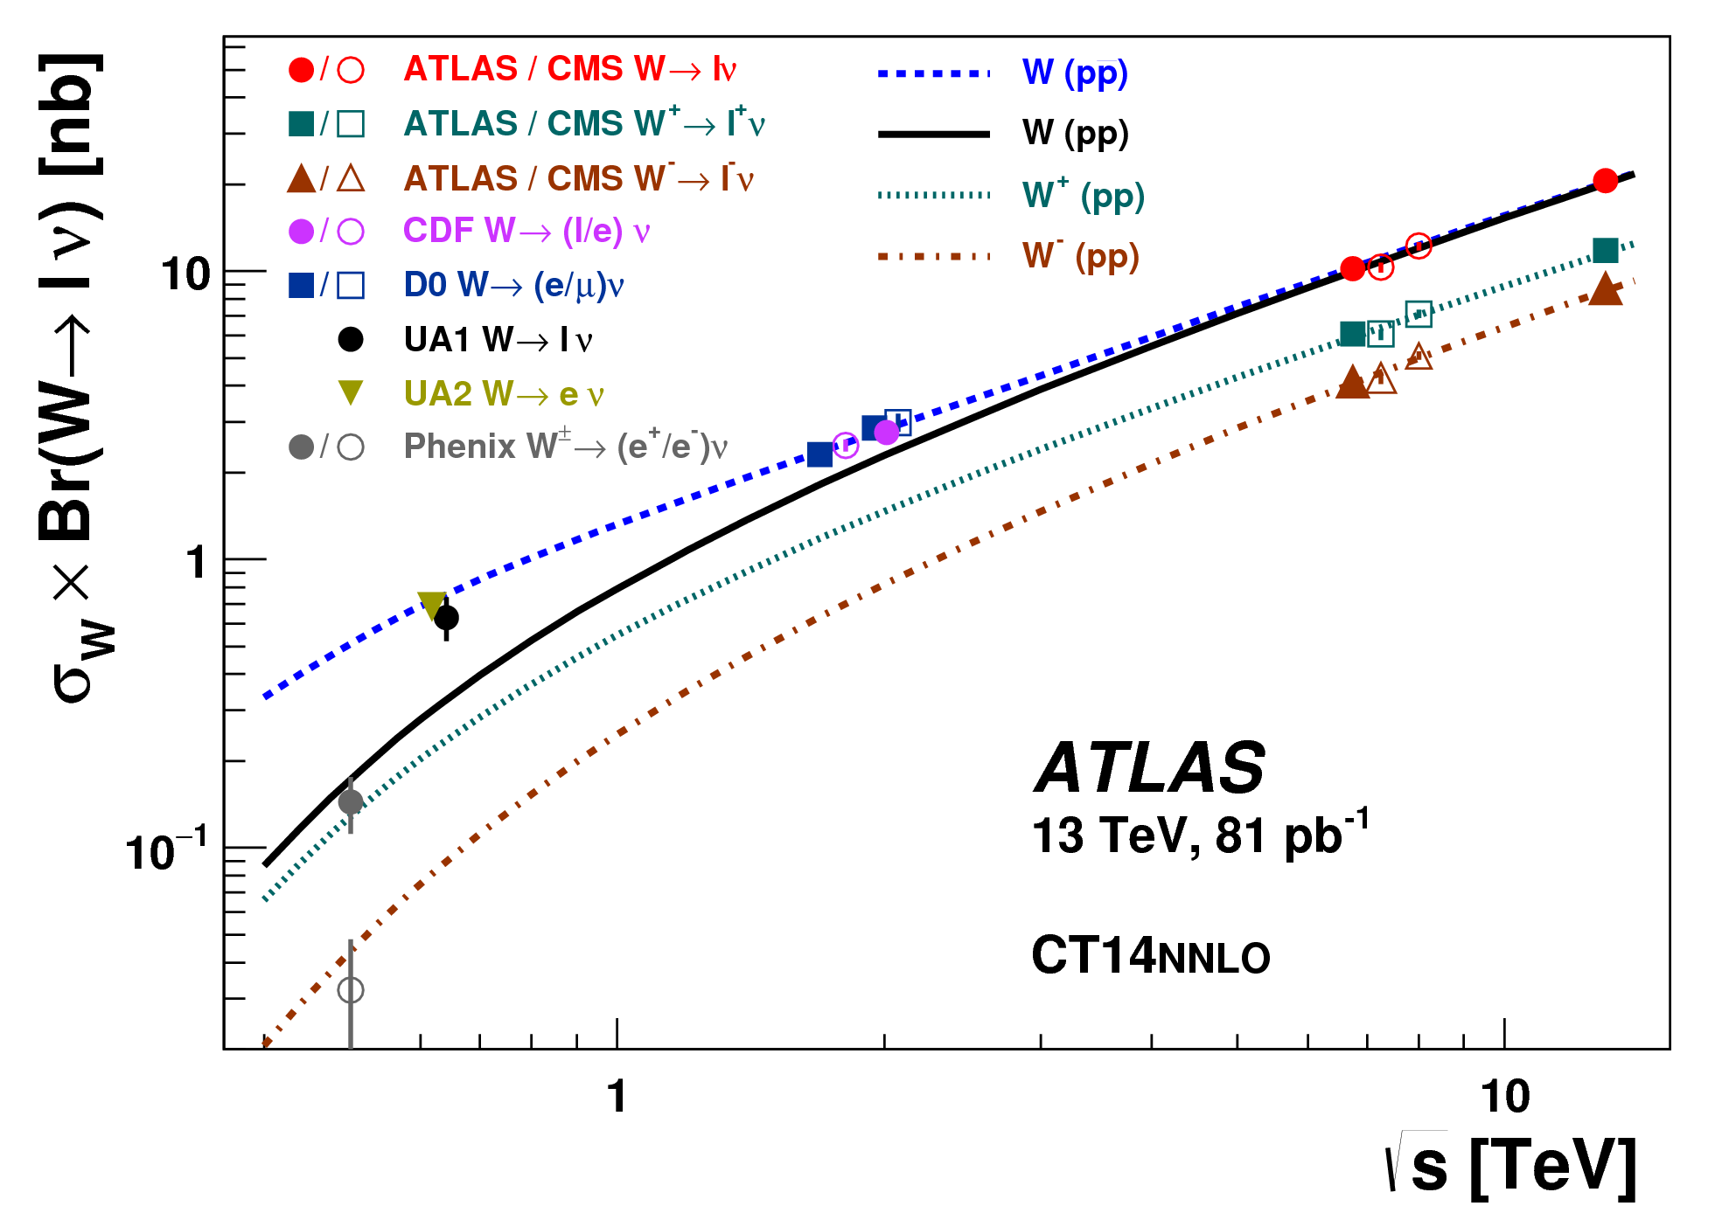
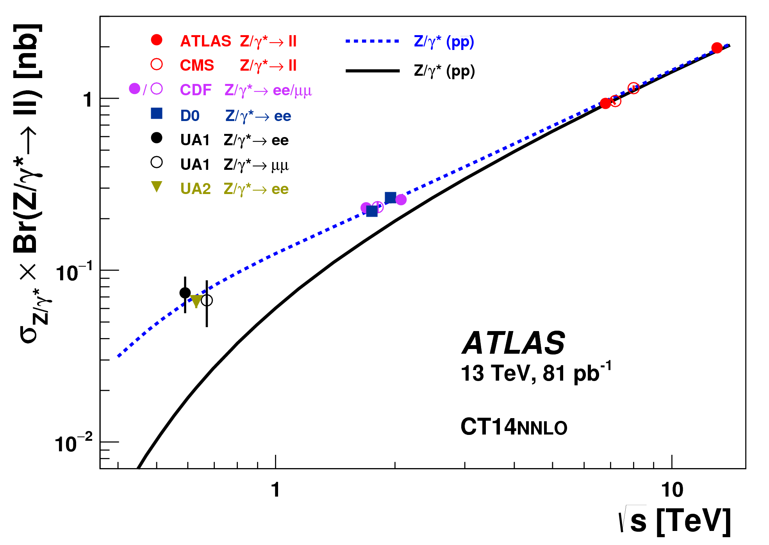
ATLAS inclusive W, Z
PLB 759 (2016) 601
  energy dependence well described

Slide 27
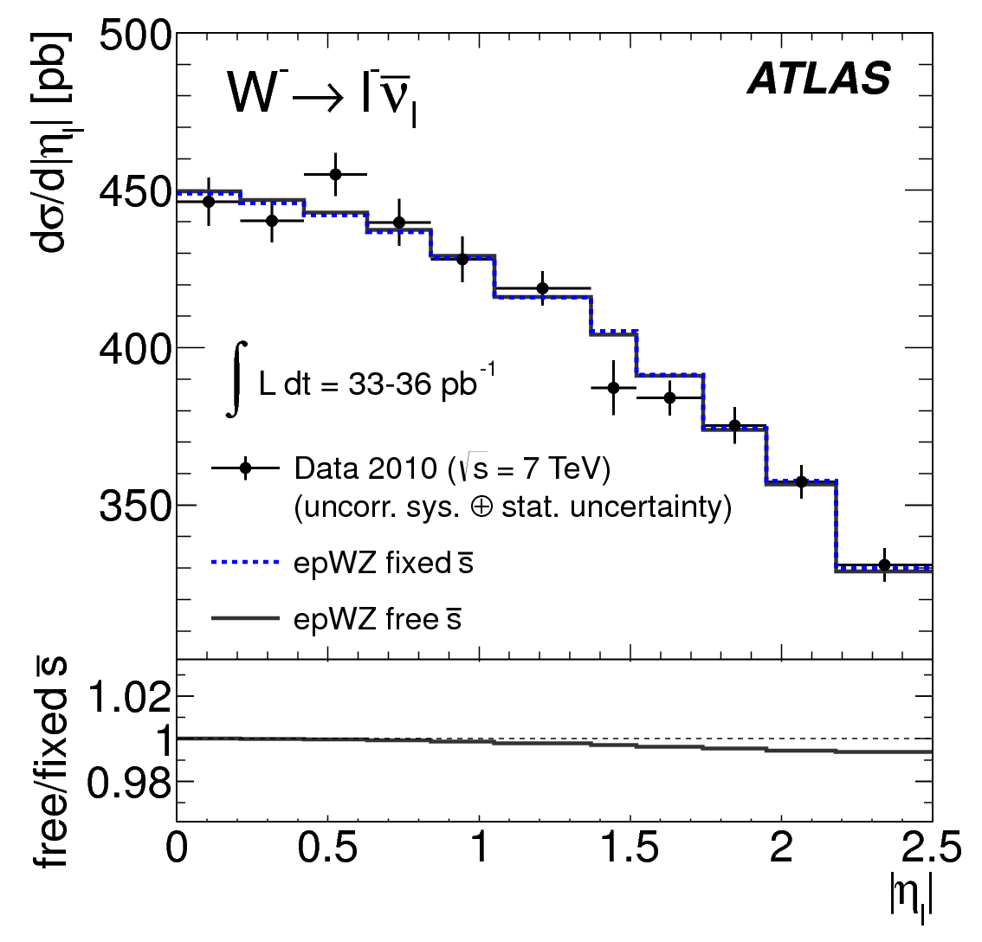
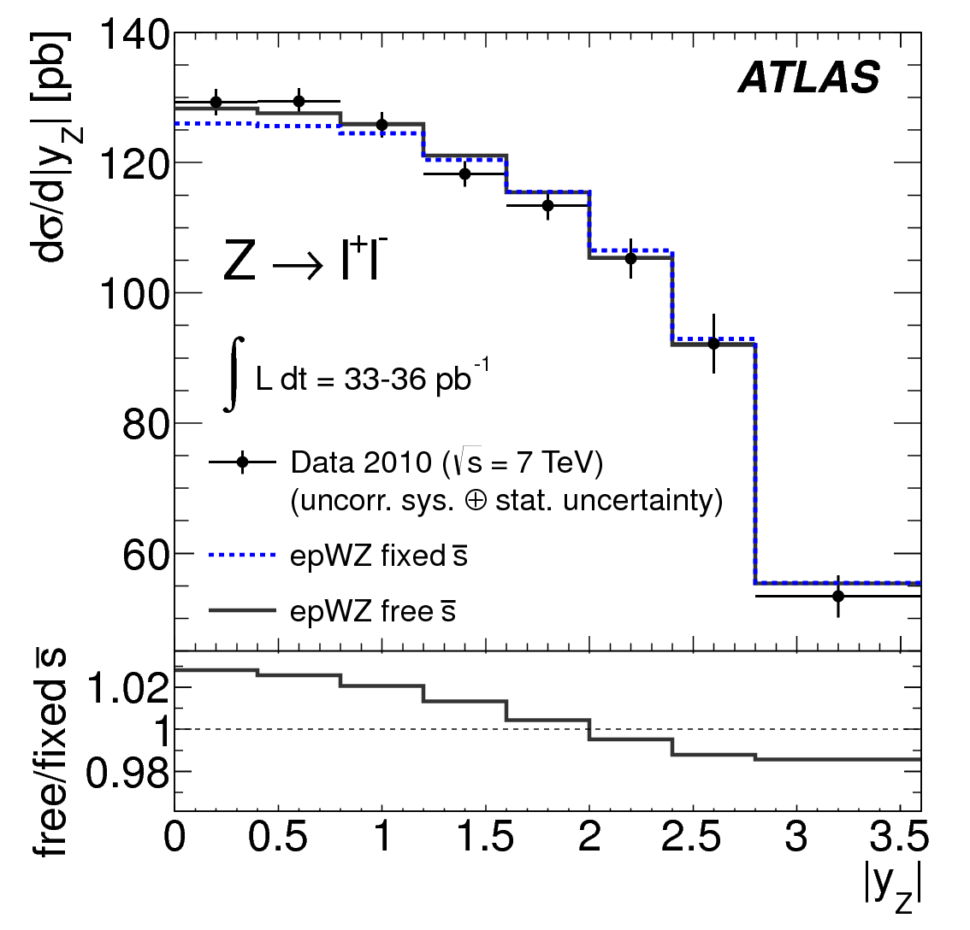
ATLAS inclusive W, Z
impact of unsuppressed strange on W,Z inclusive cross sections
Phys Rev Lett 109 (2012) 012001

Slide 28
JHEP05 (2018) 195
ATLAS inclusive jets

Slide 29
ATLAS inclusive jets at NLO QCD
JHEP05 (2018) 195

Slide 30
ATLAS inclusive jets at NNLO QCD
JHEP05 (2018) 195
scale: pt^{max}

Slide 31
ATLAS inclusive jets at NNLO QCD
JHEP05 (2018) 195
scale: pt^{jet}

Slide 32
ATLAS dijets at NLO QCD
JHEP05 (2018) 195

Slide 33
ATLAS dijets at NLO QCD
JHEP05 (2018) 195

Slide 34
top quark pair to Z cross section ratios
JHEP02 (2017) 117

Slide 35
top quark pair cross section ratios
JHEP02 (2017) 117

Slide 36
top quark pair to Z cross section double ratios
JHEP02 (2017) 117

Slide 37
top quark pair to Z cross section ratios
JHEP02 (2017) 117
constraints on medium-to-high-x sea quark and gluon pdfs
Notes:
A bit ugly – relegate to backups?

Slide 38
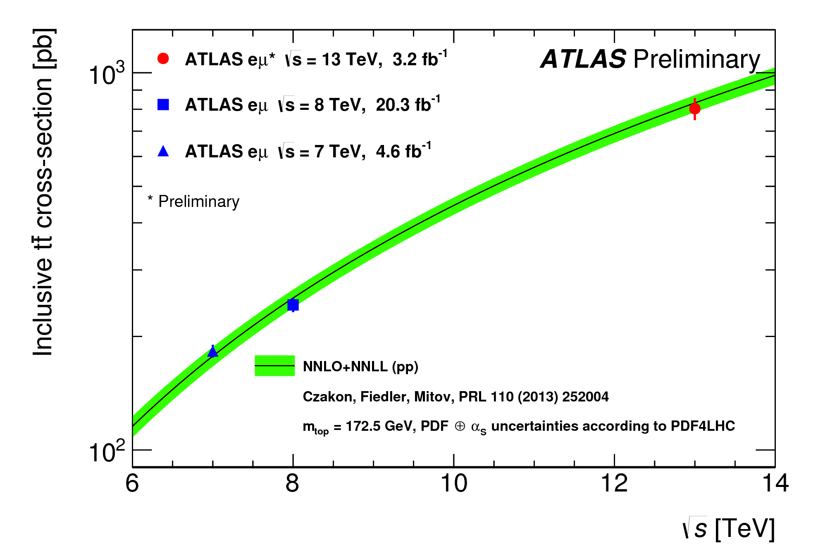
top quark pair @ 7,8,13 TeV
EPJ C76 (2016) 538
PLB 761 (2016) 136
lepton+jet
Phys Rev D94 (2016) 092003
wealth of top quark pair total and differential cross section measurements
mainly constrains high x gluon; also sensitive to quarks at large top-pt and mtt
yet more measurements to come
dileptons
Notes:
A bit ugly – relegate to backups?

Slide 39
ATLAS W+Jets
JHEP05 (2018) 077

Slide 40
a strange story
EPJ C77 (2017) 367
NNLO QCD analysis (following HERAPDF ansatz)
ATLAS-epWZ16
available on lhpadf
consistent with previous ATLAS results
PRL 109 (2012) 012001 (W, Z inclusive, 2010 data lower stats. analysis, 36 pb⁻¹)
JHEP05 (2014) 068 (ATLAS W+c analysis)

Slide 41
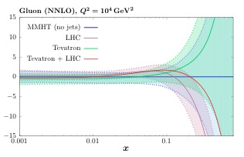
LHC: gluon from jets, top, ZPt
arXiv:1703.01630
MMHT
effect of LHC+Tevatron jet data
arXiv:1711.05757
NNPDF3.1
effect of CMS top+jet data
jet, top quark pair and ZPt measurements constrain gluon at medium and high x
numerous studies from ATLAS, CMS, xFitter and global fitters
NNLO QCD calcs. now available in all cases
effect of LHC jet+top+ZPt
arXiv:1709.04922
(LHCb forward charm and beauty measurements COULD also help at small x? )

Slide 42
PLB 770 (2017) 473
ATLAS prompt photon
isolated photons: sensitive to gluon at medium and high x
(syst uncerts. 5 – 19%; lumi uncert: 2.1%)
clean experimental environment
reasonable agreement with modern NLO QCD calcs, given large uncertainties
theory uncertainties generally dominant; larger than differences between pdfs
potentially useful for future pdf determinations
(relegate this to backups?)
Notes:
syst uncerts. 5 – 19%, stat uncert dominates at highest Et, above 600 GeV; lumi uncert: 2.1%

Slide 43
ultimate precision W, Z differential cross sections
EPJ C77 (2017) 367
clean experimental signature; advanced theoretical predictions

Slide 44
ultimate precision W,Z differential cross sections
ATLAS incl. W,Z differential cross sections: W± |ηl|, Z |yll| (3 mll central, 2 mll forward);
2011 data, 4.6 pb⁻¹
Z central
extraordinary precision; better than 1% total exp. uncertainty in both e and μ (μ channel uncerts. shown)
EPJ C77 (2017) 367
light quark pdf constraints; enhanced by using both W,Z with full correlations

Slide 45
impact of LHC data on modern global pdf fits
NNPDF3.1
effect of LHC jet+top+ZPt
jet, top quark pair and ZPt measurements constrain gluon at medium and high x
numerous studies from ATLAS, CMS, xFitter and global fitters
NNLO QCD calcs. now available in all cases
Notes:
Comment on future pdf discrimination and models with/without intrinsic charm etc

Slide 46
top quark pair and Z cross sections and ratios
JHEP02 (2017) 117
sensitivity to pdf differences

Slide 47
ttbar and Z cross sections and ratios
ttbar and Z inclusive cross sections and their ratios, plus ratios at different CM (13 TeV, 3.2 fb⁻¹)
state-of-the-art theory:
Z: NNLO QCD (DYNNLO) + NLO EW (FEWZ)
ttbar: NNLO+NNLL (Top++)
JHEP02 (2017) 117

Slide 48
ATLAS SM measurements
… providing insight into pQCD, proton structure (pdfs), non-pert. effects, and other SM parameters
extraordinary agreement between data and SM predictions
pdf uncertainties are (or are soon becoming) dominant source on many key measurements
status: March 2018
Notes:
Remarkable agreement between measurements and theoretical predictions

Slide 49
ATLAS inclusive W, Z
  sensitivity to light quarks (u, d, s)
  different quark combinations contribute to each process; flavour separation
q (’)
Z/γ* (W)
l (ν)
q
l
(accurate modelling of contribution from second-generation quarks essential for precision physics)
plots by S. Glazov, V. Radescu
Notes:
- W and Z bosons produced in abundance at LHC with clear experimental signatures
- Inclusive cross sections of W and Z well understood at NNLO
- Composition of incoming flavours different for W and Z production
- u and d quark dominate for W production; all flavours contibute for Z production

Slide 50
ultimate precision W,Z differential cross sections
ATLAS incl. W,Z differential cross sections: W± |ηl|, Z |yll| (3 mll central, 2 mll forward)
EPJ C77 (2017) 367
μ channel uncertainties shown
Z central
4.6 fb⁻¹; extraordinary total exp. precision (< 1% uncert.)
light quark pdf constraints; enhanced from provision of both W,Z with full syst. correlations

Slide 51
Slide headings (and most slides) are done, but given I could only start the talk on the day of the deadline to upload, it is not finished.
Suggest you come back in a few days time!!

Slide 52
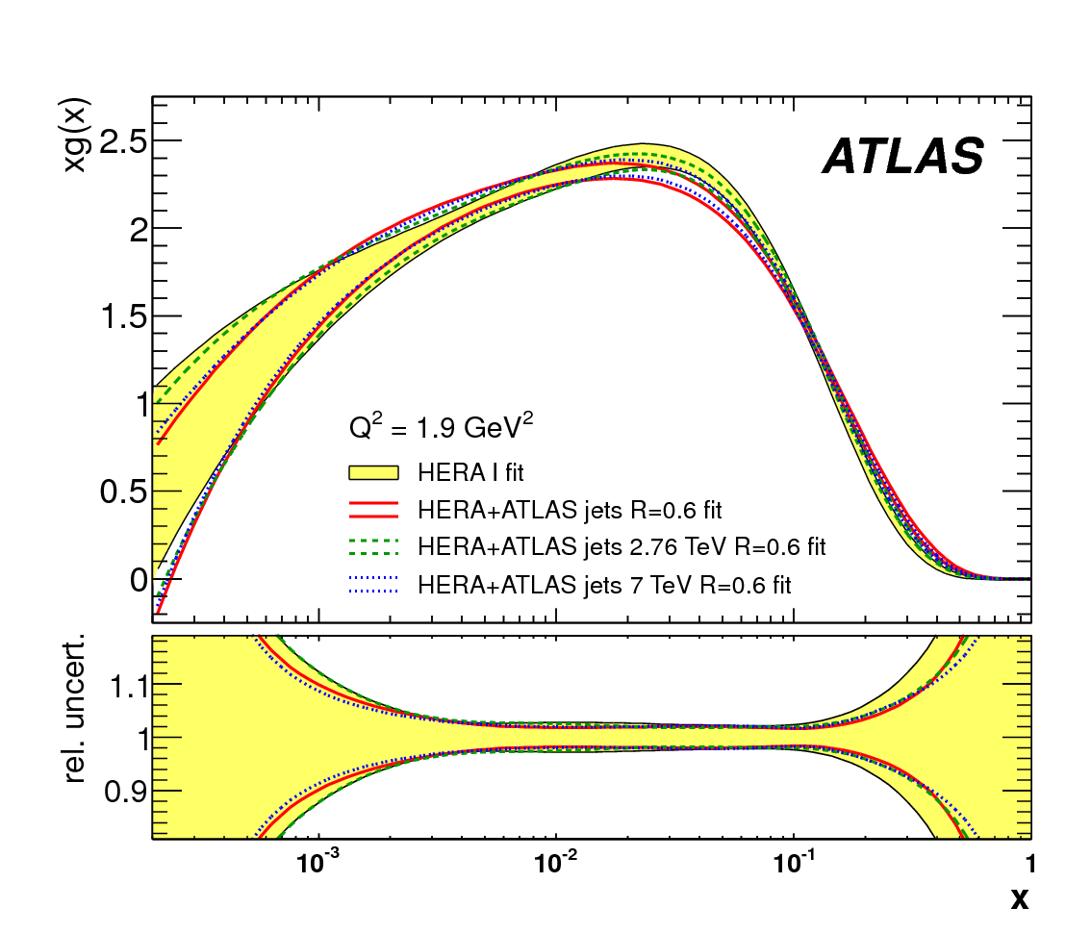
ATLAS and the gluon pdf
CG: slide is TODO - some intro to lead into next slides on jets and top etc.

Slide 53
a strange story
EPJ C77 (2017) 367
NNLO QCD analysis (HERAPDF ansatz)
HERA I+II plus ATLAS (4.6 pb⁻¹) W± |ηl|, Z |yll| (3 mll central, 2 mll forward)
NLO (MCFM interfaced to APPLGRID) plus k-factors, NNLO QCD (DYNNLO) + NLO EW (MCSANC)
→ ATLAS-epWZ16 pdf (available on lhapdf)
strange quark
consistent with previous ATLAS results
PRL 109 (2012) 012001 (W,Z inclusive, 36 pb⁻¹)
JHEP05 (2014) 068 (W+c analysis)

Slide 54
ATLAS inclusive jets at NNLO QCD
JHEP05 (2018) 195
NNLO QCD calcs. for inclusive and dijet now available (PRL 118 (2017) 072002, 119 (2017) 152001)
for scale choice of pt^{jet} description of incl. jet data improved with NNLO cf. NLO
APPLfast grid technology on the way to allow rigorous inclusion in pdf fits at NNLO (see talk at DIS18)

Slide 55
ATLAS inclusive jets at NNLO QCD
example bins
JHEP05 (2018) 195
APPLfast coll., status report, DIS18
NOT FINAL
APPLfast reproduction of NNLOJet incl. jet cross section
NNLO QCD calcs. for inclusive and dijets available (PRL 118 (2017) 072002, 119 (2017) 152001)
inclusive jets: description improved for scale choice of pt^{jet} (NNLO vs. NLO QCD)
APPLfast grid technology on the way to allow rigorous inclusion in pdf fits at NNLO

Slide 56
ATLAS top quark pair differential cross sections
mainly via gg channel – constraints on gluon
EG. ATLAS dilepton channel ttbar measurement (8TeV, 20.2 fb⁻¹); comparison to NLO QCD ↓
NLO QCD fit
EPJ C77 (2017) 804
gluon
also extracted:
Notes:
A bit ugly – relegate to backups?

Slide 57
JHEP09 (2014) 145
EPJ C76 (2016) 291
ATLAS ptZ
sensitive to pdfs, especially gluon
experimentally, very precise
ATLAS: ee, μμ channels; combined precision better than 0.5% precision for pt < 100 GeV
theoretically challenging – low pt region dominated by soft particle emission (resummation, shower models); high pt region dominated by emission of hard partons (pdfs)

Slide 58
PLB 770 (2017) 473
ATLAS prompt photon
isolated photons: mainly sensitive to gluon at medium and high x
(syst uncerts. 5 – 19% at highest Et^{γ}; lumi uncert: 2.1%)
clean experimental environment
JETPHOX (NLO QCD) underestimates data, but theory uncertainties large
only small variation for different pdfs
Notes:
syst uncerts. 5 – 19%, stat uncert dominates at highest Et, above 600 GeV; lumi uncert: 2.1%
potentially useful for future pdf determinations
(add refs to previous measurements?)

Slide 59
impact of LHC data on modern global pdf fits
MMHT
NNPDF3.1
some examples shown here
W,Z measurements constrain light quarks
jet, top quark pair and ZPt measurements constrain gluon at medium and high x
NNLO QCD calculations now available for all these measurements
effect of LHC jet+top+ZPt
arXiv:1706.00428
Notes:
Comment on future pdf discrimination and models with/without intrinsic charm etc

Slide 60
LHC measurements sensitive to pdfs
Measurement | pdf sensitivity
Inclusive W, Z and asymmetries | Quark flavor separation (u,d,s)
W with charm quarks | Direct sensitivity to s-quark
Off peak Drell-Yan at low and high mass | Quarks at low and high x (u,d), photon pdf
𝝲 or Z+c,b production | c, b quarks, intrinsic charm
Inclusive jet, dijets, trijets | High x quarks and gluon (alphas)
Isolated photons | Medium and high x gluon
ttbar production (total, differential) | Gluon (alphas)
Single top production | Gluon and b quark
W,Z, W/Z production with jets | Medium x gluon
Zpt | Gluon sensitivity

Slide 61
LHC measurements sensitive to pdfs
  wealth of SM measurements from ATLAS, sensitive to pdfs, provide:
  pdf discrimination, by confronting data with theory
  pdf improvements, by including LHC data in QCD fits
CG: update to a newer version of table
extraction of precision pdfs requires both precise data and theory calculations

Slide 62
impact on modern global pdfs
EPJ C77 (2017) 367
uv
strange pdf
dv
profiling exercise to study impact of ATLAS inclusive W,Z (4.6 pb⁻¹) differential cross sections on global pdf fits
reduced valence uncerts., enhanced strange
Notes:
table with chi2 in backups?

Slide 63
ultimate precision W,Z differential cross sections
ATLAS incl. W,Z differential cross sections: W± |ηl|, Z |yll| (3 mll central, 2 mll forward)
(LM and HM drell-yan also available: LM: JHEP06 (2014) 112; HM: JHEP08 (2016) 009, PLB 725 (2013) 223)
Z peak, central
W⁺
EPJ C77 (2017) 367
EPJ C77 (2017) 367
4.6 fb⁻¹; extraordinary total exp. precision (< 1% uncert.)
light quark pdf constraints; enhanced from provision of both W,Z with full syst. correlations
Notes:
Light quark pdf constraints, including strange

Slide 64
ATLAS inclusive jets in detail
JHEP05 (2018) 195
cf. NLO QCD – quantitative comparisons performed for CT14, MMHT14, NNPDF3.0, ABMP16, HERAPDF2.0
(tension when considering all rapidity bins together; also seen previously with 7,8 TeV measurements)

