Slide 1



PDFs, QCD and small x physics in energy frontier DIS with the LHeC and FCC-eh
Claire Gwenlan, Oxford
for the LHeC and FCC-eh study groups
special thanks to Max Klein and Gavin Pownall

Slide 2
LHeC and FCC-eh
HERA: world’s first and still only ep collider (√s ≃ 300 GeV)
LHeC: future ep (eA) collider, proposed to run concurrently with HL/HE-LHC; CDR arXiv:1206.2913
(complementary to LHC; extra discovery channels; Higgs; precision pdfs and 𝝰s)
FCC-eh: further future ep (eA) collider, integrated with FCC (further kinematic extension wrt LHeC)
LHeC: √s= 1.3 TeV ×100–1000 HERA lumi.
FCC-eh: √s= 3.5 TeV
LHeC (FCC-eh) complementary to, synchronous with, HL-LHC (FCC)
Notes:
EIC pdf programme for precision LHC being worked out in detail… important to establish what it can do…

Slide 3
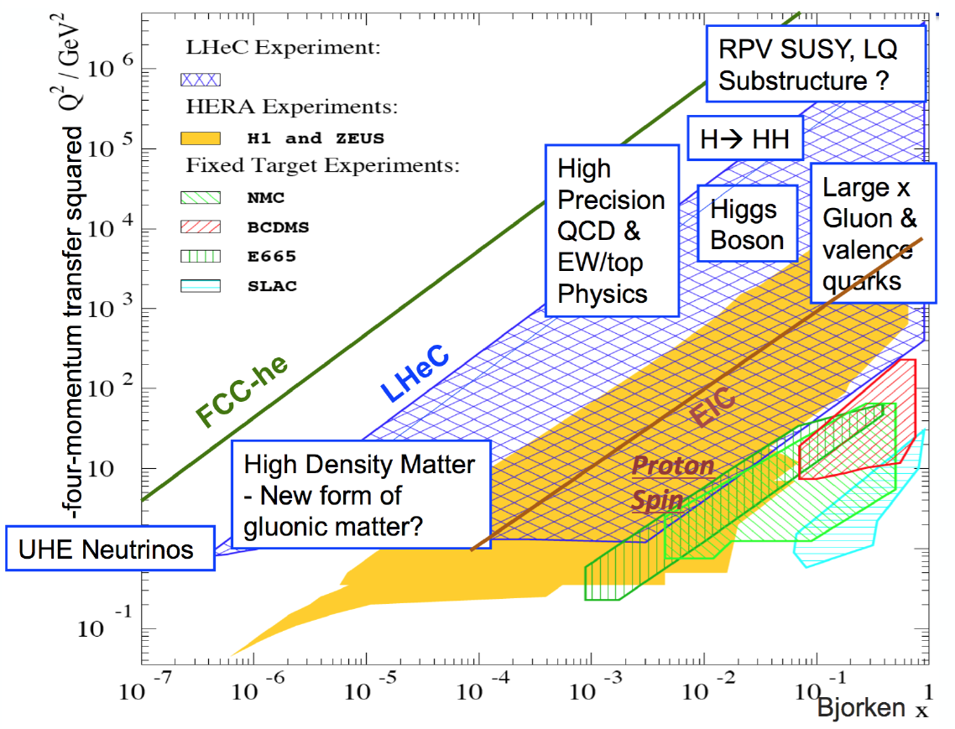
kinematic coverage
LHeC:
Q² to 10⁶ GeV², x: 10⁻⁶ ⟶ 1
FCC-eh:
Q² to 10⁷ GeV², x: 10⁻⁷ ⟶ 1
(⨉15/120 extension in Q²,1/x reach vs HERA)
outline of this talk:
proton pdfs, small x
electroweak
very rich physics programme; see also other talks in this workshop:
LHeC and FCC-eh machine (D Schulte); BSM (D Britzger); eA (Z Zhang); SM and BSM Higgs (C Zhang)
Notes:
Here concentrating on their prospects for pdfs and alpha_s for LHC

Slide 4
proton pdfs today
xg(x,Q), NNLO, Q²=100 GeV², αs(MZ)=0.118
pdf luminosities (LHC@14TeV)
qqbar
gluinos, KK gravitons, boosted top quarks, …
Higgs production in gluon fusion
W,Z,VH
c, b, low mass DY, soft QCD, MC tuning
gg
current data only above x=5.10⁻⁵, and below x=0.6–0.7
H,t
BSM
pdfs poorly known at large and small x
higher precision needed also for H, W, t
Notes:
small x: no current data constrain x ≤ 5⨉10⁻⁵
… and DGLAP will break down at small x (evidence for onset of BFKL dynamics recently demonstrated in HERA inclusive data, R. Ball et al. arXiv:1710.05935)
FCC: small x becomes relevant even for W, Z, H, t
large x: crucial for new physics searches in extended kinematic regime

Slide 5
pdfs today
ATLAS 2017
W± production
MW
Higgs
BSM
…
ATLAS today
large x quarks matter
with higher luminosity and energy machines on horizon, will need transformation in precision
large x gluons matter

Slide 6
HL-LHC ‘ultimate’ pdf projections
LHC measurements are providing useful pdf constraints (EG. see previous talk);
should certainly be exploited; and currently we have nothing else …
is there a NEED for future ep collider for pdfs? will we improve the precision of pdfs sufficiently using LHC data?
HL-LHC ultimate pdf projection studies ongoing:
preliminary
preliminary
impact of HL-LHC W,Z, top, Zpt
(L Harland-Lang, HL/HE-LHC WS, CERN, June18)

Slide 7
LHeC and FCC-eh pdf programme
,ν
,W
simulation: M Klein
QCD analysis: V Radescu, G Pownall
LHeC (FCC-eh) simulated NC and CC inclusive
+NEW: additional LHeC simulation with 1/10th integrated luminosity (no low energy data)
LHeC (FCC-eh) goals: completely resolve all proton pdfs, and αs to permille precision
no higher twist, no nuclear corrections, free of symmetry assumptions, N3LO theory (on the way)
ubar, uv, dbar, dv, s, c, b, t, xg and αs
NB, fit studies do not yet include simulated s, c, b, t or FL data

Slide 8
valence quarks from LHeC
LHeC
(1/10 lumi.)
u valence
d valence
precision determination, free from higher twist corrections and nuclear uncertainties
large x crucial for searches; relevant for DY, MW; resolve mystery of d/u at large x; …
Notes:
Mention that knowledge is very limited:
High x: lumi, challenging systematics which go as 1/1-x, nuclear correction uncertainties; free from higher twist since high x accessed at high Q2 (higher twist is low Q2)
Low x: valence quark smaller than sea
Valence at high x from NC and CC which tend to 4uv+dv and uv (dv) for e- (e+)
Valence at low x requires e+-p NC differences
- with deuteron running as well, symmetrise knowledge of u and d

Slide 9
gluon at large x
gluon at large x is small and currently very poorly known;
crucial for new physics searches
LHeC sensitivity at large x comes as part of overall package
high luminosity (×100–1000 HERA);
fully constrained quark pdfs; low x; momentum sum rule
LHeC
(1/10 lumi.)
gluon and sea intimately related
LHeC can disentangle sea from
valence quarks at large x, with precision measurements of CC and NC F2^{γZ}, xF3^{γZ}
Notes:
gluon and sea evolution intimately related
important to disentangle sea from valence at large x – can be done with precise LHeC measurements of CC cross sections and NC F2^{γZ}, xF3^{γZ}
with different beam charge and polarisation, can access all quark types

Slide 10
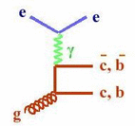
c, b quarks
LHeC: enormously extended range and much improved precision c.f. HERA
δMc = 60 (HERA) to 3 MeV: impacts on αs, regulates ratio of charm to light, crucial for precision t, H
MSSM: Higgs produced dominantly via bb → A
Notes:
Reasons for improvement over HERA: large luminosity, large cross section, modern Si, excellent charm tagging, …

Slide 11
strange
strange pdf poorly known; suppressed cf. other light quarks? strange valence?
LHeC: direct sensitivity to strange via W+s → c
(x,Q²) mapping of (anti) strange quark for first time
ATLAS† see large strange fraction at mean x~0.01
also top pdf via CC DIS becomes possible!
†ATLAS arXiv:1203.4051, confirmed with high stats in 1612.03016; and by global fitters EG. NNPDF 1706.00428, MMHT 1708.00047

Slide 12
gluon at small x
no current data much below x=5⨉10⁻⁵
LHeC provides single, precise and unambiguous dataset down to x=10⁻⁶
FCC-eh probes to even smaller x=10⁻⁷
explore low x QCD:
DGLAP vs BFKL; non-linear evolution;
gluon saturation; implications
for ultra high energy neutrino cross sections
FCC-eh
LHeC (1/10 lumi.)
FCC-eh
LHeC
HERA
Notes:
FL would provide further constraints and discrimination
between theoretical frameworks at low x (not yet included in simulation)

Slide 13
gluon at small x
effect of small x resummation
R. Ball et al, arXiv:1710.05935
xg(x)
NNLO only
effect of small x resummation
gg lumi
recent evidence for onset of BFKL dynamics in HERA inclusive data
impact for LHC and most certainly at ultra low x values probed at FCC
(see also xFitter study, arXiv:1802.00064)

Slide 14
gluon at small x
effect of small x resummation on ggH cross section for LHC, HE-LHC, FCC
impact on other EW observables could be of similar size
M. Bonvini and S. Marzani, arXiv:1802.07758

Slide 15
gluon at small x
arXiv:1710.05935
FL
F2 and FL predictions for simulated kinematics of LHeC and FCC-eh
ep simulated data very precise – significant constraining power to discriminate between theoretical scenarios of small x dynamics
measurement of FL has a critical role to play

Slide 16
summary of LHeC pdfs
PDF4LHC15
LHeC pdf
(1/10 lumi.)
100 TeV
100 TeV
gg
qqbar

Slide 17
example impact for LHC
precision Higgs from LHC
BSM searches
~3 MeV uncert. on MW from LHC
Notes:
Mixture of old and new LHeC pdfs

Slide 18
diffractive pdfs
HERA: diffractive processes constitute ≈10% of visible DIS cross section
Q²min ≈ 5 GeV²
simulation: extrapol. from ZEUS-SJ; 5% Gaussian noise (syst.) assumed
precision increased by about ×10 (20) at LHeC (FCC-eh)
diffractive dijets could provide further gluon info.
top quark PS also accessible
see also talk by A. Stasto, LHeC and PERLE workshop, LAL-Orsay, June 2018
Notes:
dpdfs: describing parton content of proton in diffractive final states
‘infinite’ lumi c.f. 2 fb⁻¹ gives little further gain

Slide 19
electroweak physics
preliminary
preliminary
inner error bars: exp. only
outer: exp.+pdf
simultaneous pdf and electroweak fits
extraordinarily precise determinations of EW params, EG: NC vector and axial-vector light quark couplings, MZ, MW and sin²θW
see also talk by D. Britzger, LHeC and PERLE workshop, LAL-Orsay, June 2018
Notes:
- couplings sensitive to new physics (Z’, leptoquarks, RPV SUSY)

Slide 20
summary
much of LHC and FCC programme is or will become pdf or αs limited
wealth of LHC pdf-constraining measurements available; widely exploited in modern pdf fits EG. see previous talk
nevertheless, pp constrains, it does not precisely determine pdfs
electron-hadron colliders essential for future of high energy physics
LHC-eh and FCC-eh go beyond HERA in energy, luminosity (and eA)
unprecedented kinematic reach; accesses scales sensitive to BSM and Higgs physics; precision EW;
precise determination of all pdfs, and αs to permille precision
Notes:
Reword this to something else!!! LHC future measurements likely to give incremental rather than dramatic improvements;
also may have to worry about LHC feedback (BSM?) for SM pdfs
more concrete studies being performed in context of HL/HE-LHC workshop

Slide 21
extras

Slide 22
LHeC and FCC-eh
LHeC
LHeC and FCC-eh
energy recovery LINAC
e-beam: 60 GeV
Lint ⇾ 1 ab⁻¹
FCC
ep IP
(M Klein, Rencontre du Vietnam, Sept 2017)
LHeC (FCC-eh) complementary to, synchronous with, HL-LHC (FCC)

Slide 23
d/u at large x
d/u essentially unknown at large x
no predictive power from current pdfs; conflicting theory pictures;
data inconclusive, large nuclear uncerts.
with precision ep(n) data to v. large x
no nuclear corrections; relax assumptions
resolve long-standing mystery of d/u ratio at large x
LHeC

Slide 24
strong coupling 𝝰s from LHeC (FCC-eh)
𝝰s is least known coupling constant precise 𝝰s needed to constrain GUT scenarios; for cross section predictions, including H; …
measurements not all consistent
what is true central value and uncertainty?
𝝰s(DIS) smaller than world average?
LHeC: permille precision from QCD fit of inclusive NC and CC DIS (𝝰s(DIS-jets)?)
can challenge lattice QCD
PDG
LHeC
Higgs XS
(LHeC: NC+CC incl.; total exp. uncerts; independent of BCDMS)
(G. Zanderighi, Moriond16;
from C. Anastasiou et al, arXiv:1602.00695)

Slide 25
arXiv:1512.05194
lattice QCD
ep: per mille level (LHeC/FCC-eh combined with HERA)
ee: order per mille with an FCC-ee

Slide 26
diffractive pdfs
A. Stasto, LHeC and PERLE workshop, LAL-Orsay, June 2018

Slide 27
dpdfs: top contribution
top quark phase space region does not have a big effect on the dpdf extraction
A. Stasto, LHeC and PERLE workshop, LAL-Orsay, June 2018

Slide 28
FL at the LHeC
M. Klein, arXiv:1802.04317
Notes:
e+Au, but expect similar precision in e+p
(and additional kin. coverage, √s =141 GeV)

Slide 29
importance of pdfs
current uncerts. in proton parton distribution functions (pdfs): limit searches for new heavy particles; dominate (together with αs) theory uncerts on Higgs production cross sections; limit precision of fundamental parameters EG. MW, and of backgrounds to BSM searches
with higher luminosity and higher energy pp machines on horizon, will need higher precision pdfs
LHC measurements are providing useful pdf constraints;
should certainly be exploited; and currently we have nothing else …
is there a NEED for future ep collider for pdfs? will we not improve the precision of pdfs sufficiently using LHC data?

Slide 30
diffractive pdfs
HERA: diffractive processes constitute ≈10% of visible DIS cross section
Q²min ≈ 5 GeV²
c.f. baseline ZEUS-SJ fit
precision increased by about ×10 (20) at LHeC (FCC-eh)
simulations
as done at HERA, LHeC/FCC-eh jets could be used for even further gluon constraint (only inclusive used here)
see also talk by A. Stasto, LHeC and PERLE workshop, LAL-Orsay, June 2018
Notes:
dpdfs: describing parton content of proton in diffractive final states

Slide 31
diffractive pdfs
HERA: diffractive processes constitute ≈10% of visible DIS cross section
Q²min ≈ 5 GeV²
simulated data: extrapolated from ZEUS-SJ fit; 5% Gaussian noise
precision increased by about ×10 (20) at LHeC (FCC-eh)
(‘infinite’ lumi c.f. 2 fb⁻¹ gives little further gain)
LHeC/FCC-eh jets could provide further gluon constraint (only incl. used here)
top phase space also accessible
see also talk by A. Stasto, LHeC and PERLE workshop, LAL-Orsay, June 2018
Notes:
dpdfs: describing parton content of proton in diffractive final states

Slide 32
HL-LHC ‘ultimate’ pdf projections

Slide 33
electroweak physics
preliminary
preliminary
preliminary
simultaneous pdf and electroweak fits
extraordinarily precise determinations of EW params, including: NC vector and axial-vector light quark couplings, MZ, MW and sin²θW
inner errors: exp only
outer: exp+pdf
see also talk by D. Britzger, LHeC and PERLE workshop, LAL-Orsay, June 2018

Slide 34
LHeC and FCC-eh pdf programme
LHeC (FCC-eh) simulated NC and CC inclusive DIS data
NC/CC | Ee [GeV] | Ep [TeV] | P(e) | charge | lumi. [fb-1]
NC CC | 60 (60) 60 (60) | 7 (50) 7 (50) | –0.8 –0.8 | –1 –1 | 1000 1000
NC CC | 60 (60) 60 (60) | 7 (50) 7 (50) | +0.8 +0.8 | –1 –1 | 300 300
NC CC | 60 (60) 60 (60) | 7 (50) 7 (50) | 0 0 | +1 +1 | 100 100
NC CC | 60 (20) 60 (20) | 1 (7) 1 (7) | 0 0 | –1 –1 | 100 100
LHeC/FCC-eh goals: completely resolve all proton pdfs, and αs to permille precision
no higher twist, no nuclear corrections, free of symmetry assumptions, N3LO theory (on the way)
ubar, uv, dbar, dv, s, c, b, t, xg and αs
NEW: additional LHeC simulation with 1/10th integrated luminosity (and no low energy data)
NB, fit studies do not yet include simulated s, c, b, t or FL data
(simulation: M Klein; QCD analysis: V Radescu, G Pownall)

Slide 35
LHeC and FCC-eh pdf programme
LHeC and FCC-eh simulated NC and CC inclusive DIS data
NEW: additional LHeC simulation with 1/10th integrated luminosity (and no low energy data)
LHeC/FCC-eh goals: completely resolve all proton pdfs, and αs to permille precision
no higher twist, no nuclear corrections, free of symmetry assumptions, N3LO theory (on the way)
ubar, uv, dbar, dv, s, c, b, t, xg and αs
NB, fit studies do not yet include simulated s, c, b, t or FL data
(simulation: M Klein; QCD analysis: V Radescu, G Pownall)

Slide 36
LHeC WS version
valence quarks from LHeC
LHeC
LHeC (1/10 lumi.)
u valence
d valence
precision determination, free from higher twist corrections and nuclear uncertainties
large x crucial for searches; relevant for DY, MW; resolve mystery of d/u at large x; …
Notes:
Mention that knowledge is very limited:
High x: lumi, challenging systematics which go as 1/1-x, nuclear correction uncertainties; free from higher twist since high x accessed at high Q2 (higher twist is low Q2)
Low x: valence quark smaller than sea
Valence at high x from NC and CC which tend to 4uv+dv and uv (dv) for e- (e+)
Valence at low x requires e+-p NC differences
- with deuteron running as well, symmetrise knowledge of u and d

Slide 37
LHeC WS version
gluon at large x
gluon at large x is small and currently very poorly known;
crucial for new physics searches
LHeC sensitivity at large x comes as part of overall package
high luminosity (×100–1000 HERA);
fully constrained quark pdfs; low x; momentum sum rule
LHeC
gluon and sea intimately related
LHeC can disentangle sea from
valence quarks at large x, with precision measurements of CC and NC F2^{γZ}, xF3^{γZ}
Notes:
gluon and sea evolution intimately related
important to disentangle sea from valence at large x – can be done with precise LHeC measurements of CC cross sections and NC F2^{γZ}, xF3^{γZ}
with different beam charge and polarisation, can access all quark types

Slide 38
gluon at large x
with Dg
Notes:
gluon and sea evolution intimately related
important to disentangle sea from valence at large x – can be done with precise LHeC measurements of CC cross sections and NC F2^{γZ}, xF3^{γZ}
with different beam charge and polarisation, can access all quark types

Slide 39
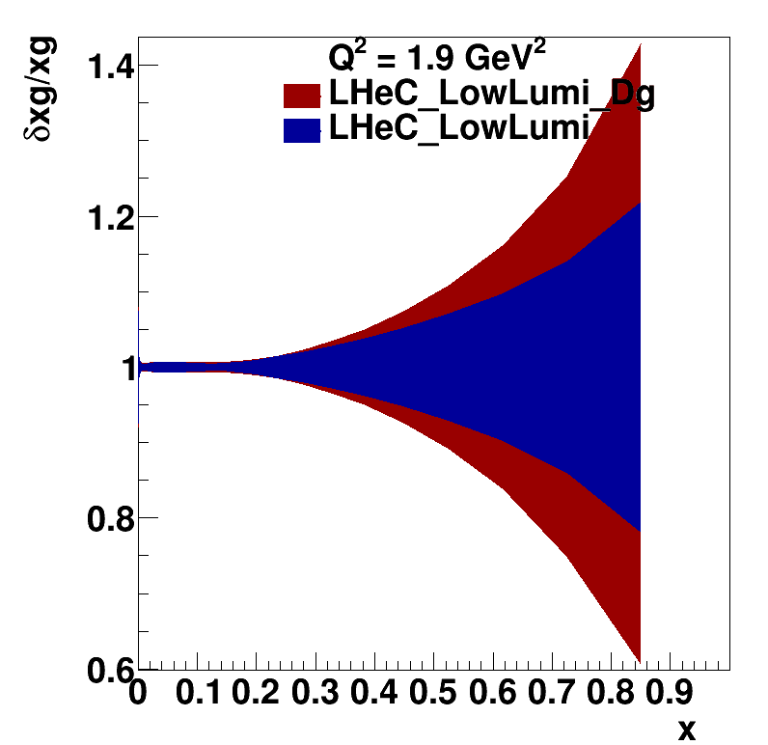
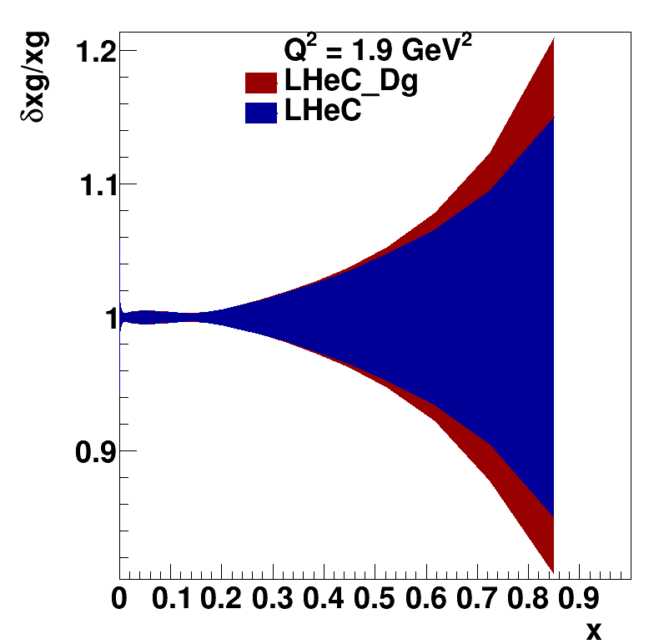
gluon at large x
with Dg
Notes:
gluon and sea evolution intimately related
important to disentangle sea from valence at large x – can be done with precise LHeC measurements of CC cross sections and NC F2^{γZ}, xF3^{γZ}
with different beam charge and polarisation, can access all quark types

Slide 40
gluon at small x
with Dg
Notes:
gluon and sea evolution intimately related
important to disentangle sea from valence at large x – can be done with precise LHeC measurements of CC cross sections and NC F2^{γZ}, xF3^{γZ}
with different beam charge and polarisation, can access all quark types

Slide 41
gluon at small x
with Dg
Notes:
gluon and sea evolution intimately related
important to disentangle sea from valence at large x – can be done with precise LHeC measurements of CC cross sections and NC F2^{γZ}, xF3^{γZ}
with different beam charge and polarisation, can access all quark types

Slide 42
example impact for LHC
other examples? Maybe put in SUSY one, and also Higgs plot if nothing else…
with LHeC pdf set (older version):
~3 MeV uncert. on MW from LHC

