Slide 1
FCC week 15
Washington
some reminder notes

Slide 2
Opening – congressman Bill Foster
sees Geneva-based design having ring diameter set by geological conditions, whereas if somewhere else (China? US?) diameter could suit physics needs
very much pro international stuff (not single country) e.g. feels that international political momentum (in CERN) saw LHC through budget overruns c.f. SSC that was much more easily cancelled
mentioned China a lot… (feels like they are doing things for prestige purposes, rather than working in international collaborations? However, also impressed that if they make up their mind to do something, they do it…)
mentioned something about Obamacare giving more room for manouevre in budget
also something about wanting PP experiments to be more expensive: if built in Rust belt states where there is a current net outflow of federal tax, that is good for voters as they would see more federal spending? (half joking?)
I think by the end he was not necessarily saying he thought it should be in US, despite the above!

Slide 3
A Della Corte/B Strauss – openings
focus on superconductors (want to use FCC to increase number of superconductor suppliers!)

Slide 4
FCC study overview + status – M Benedikt
Goal to provide CDR by end of 2018 in time for next European strategy update
US P5 recommendation also supporting high energy pp (do not seem especially interested in ee, ep)

Slide 5
FCC study overview + status – M Benedikt
Main goal is FCC-hh 100TeV; FCC-ee as ‘intermediate’ (first) step; possible FCC-eh option (but US not interested in these really)
key technologies are 16T magnets, SRF technologies and RF power sources
Study will also include site specific study of a CERN-based acc complex
Physics motivation – elaborate and document
Exp concepts for all of hh,ee,eh + MDI
Cost model – cost scenarios for different options

Slide 6
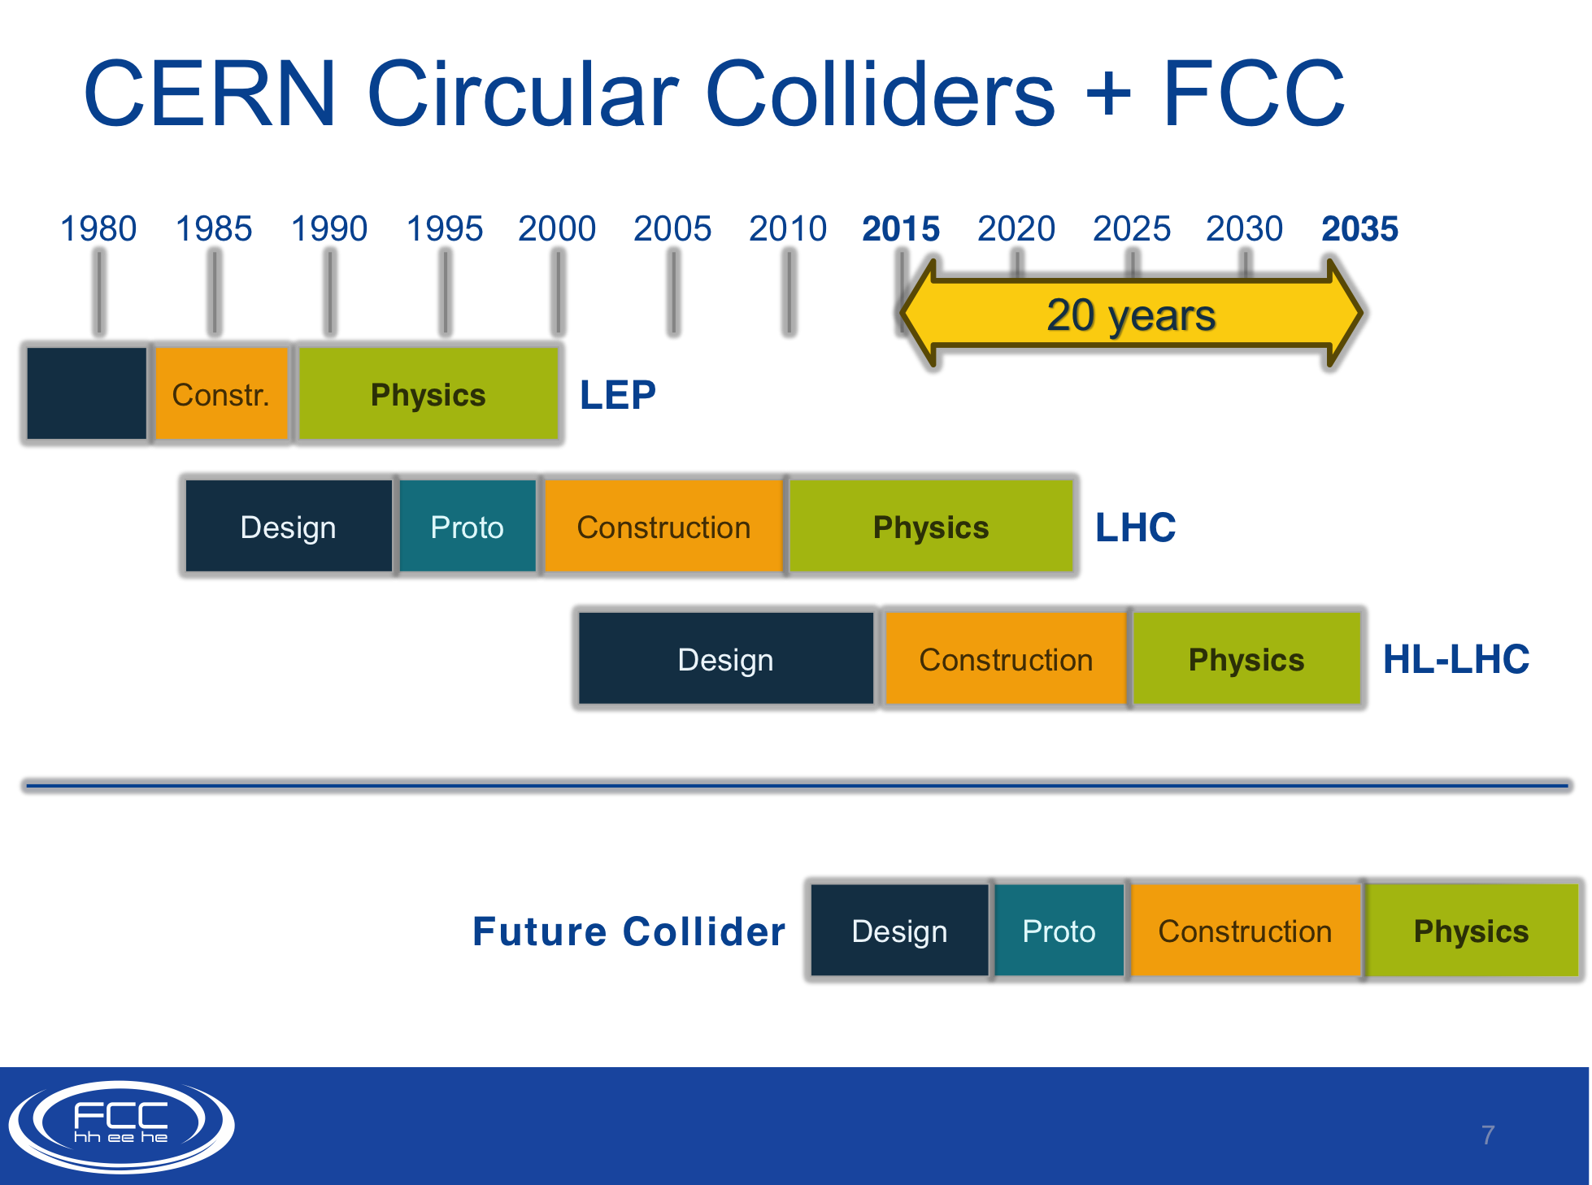
FCC study overview + status – M Benedikt
Timescale:
Physics straight after HL-LHC

Slide 7
FCC study overview + status – M Benedikt
CDR timescale

Slide 8
FCC study overview + status – M Benedikt
5ns option to reduce pileup

Slide 9
FCC study overview + status – M Benedikt

Slide 10
FCC study overview + status – M Benedikt
Phase 2 operation challenging – beam retention time small – need quick machine turnaround (LHC = 5-6 hours)

Slide 11
FCC study overview + status – M Benedikt
Apparently 90-100km fits geological situation well (better than smaller one)
LHC suitable as potential injector

Slide 12
FCC study overview + status – M Benedikt
FCC-ee: (at least?) 4 different beam energies
pointed out in other talks that this is really 4 different machines (beam current, RF voltages very different in different cases)
also was later suggested synchrotron radiation beams in vicinity of IP probably too high in current design – shielding could be problematic

Slide 13
FCC study overview + status – M Benedikt
EuroCirCol – EC financing for core aspects of hadron collider design and feasibility of key technologies – 16T magnets, cryogenic beam vacuum system, …
FCC Coll as it stands – 51 institutes from 19 countries (Oxford/JAI included) + Cockcroft, Liverpool, Kings College, from UK

Slide 14
Physics Motivation – J Thaler
Not tied into politics or geology or site considerations – just the science – his personal view

Slide 15
Physics Motivation – J Thaler
Higgs alone worth the investment
Need all 3 hh,ee,eh to make the most of it

Slide 16
Physics Motivation – J Thaler
Dark Matter – Wimp paradigm
Make it, break it, shake it….
Take the universe, heat it up with a chargino just above a 3TeV neutralino, cool it down, get the amount of DM we want. 3TeV beyond LHC, but accessible at FCC

Slide 17
Physics Motivation – J Thaler
Plus Hierarchy problem
Frontier exploration alone worth the investment (said in a number of ways a number of times by other speakers)

Slide 18
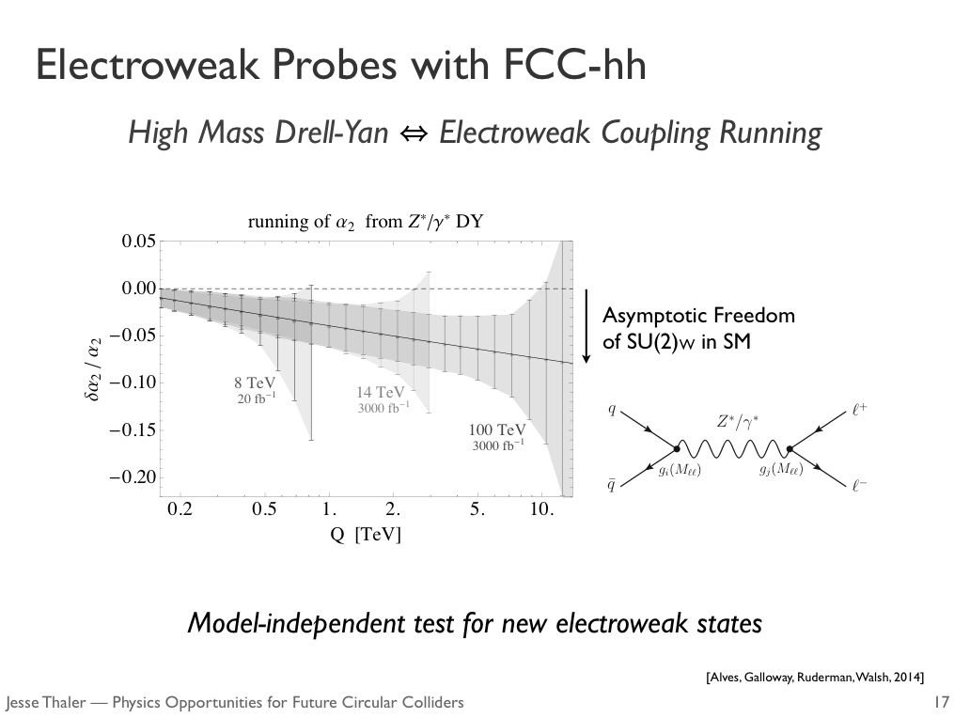
Physics Motivation – J Thaler
Revelations within SM
With FCC-hh – can we test running (asymptotic freedom) of alpha electroweak?

Slide 19
Physics Motivation – J Thaler
FCC-ee

Slide 20
Physics Motivation – J Thaler
Many measurements possible that are not trivial elsewhere

Slide 21
Physics Motivation – J Thaler

Slide 22
Overview of experiment studies hh,ee,eh – P Janot

Slide 23
Overview of experiment studies hh,ee,eh – P Janot

Slide 24
Overview of experiment studies hh,ee,eh – P Janot
Lots of info about organisation of:
FCC-hh
FCC-eh
FCC-ee
Programme organisation
Lots of useful slides about Physics case, what studies will be performed, where to subscribe etc

Slide 25
Overview of experiment studies hh,ee,eh – P Janot
FCC-ee better Lumi by far, though lower energy
Precision Z,W,H,t; rare decays; BSM
… also Higgs coupling to 1st generation; rare Z,W,H,t decays; sensitivity to sterile neutrinos

Slide 26
Overview of experiment studies hh,ee,eh – P Janot

Slide 27
Overview of experiment studies hh,ee,eh – P Janot
Resolving complete set of PDFs
Needed for precision at FCC-hh
Tentative design of FCC-eh already exists
Next two talks go into FCC-hh and FCC-ee

Slide 28
FCC-hh machine overview – D Schultz
Main cost and parameter driver are the dipole magnets
Concentrating on Nb3Sn at 16T
(also looking at HTS at 20T)
Not only field strength that is challenging – also length, weight, cost; aperture; field quality; separation

Slide 29
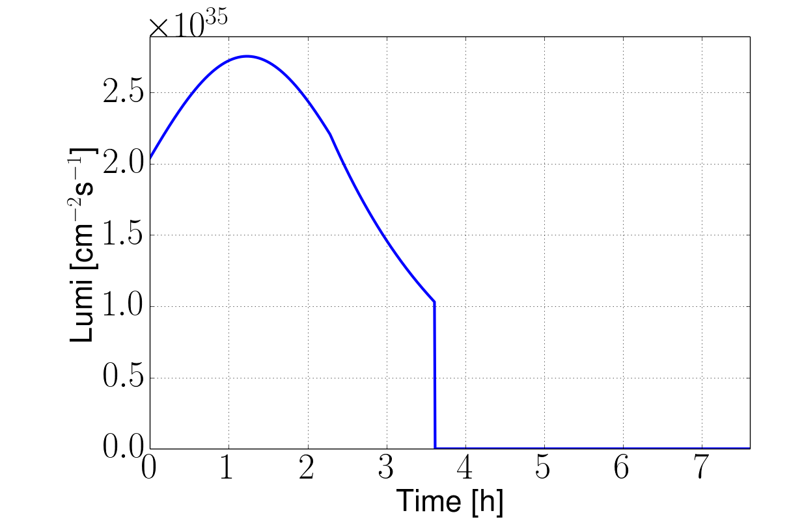
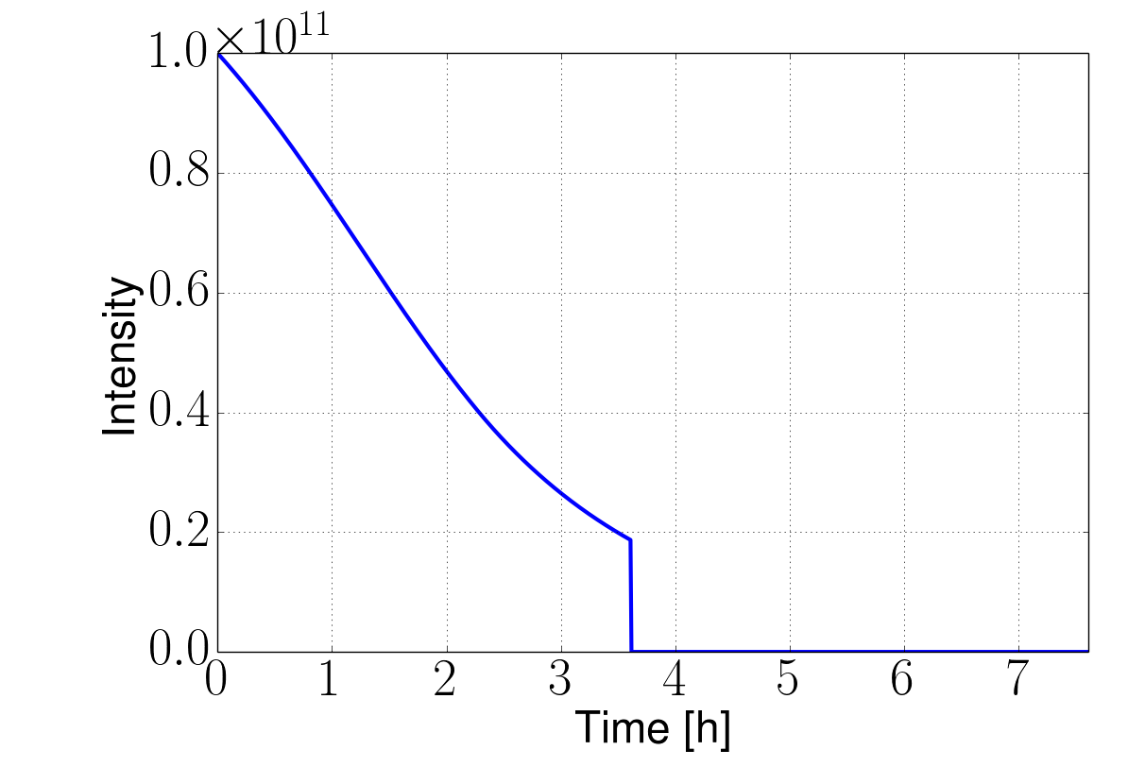
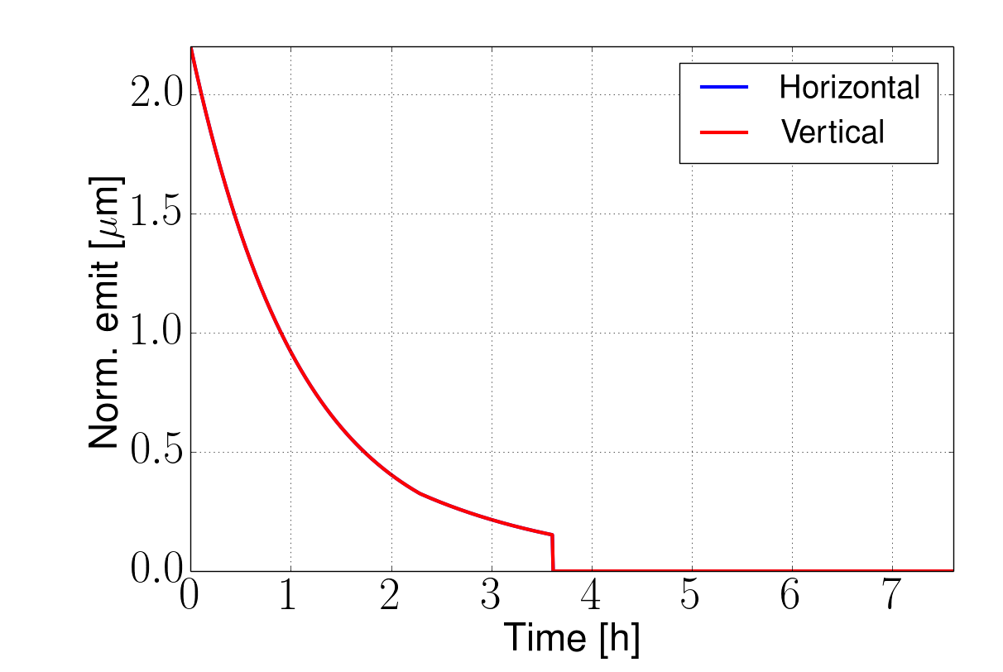
Integrated Luminosity
Developing model including all relevant effects
Iterations required
Can reach >2fb⁻¹ with baseline
  1250fb⁻¹ per 5 year run
Can reach >8fb⁻¹ with ultimate for ξ=0.03
    5000fb⁻¹ per 5 year run
Beyond ultimate need shorter turn-around
Ultimate example, 25ns, no luminosity levelling
8fb⁻¹/day
Turn-around time
Talk by X. Buffat

Slide 30
FCC-ee machine overview – F Zimmermann
Goal is highest possible university, 45-175GeV beam
Optimise for Higgs

Slide 31
FCC-ee machine overview – F Zimmermann
Preliminary layout ready
Parameters (optimal parameters for different objectives are different)

Slide 32
FCC-ee machine overview – F Zimmermann
2 ring issue?

Slide 33
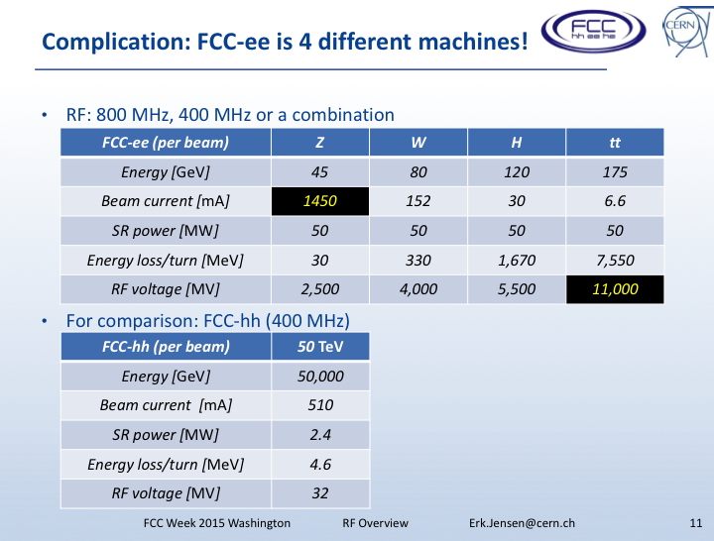
Magnet and RF talks – L Bottura, E Jensen
Magnets: Challenge is FCC-hh – other accelerators in complex within reach of current technology
RF: FCC-ee is 4 different machines – very different requirements on current/RF voltage for the different proposed energies

Slide 34
Infrastructure– P Lebrun
Physics, detector, accelerator are site independent
But being studied also is infrastructure for 80-100 km in neighbourhood of CERN
CERN-based has strong asset in form of existing infrastructure
Nice details of topological constraints

Slide 35
Scope
The physics, detector and accelerator physics & technology parts of the FCC conceptual design are essentially site-independent
They are to be complemented by a study of the implantation and infrastructure for the 80 km to 100 km perimeter ring in the neighbourhood of CERN
This would permit optimal re-use of the existing infrastructure, a strong asset of a CERN-based FCC
The study should also address integration, installation, computing and control, as well as operational aspects including reliability/availability, power/energy consumption and safety
Together with the detector and accelerator parts of the FCC conceptual design, the infrastructure study is an essential input to the cost, schedule and risk assessments, as well as to the future environmental impact assessment

Slide 36
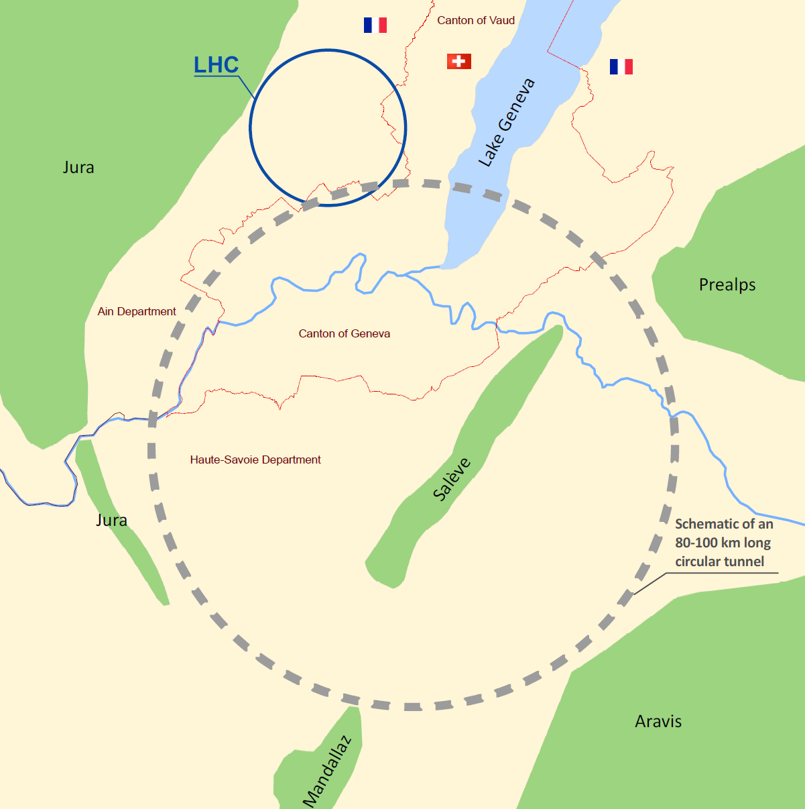
Basic input to FCC Infrastructure & Operation
Quasi-circular tunnel of 80 to 100 km perimeter
Hadron collider
16 T ⇒ 100 TeV for 100 km
20 T ⇒ 100 TeV for 80 km
e+ e- collider
Collision energy 90 to 350 GeV
Very high luminosity

Slide 37
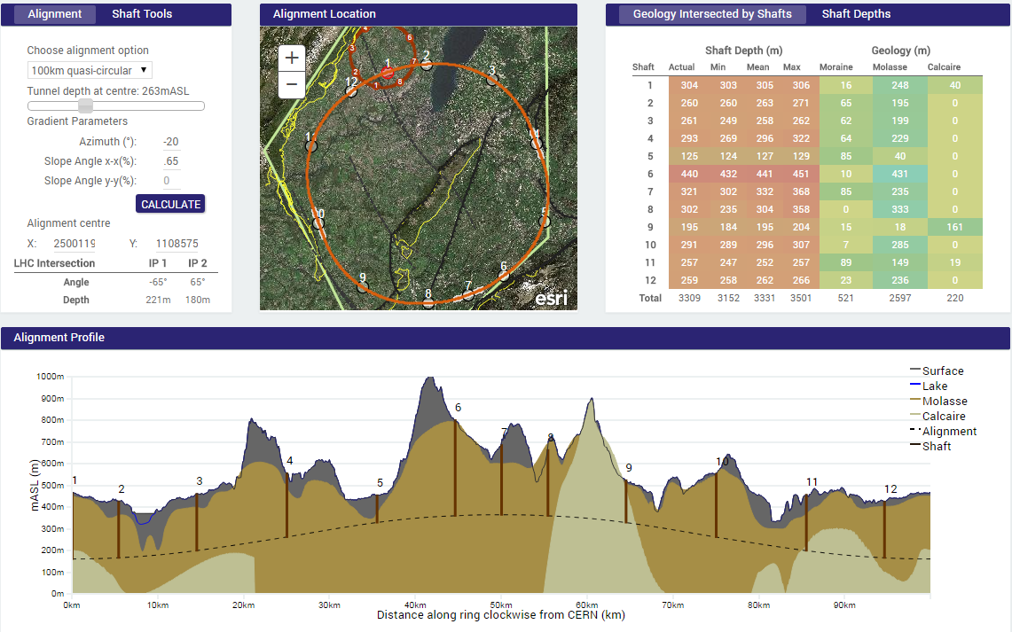
FCC 100 km perimeter
Possible siting

Slide 38
European Strategy and CERN roadmap – F Bordry

Slide 39
US activities related to future colliders – J Siegrist

Slide 40
US activities related to future colliders – J Siegrist
Do not have obvious support for FCC-ee – favour ILC due to technical readiness
Want parameters to be agreed upon before supporting(?)

Slide 41
US activities related to future colliders – J Siegrist
Community must provide compelling arguments for E, lumi to inform tunnel length and other machine parameters

Slide 42
US activities related to future colliders – J Siegrist
US guy said “if what you really want is a proton machine, just go build a proton machine” – that the US funding bodies won't buy an intermediate circular ee machine if what you really want is pp. Camel's nose under the tin.
His slide 12 or 13 also shows again that (1) critical currents have been doubled, and (ii) the surface coatings of the niobium cavities are doing something really good with their properties.
Fabiola and others comment that there was no real support at Snowmass for a CIRCULAR e+e- collider since the main P5 US support was for ILC. Generally there seems to be little support for cicrular e+e- anywhere, except that (given the tunnel) it might be cheap.

Slide 43
Tuesday sessions

Slide 44
FCC-ee 8.30 session
First look at detector requirements – M Dam
FCC-ee may have 4 detectors – could specialise into (at least) two sorts:
1. precision physics detector
2. new physics detector (with large tracking volume for displaced vertices)
access to rarer decays of Higgs
  Bb,cc, mumu(?), 4nu
Many, many stats – 10¹⁰tautau, 10¹¹bb, QCD, QED
Factors of 10 improvements in precision of EW quantities (MZ, Z width, MW,…)
Searches for weakly coupled particles
Top quark coupling

Slide 45
First look at detector requirements – M Dam

Slide 46
First look at detector requirements – M Dam
Crab waist:

Slide 47
First look at detector requirements – M Dam
Detector design – steal from ILC and SID (CLIC) – possibly with relaxed requirements on momentum resolution(?) and calorimeter depth and resolution (?)

Slide 48
CEPC talk – H Zhu
Chinese (alternative) project
Seems to show a scenario where it is better than the ILC (can presumably be applied to FCC-ee) i.e. lumi matters
Last talk in session was about wireless DAQ readout!

Slide 49
FCC-hh 8.30 session
SPPC – J Tang

Slide 50
SPPC – J Tang

Slide 51
SPPC – J Tang

Slide 52
SPPC – J Tang

Slide 53
FCC-ee 10.30 physics session
Precision Electroweak – D Wackeroth

Slide 54
Precision Electroweak – D Wackeroth

Slide 55
Precision Electroweak – D Wackeroth
Can get very precise MW
She said “But we had a REALLY hard time coming up with really appealing explanations for what we can DO with all these wonderful measurements.” !

Slide 56
Precision Electroweak – D Wackeroth
Can search for indirect signals of BSM (lead to modifications of gauge boson self energies…)
Constraints on SUSY particles e.g. if light stop found, MW constrains others (also see Chris’ recent talk in Oxford ATLAS meeting)
Discover higher dimensional operators
aQGCs and heavy resonances (that leave traces in form of deviations from SM couplings)

Slide 57
CP violation in Higgs – F Yu
Search for new sources of CP violation (in Higgs decays to tautau)

Slide 58
FCC-ee 13.30 physics session top physics at FCC-ee – P Azzi
Shows some FCC-ee/ILC comparisons .g. slides 4,10
Strength of FCC-ee is to span several CM energies (but, pointed out elsewhere, this makes it 4 different machines)

Slide 59
top physics at FCC-ee – P Azzi

Slide 60
top physics at FCC-ee – P Azzi

Slide 61
top physics at FCC-ee – P Azzi
Comparison with ILC – cross section higher at FCC (threshold scan gives handle on mass, width, alphas, Yukawa coupling)
10% better uncertainty on top mass at FCC-ee c.f. ILC

Slide 62
top physics at FCC-ee – P Azzi
EWK couplings of top, comparable to HL-LHC and (full upgrade) ILC

Slide 63
top physics at FCC-ee – P Azzi
very large sqrt(s) doesn’t seem necessary, polarisation doesn’t seem necessary (e.g. see slide 17)

Slide 64
top physics at FCC-ee – P Azzi
So differences between FCC-ee and ILC are:
Luminosity (much higher at FCC-ee)
Beam-strahlung (less at FCC-ee)
Polarisation of beam (harder at FCC-ee, at least at the higher energies; argued that not necessary – at least for top)
Different max/min beam energies

Slide 65
DM and BSM searches – M Pierini
No statement yet on DM sensitivity on monophoton search yet (strongly model dependent) – need to establish set of simplified models to work with

Slide 66
Flavour physics – S Moteil
What would we like to do with 1012-1013 Z’s? (LFV, rare decays etc)

Slide 67
Sterile Neutrinos – A Blondel
Search for clean, displaced vertices

Slide 68
Sterile Neutrinos – A Blondel

Slide 69
Sterile Neutrinos – A Blondel

Slide 70
FCC-he 16.00 session
Introduction to FCC-he – M Klein
NOTE: not in competition with high priority machines (HL-LHC, HE-LHC, CLIC, FCC) – complementary (in time, resources)

Slide 71
Introduction to FCC-he – M Klein

Slide 72
Introduction to FCC-he – M Klein

Slide 73
eh accelerator prospects – F. Zimmermann
Could have:
e- from LHeC (or other) ERL
e+- from FCC-e (if co-existing with FCC-hh) (seems not current plan)
Ring-ring option could have higher luminosity, higher energy, positrons and some polarisation (but large disruption D>30, and hourglass (Hhg<0.5) ?? would require careful study)

Slide 74
eh accelerator prospects – F. Zimmermann
Comparison of LHeC with FCC-ee (phase I)

Slide 75
eh accelerator prospects – F. Zimmermann
Comparison of LHeC with FCC-ee (phase II)

Slide 76
Circular ERL – A. Valloni

Slide 77
Circular ERL – A. Valloni
Explained that FCC-he could:
collide p from FCC-hh with e from FCC-ee if both live in same tunnel at same time, or
* collide p from LHC with e from an ERL (energy recovery linac) such as the LHeC energy proton = 7 TeV
energy electron = 60 GeV (if LHeC)
sqrts = 1.3 TeV
collide p from FCC-hh with e from ERL (energy recovery linac)
  energy proton = 50 TeV
energy electron = 60 GeV
sqrts = 3.5 TeV
These assume that the ERL is the LHeC which uses two superconducting energy recovery linacs in a racetrack configuration ... each linac able to add 10 GeV

Slide 78
Circular ERL – A. Valloni

Slide 79
Circular ERL – A. Valloni

Slide 80
Circular ERL – A. Valloni
‘ERL Facility’ – a smaller testing version for LHeC/FCC-eh (CDR – June 15)

Slide 81
Circular ERL – A. Valloni
‘ERL Facility’ – a smaller testing version for LHeC/FCC-eh (CDR – June 15)

Slide 82
Circular ERL – A. Valloni
‘ERL Facility’ – a smaller testing version for LHeC/FCC-eh (CDR – June 15)

Slide 83
Beam-Beam effects in ep – E. Nissen
Lepton Energy Recovery Linac – V Litvinenko
Better for higher energy (no synchrotron losss)
But also high cost

Slide 84
Wednesday
FCC-ee 15.30 session
Prospects for FCC-ee polarisation – E Gianfelice Wendt
Look at slides later…
Other talks on injectors etc

Slide 85
FCC-eh 15.30 session
A new detector for ep/eA – P Kostka
Detector layout established (based on LHeC)
FCC-he detector feasible with technology available today (though would benefit from technology in progress)
IR magnet design – B Parker

Slide 86
FCC-eh 15.30 session – Physics talks
Higgs in ep – M Klein
H-HH is a primary goal

Slide 87
Higgs in ep – M Klein
NC and CC processes; very clean; S/B~1
LHeCor FCC-eh can also massively improve the PDFs (and alphas) for pp

Slide 88
Higgs in ep – M Klein
O(1%) precision for H->bb couplings
also, high production rates for many decay channels

Slide 89
PDFs – F Olness
FCC-he, combined with FCC-hh, would maximise potential
PDFs dominate e.g. Higgs, BSM
At high E, Higgs is medium x, but still….
LHeC/FCC_eh can hugely restrict PDFs
At higher energies – will need to include c,b,top in PDF, at high energies
And will need to worry about photon, W, Z PDFs

Slide 90
BSM – G Azeulos
LQ, contact interactions, compositeness, heavy/excited fermions, anomolous couplings, composite Higgs
Can improve on sensitivity, better potential in some cases
Gave some examples of improved sensitivity
  e.g. LQ much better than LHC14 sensitivity + fermion couplings and spin
  Contact interactions – scale (40TeV at LHC14, 60-100 at LHeC, 150-300 at FCC_he)
  top quark FCNC coupling
  Sensitivity to small (dimension 5) anomolous couplings of Higgs (HWW, HZZ)
Also, simply through precision measurements of proton and nuclear structure, we improve LHC and HL-LHC searches and measurements hugely

Slide 91
Thursday

Slide 92
FCC-hh physics – 8.30 session
EW precision measurements summary – R Tenchini

Slide 93
Potential for Higgs Coupling Measurements – M Klute

Slide 94
Potential for Higgs Coupling Measurements – M Klute
Continuation of LHC/HL-LHC – FCC-pp is a G-Higgs factory
But also new measurements, not possible at LHC/HL-LHC (ttH, ttZ)
Also, FCC-ep helps improve PDFs for FCC-pp study. Plus in its own right – clean environment, high precision H->bb etc, also diHiggs (in bbbb)
FCC-ee (M-Higgs factory): precision Higgs coupling including Z->inv, self-coupling, rare and exotic decays

Slide 95
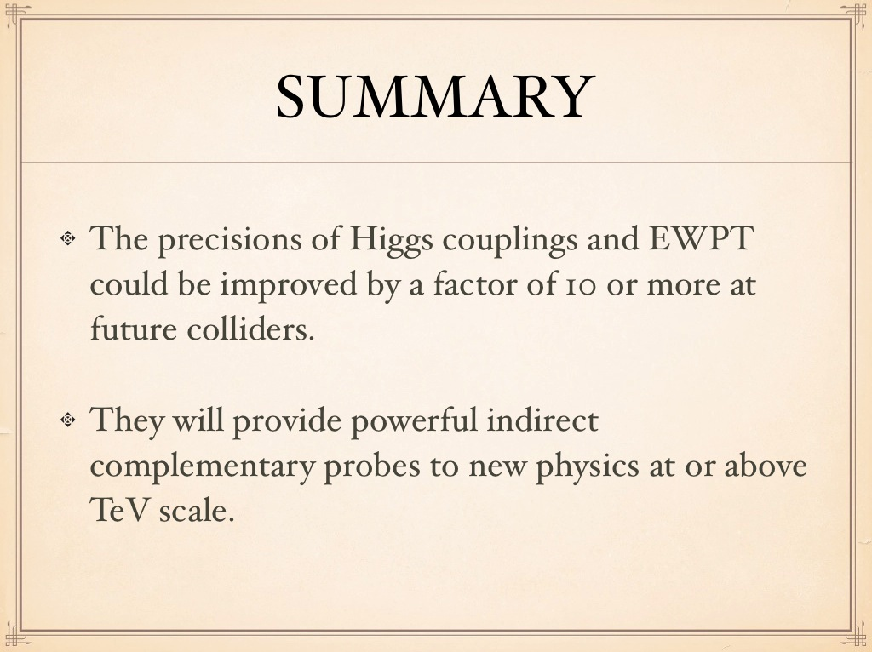
Sensitivity to new physics of precision Higgs and EW observabls – Jiji Fan

Slide 96
H self couplings, VBS at high mass and high energy probes of EWSB – M Son
Some useful slides on required precision gains in order to measure some H proprties + HL-LHC/ILC/FCC-hh physics reach comparisons
HHH not yet accessible; challenging even at HL-LHC
Will need FCC-pp or ILC/CLIC to reach 5-10% precision
also FCC-ee (and FCC-eh) can contribute
HH -> bbgamgam most promising? (clean, low rate, but enough stats at FCC-pp) e.g. Alan’s paper

Slide 97
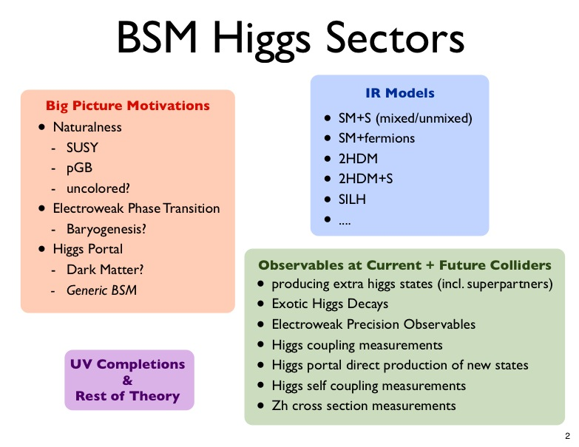
BSM Higgs sectors – D Curtin
Big picture

Slide 98
BSM Higgs sectors – D Curtin
Higgs portal observables e.g. what if TeV-scale new physics couples *only* to Higgs?
Mass reach of these probes in relevant models is only a few 100GeV at 100TeV collider

Slide 99
BSM Higgs sectors – D Curtin

Slide 100
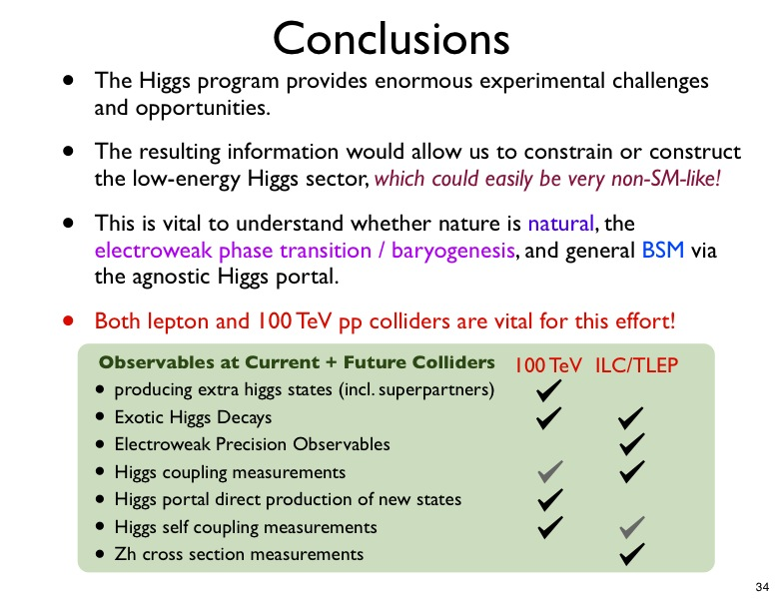
BSM Higgs sectors – D Curtin
What can be done at FCC-pp versus ILC/FCC-ee

Slide 101
Naturalness @ 100TeV – N Craig
Argument: we should do it for the sake of exploration
… but, if you want a specific motivation….
Before LHC we knew we had to find something
We do not have a No Lose Theorem now, for energies accessible at colliders
But we have compelling strategies – NATURALNESS
Not a No Lose Theorem, but a strategy for new physics near mH (but often successful in the past)
Question of EW naturalness CANNOT be settled at the LHC (will probe conventional ‘colourful’ theories to at least 1% - but will still leave certain kinematic regions, and all regions of less conventional theories, untested)

Slide 102
Naturalness @ 100TeV – N Craig

Slide 103
Direct BSM exploration at high mass frontier – M Pierini
Spent some time showing/arguing how important/impactful energy increase is c.f. lumi
Though lumi helps at low mass
Challenge will be in retaining low mass sensitivity
Showed significant enhancement in SUSY sensitivity by cutting simply on mT2 (study by M Hance) – hmmm…. wonder if we should be referenced …
Challenges for detector geometry/granularity (boosted substructure signatures)

Slide 104
Direct BSM exploration at high mass frontier – M Pierini

Slide 105
Precision measurement of alphas, PDFs and role of PDFs in high mass BSM – V Radescu
We have no data below ~10-4 now
We don’t know when BFKL effects become important
Also high x – little known
Note – at high energy colliders, low masses become challenging
eh scenarios can provide all the PDFs, and precision alphas

Slide 106
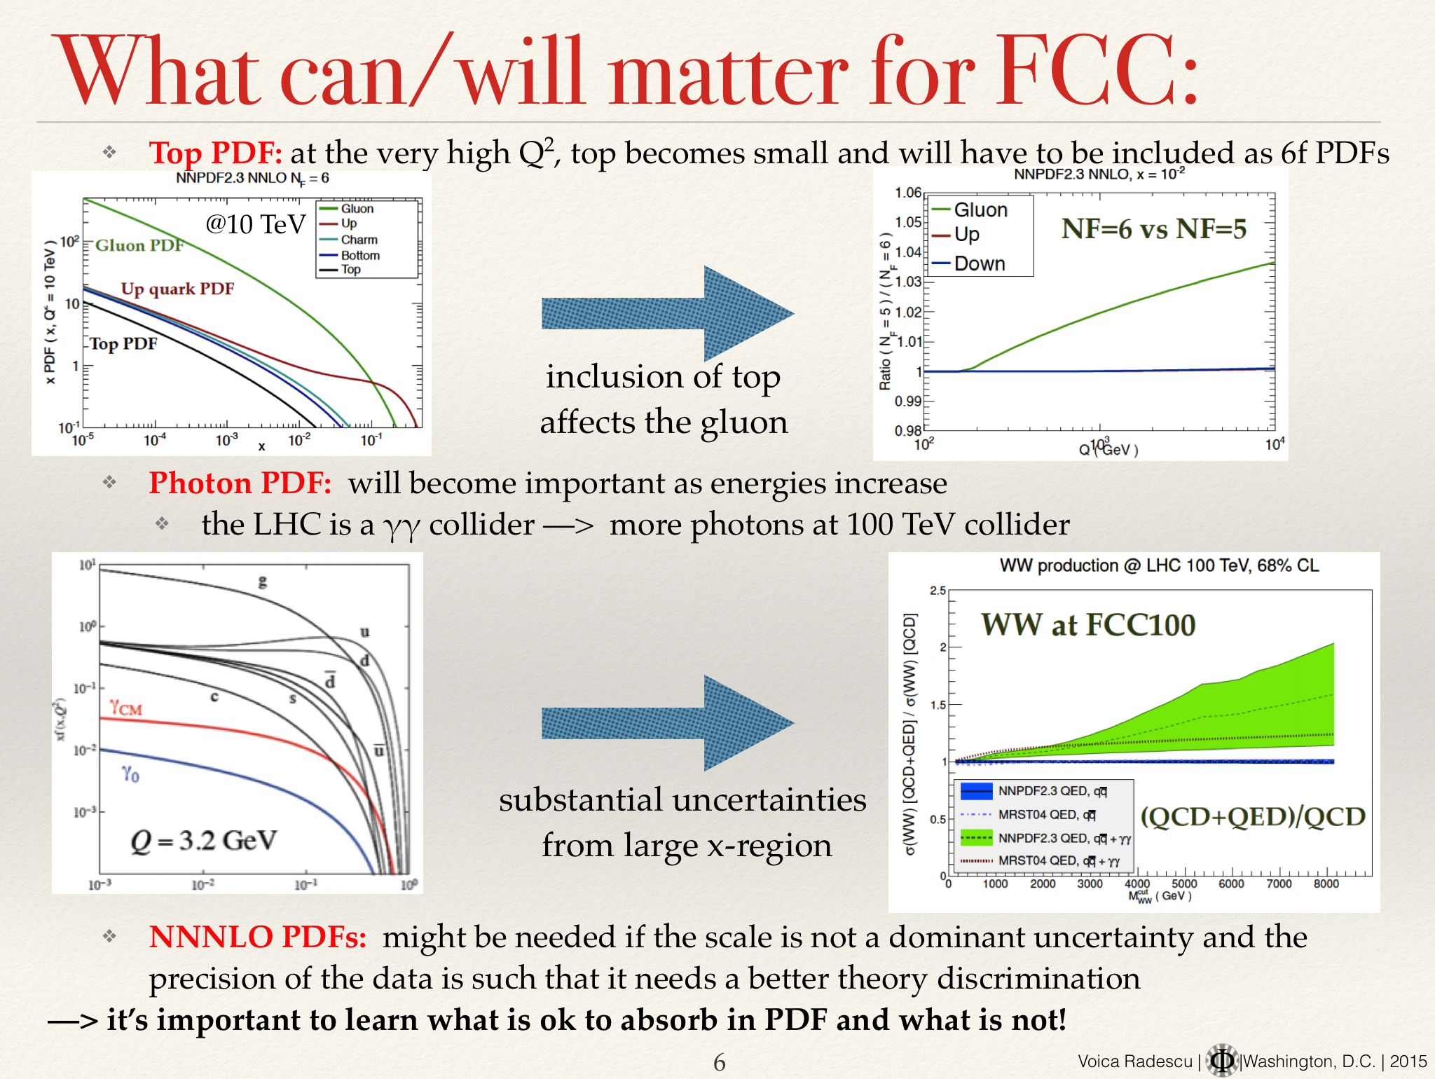
Precision measurement of alphas, PDFs and role of PDFs in high mass BSM – V Radescu

Slide 107
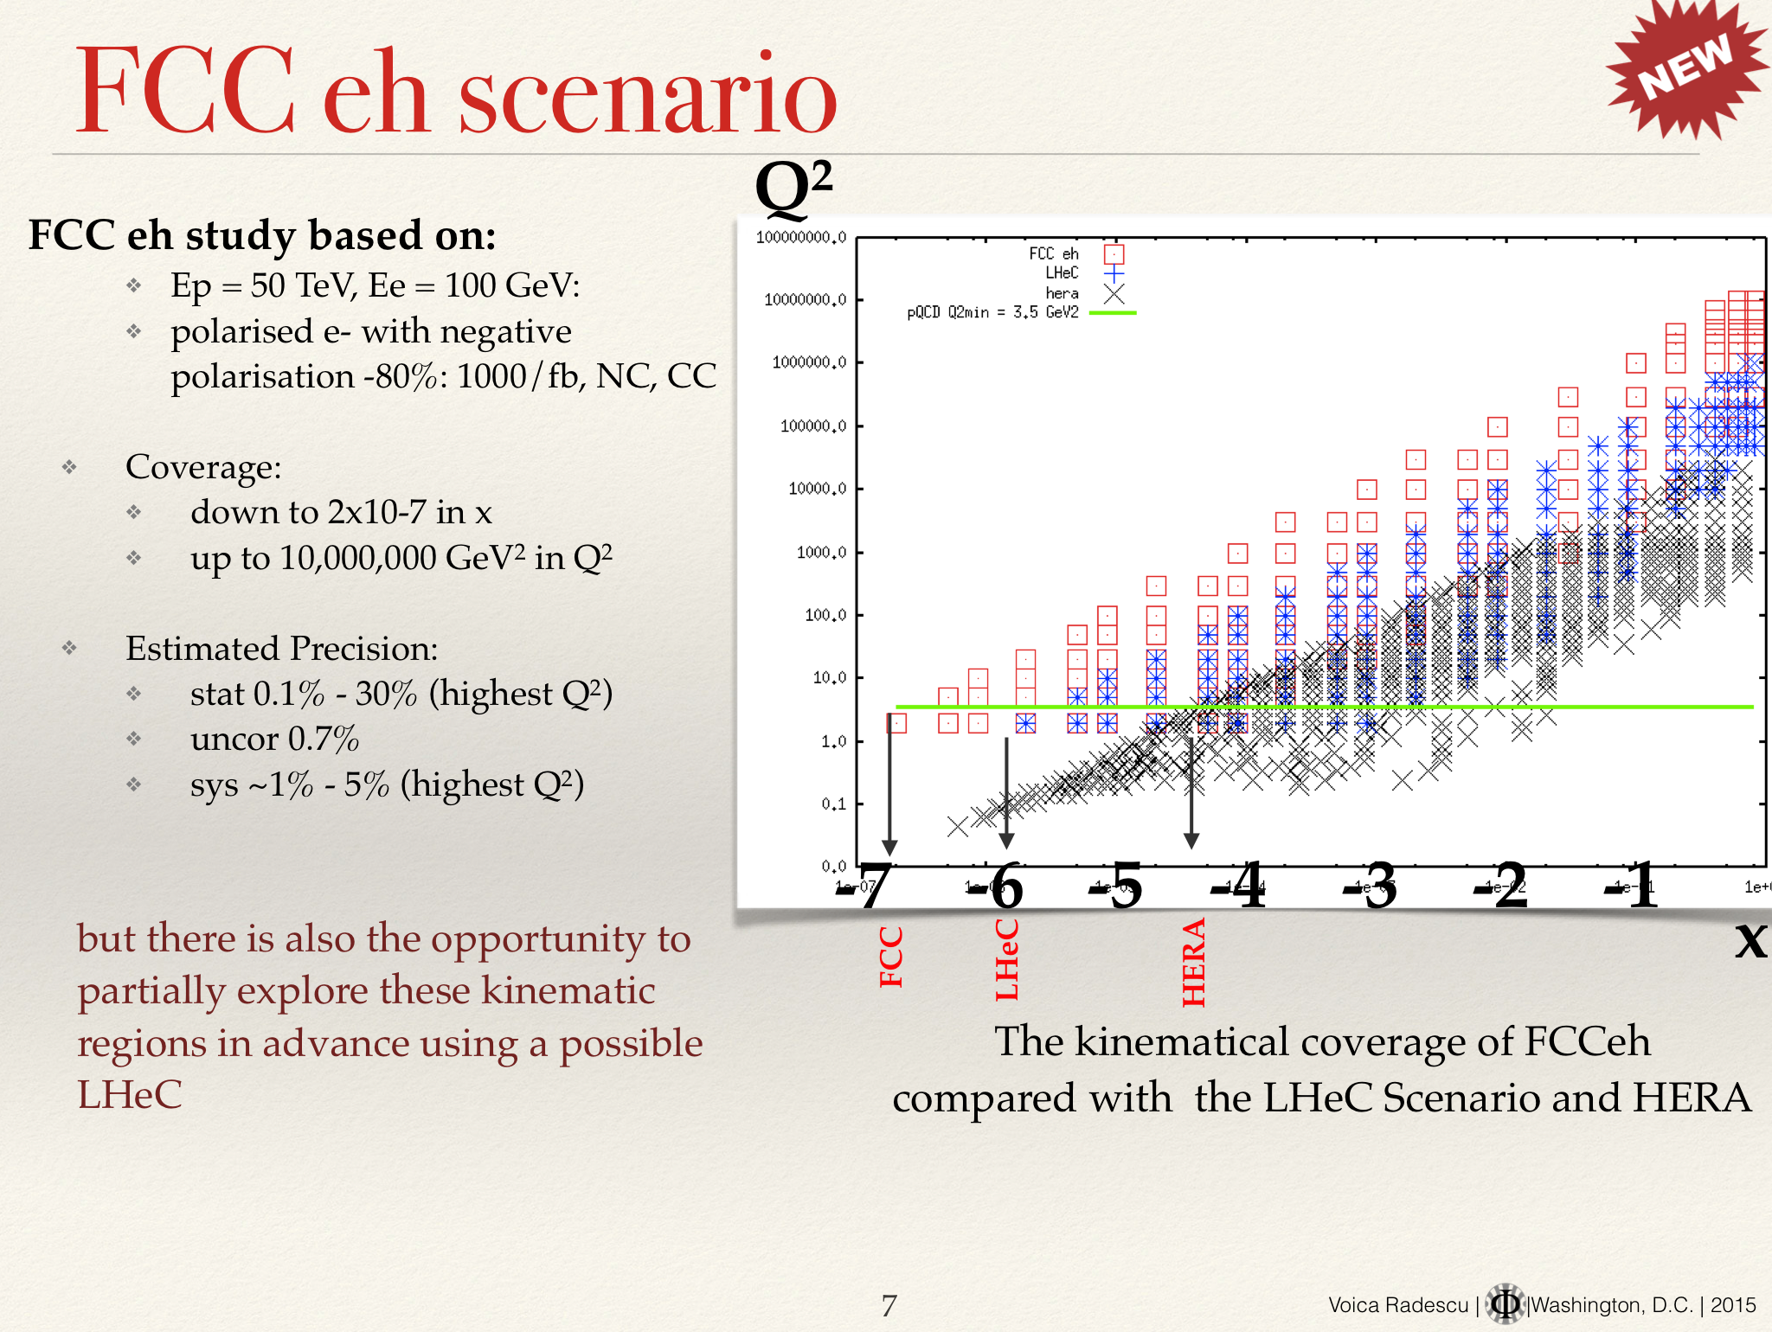
Precision measurement of alphas, PDFs and role of PDFs in high mass BSM – V Radescu

Slide 108
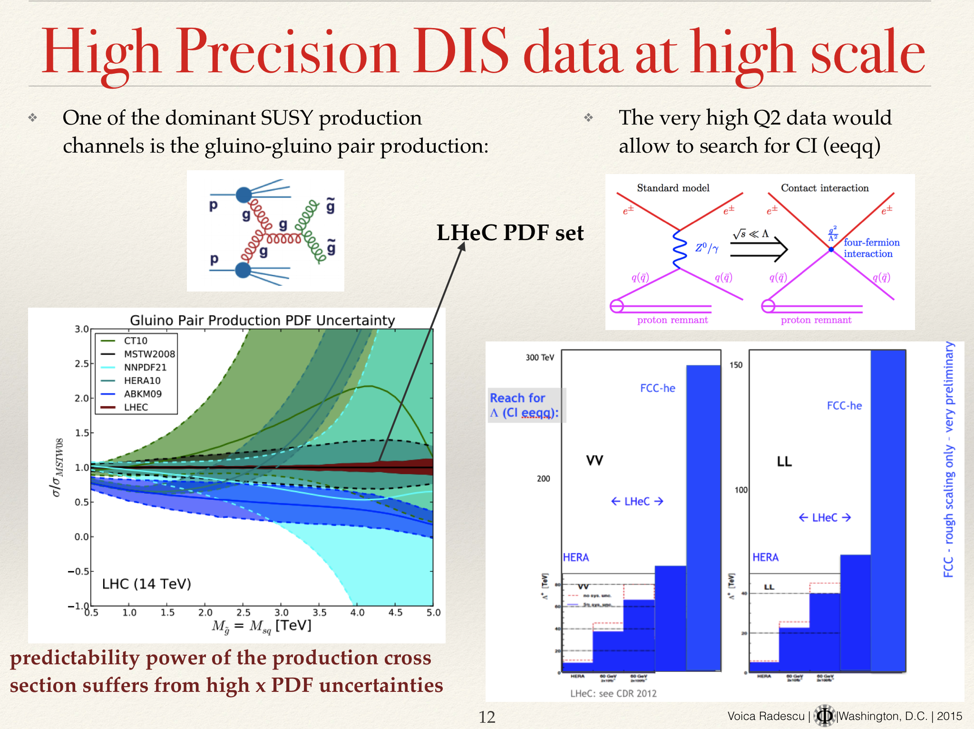
Precision measurement of alphas, PDFs and role of PDFs in high mass BSM – V Radescu

Slide 109
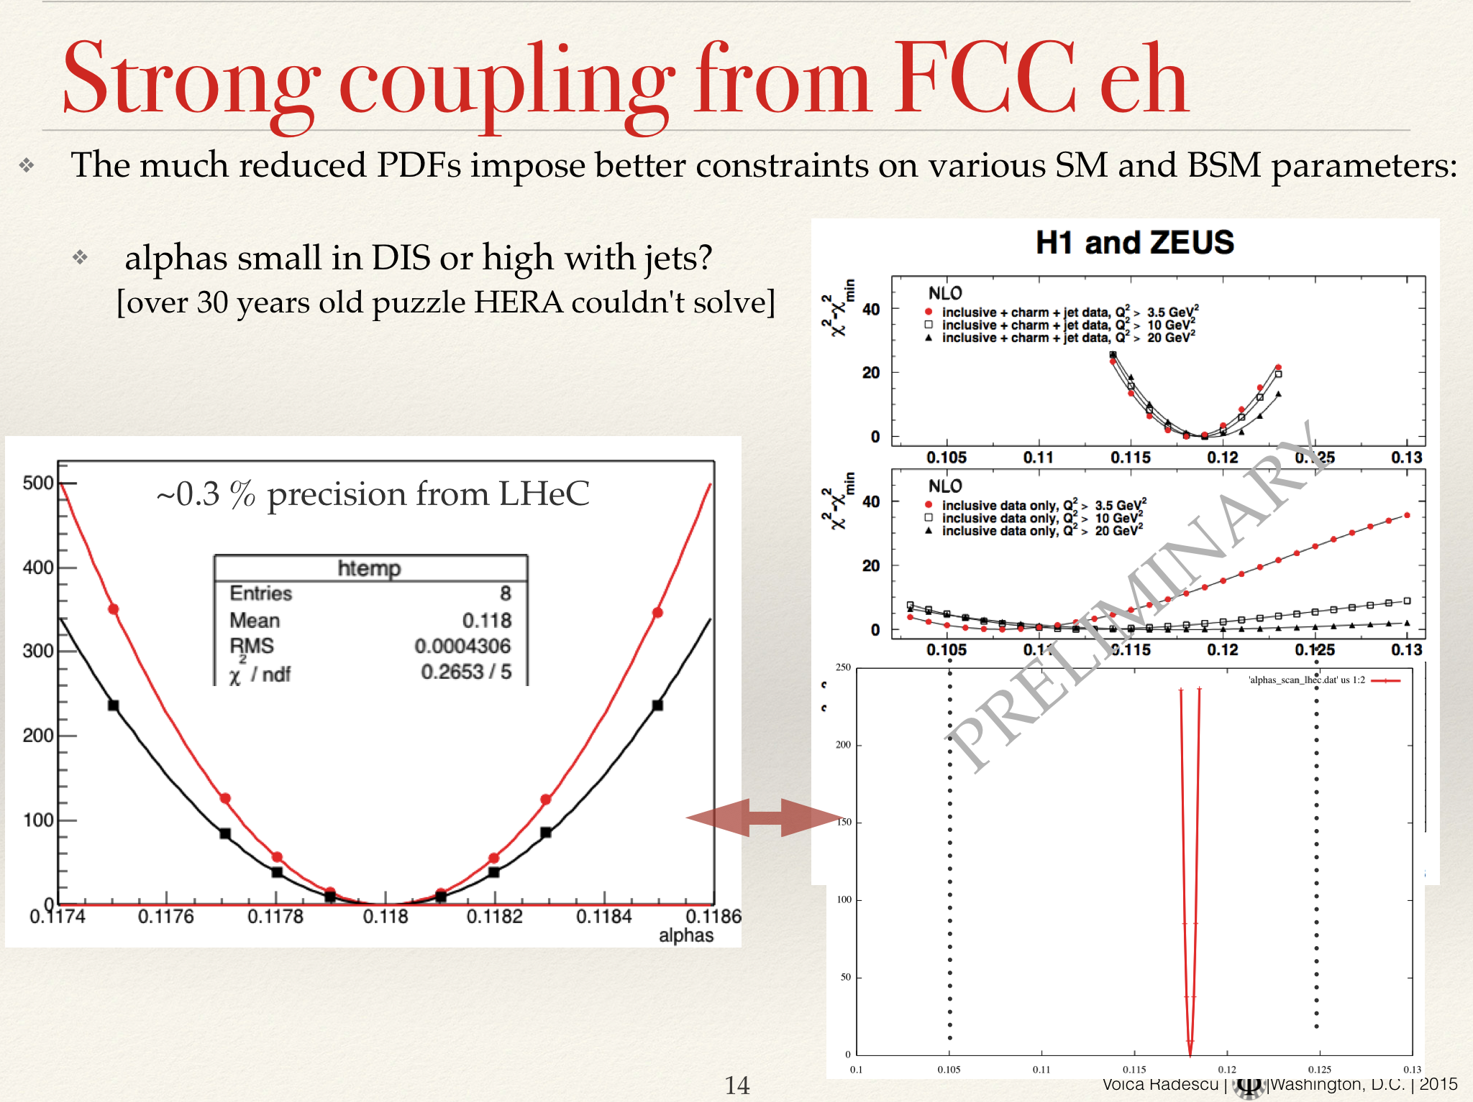
Precision measurement of alphas, PDFs and role of PDFs in high mass BSM – V Radescu

Slide 110
Dark Matter @ FCC – P Harris/L-T Wang (exp/theor)
Search for WIMP DM is largely out of reach of LHC (LHC14 ~ 200 GeV)
100 TV collider significantly enhances by factor of ~5
Main motivation for going higher in energy

Slide 111
Dark Matter @ FCC – P Harris/L-T Wang (exp/theor)

Slide 112
Dark Matter @ FCC – P Harris/L-T Wang (exp/theor)
Disappearing track; essentially free of physics background; dominated by pT mis-measured tracks
Very promising reach, much better than monojet

Slide 113
Dark Matter @ FCC – P Harris/L-T Wang (exp/theor)

Slide 114
Friday – Summary Talks
FCC-hh + ee colliders – M Syphers, U Wienands
FCC-ee:
Crab waist option – can provide x10 lumi at Z pole
FCC-hh:
Want free space (lessons from SSC + VLHC); report on SPPC too

Slide 115
Infrastructure & Operations – P Lebrun
Summarising issues on geology, power estimates, size of needed cryoplants, helium refrigeration, cooling, safety, …
Special Technologies – J Miguel Jimenez, O Brunner
Beam dump and collimators: main issue – accidental beam losses (lots of power deposition, stress in materials)
Mentioned FCC-ee synchrotron in vicinity of IP probably too high in current design – shielding an issue

Slide 116
Magnets– E Todesco
Currently Nb3Sn cost is a showstopper
RF summary – R Rimmer
FCC-ee is 4 different machines
Different current versus RF voltages

Slide 117
Physics+Phenomenology summary - MLM
Goal: highlight synergy and complementarity between ee,eh,hh programmes

Slide 118
Physics+Phenomenology summary - MLM
Higgs coupling ->
  e.g. 2% on Hmumu at FCC-hh
  5% on Higgs self coupling
Stability of Higgs potential
ttH coupling (1% on ytop)
BSM Higgs incl
Composite Higgs (FCC-ee)

Slide 119
Physics+Phenomenology summary - MLM
D Curtin – towards first ‘no lose’ arguments?

Slide 120
Physics+Phenomenology summary - MLM
need both FCC-ee and FCC-hh to make most of it

Slide 121
Physics+Phenomenology summary - MLM
EW precision – need to clear up some outstanding issues left by LEP/SLC

Slide 122
Physics+Phenomenology summary - MLM
FCC-eh: QCD precision physics – FCC-eh: PDFs, alphas – precision extraction
+ contact interactions

Slide 123
Physics+Phenomenology summary - MLM

Slide 124
Physics+Phenomenology summary - MLM
DM: LHC only sensitive to couple of hundred GeV – FCC-pp 100TeV will probe TV WIMPs very well

Slide 125
Physics+Phenomenology summary - MLM

Slide 126
FCC-ee summary – A Blondel
Some nice comparitive plots of precision on couplings at different facilities
Mainly, FCC-ee does better?

Slide 127
FCC-ee summary – A Blondel

Slide 128
FCC-ee summary – A Blondel

Slide 129
FCC-ee summary – A Blondel

Slide 130
FCC-ee summary – A Blondel

Slide 131
FCC-ee summary – A Blondel

Slide 132
FCC-hh summary – W Riegler
Some useful slides on comparative detector concepts

Slide 133
FCC-hh summary – W Riegler
Some useful slides on comparative detector concepts

Slide 134
FCC-hh summary – W Riegler
Some useful slides on comparative detector concepts

Slide 135
FCC-he summary – M Klein
World’s cleanest and most powerful microscope
New physics in Higgs, QCD, BSM (l=q?)

Slide 136
FCC-he summary – M Klein

Slide 137
FCC-he summary – M Klein

Slide 138
FCC-he summary – M Klein

